Slide 1
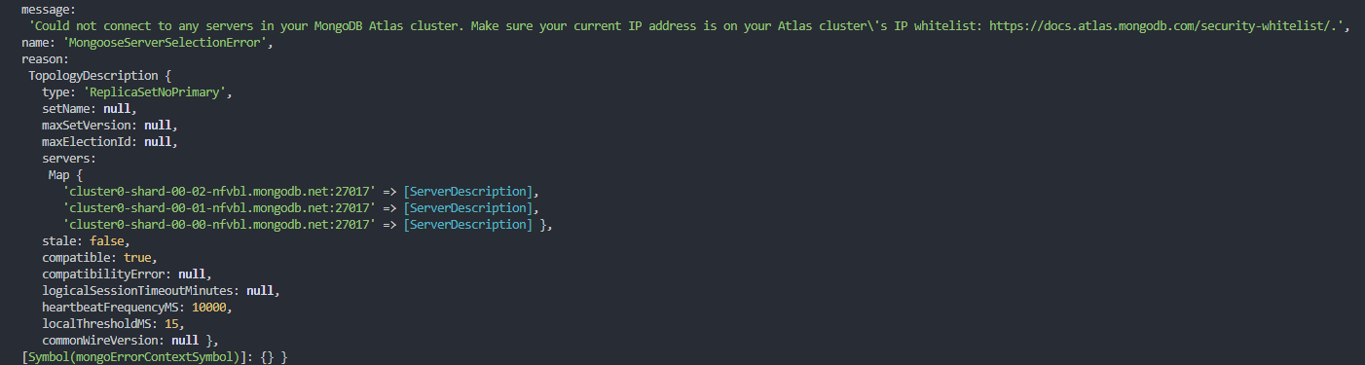
message:
'Could not connect to any servers in your MongoDB Atlas cluster. Make sure your current IP address is on your Atlas cluster\'s IP whitelist: https://docs.atlas.mongodb.com/security-whitelist/.',

Slide 2
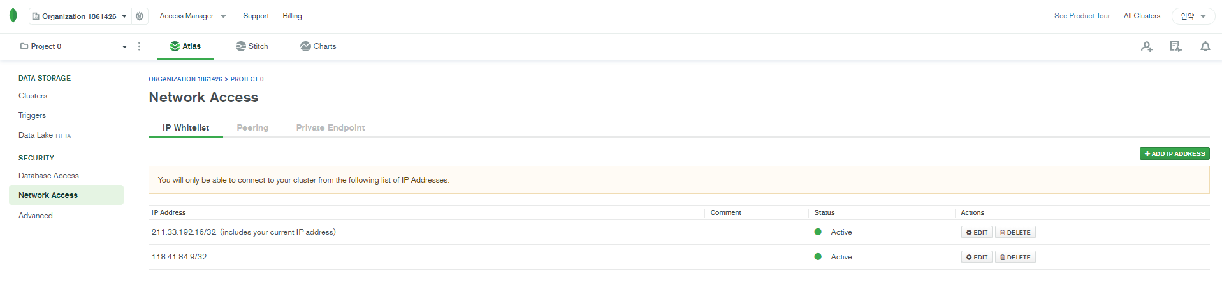

Slide 3
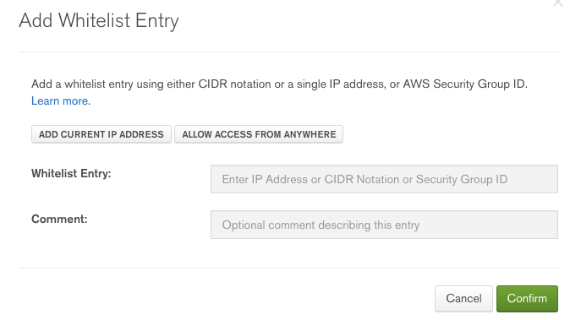

Slide 4
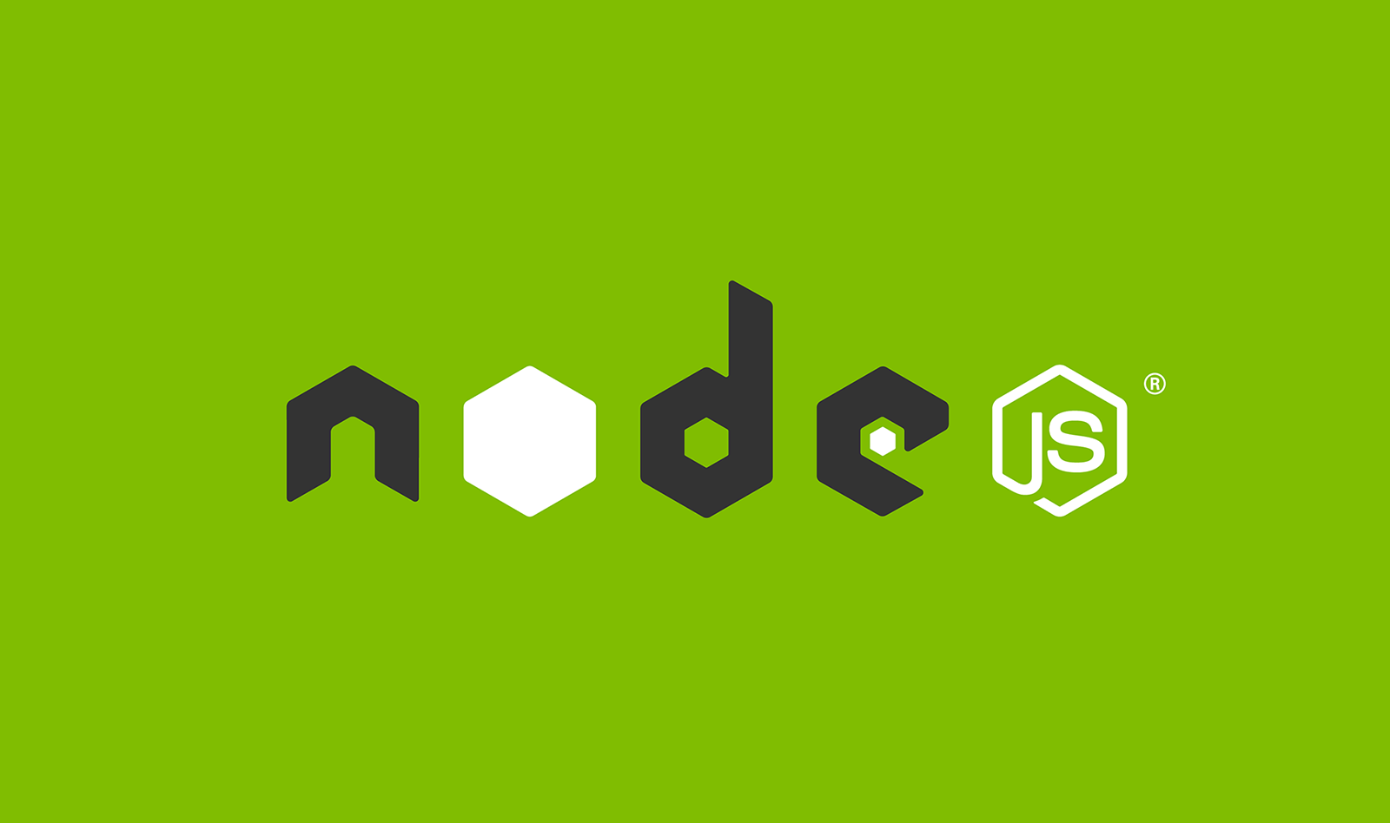

Crush Error

