Slide 1
ADMIN PAGE
네이버 그린
Baloo Chettan 2
구글 무료폰트
Covenant
Merriweather
구글 무료폰트
Covenant
Markazi Text
구글 무료폰트
Covenant
Nanum Pen Script
구글 무료폰트
Covenant
Bitter
구글 무료폰트
Covenant
팬톤 색상

Slide 2
Virtual Memory: 2 Three problems with Memory

Slide 3
32-bit program
address space(4GB)
32-bit RAM address space(1GB)

Slide 4
32-bit program
address space(4GB)
32-bit RAM
address space(4GB)
program 1 1GB
program 3 2GB
program 2 2GB
program 2 2GB

Slide 5
32-bit RAM
address space(4GB)
0x1000
program 1
???
0x1000
0x1000
program 2

Slide 6

32-bit program
address space(4GB)
32-bit RAM address space(1GB)
MAP
Disk

Slide 7
32-bit RAM
address space(4GB)
program 1 2GB
MAP 1
program 2 2GB
MAP 2

Slide 8
RAM
address space
1000
1
program 1 2GB
MAP 1
5
1000
program 2 2GB
MAP 2

Slide 9
Virtual Memory: 7 Address Translation Example Walkthrough
Notes:
https://www.youtube.com/watch?v=6neHHkI0Z0o&list=PLrHrLnaO-kCe5ttpzdgNiCie5pddUX71A&index=33&t=43s

Slide 10
Virtual page nubmer
Page offset
Virtual Address
20 bits
12 bits
Page Table
Physical Address
16 bits
12 bits
Physical page number
Page Offset
Notes:
page offset

Slide 11
Virtual page nubmer
Page offset
Virtual Address
20 bits
12 bits
Physical page number
0x00000
DISK
0x00001
0x0003
Page Table
0x00002
0x0010
0x00003
0x0020
…
…
0xfffff
0x00f6
Physical Address
16 bits
12 bits
Physical page number
Page Offset
Notes:
PTE

Slide 12
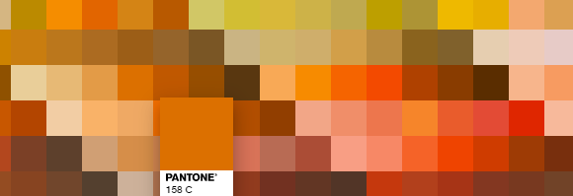
Virtual page nubmer
Page offset
Virtual Address
20 bits
12 bits
Physical page number
0x00000
DISK
0x00001
0x0003
Page Table
0x00002
0x0010
0x00003
0x0020
…
…
0xfffff
0x00f6
Physical Address
16 bits
12 bits
Physical page number
Page Offset

Slide 13
Virtual page nubmer
Page offset
31
11
0
Virtual Address
0x00003
12
0x204
Physical page number
0x0003204
0x00000
DISK
20 bits
Virtual Page Number
12 bits
Page offset
0x00001
0x0003
Page Table
0x00002
0x0010
0x0006204
0x00003
0x0020
16 bits
Physical Page Number
12 bits
Page offset
…
…
0xfffff
0x00f6
Physical Address
0x0020
0x204
Physical page number
Page Offset

