Slide 1

Brute-Force
Backtracking
N-Queens
완전 탐색
Exhaustive Search
Optimization Problems
TSP
Divide & Conquer
Binary Search
Notes:
https://www.webdesignrankings.com/resources/lolcolors/

Slide 2
Brute-Force
Backtracking
N-Queens
완전 탐색
Exhaustive Search
Optimization Problems
TSP
Divide & Conquer
Binary Search
Notes:
https://www.webdesignrankings.com/resources/lolcolors/

Slide 3
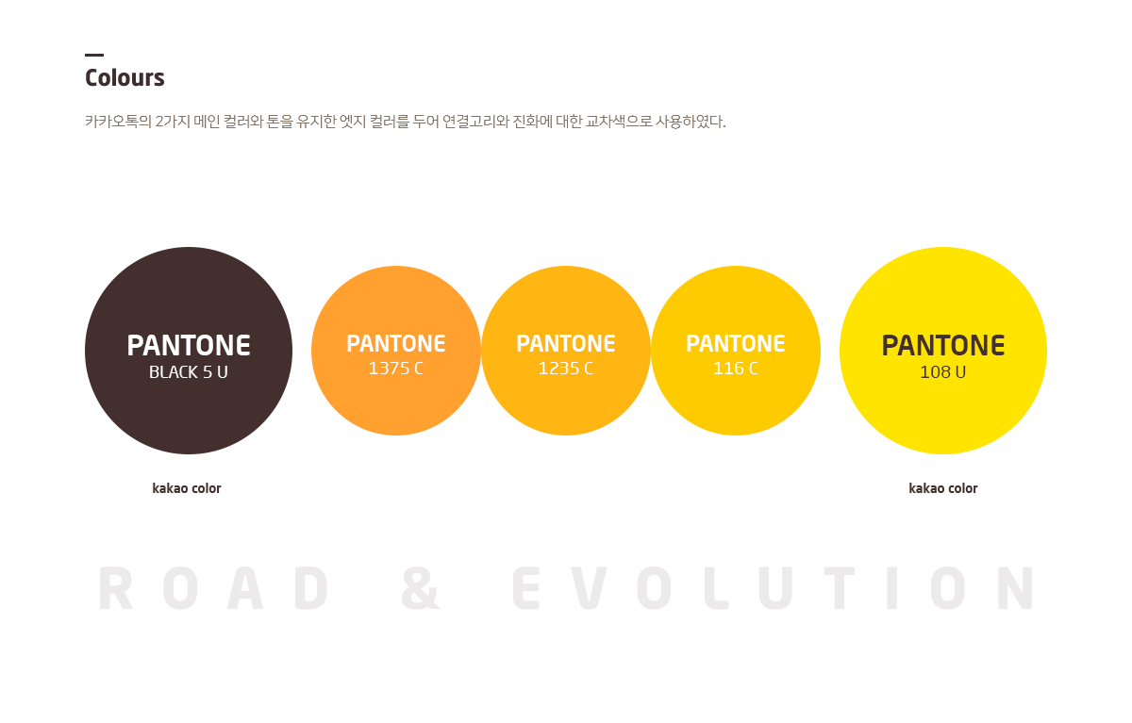

Slide 4
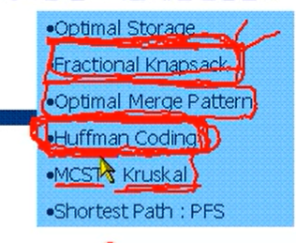
Optimal Storage
Fractional Knapsack
Optimal Merge Pattern
탐욕 알고리즘
Greedy Method
Minimum cost spanning tree : Kruskal
Huffman Coding
Shortest Path : Priority First Search
Notes:
미니멈 코스트 스패닝 트리
프라이어티 퍼스트 서치

Slide 5
Start
Start
Start
A
A
A
5
15
5
15
5
15
10
10
10
B
C
B
C
B
C
8
8
8
7
6
7
6
7
6
D
D
D
Notes:
5 7 6 15
5 8 6 10

