Slide 1

Hexagonal
Architecture
Notes:
<a href='https://www.freepik.com/photos/background'>Background photo created by rawpixel.com - www.freepik.com</a>
https://www.freepik.com/search?dates=any&demographic=any-people&format=search&page=1&query=hexagon&sort=popular&type=photo

Slide 2
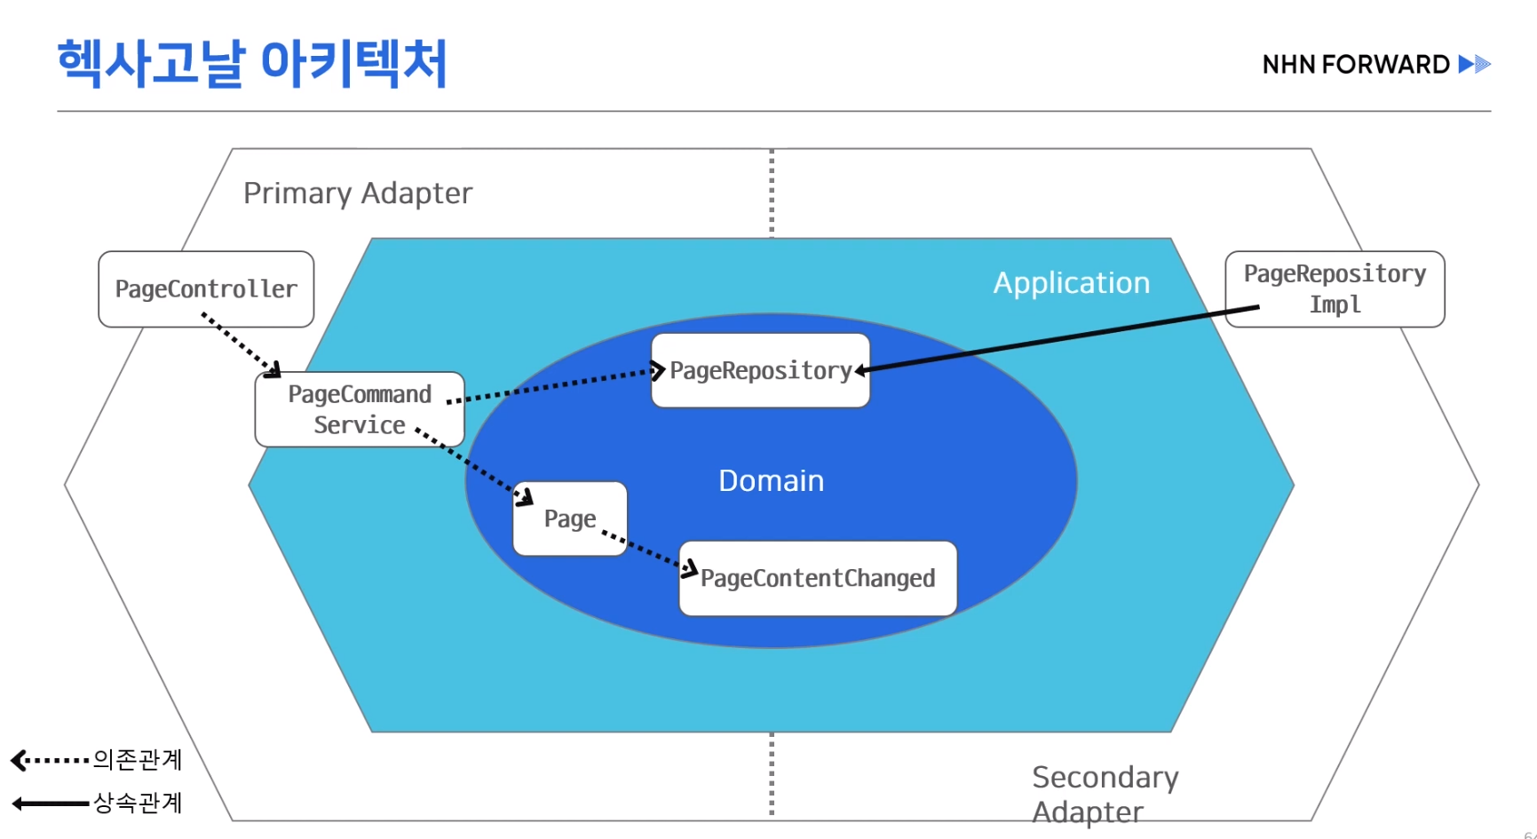
Notes:
데이터의 방향이 아닌 의존의 방향이 의존성 화살표가 밖에서 안으로
루프 패키지에 두는데 스프링 기술이기에
https://blog.sapiensworks.com/post/2012/04/07/Just-Stop-It!-The-Domain-Model-Is-Not-The-Persistence-Model.aspx

Slide 3
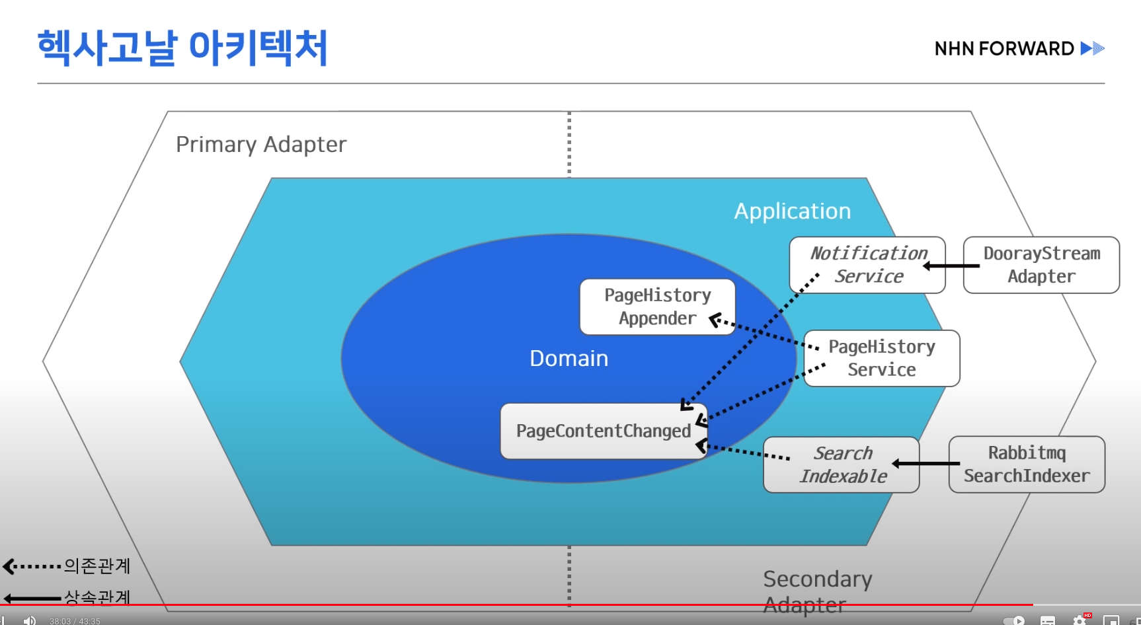

Slide 4
DepositUseCase
BankAccount
Controller
WithdrawUseCase
BankAccountService
BankAccount
LoadBankAccount
BankAccount
PersistentAdapter
SaveBankAccount
Application Core
Notes:
Input Port
Output Port

Slide 5
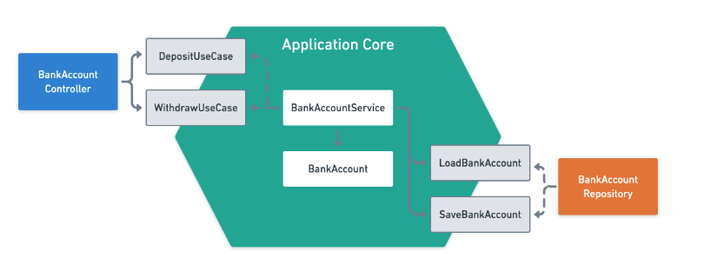
Input Port
DepositUseCase
BankAccount
Controller
WithdrawUseCase
BankAccountService
Output Port
BankAccount
LoadBankAccount
BankAccount
PersistentAdapter
SaveBankAccount
Application Core

Slide 6
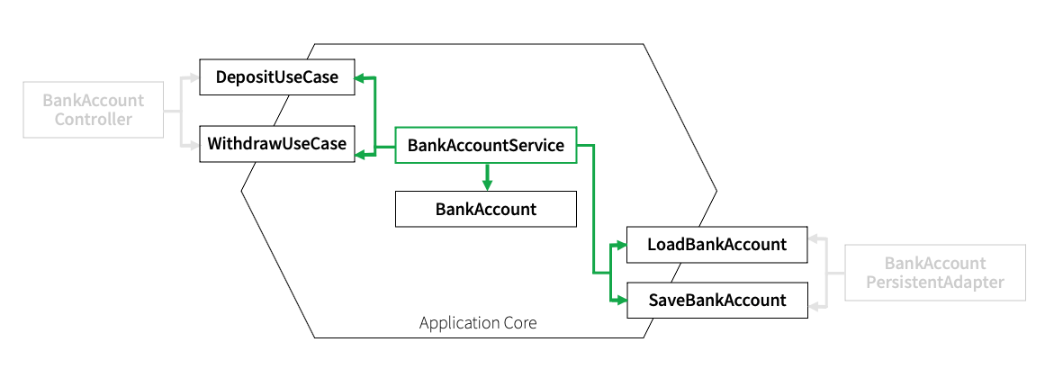
DepositUseCase
BankAccount
Controller
WithdrawUseCase
BankAccountService
BankAccount
LoadBankAccount
BankAccount
PersistentAdapter
SaveBankAccount
Application Core

Slide 7
DepositUseCase
BankAccount
Controller
WithdrawUseCase
BankAccountService
BankAccount
LoadBankAccount
BankAccount
PersistentAdapter
SaveBankAccount
Application Core
Notes:
Input Port
Output Port

Slide 8
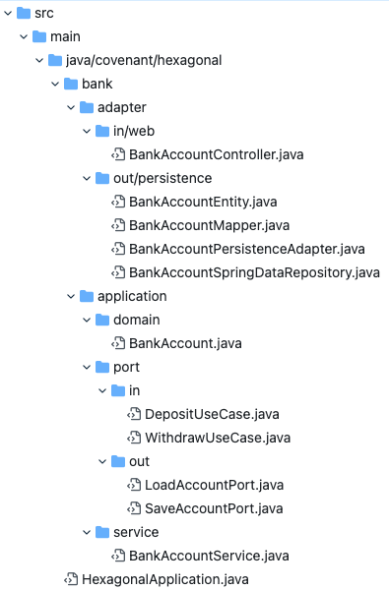
DepositUseCase
BankAccount
Controller
WithdrawUseCase
BankAccountService
BankAccount
LoadBankAccount
BankAccount
PersistentAdapter
SaveBankAccount
Application Core

Slide 9
Input Port
Adapter
Output Port
Business Logic
Adapter
Input Port
Output Port
Output Port
Adapter
Output Port
Application Core

Slide 11
Input Port
REST API
Output Port
Business Logic
Adapter
Input Port
Output Port
Output Port
Adapter
gRPC
Output Port
Application Core

Slide 12
Input Port
REST API
Output Port
Business Logic
Adapter
Input Port
Output Port
Output Port
Adapter
Output Port
Application Core

Slide 13
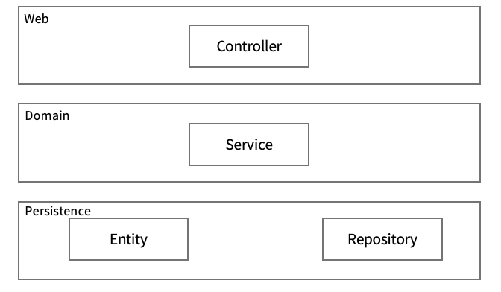

Slide 14
