Slide 1






Service A
등록
등록
Service B
Service Discovery
등록
Service C

Slide 2


Slide 3


Slide 4



Auth
Instance
등록
등록
Service
Discovery
Coupon
Instance
등록
Order
Instance

Slide 5
마이크로서비스
Spring Boot
Instance
API
GATEWAY
Go
Instance
Service
Discovery
Flask
Instance

Slide 6



클라이언트
마이크로서비스
Auth
Instance
Coupon
Instance
Order
Instance

Slide 7
클라이언트
마이크로서비스
Auth
Instance
Coupon
Instance
어디 서버로 가야할까?
Order
Instance
Order
Instance
Order
Instance
Order
Instance

Slide 8
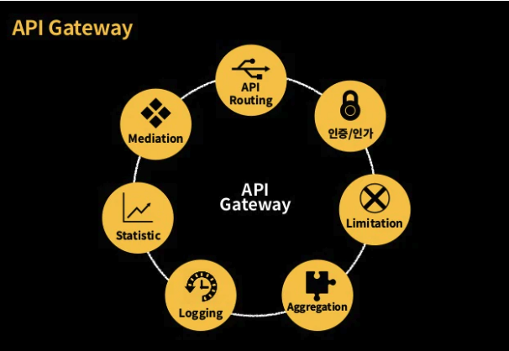

Slide 9
Auth
Instance
❺
❻
❶
API
GATEWAY
Coupon
Instance
❷
❶
❹
❸
❶
Service
Discovery
Order
Instance

Slide 10
Spring Boot
Instance
등록
API
GATEWAY
Go
Instance
등록
등록
Service
Discovery
Flask
Instance

Slide 11
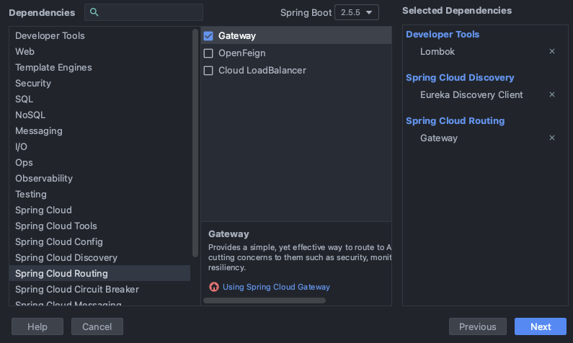

Slide 12
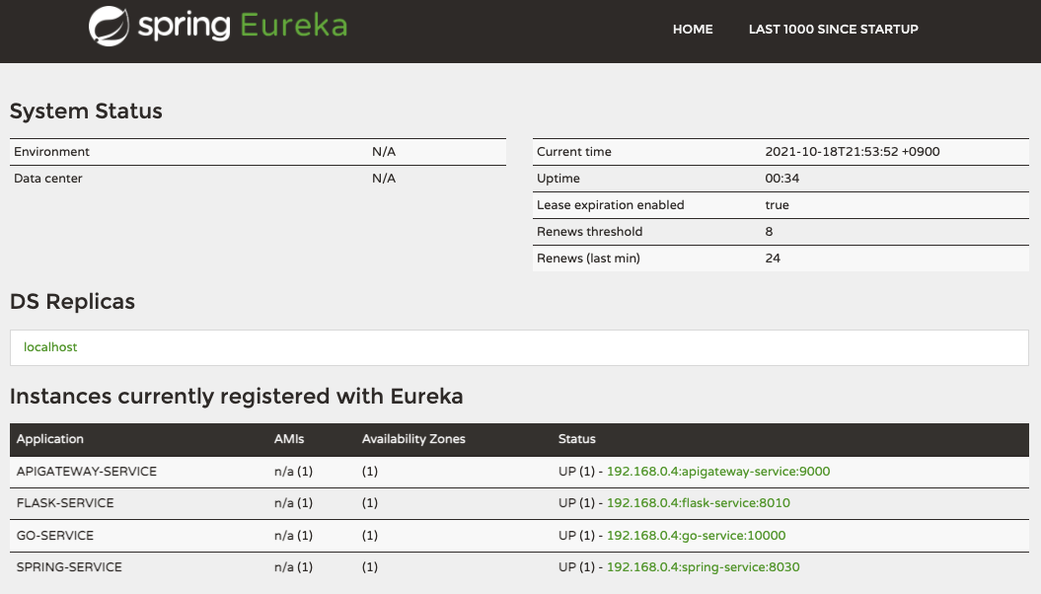

Slide 13
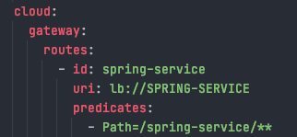
API GATEWAY yml
Spring Boot
Instance
❺
❻
❶
API
GATEWAY
Go
Instance
❷
❶
http://apigateway/spring-service
❹
❸
❶
Service
Discovery
Flask
Instance

Slide 14
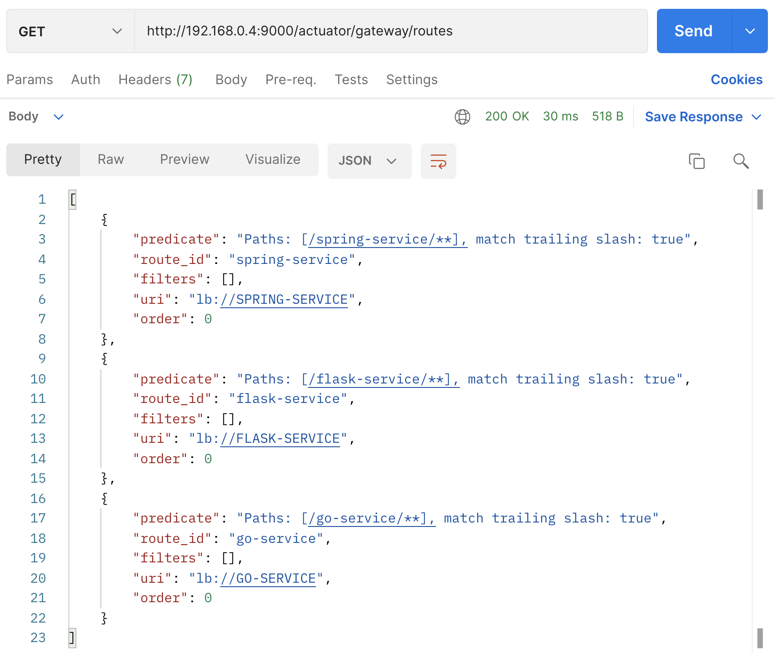

Slide 15
