Slide 1
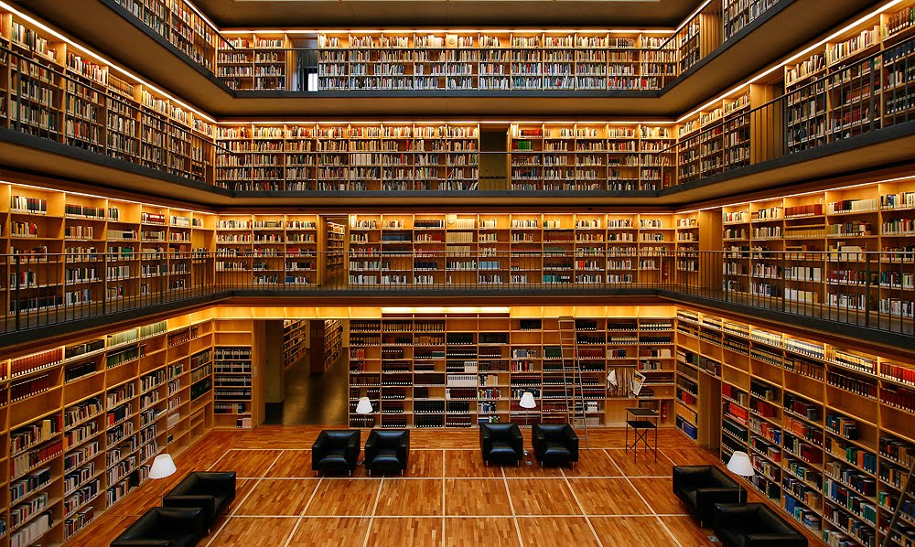
Notes:
http://centeredlibrarian.blogspot.com/2011/10/another-beautiful-library.html

