Slide 1
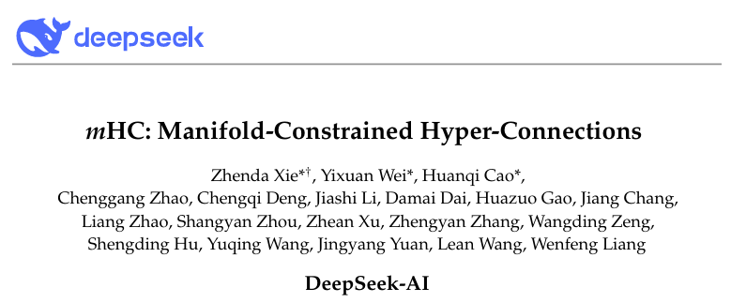
mHC:Manifold-Constrained Hyper-Connections
mHC: 流形约束的超连接
孙霖

Slide 2
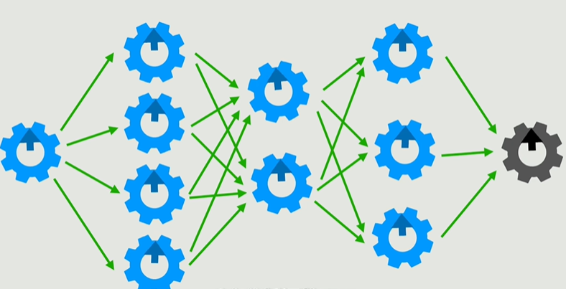
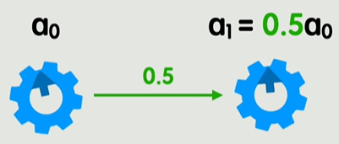
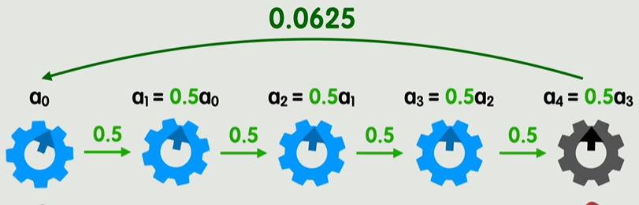
梯度
用一个简单的函数举例
调整参数使损失最小
多层神经网络导致的梯度消失/梯度爆炸

Slide 3
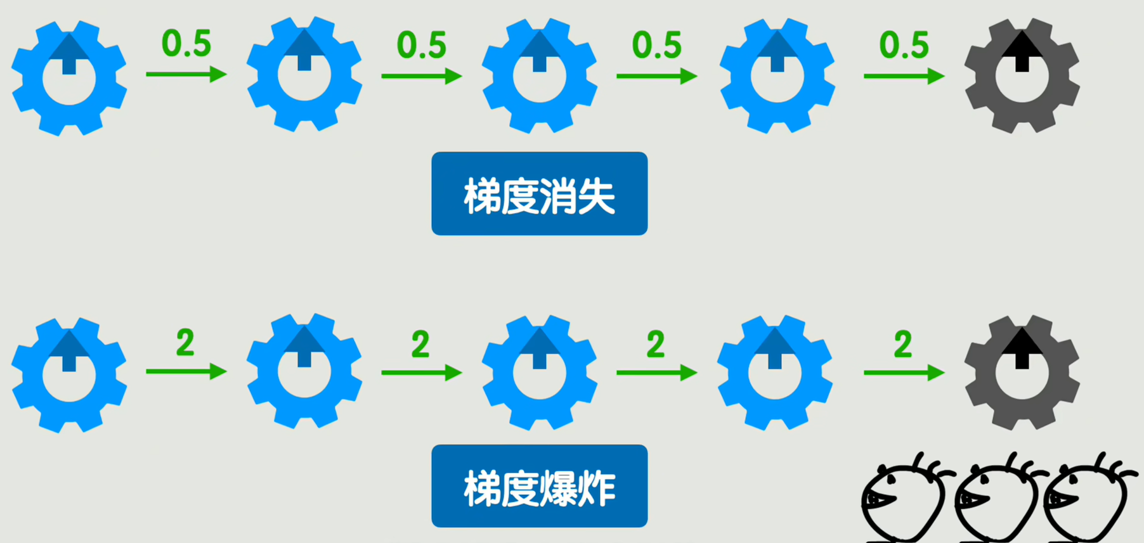
令人头疼
梯度裁剪、归一化、合理初始化、优化激活函数……

Slide 4
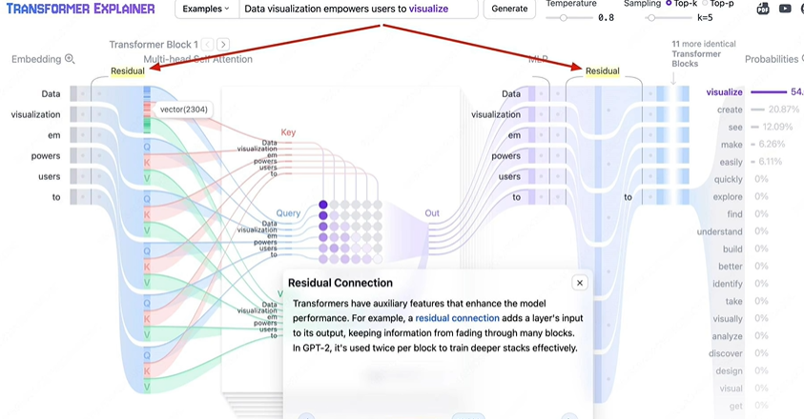
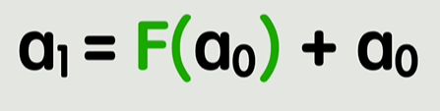
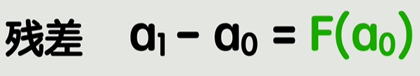
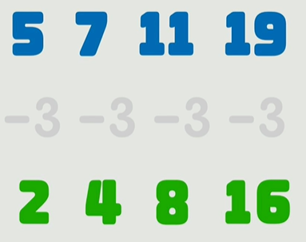
残差链接
学习变化的部分比学习整体要来的更简单
恒等映射通路
稳定性↑效率↑

Slide 5
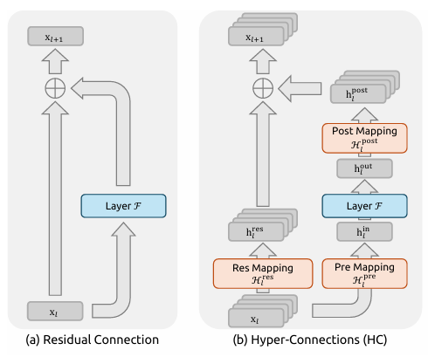
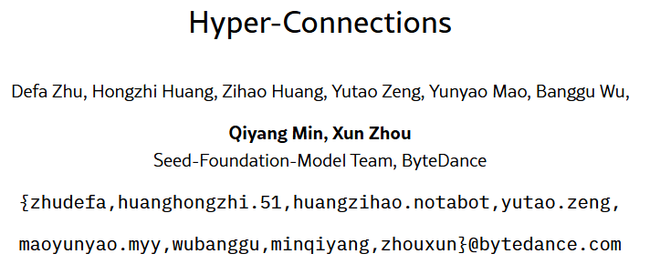

Slide 6
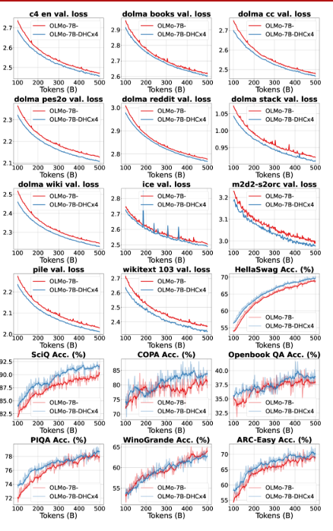
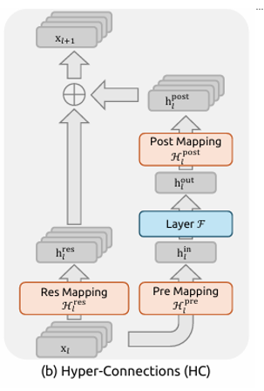
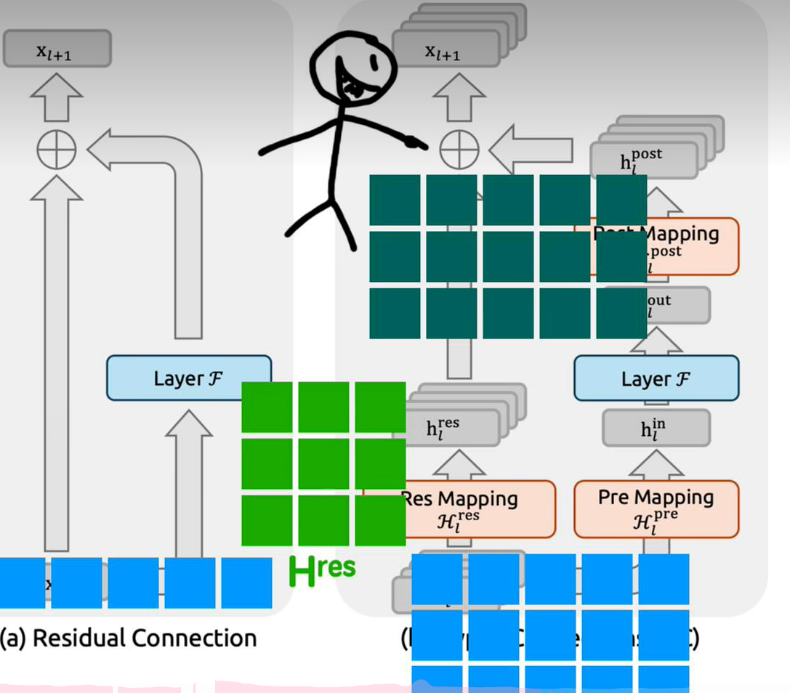
超链接
传统残差链接通道扩展n倍
引入可学习的变换矩阵管理交互和计算
学到的信息更灵活复杂

Slide 7
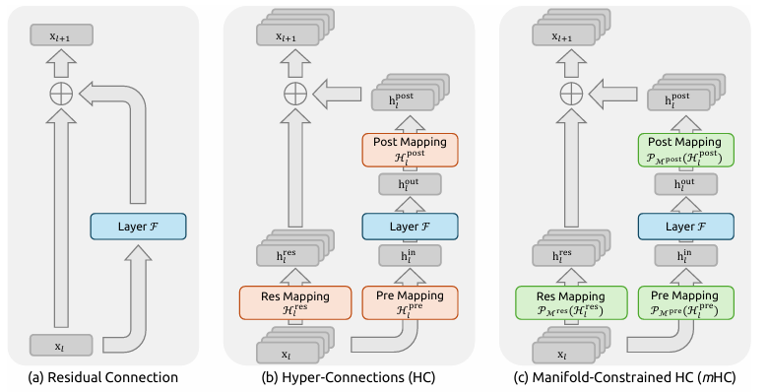
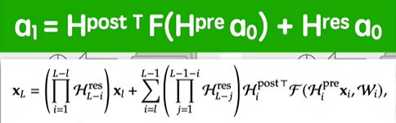
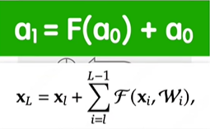
给学习矩阵加约束条件
灵活且可控
连乘！梯度消失/爆炸？

Slide 8
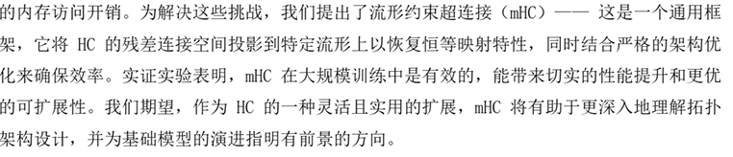
流形约束的超连接
To address these challenges, we pro pose Manifold-Constrained Hyper-Connections (mHC), a general framework that projects the residual connection space of HC onto a specific manifold to restore the identity mapping property, while incorporating rigorous infrastructure optimization to ensure efficiency. Em pirical experiments demonstrate that mHC is effective for training at scale, offering tangible performance improvements and superior scalability. We anticipate that mHC, as a flexible and practical extension of HC, will contribute to a deeper understanding of topological architecture design and suggest promising directios for the evolution of foundational models.

Slide 9
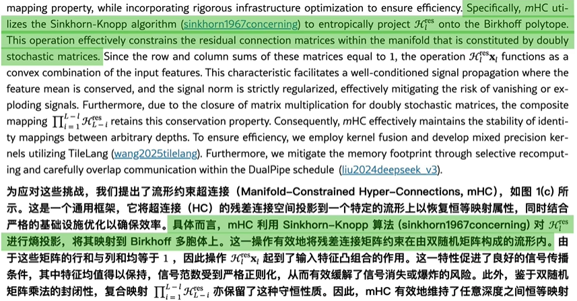
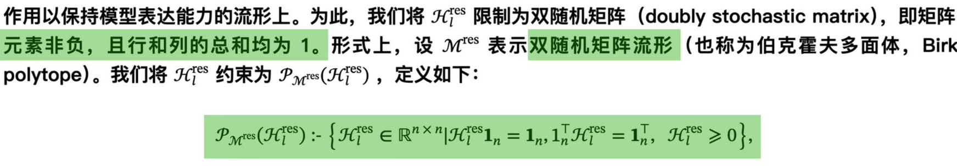
具体算法
最终目标

Slide 10
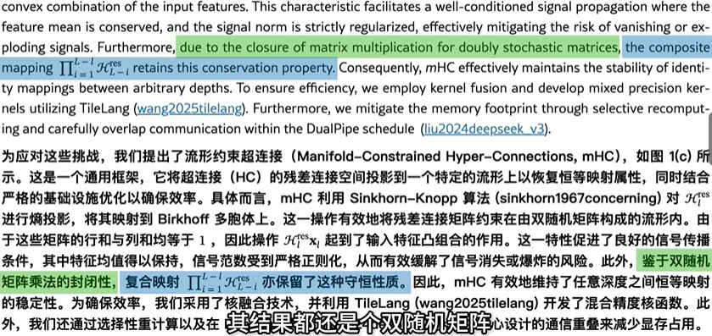
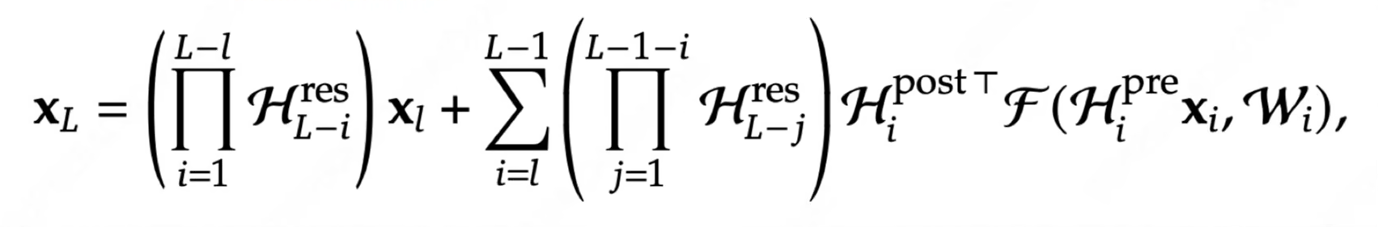
连乘可控
没有梯度消失/爆炸的风险

Slide 11
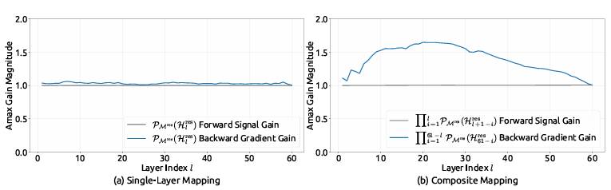
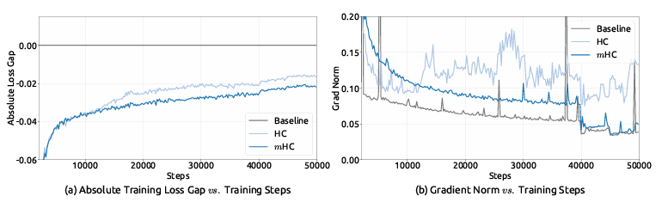
效果拔群！
绝对训练损失差距-训练步数
梯度范数-训练步数

Slide 12
最初使用残差连接的方法防止梯度消失/爆炸
Qiyang Min, Xun Zhou等人提出HC，将传统残差连接的通道变多，并引入学习矩阵提升训练灵活性，但是带来了新的问题
Zhenda Xie等人提出mHC，借助双随机矩阵流形与相应的映射方法，让学习矩阵连乘的结果变得更可控

Slide 13
mHC:Manifold-Constrained Hyper-Connections
mHC: 流形约束的超连接
HC：https://arxiv.org/html/2409.19606v3
mHC：https://arxiv.org/html/2512.24880v1

