Slide 1
Regultion and Deregulation
By Koba Khitalishvili

Slide 2
Agenda
Examples of research on regulation and deregulation
The impact of utility deregulation in Arizona (Macfie, 2008)
Minimum Wages and Employment: A Case Study of the Fast-Food Industry in New Jersey and Pennsylvania (Card and Krueger, 1994)
My topic
Minimum wage argument
Data
Methodology

Slide 3
Utility deregulation in Arizona
MACFIE, BRIAN P. "The Impact of Utility Deregulation in Arizona." Contemporary Economic Policy 26.2 (2008): 335-50. Print.
Deregulation of utility prices (gas,eletricity) to increase short term price elasticity and industry competitiveness
Used time series natural log transform OLS model
Prices for gas and electricity has not become significantly more elastic

Slide 4
Fast food industry in NJ and PA
Card, David Edward and A. B. Krueger. "Minimum Wages and Employment: A Case Study of the Fast Food Industry in New Jersey and Pennsylvania." The American economic review 84.4 (1994): 772-93. Print.
Surveyed 410 restaurants before and after wage increase that appeared on April 1st 1992 (from $4.25 to $5.05 )
Found little correlation between minimum wage increase and changes in employment

Slide 5
My topic
Effect of the Increase of the Minimum Wage on the Food Services and Drinking Places Industry in Pennsylvania
Primary source:
Minimum Wages and Employment: A Case Study of the Fast-Food Industry in New Jersey and Pennsylvania (Card and Krueger, 1994)

Slide 6
My topic: Minimum Wage Argument
Monopsony
market form in which only one buyer interfaces with many sellers.(Wikipedia)
Shock theory
Increase in the price of labor “shocks the firms and forces them to (1) optimize production,(2) innovate, (3) reduce costs.(West and McKee,1980)

Slide 7
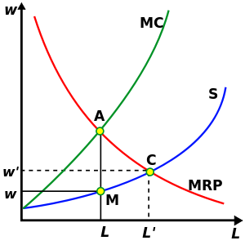
Minimum wage argument: Monopsony

Slide 8
Minimum wage argument: Monopsony
Nine out of thirteen studies conducted before 1980 find little to no empirical evidence that backs up the monopsony model, hence, the monopsony argument is inconclusive (West and McKee, 1980).

Slide 9
Minimum wage argument: Shock
The increase in productivity after the increase in minimum wage may happen due several factors such as (West and McKee, 1980):
Labor for capital substitution.
Optimization and innovation.
Reduction of production costs.
Has not been proven empirically either
(West and McKie,1980)
Notes:
A company increases its capital as a result of the increase in the price of labor.
Managers reevaluate the production process, optimize it and innovate.
A firm seeks ways to decrease its production costs.

Slide 10
My Topic: Data
Monthly Current Population Survey (CPS) from the US Bureau of Labor (BLS)
Monthly Retail and Trade Survey (MRTS) offered by the United State Census Bureau (USCB)
Survey of Business Owner’s offered by USCB UNAVAILABLE ☹

Slide 11

Data: Look
Current Population Survey

Slide 12
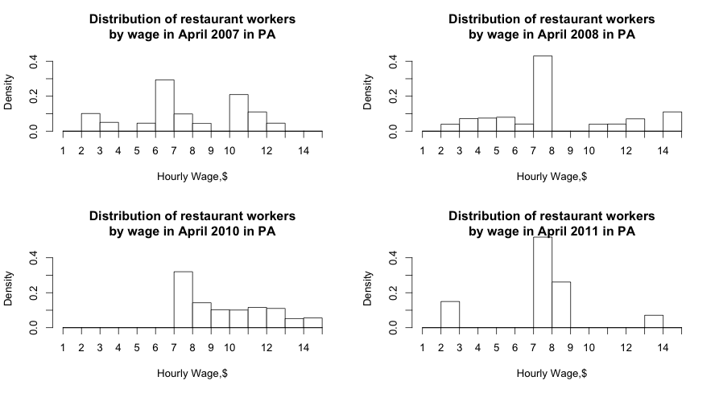
My topic: Methodology
Figure 1. Distribution of workers by hourly wage in PA in Food services and Drinking Places industry in 2007,2008,2010, and 2011

Slide 13
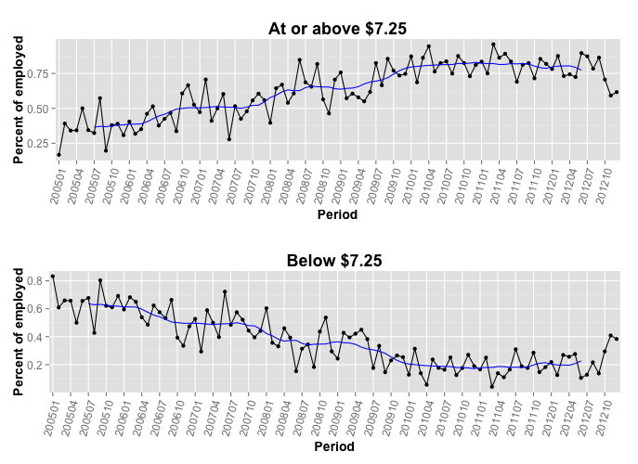
My topic: Methodology
Figure 2. Proportions of workers working at or above $7.25 and below $7.25 in Food services and Drinking Places industry in PA during period January 2005 to December 2012; blue line is trend

Slide 14
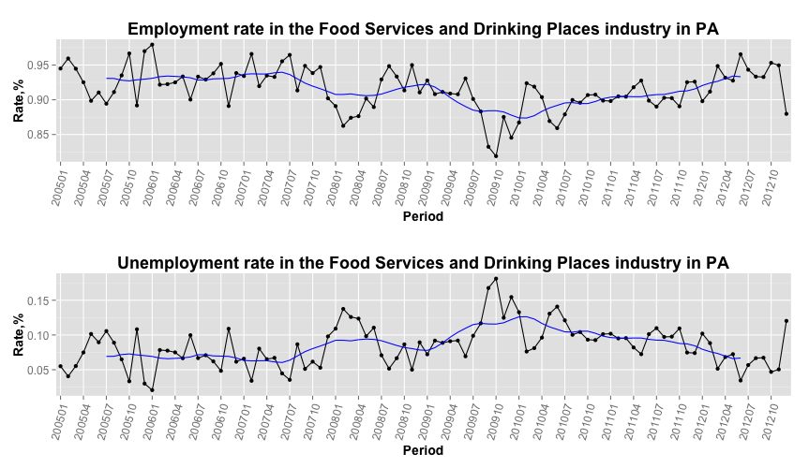
My topic: Methodology

Slide 15
My topic: Issues and carrying on
Data concern
Limited availability
Quality
Choosing the right regressors for the model
Time series approach
Cross-sectional approach

Slide 16
Thank you.
Card, David Edward and A. B. Krueger. "Minimum Wages and Employment: A Case Study of the Fast Food Industry in New Jersey and Pennsylvania." The American economic review 84.4 (1994): 772-93. Print.
McKee, Michael, and E. G. West. "Monopsony and "Shock" Arguments for Minimum Wages." Southern economic journal 46.3 (1980): 883-91. Print.
US Department of Labor. Changes in basic minimum wage in non-farm employment under state law: selected years 1968 to 2013. Office of Communications Wage and Hour Division U.S. Department of Labor. Available at:
http://www.dol.gov/whd/state/stateMinWageHis.htm

