Slide 1
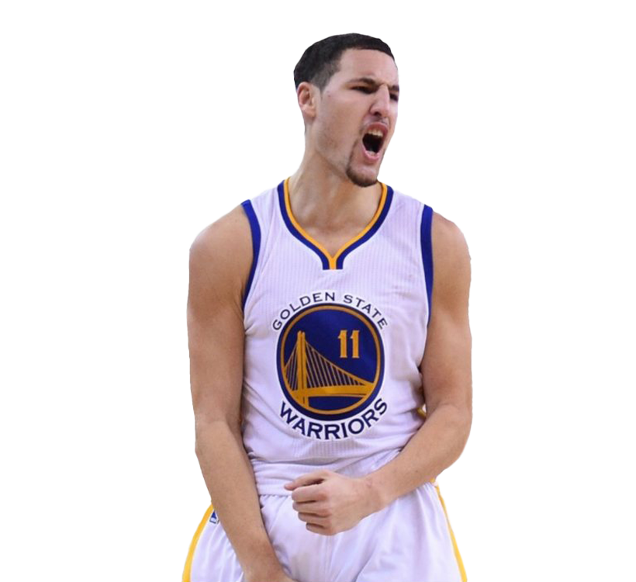
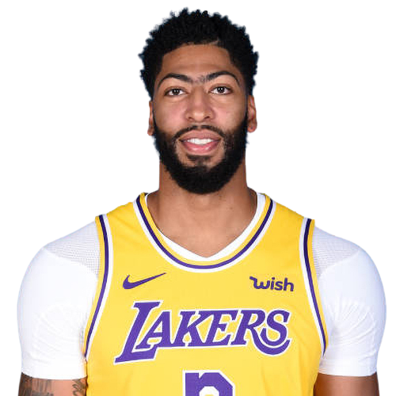
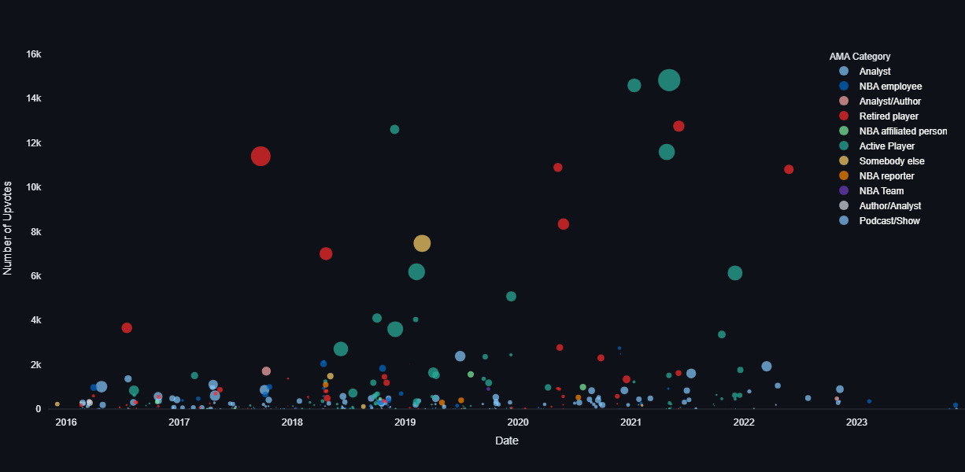
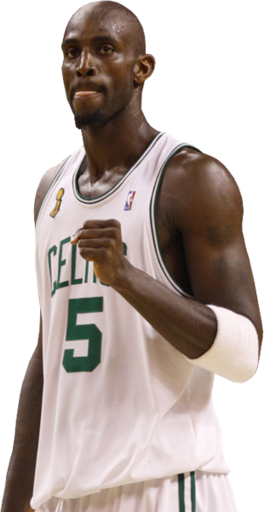
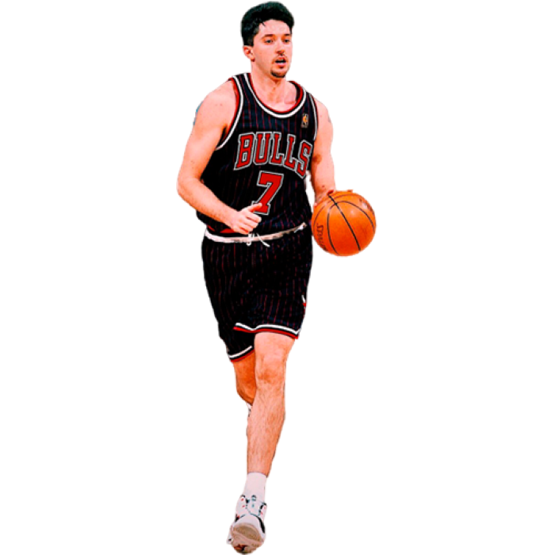
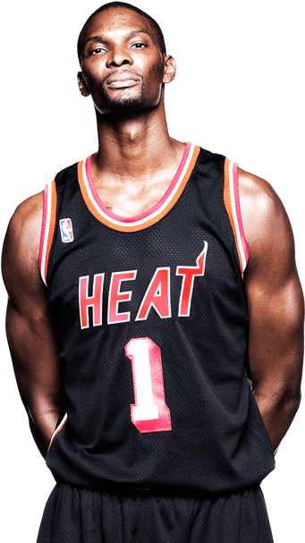
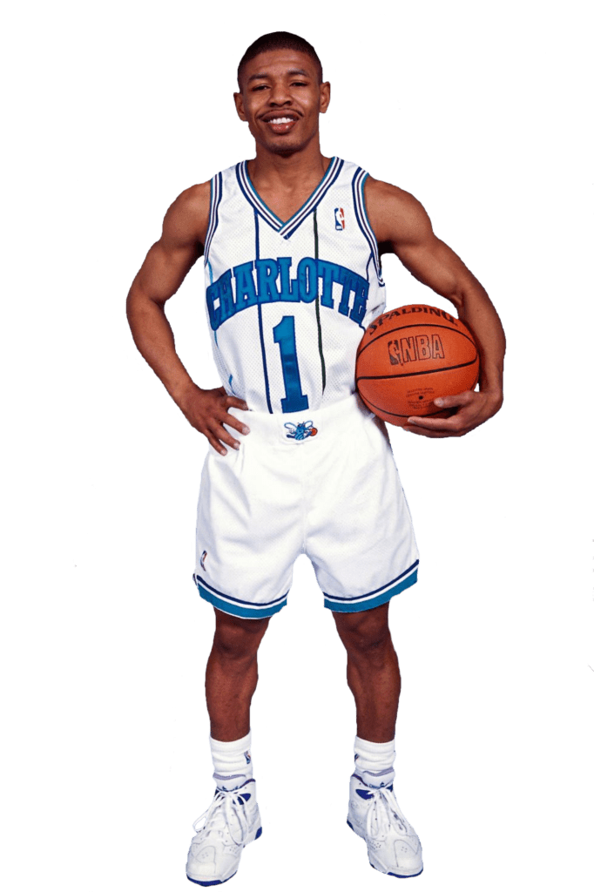
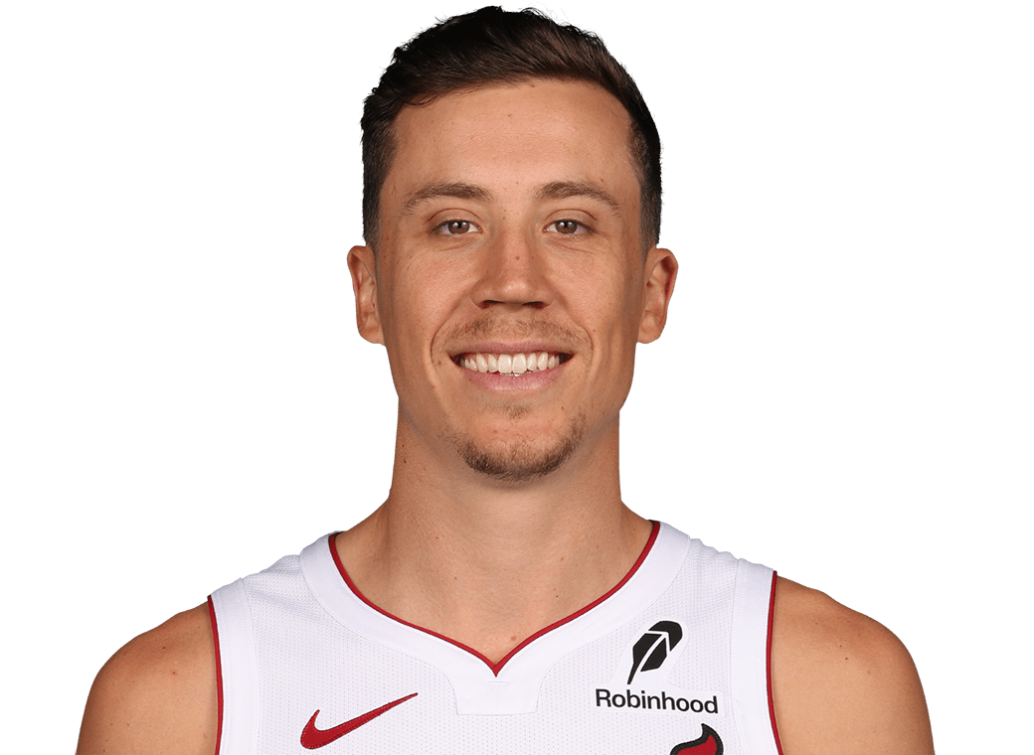
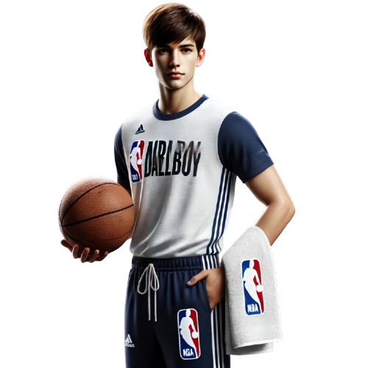
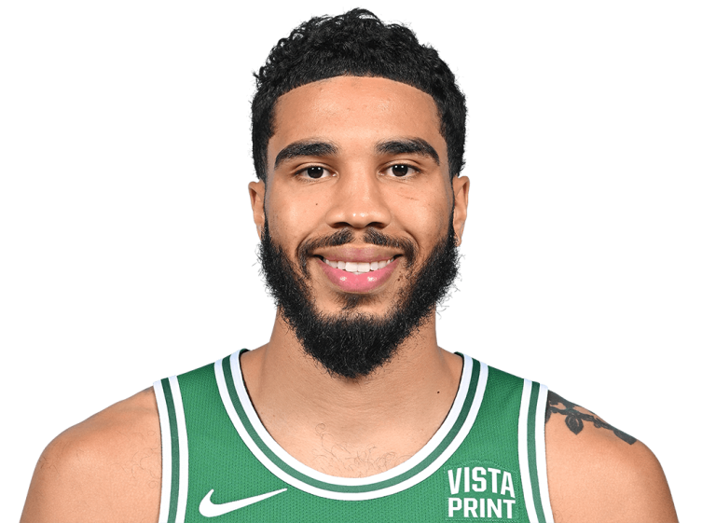
r/NBA AMAs 2015/12/03 to 2023/11/19
Size represents # of comments
This visualization tracks Ask Me Anything threads in r/NBA. Active Players and a Ballboy captured most attention. There are elevated engagement levels between 2019 and 2022 very likely attributable to work from home.
Anthony
Davis
Klay
Thompson
Chris
Bosh
KG
Toni
Kukoc
Muggsy
Bogues
Duncan
Robinson
Ballboy
Jason
Tatum

