Slide 1
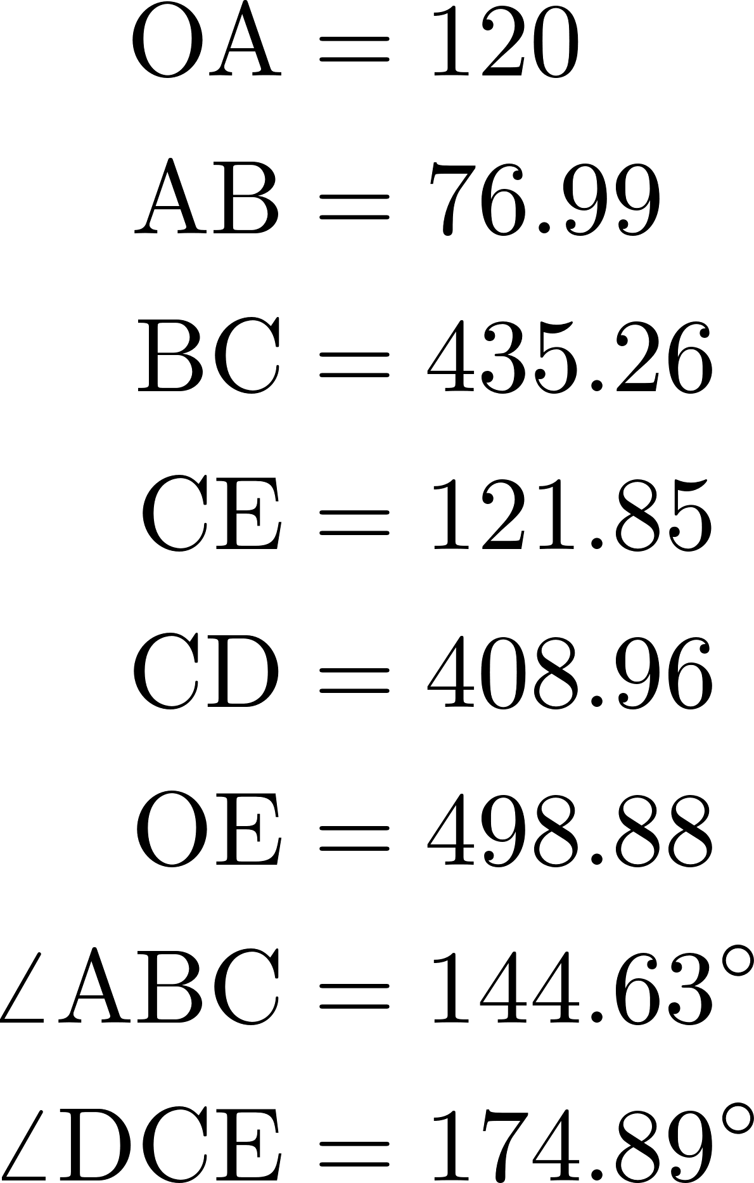
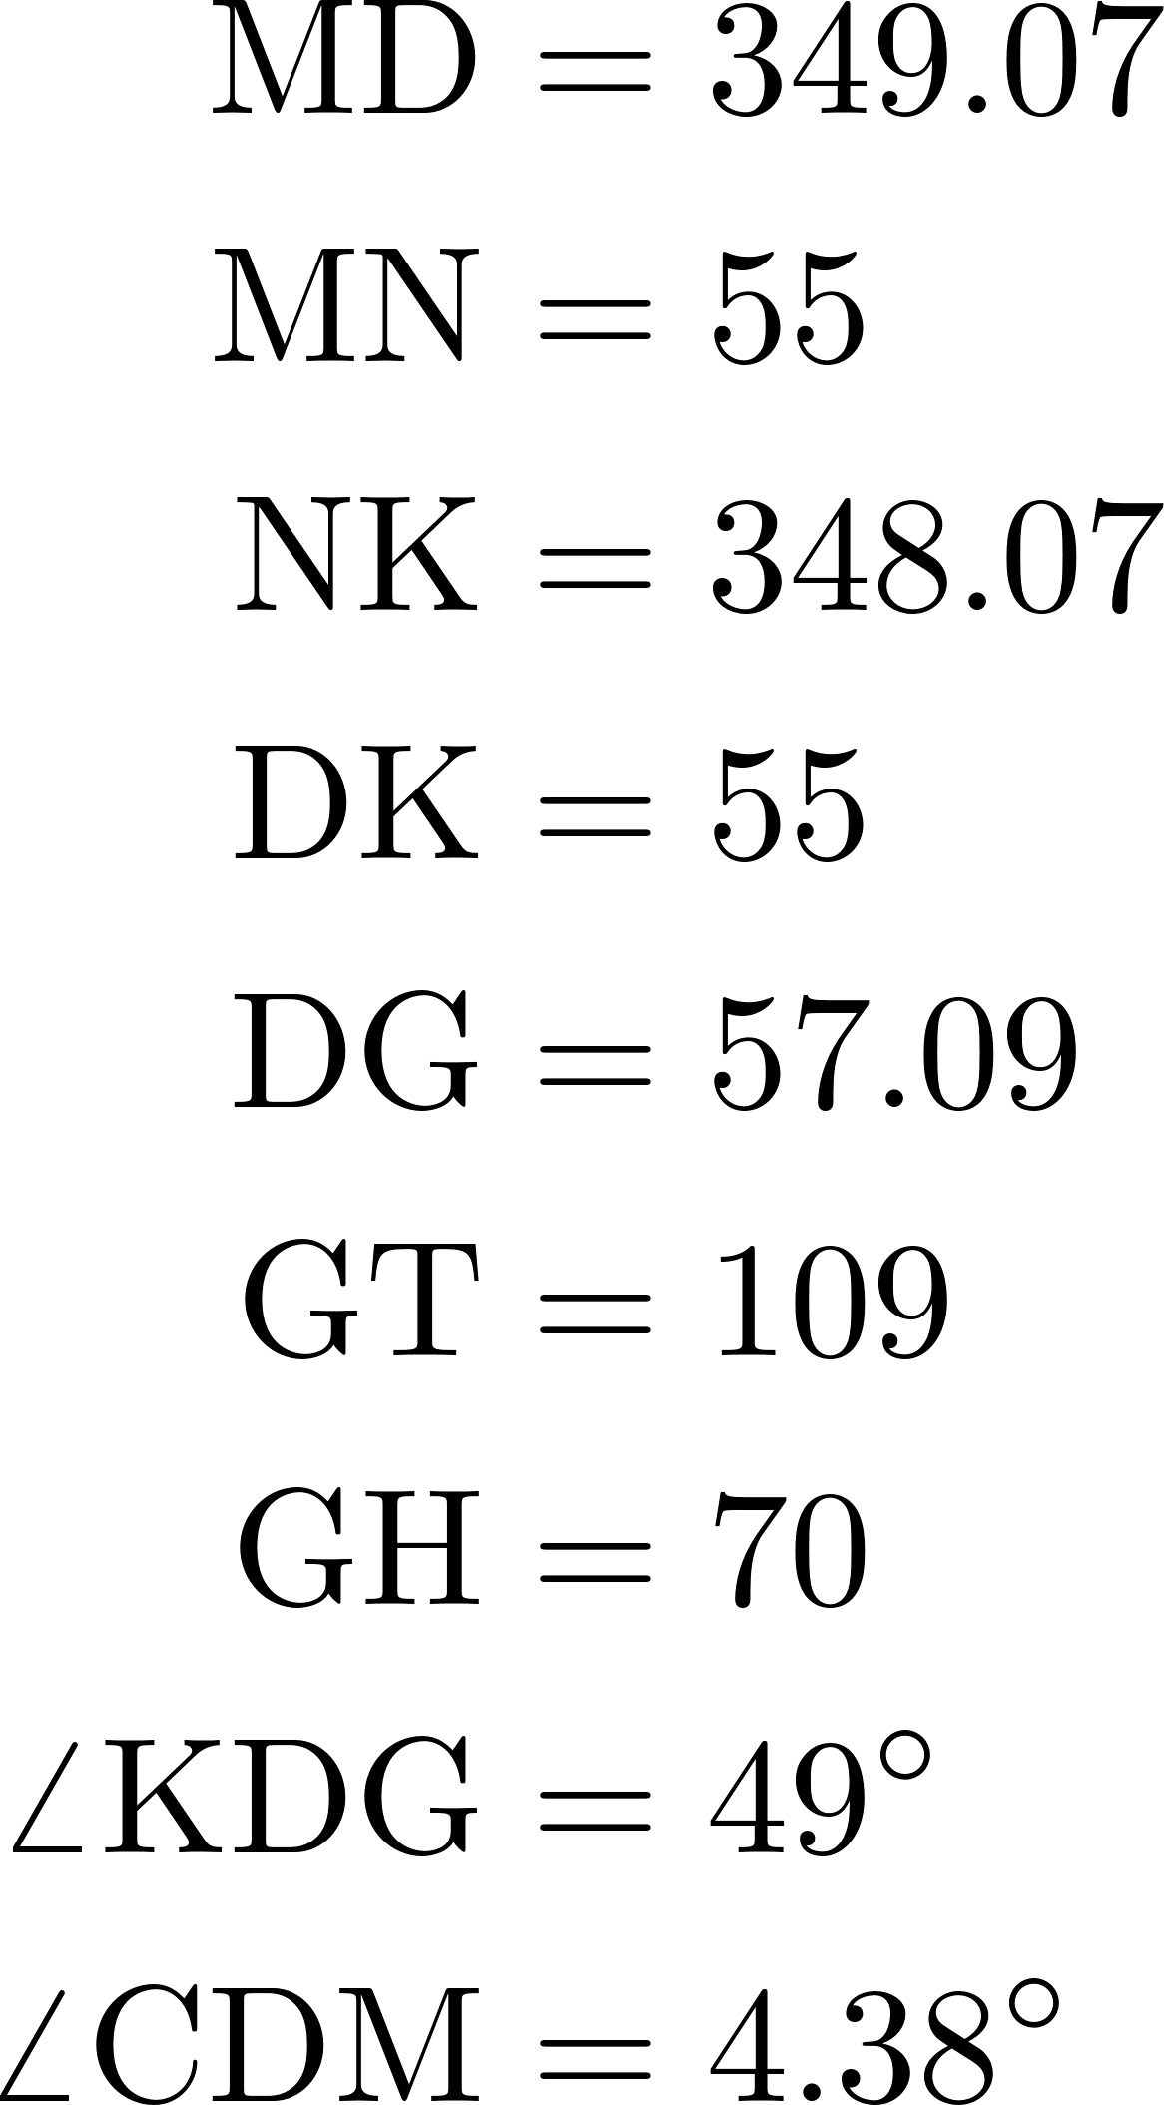





y
x
C
$$q_{3}$$
M
O
N
$$q_{4}$$
A
$$q_{5}$$
B
$$q_{6}$$
E
D
K
C
T
G
H
$$q_{7}$$
D

