Slide 1
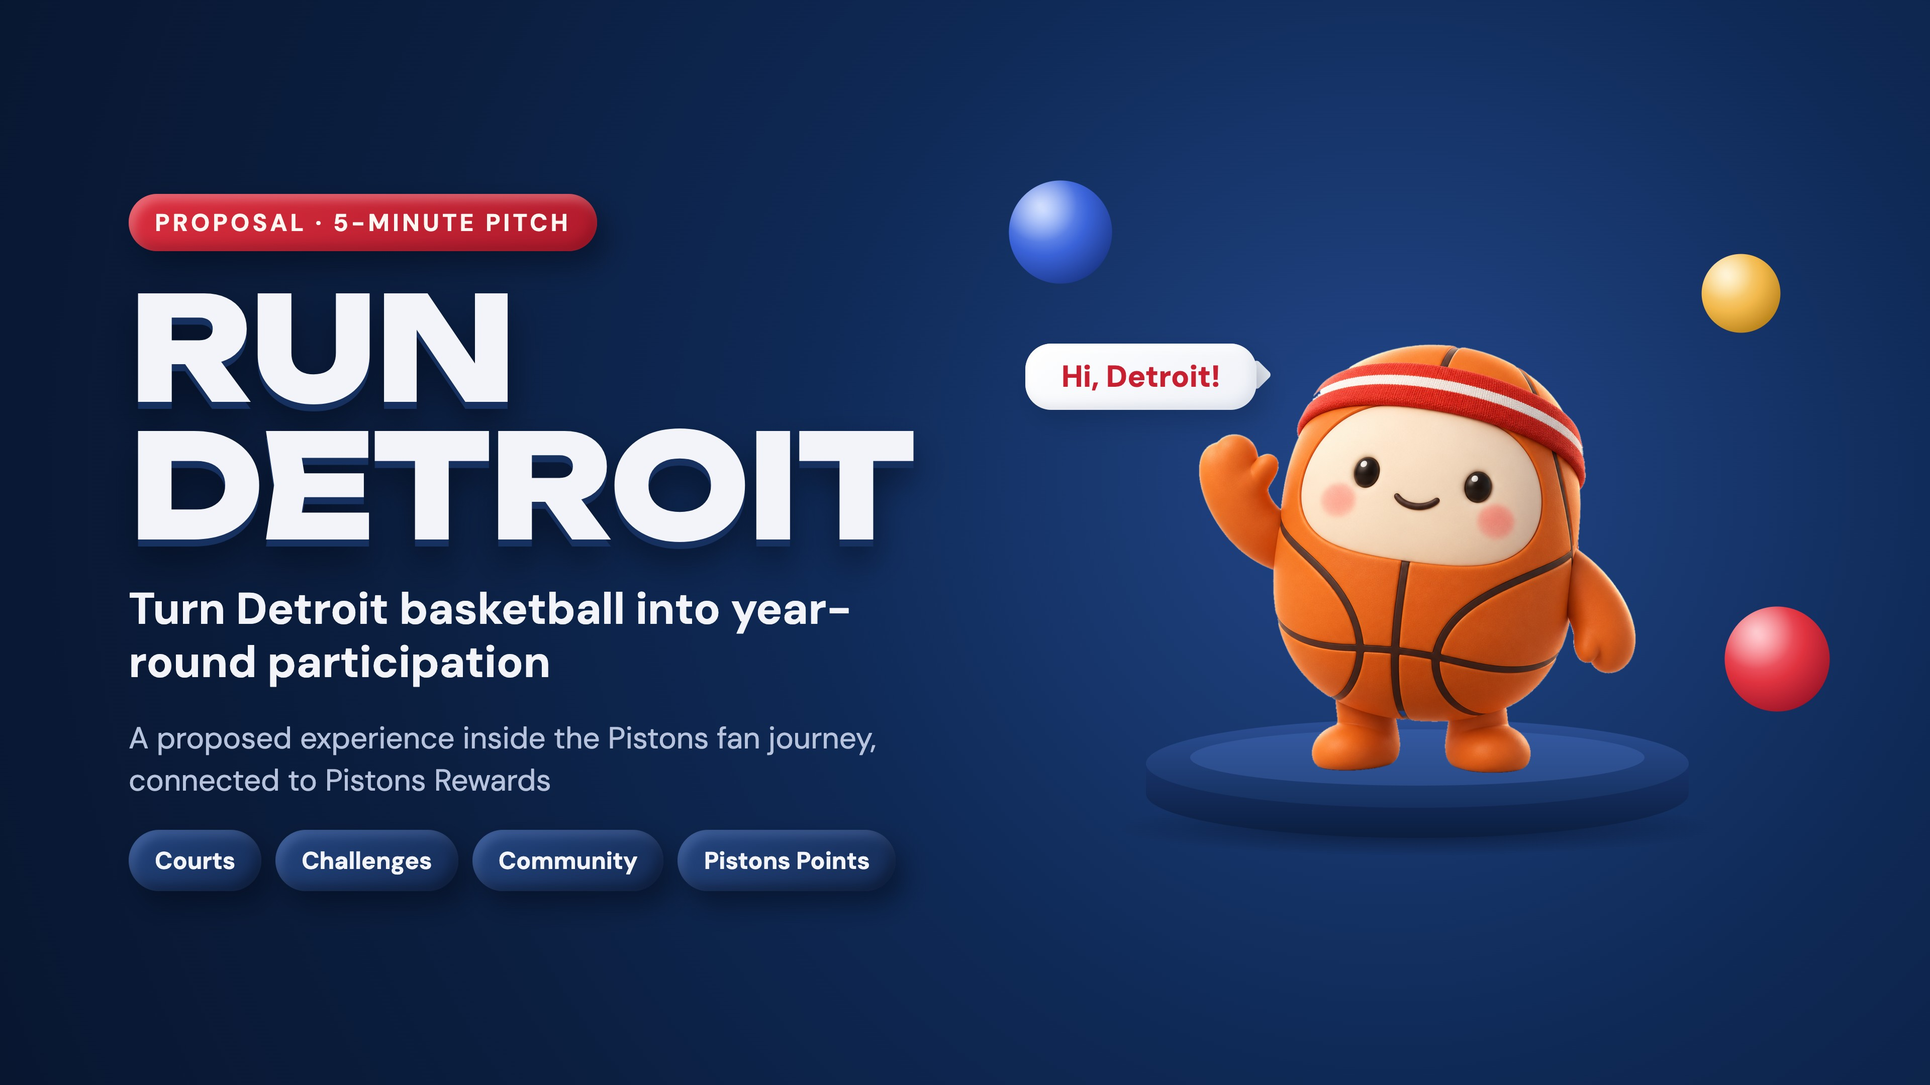
Notes:
Dickson · 0:00–0:30. Key line: Run Detroit connects fan engagement to neighborhood basketball. Frame it as a proposal — an experience inside the Pistons fan journey, connected to Pistons Rewards — not a separate app.

Slide 2
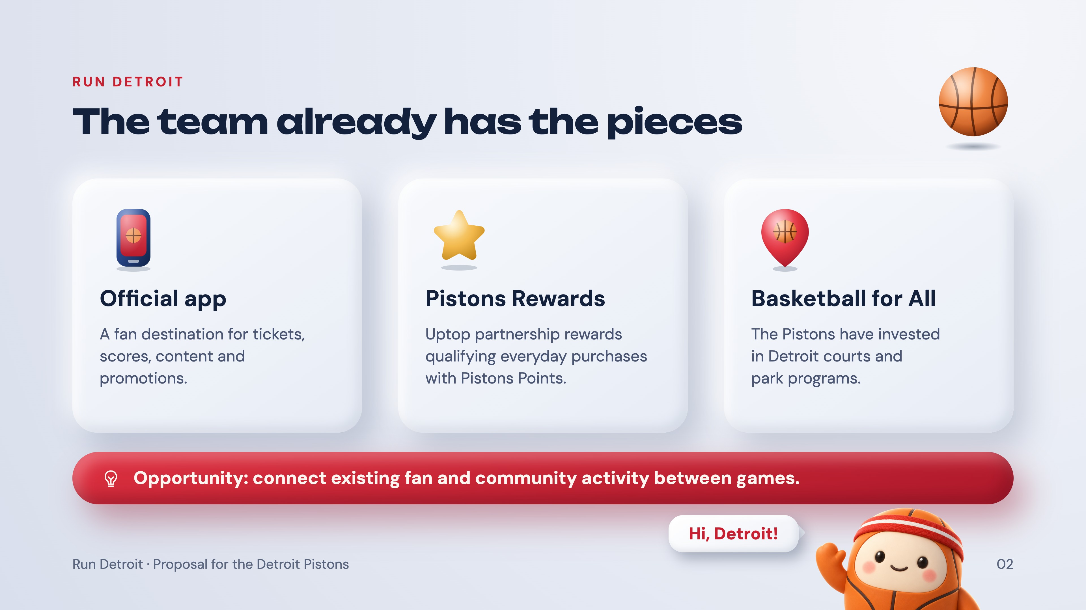
Notes:
Quinstella · 0:30–1:10. Key line: the app, the rewards program and the court initiatives are real foundations. Everything on this slide exists today — Run Detroit is the connection between them, between games.

Slide 3
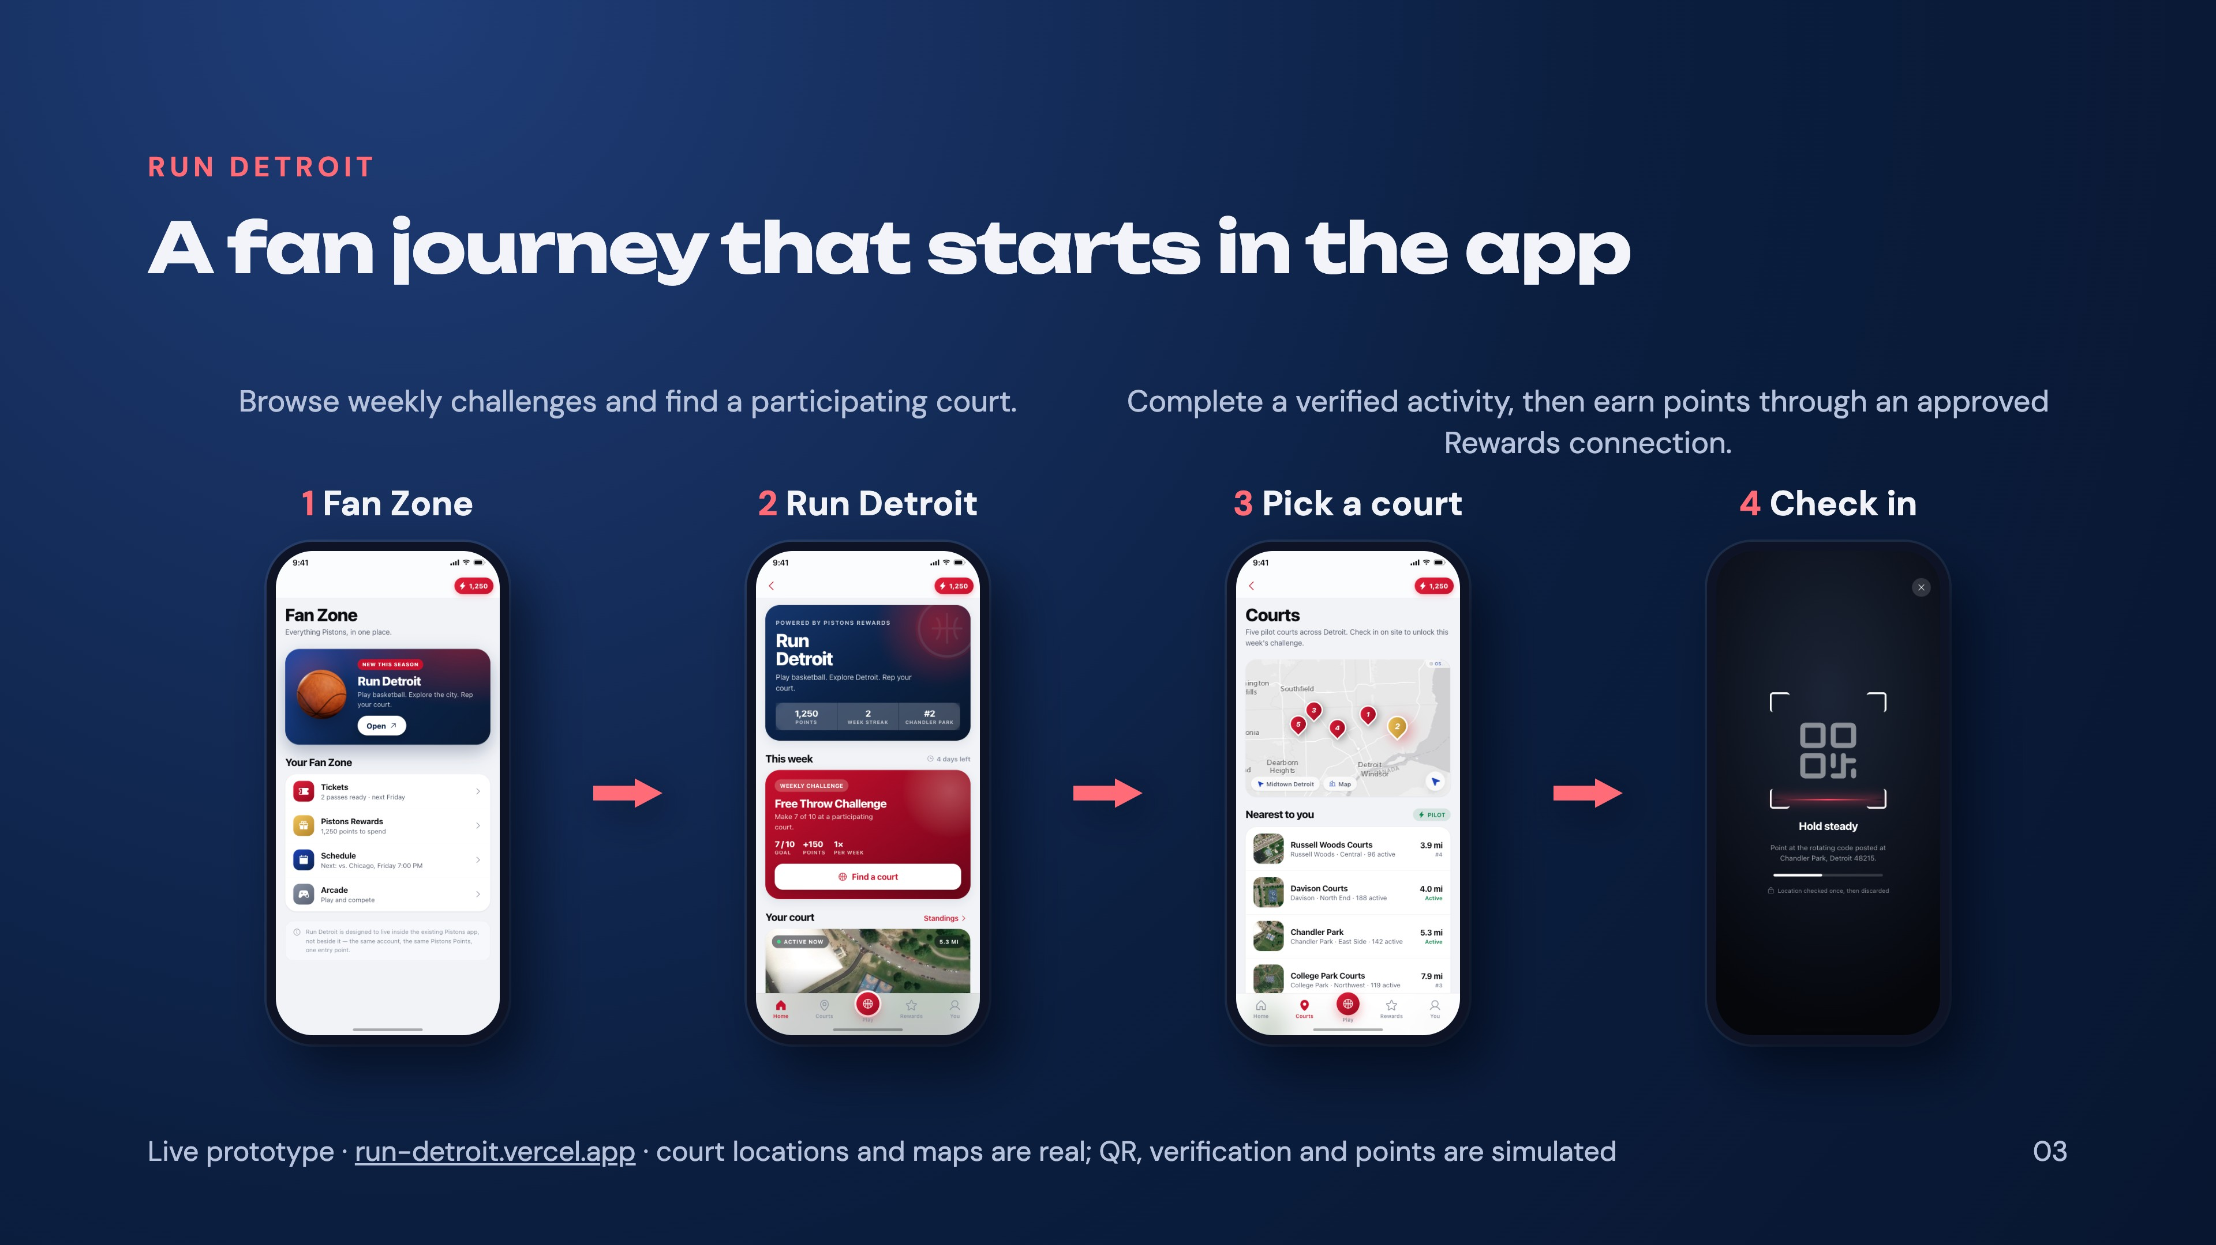
Notes:
Kobby · 1:10–2:05, live demo. Key line: Fan Zone to Run Detroit to court check-in and challenge. Demo path on run-detroit.vercel.app: Start playing → Open on the Run Detroit card → Courts → Chandler Park → Scan court code → Start the challenge → Begin attempt → Get it verified → Court host confirms. About 22 seconds end to end, so there is room to talk over it. Say plainly: QR, verification and point transfers are simulated; the court locations and maps are real.

Slide 4
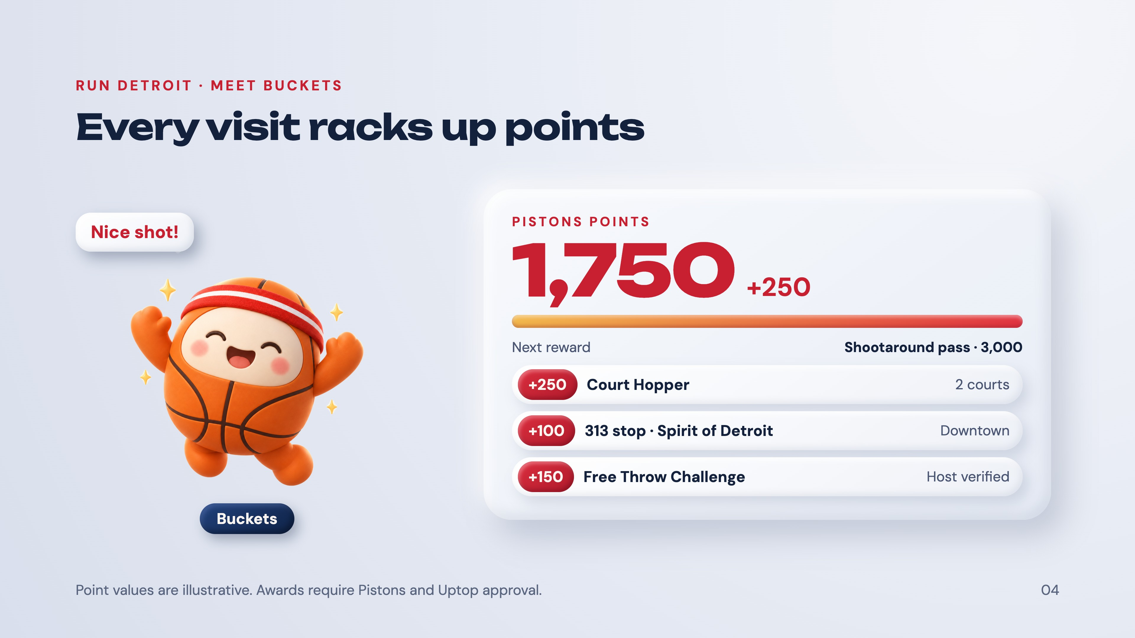
Notes:
Kobby · last 10 seconds of the demo slot, or Asher's lead-in. Key line: every verified visit racks up Pistons Points. Meet Buckets — a proposed Run Detroit mascot (the name is a placeholder). Walk the feed bottom to top: a host-verified free-throw round, a 313 stop, then Court Hopper, each adding to the balance. Point values are illustrative.

Slide 5
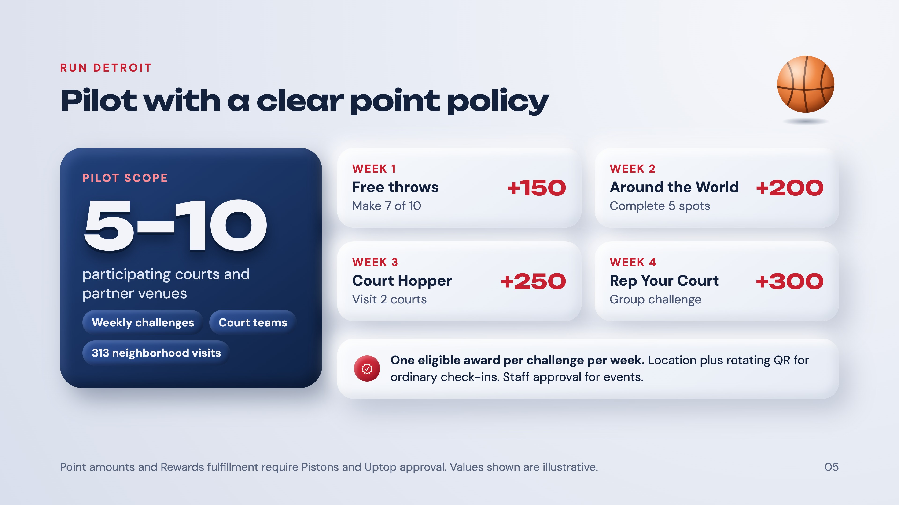
Notes:
Asher · 2:05–2:45. Key line: four weekly reasons to return, with capped awards. Walk the four weeks left to right, top to bottom. The policy is the point: one eligible award per challenge per week, location plus rotating QR for ordinary check-ins, staff approval for events. Point values are illustrative and need Pistons and Uptop approval.

Slide 6
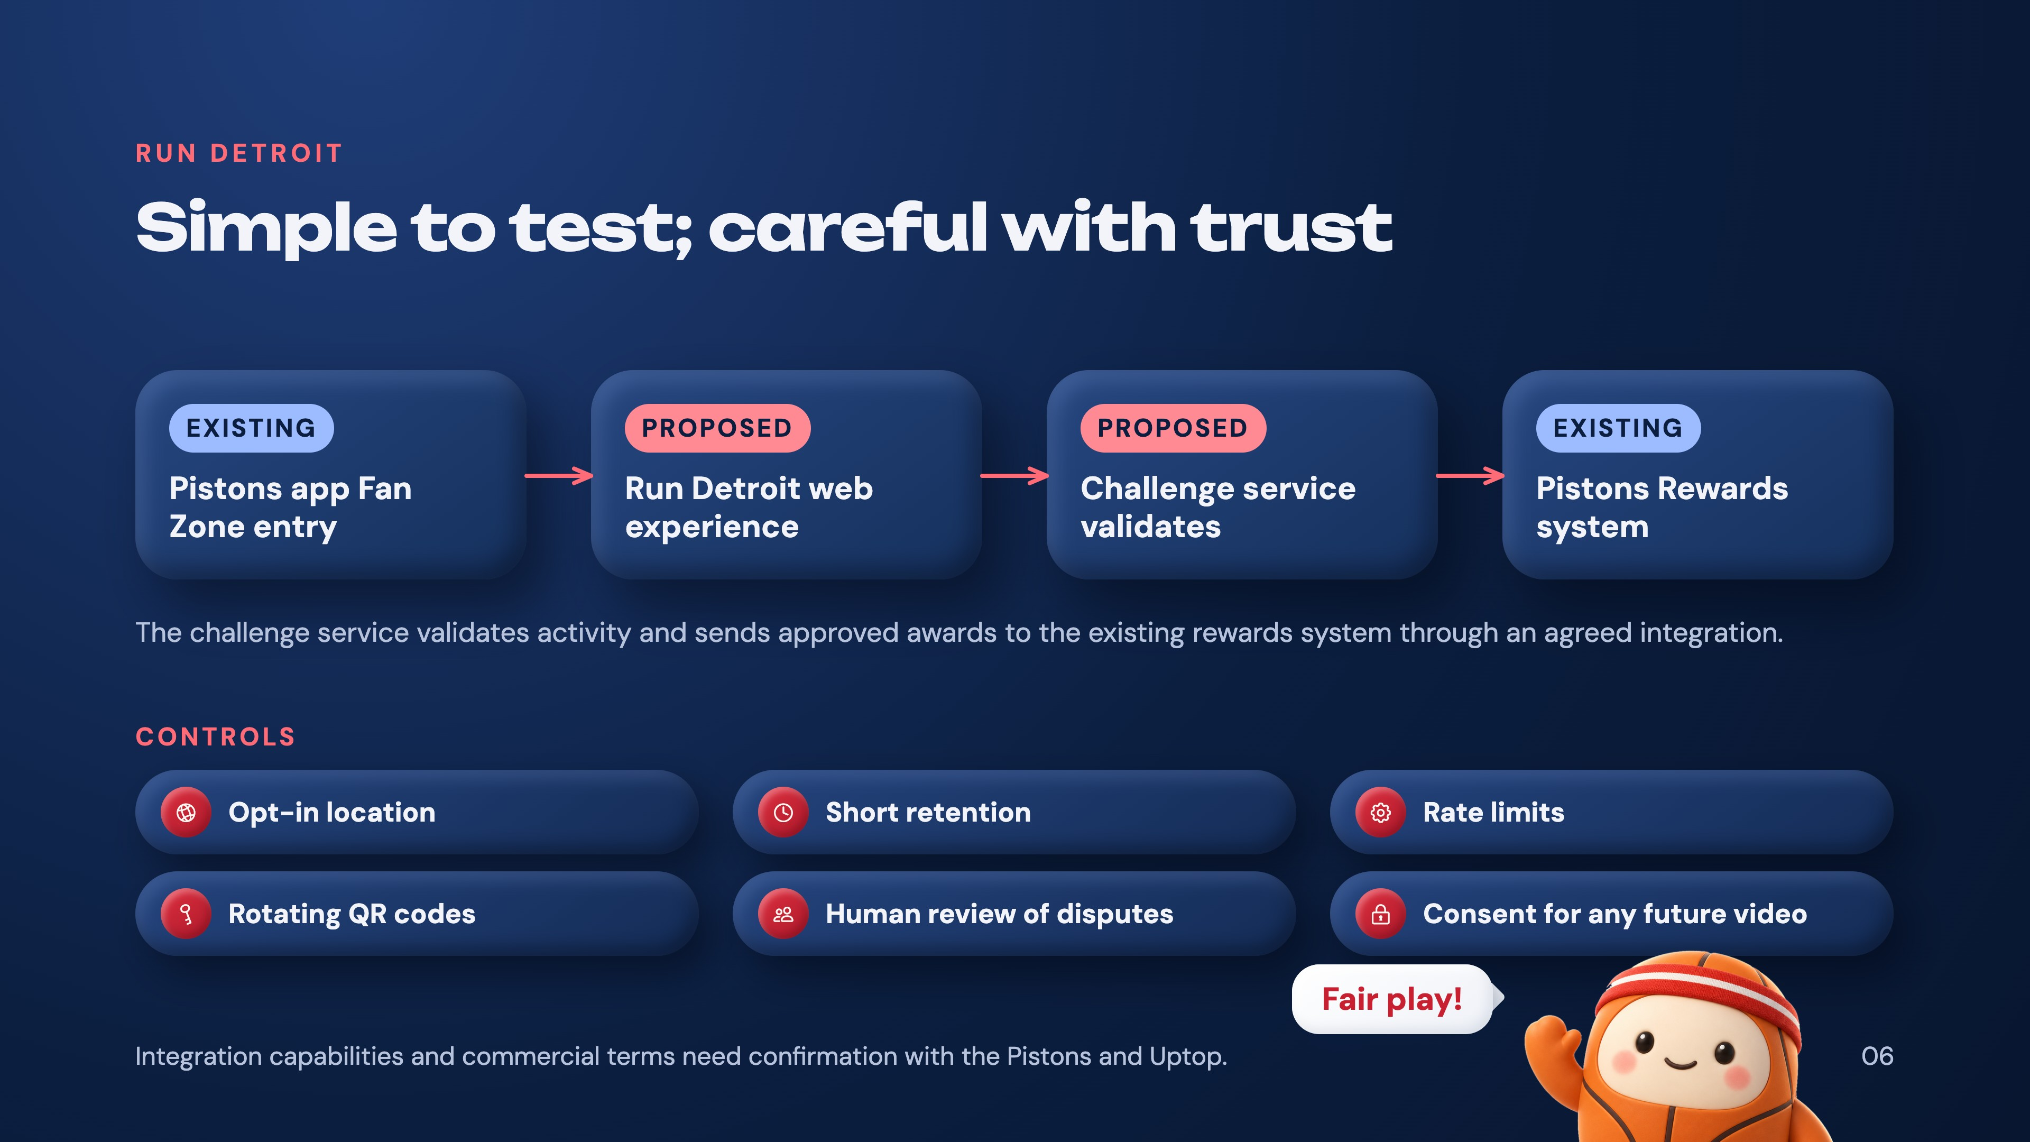
Notes:
Technology lead · 2:45–3:35. Key line: proposed handoff, verification and safeguards. Point at the tags: the app and the rewards system exist today; the Run Detroit web experience and the challenge service are what we propose. The integration and its commercial terms are unconfirmed until discovery — say that before anyone asks.

Slide 7
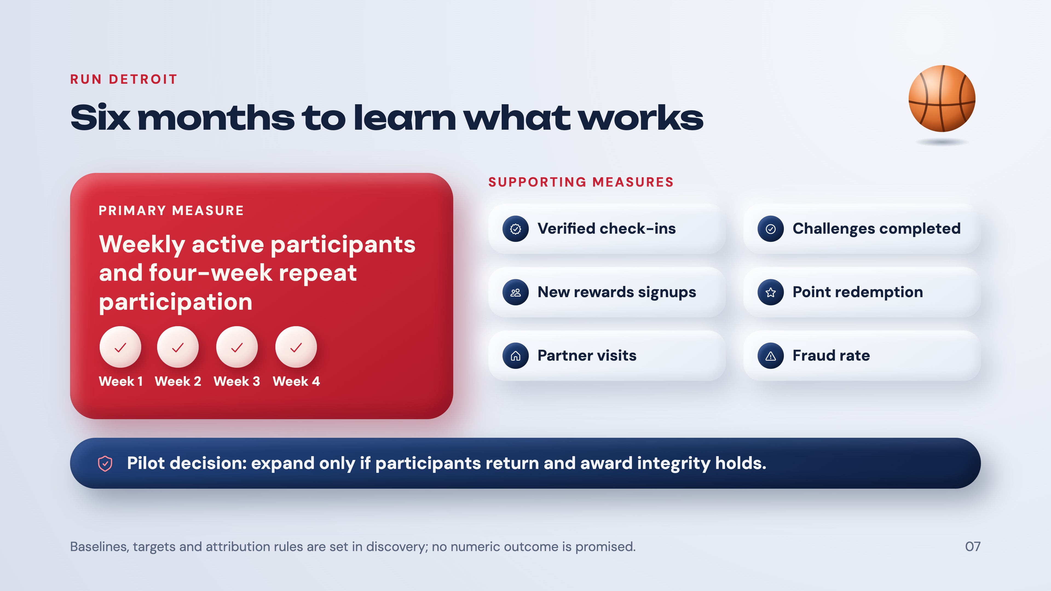
Notes:
Quinstella · 3:35–4:25. Key line: measure return participation and award integrity. The four check circles are the definition of repeat participation — the same person back in each of four weeks. No numeric business outcome is promised; baselines and targets come out of discovery.

Slide 8
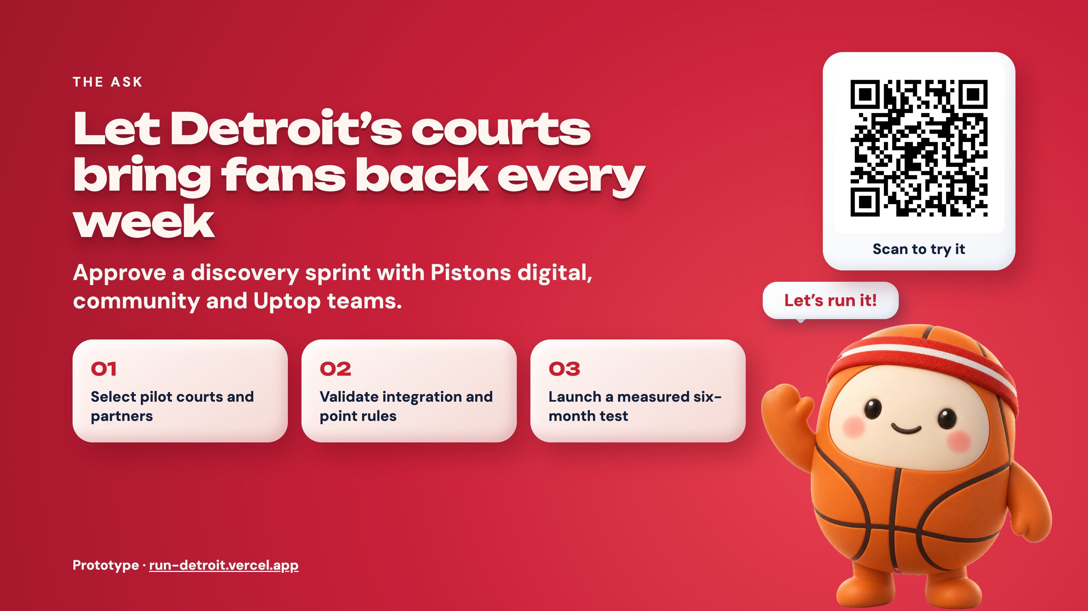
Notes:
Dickson · 4:25–5:00. Key line: request a discovery sprint and pilot design approval. Read the three steps, stop, and leave the prototype link on screen for questions.

Slide 9
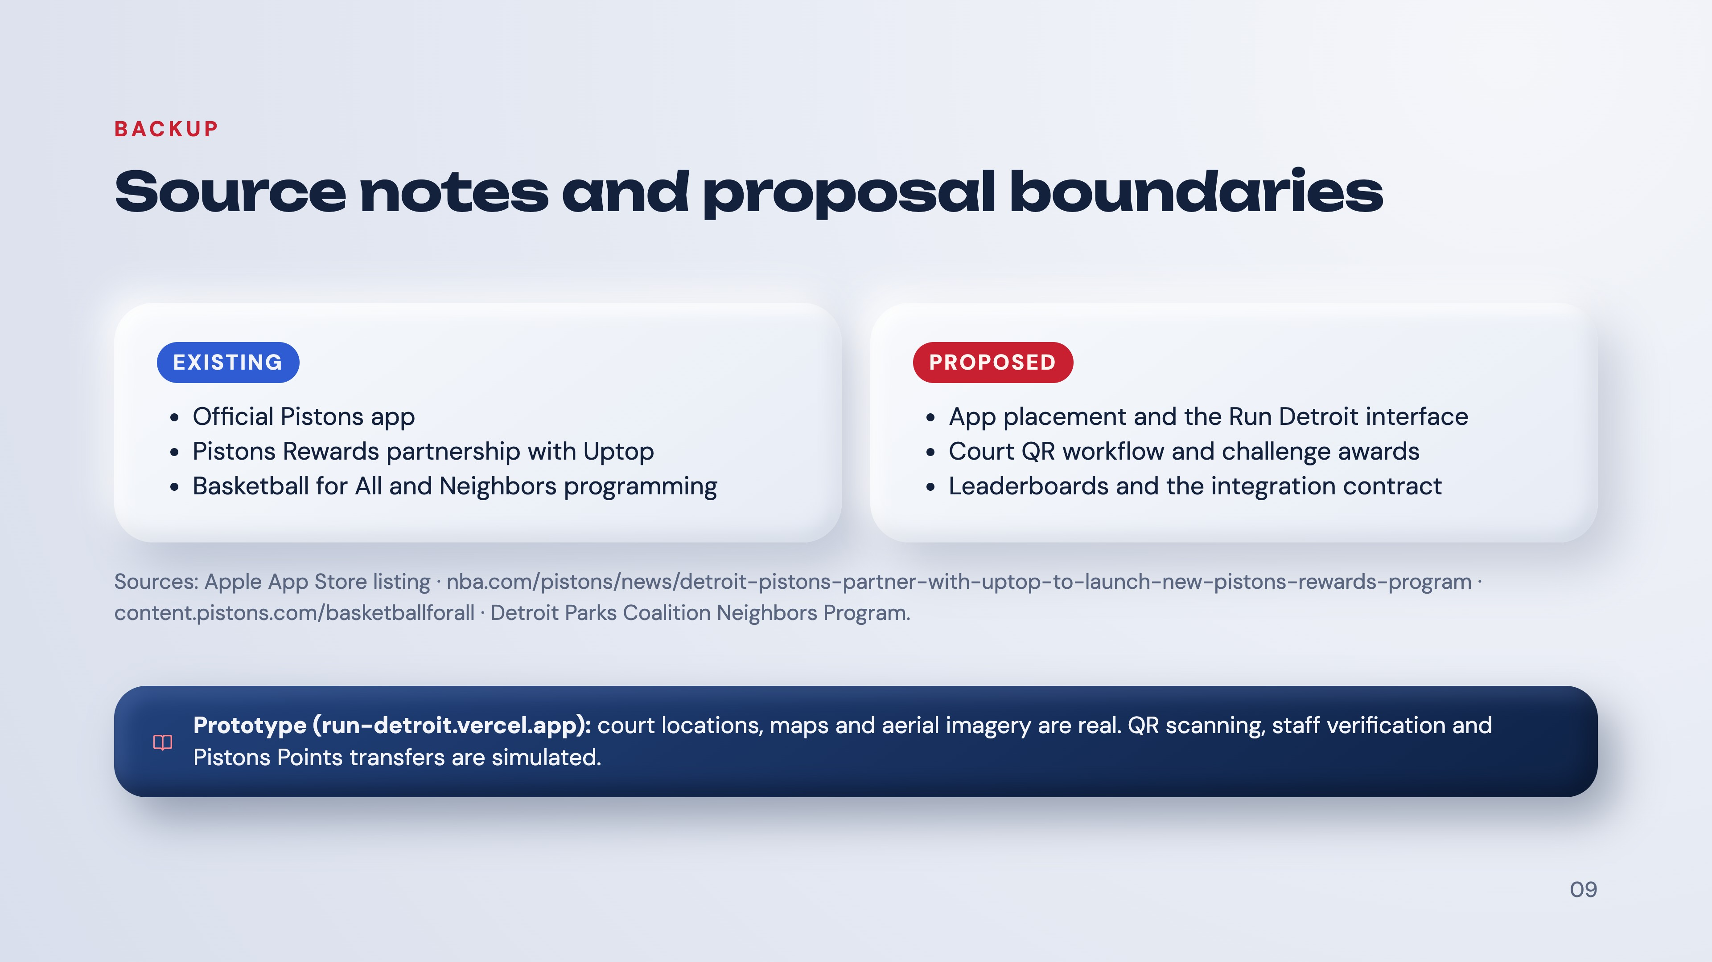
Notes:
Backup — use if asked what exists versus what is proposed. Existing public sources establish the app, the rewards partnership and the community programs. They do not establish a Run Detroit feature, a public Uptop API, a point-award contract or exact Fan Zone placement.

