Slide 1
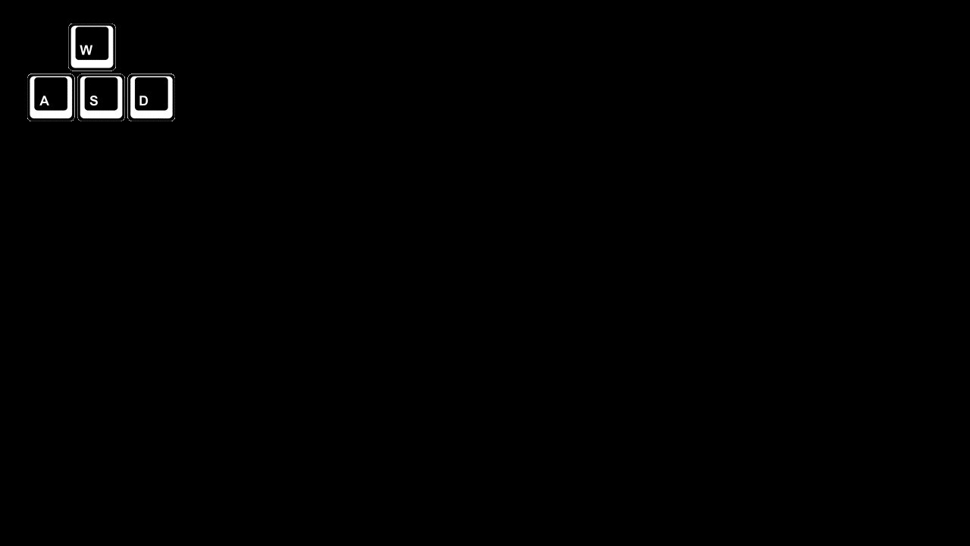
The frog in this game could be manipulated by using “W”, “A”, “S” and “D” on your key board. You could press two keys together, however your frog with only moves in one direction.

Slide 2
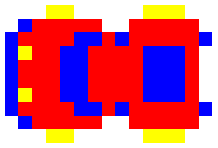
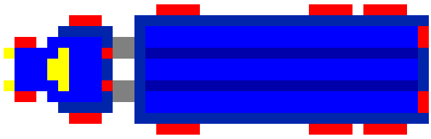
Cars:
One kind of moving obstacles, could move fast.
Trucks:
Another kind of moving obstacles, always moves slowly.

Slide 3

Logs:
A reliable platform to help you cross the river.
Turtles:
Another platform to help you cross the river, could be unreliable.

Slide 4




Bug destination:
Reach to get bonus.
Empty destination:
Normal destination.
Crocodile destination:
Could kill your frog.
Occupied destination:
Could never be reached again.

