Slide 1
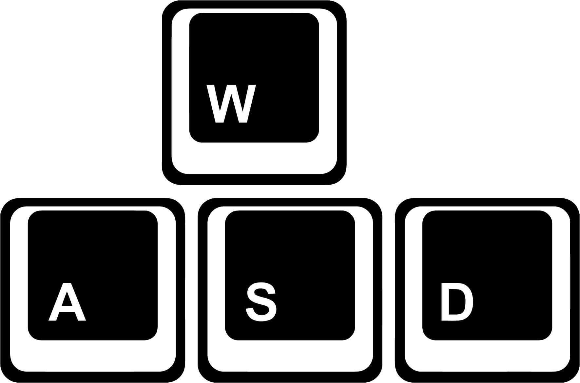

The frog in this game could be manipulated by using “W”, “A”, “S” and “D” on your key board.
You could press space to pause game during playing.

Slide 2
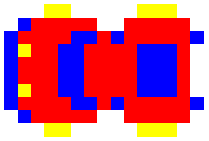
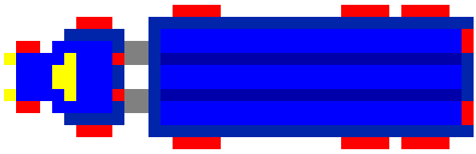
Cars:
One kind of moving obstacle, could move fast.
Trucks:
One kind of moving obstacle, always moves slowly.
Snake:
Another kind of moving obstacle, only appears in middle lane.

Slide 3


Logs:
A reliable platform to help you cross the river.
Turtles:
Another platform to help you cross the river, could be unreliable.
Crocodile:
Another platform to help you cross the river, dangerous when its month is open.

Slide 4




Bug destination:
Reach to get bonus.
Empty destination:
Normal destination.
Crocodile destination:
Could kill your frog.
Occupied destination:
Could never be reached again.

