Slide 1
Icon Library
Current as of March 7, 2006

Slide 2


























Icons: Cisco Products
Router-
Color and subdued
100BaseT
Hub
Workgroup
Director
Cisco MeetingPlace Express
uBR910
Cable DSU
Router
w/Silicon Switch
Network Management Appliance
Software-
Based Router on File/Application Server
CDDI/
FDDI Concentrator
Wavelength
Router
Storage Solution
Engine
(SSE)
PC Adapter Card
Protocol Translator
TransPath
PC Router
Card
Bridge
VIP
CiscoWorks
Workstation
Workgroup
Switch
Color/Subdued
Cisco
Hub
Small Hub (10BaseT Hub)
Workgroup
Switch
Voice-Enabled
Access
Server
NetFlow
Router
IOS SLB
Terminal Server

Slide 3


























Icons: Cisco Products (Cont.)
Route/Switch Processor
with and without Si
PC with Router-Based Software
Cisco CA
ATM
Switch
PC with
Software
MGX 8000
Multiservice
Switch
LAN2LAN Switch
PXF
ASIC Processor
General Processor
Voice Gateway
ISDN
Switch
Application Velocity System
BBSM
Switch Processor
Multi-
Switch
Device
ATA
Content Engine
Cisco
5500
Family
IP
Transport Concentrator
SIP Proxy Server
Management Engine
(ME 1100)
Broadband
Router
MicroWeb
Server
ITP

Slide 4




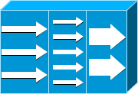



















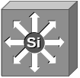
Icons: Cisco Products (Cont.)
NetRanger
IP
Standard
and Old
(Some
Prefer)
System
Controller
Program Switch
Cisco 6920
RateMux
Application Control Engine
Router
with TDM
Cisco
7505
Voice-Enabled
Access Server
(or Voice-Enabled Communications Server)
NetSonar
ADM
Cisco
7507
Cisco 1000
Cisco
Directory
Server
Firewall
Services
Module
Cisco
7500
(7513)
Edge Label Switch
Router
Voice-
Enabled
Router
Cisco 4310 End Office System
Edge Label
Switch
Router
with NetFlow
Cisco Unity Express
Multilayer Switch,
with and without Text
and Subdued

Slide 5















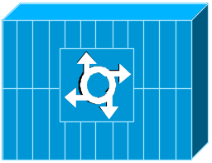



Icons: Cisco Products (Cont.)
Centri
Firewall
Cisco IOS Firewall
MGX 8220
MGX 8240
Cisco Security Manager
Router with Firewall
MGX 8260
Data Switch Processor,
AKA Data
Center Switch
PIX Firewall
Right and Left
Voice-Enabled ATM Switch
Cisco CallManager
DSLAM
Data Center Switch,
Reversed
IP Telephony Router
Cisco 6732 Access Server
Cisco MP
Cisco 6705 Access Server
Cisco 6701

Slide 6






















Icons: Cisco Products (Cont.)
IP DSL
Switch
VPN Concentrator
Cisco
VN 2900
Cisco 15200
SSL
Terminator
CSS 11000
Cisco
VN 5900
H.323
CDM
(Content Distribution Manager)
Cisco 15800
Cisco
VN 5902
IAD Router
Access
Gateway
BTS 10200 Softswitch
Cisco
Storage
Router
Content
Router
Content
Service
Module
ICS 7750
Content
Switch
ICM
Generic Softswitch
Content
Transformation Engine

Slide 7
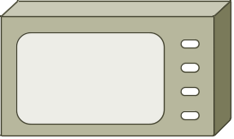















Icons: Cisco Products (Cont.)
Handheld
Tablet
Wi-Fi Tag
Wireless
Transport
PC Card
WiSM
Wireless Location Appliance
Access Point
Wireless
Bridge
Mesh
Access Point
Dual Mode
Access Point
Wireless
Router
Lightweight
Single Radio
Access Point
Scanner
Lightweight
Double Radio
Access Point
Wireless
Connectivity,
Different
Orientations
EtherClient
WLAN Controller

Slide 8














Icons: Cisco Products (Cont.)
SC2200 Signaling Controller
Mobile
Access
Router
IP/TV Content Manager
VSC3000 Virtual Switch Controller
IP/TV Broadcast
Server
Cisco Carrier Routing System
VSC3000 or
SC2200 Host
Universal Gateway
FC Storage
BTS 10200 Softswitch
Generic Softswitch
Generic Softswitch
(Cisco Branded)
IntelliSwitch Stack
Service Control
Detector
Guard

Slide 9







Icons: Cisco Products (Cont.)
Virtual Layer Switch
DWDM Network Line
DWDM Ring
Multilayer Remote Switch
Layer 2 Remote Switch
DWDM Filter
Multi-Fabric Server Switch
Server Switch

Slide 10












Icons: Cisco Products, Optical (Cont.)
Optical Services Router
Automatic
Protection Switching
WDM
Optical Fiber
Cisco 10700
Channelized
Pipe
ONS15104
Optical Transport
SONET MUX
Concatenated Payload
Optical Amplifier
Wide Area Application Engine
Optical Cross- Connect
Digital Cross-Connect

Slide 11


Icons: Cisco Products, Optical (Cont.)
Protected Optical
Unprotected Optical
Metro 1500
ONS 15540

Slide 12










Icons: Security
Secure Switch
(Cisco and Subdued Color Schemes)
Cisco ASA 5500
Secure Router
(Cisco and Subdued Color Schemes)
Secure
Server
Secure Catalyst Switch
(Cisco and Subdued Color Schemes)
Security Management
(Cisco and Generic Color Schemes)
Secure Endpoints
(PC and Laptop)

Slide 13
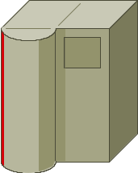
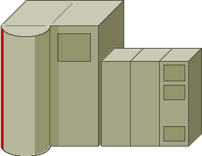

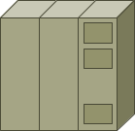
Icons: IBM
IBM
Mainframe
Cluster Controller/3174
(Desktop Model, Not Used Much)
IBM
Mainframe
with FEP
IBM Mini
(AS400)
FEP
(Front End Processor)
Cluster Controller/
3274 or 3174
(Most Common Type)

Slide 14










Icons: WAN
DSU/CSU
(Add Text in PowerPoint)
Network Cloud,
Dark
Distributed Director
WAN
Network Cloud,
Gold
Local Director
MUX
Network Cloud,
White
PBX/
Switch
PBX
(Small)
Network Cloud, Standard Color
Hub
Gray and Blue
DPT Ring
NAT

Slide 15
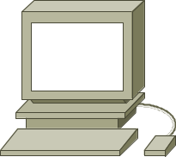







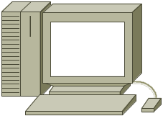

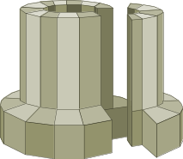

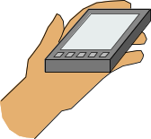



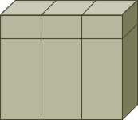
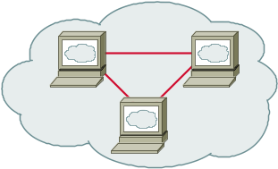

Icons: LAN
Workstation
(Sun)
Printer
ATM/FastGb Etherswitch
Web Server
PC
Laptop
HP Mini
Web Browser
Mac
File/
Application Server
Super-
computer
Repeater
Newton
Terminal
Monitor
LAN2LAN
Mini or
VAX/VMS
with DECnet
Web Cluster
Intelligence Engine 2100 Series

Slide 16







Icons: Media
Token Rings, with and without Text
and Subdued
Line: Serial (Use Thicker where There Is Space)
FDDI Rings, with and without Text, Vertical and Horizontal
Line: Circuit-Switched
(Use Thicker where There Is Space)
Line: Ethernet
(Use Thicker where There Is Space)

Slide 17

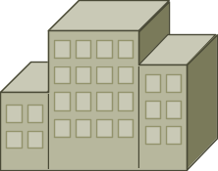
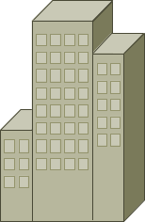


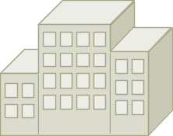





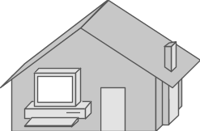
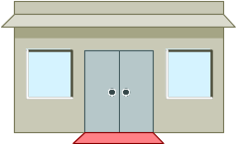
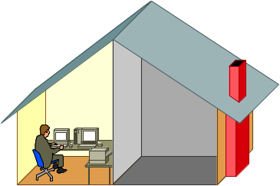
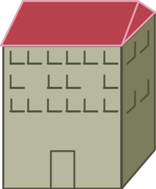
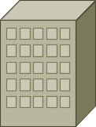


Icons: Buildings
Government
Headquarters, Regular, Subdued,
and Blue
University
House, Regular and Blue
Medium Building, Regular, Subdued,
and Blue
Small
Business
Telecommuter
House (Color and Subdued)
Branch
Office,
Regular, Subdued,
and Blue
MDU
Home Office

Slide 18
















Icons: People
Androgynous Person
Symbol Woman, Various Colors
Man
Woman
Symbol Man, Various Colors
End User Male,
Left and Right
End User Female,
Left and Right
Running Man
(Color and Subdued)
Running Woman
End User,
CiscoWorks

Slide 19


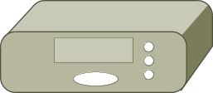








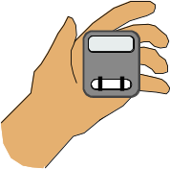




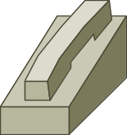




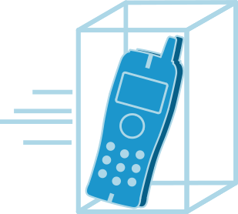



Icons: Multimedia/Voice/Phone
Phone
Camera
PC/Video
Set Top
Box (STB)
BBFW
Phone-Appliance
Television
Camera
PC/Video
BBFW
Media
Fax/
Phone
Speaker
Pager
Phone Feature
Cell Phone
Microphone
Class 4/5
Switch
Phone Ethernet
Phone 2
Fax
Headphones
Hoot and Holler Phone
Mobile
Access
Phone
Turret
Phone Polycom
IP Phone

Slide 20





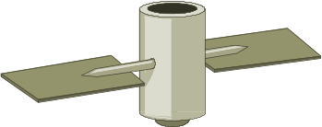














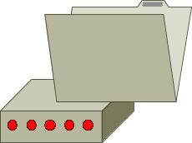
Icons: Miscellaneous
Firewall, Horizontal and Vertical, Subdued
Satellite
Dish
File Cabinet
Lock
Satellite
Breakout Box
UPS, RPS
Key
Host
MAU
Lock and Key
Database, Relational
PAD
Car
Modem
BBS
(Bulletin
Board
System)
Diskette
(3.5" Floppy)
Truck

Slide 21

Information Graphics
Notes:
Thanks for joining us today to attend the Cisco Brand and Corporate Identity Workshop.
In the first half of the workshop I am going to cover Brand Matters and talk in detail about the Cisco brand, and in the second half my colleague Gary McCavvit is going to take you through our updated visual identity system.
At the end of the workshop we’re going to leave some time for a fun quiz as well as some Q&A.

Slide 22
Informational Graphics
Informational graphics are a library of graphic shapes used to develop charts, diagrams, and abstract visuals. These graphics help illustrate business and technology ideas while maintaining brand compliance and consistency across Cisco presentations
They also serve as a reference point when developing new and different graphics
This library is not static and will be updated on a quarterly basis

Slide 23
How to Use Them
Use simple shapes to create charts or diagrams. When Photos are too general, and Network Diagram Icons are too specific, use Informational Graphics to help illustrate business and technology ideas

Slide 24

Library
Ungroup shapes to modify and change colors

Slide 25
Library (Cont.)
Ungroup shapes to modify and change colors

Slide 26
Library (Cont.)
Ungroup shapes to modify and change colors
Notes:
The obvious question now is, how successful have we been so far in conveying our brand aspirations. For the most part, very successful. How do we know. We’ve asked our customers.
In the fall of 2002, Ogilvy Mather interviewed Cisco customers—TDMs, BDMs, Enterprise, Service Provider, Channel Partners, Media, Employee—from our 8 most important countries (US. Canada, Japan, China, UK, France, Germany, and Italy) to better understand their perception of Cisco. They found that Cisco had an unequaled position as a stable market leader, that we have a close—almost synonymous association with the network and the Internet, and that our products are known for their reliability and high quality. Most of the interviewees saw Cisco as a pragmatic yet visionary company that is not necessarily leading edge but focuses on delivering the right technology at the right time. They viewed Cisco as honest, confident, knowledgeable, and market driven.
On the negative side, participants in the study were not consistent in their impression of Cisco’s customer service and support—most commented favorably, but too many did not, and this should be a concern. Cisco is also frequently seen as arrogant and inflexible and the high cost of the products is not always seen as worth the money.

