Slide 1
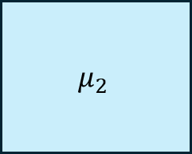
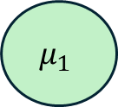

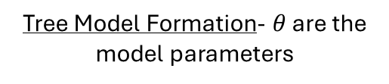
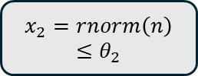
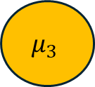
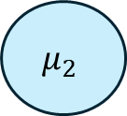
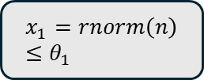

Simulated Studies using Bayesian regression tree models for causal
inference
Tree Model Formation- $θ$ are the model parameters
$$x_{2}=rnorm\left(n\right)≤θ_{2}$$
Sample Space
False
True
$$μ_{1}$$
$$μ_{1}$$
$$x_{1}=rnorm\left(n\right)≤θ_{1}$$
$$x_{2}$$
False
True
$$μ_{2}$$
$$μ_{3}$$
$$μ_{2}$$
$$μ_{3}$$
$$x_{1}$$

