Slide 1
Intrinsic bursting enhances neuronal model of sequence generation by avian brain area HVC
Dezhe Jin, Fethi M. Ramazanoğlu, H. Sebastian Seung
Presented by: Matthew Kobilas

Slide 2
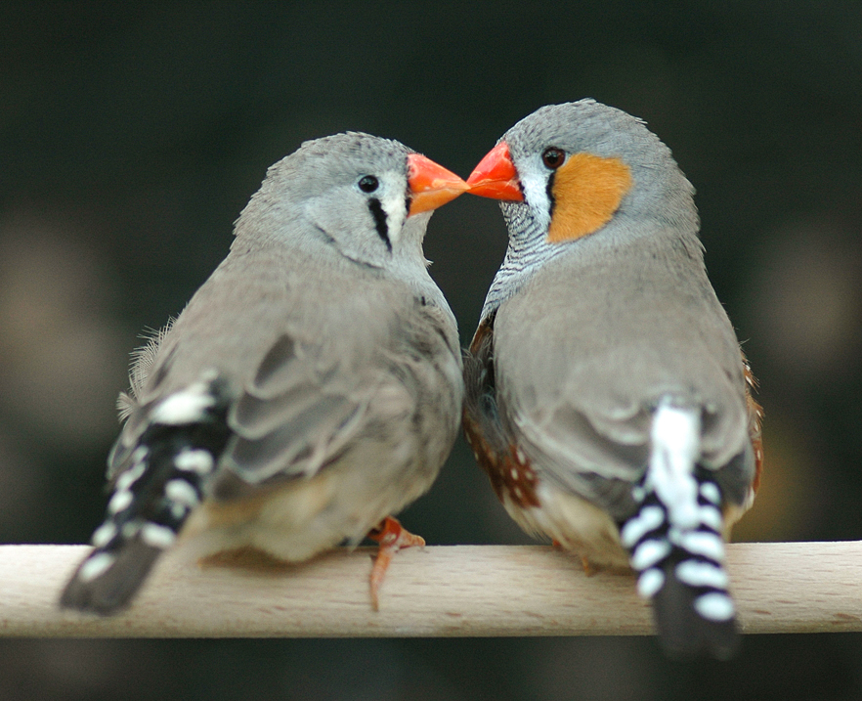
Background
Avian brain area HVC is important for production of birdsong
RA-projecting neurons in HVC emit single burst of spikes during song
Activated in precisely timed, stereotyped sequence
This model is proposed as an enhancement to existing models
Reduced model from HVC -> HVC(RA)
Based on two assumptions

Slide 3
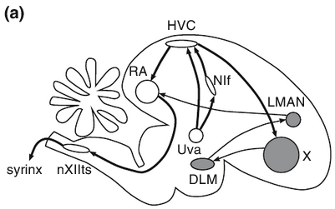
Assumptions
Assume that burst sequences are generated within HVC, rather than by upstream brain area
Nlf and Uva brain areas are upstream, however
Nlf not required for song production
Uva not precisely timed enough
Provisionally reasonable to assume that HVC generates burst sequences

Slide 4
Hypotheses
Hypothesis 1
Sequential order of bursting is embedded in organization of excitatory synapses between HVC(RA) neurons
Structure is related to function
Hypothesis 2
HVC(RA) neurons are intrinsically bursting, so burst duration is set by cellular properties
Explains the timing of bursts required to create coherent song

Slide 5
Model overview
Somatic compartment:
Hodgkin-Huxley type Na and delayed rectifying K conductances for spike generation
Leak conductance
High-threshold K (KHT) conductance provides re-polarizing current during spiking
Low-threshold K (KLT) conductance introduced to account for strong spike-frequency adaptation
Dendritic compartment:
Leak conductance
High-threshold Ca conductance and Ca-activated K conductance generate Ca spike in dendrite if depolarized over threshold

Slide 6
References
https://www.researchgate.net/publication/6387453_Intrinsic_bursting_enhances_the_robustness_of_a_neural_network_model_of_sequence_generation_by_avian_brain_area_HVC

