Slide 1
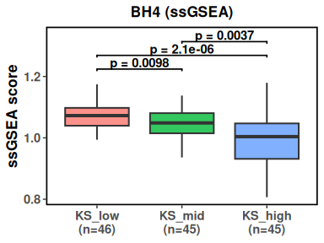
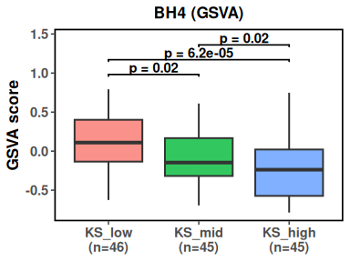
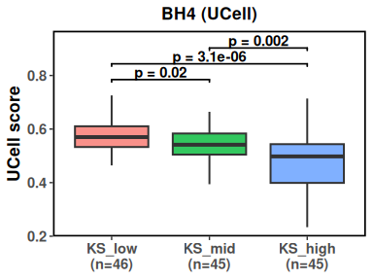
Figure 1b – Breast Cancer Atlas, pseudobulk, BH4 gene set scores by ssgsea, gsva, ucell, stratified by KS tertile

Slide 2
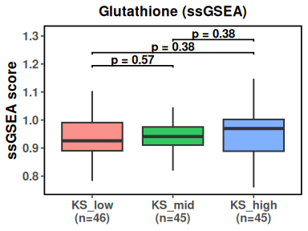
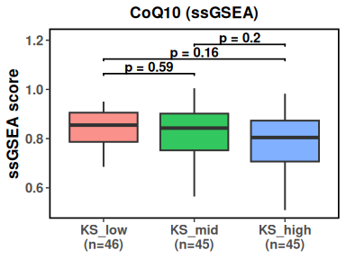
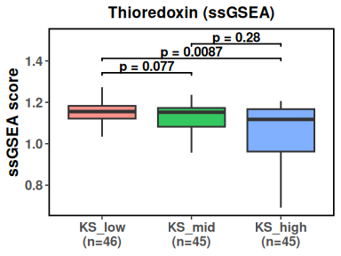
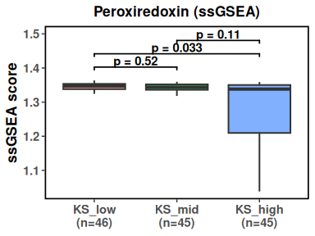
Extended Data Figure 5a-d – Option 1 - gene set scores with ssgsea

Slide 3
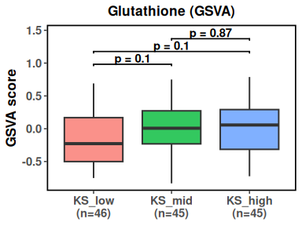
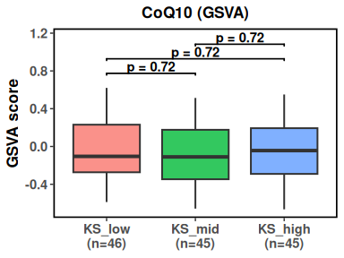
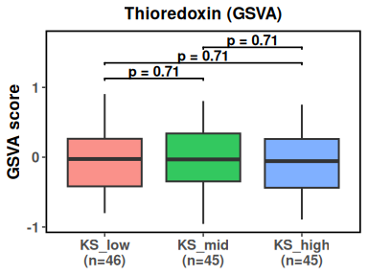
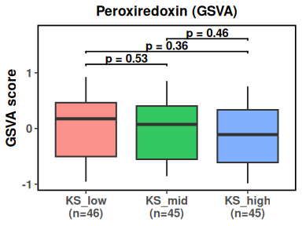
Extended Data Figure 5a-d – Option 1 - gene set scores with gsva

Slide 4
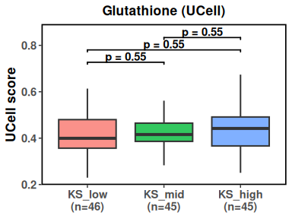
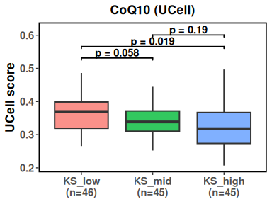
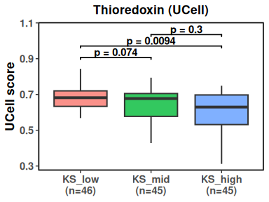
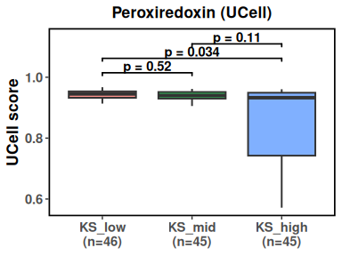
Extended Data Figure 5a-d – Option 1 - gene set scores with ucell

Slide 5
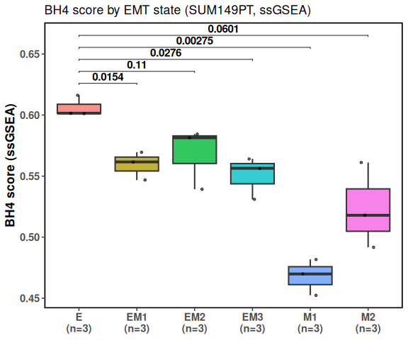
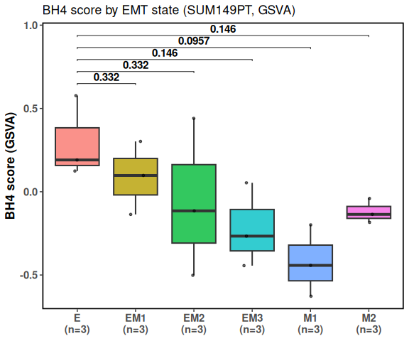
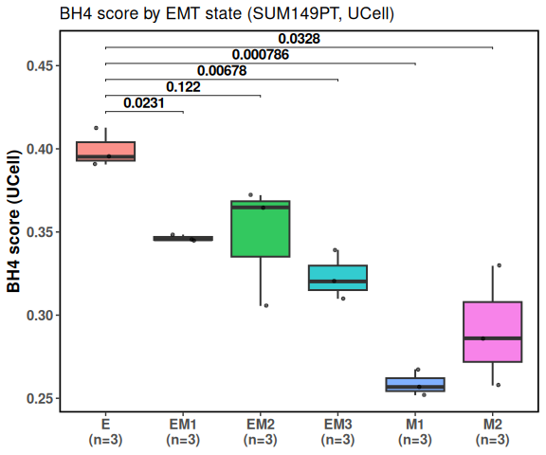
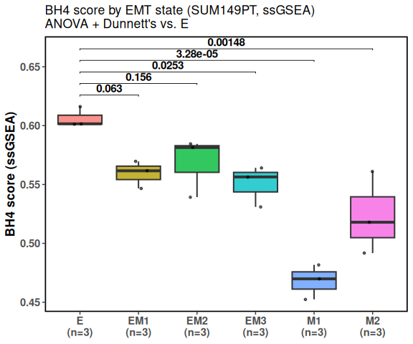
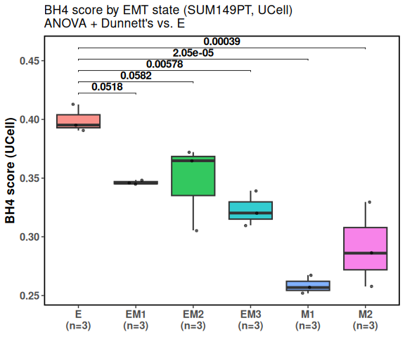
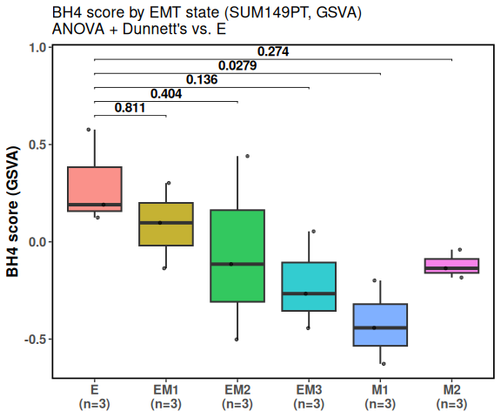
Extended Data Figure 5e – SUM149PT BH4 gene set score box plots – parental droppeds, stats only show vsE
ssgsea
gsva
ucell
T-test
anova

Slide 6
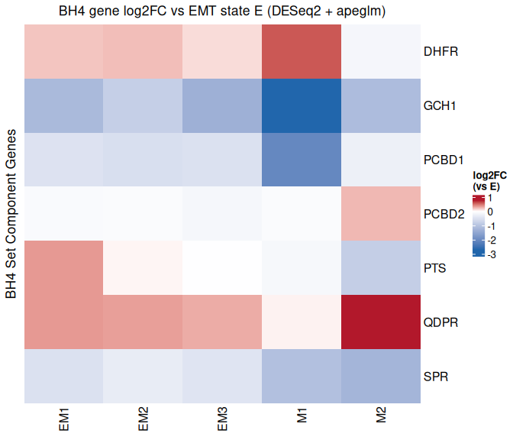
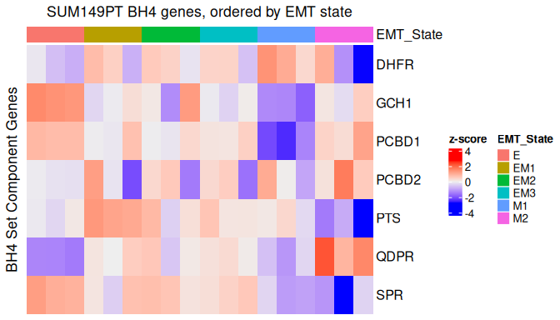
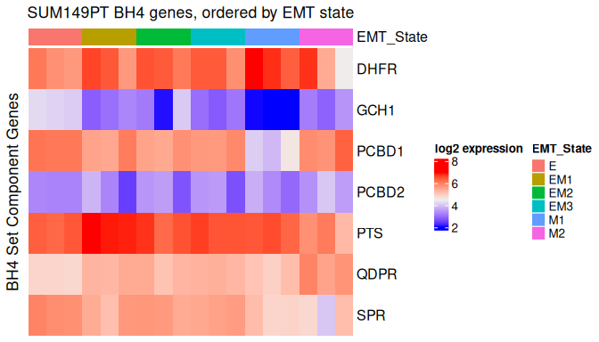
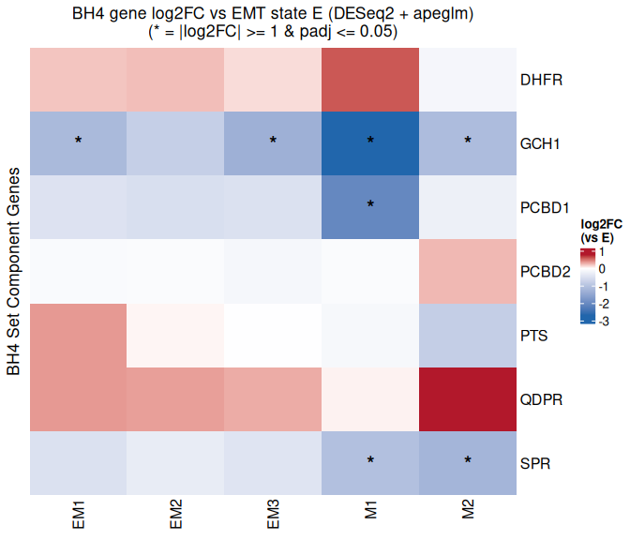
Extended Data Figure 5f – SUM149PT BH4 gene expression set score box plots – parental dropped (part1)
Log Fold change vs E - heatmap
Gene-level heatmaps
Z-score
With significant changers indicated
Log2 experssion

Slide 7
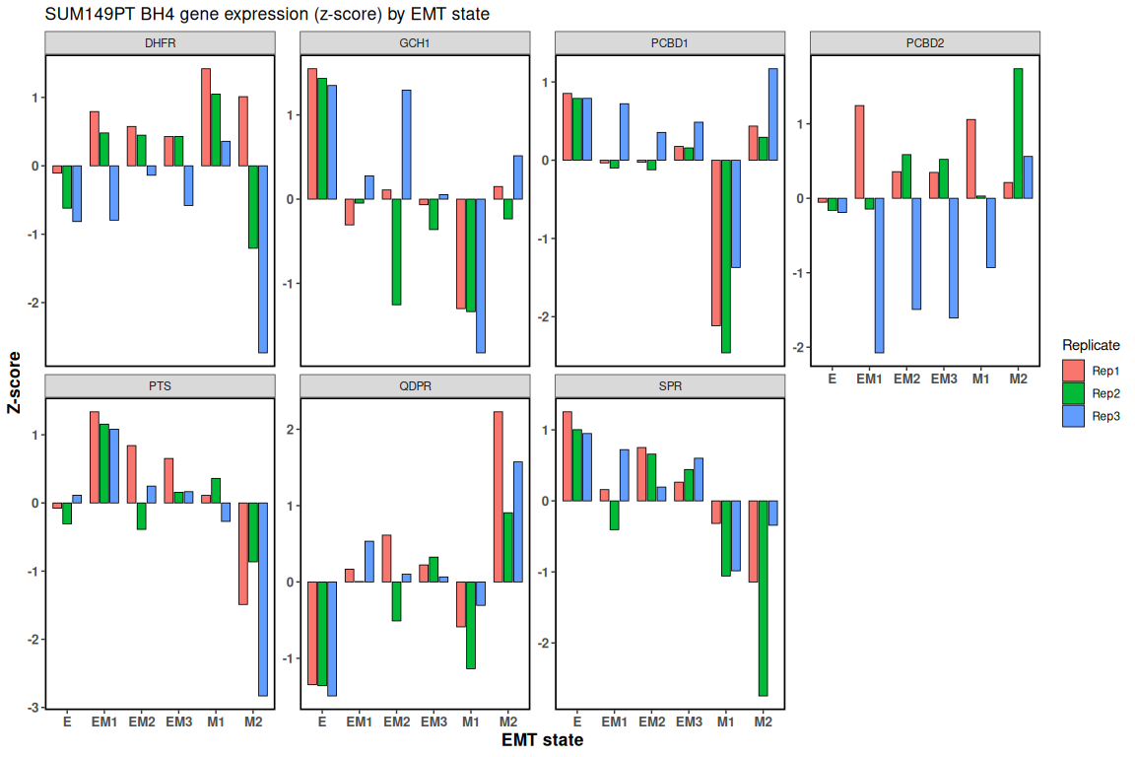
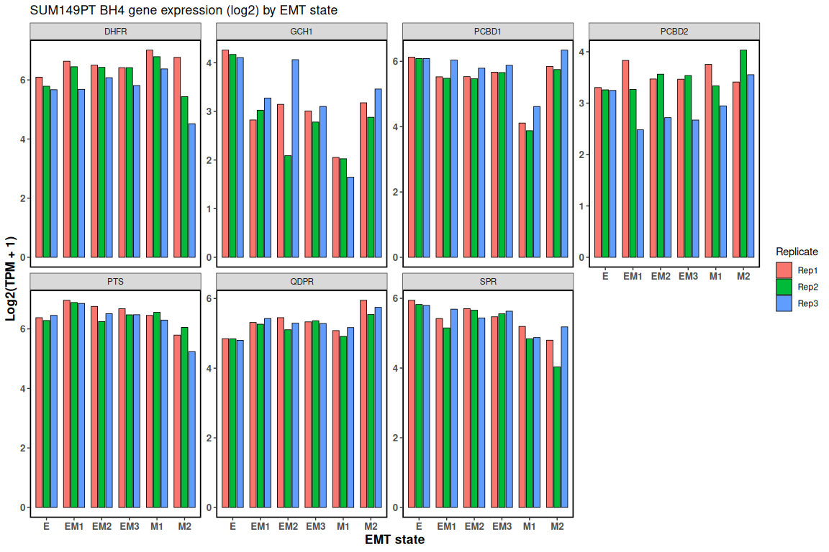
Extended Data Figure 5f – SUM149PT BH4 gene expression set score box plots – parental dropped (part2)
Bar charts of gene expression
Z-scores
Log2 expression

