Slide 1
RDBMS (Relational DataBase Management Systems )
MySQL, PostgreSQL and SQL SERVER

Slide 2
What is RDBMS??
A database management system (DBMS) that incorporates the relational-data model, normally including a Structured Query Language (SQL) application programming interface. It is a DBMS in which the database is organized and accessed according to the relationships between data items. In a relational database, relationships between data items are expressed by means of tables. Interdependencies among these tables are expressed by data values rather than by pointers. This allows a high degree of data independence.

Slide 3
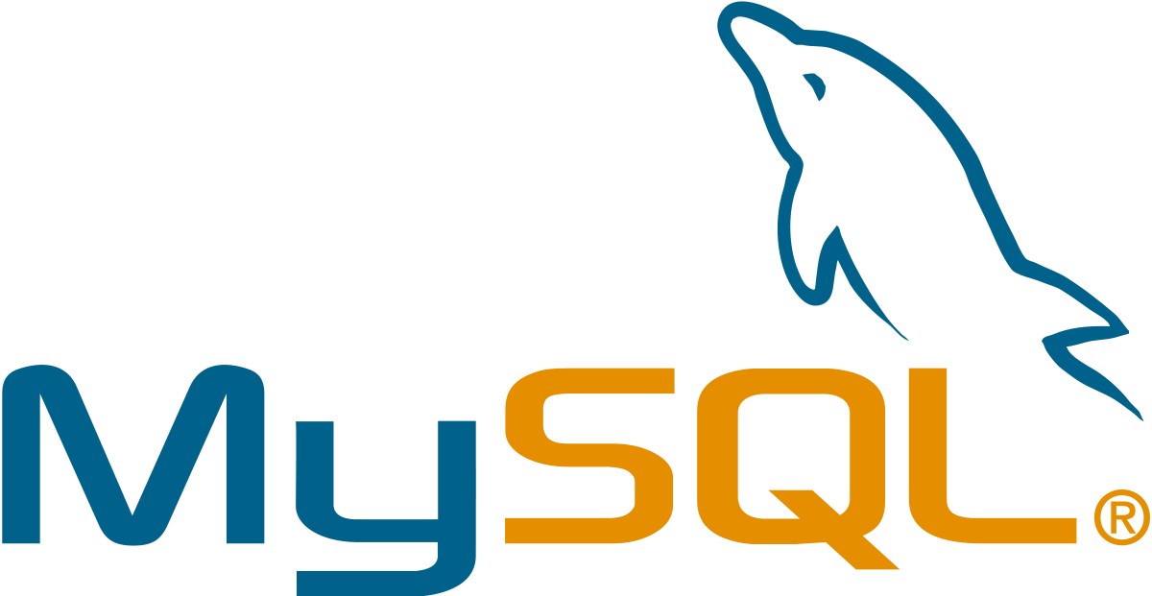
MySQL
MySQL Is a free and open-source software.
It has standalone clients that allow users to interact directly with a MySQL database using SQL, but more often, MySQL is used with other programs to implement applications that need relational database capability. MySQL is a component of the LAMPP web application software stack (and others), which is an acronym for Linux, Apache, MySQL, Perll/PHP/Python. MySQL is used by many database-driven web applications, including Drupal, Joomla, php BB, and WordPress. MySQL is also used by many popular websites, including Facebook, Flickr, MediaWiki, Twitter, and YouTube.

Slide 4
Advantages of MySQL
Data Security
On-Demand Scalability
High Performance
Comprehensive Transactional Support
Complete Workflow Control
Reduced Total Cost Of Ownership

Slide 5
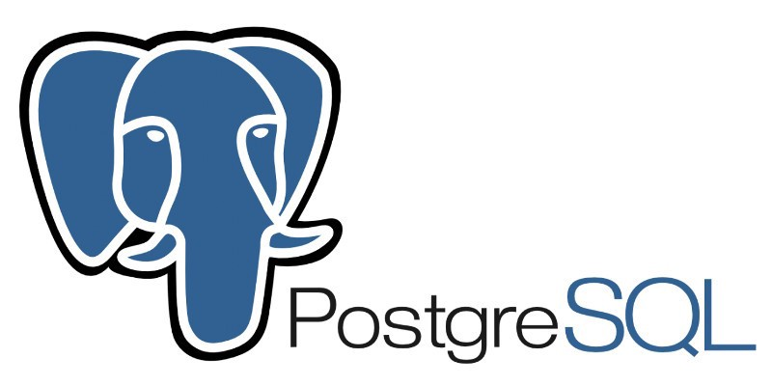
PostgreSQL
PostgreSQL is a powerful, open source object-relational database system that uses and extends the SQL language combined with many features that safely store and scale the most complicated data workloads. The origins of PostgreSQL date back to 1986 as part of the POSTGRES project at the University of California at Berkeley and has more than 30 years of active development on the core platform.
PostgreSQL has earned a strong reputation for its proven architecture, reliability, data integrity, robust feature set, extensibility, and the dedication of the open source community behind the software to consistently deliver performant and innovative solutions. PostgreSQL runs on all major operating systems,

Slide 6
Advantages of PostgreSQL
Data Types
Data Integrity
Concurrency, Performance
Reliability, Disaster Recovery
Security
Extensibility
Internationalisation, Text Search

Slide 7
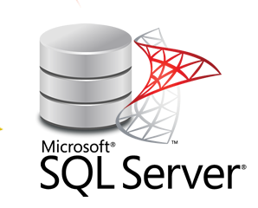
SQL SERVER
SQL Server is a relational database management system (RDBMS) developed and introduced by Microsoft. It includes its SQL language and Transact-SQL (T-SQL), Microsoft’s proprietary language with capabilities of exception handling, declaring a variable, and stored procedures. SQL Server Database Engine is the core component of SQL Server responsible for controlling, processing, and securing the data storage. The database engine is divided into two segments, the relational engine, which is used to process commands and queries. The second is the storage engine designed to manage various database features such as tables, pages, files, indexes, and transactions.

Slide 8
ADVANTAGES OF SQL SERVER
Easy to Install
Enhanced Performance
Several SQL Server Editions
Highly Secure
Excellent Data Restoration and Recovery Mechanism
Lower Cost Of Ownership

Slide 9
 | MySQL | PostgreSQL | SQL Server
Maturity | Initial release was in 1995 | Initial release was in 1989 | MSMS SQL Server for OS/2 was released in 1989 (together with Sybase)
Language | Written in C, has a few C++ modules | Written in C | C++ with a few expetions
Cost | Open source/ Owned by Oracl and have several paid editions | Completely free / Open source | SQL Server Express is a free edition, but it is limited to using 1 processor, 1 GB memory and 10 GB database files.
Row Updates | Updates happen in place, changed data is copied to the rollback segment. This makes vacuuming and index compaction very efficient. MySQL is slower for reads, but writes are atomic and if columns in a secondary index change, | Updates are being implemented as inserts + mark as delete for vacuum. All indexes have a link to the physical id of the row. This has an update amplifying effect because when the column gets updated, new row with new physical id gets created and all indexes require updates, | Row-Store database engine. In-Memory database engine: updates implemented as insert + mark for delete. Garbage collector is not non-blocking and parallel. Column store database engine: in-place updates

