Slide 1


2DC Hardware Operation
Mark Butler
PowerVR

Slide 2
Presented by:
Mark Butler - Program Manager - VideoLogic Ltd.
PowerVR Developer Relations
  mark.butler@powervr.com
  http://www.powervr.com
  http://www.pvrdev.com
Use the List Server as first point of contact
  elite@sega.com

Slide 3
Introduction
PowerVR 2DC Overview
2DC Components
  Operation, Peak rate, Typical rate, Rate Factors
Translucency
  Pre-Sort, Auto-Sort and Punch Through
Texture Compression & Modifier Volumes
Feature Usage Hints
Performance Hints
Summary

Slide 4
2DC Overview - Fundamentals
The fundamentals of PowerVR
  Scene Capture
  Tiling the screen and then processing a tile at a time
  Traditional HSR: ‘For each polygon, process all the pixels’
  PowerVR HSR: ‘For each pixel, process all the polygons in a tile’
    Processing elements in a Tile
  Traditional texturing: ‘Texel fetch for every pixel in a polygon’
  PowerVR rendering: ‘Paint by numbers - fetch only the visible texels’
    Deferred texturing

Slide 5
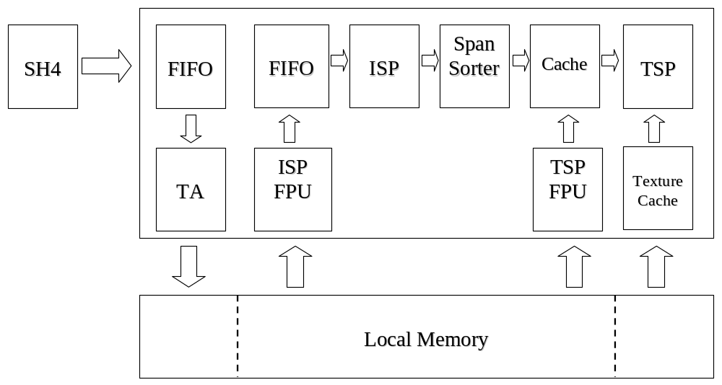
2DC Overview - Block Diagram

Slide 6
2DC Overview - Acronyms
Dreamcast Graphics Chip “PowerVR 2DC”
  Internal project names: CLX, Holly
TA - Tile Accelerator
  Delivers the polygon data and sort them into screen Tiles
ISP - Image Synthesis Processor
  Performs the Hidden Surface Removal, HSR
TSP - Texture and Shading Processor
  Performs the texture and shading
VQ - Vector Quantisation
  PowerVR Texture compression

Slide 7
TA Operation - Data
Vertex Data Movement
  Delivers data to Local Memory for each polygon (or strip)
  Only if the polygon is on screen
  From SH4 to the TA via a 256 byte FIFO in 32 bit words
Fast Write
  A data path is provided for texture downloads using the full 64bit bus at 100MHz
  Can occur at the same time as the other memory accesses

Slide 8
TA Operation - Pointers
Bounding Box
  Calculated as the data is being sent to the TA
Region Header Table
  Generated in SW at the start of the scene
  A list of pointers to each of the passes for the ISP for each Tile
    Opaque, Translucent, Modifier Volume, Translucent Modifier Volume, and Punch Through
Object Pointer Generation
  An Object Pointer is generated for each Tile needed
  Object Pointer Tables are fixed sized link lists
  Pointer cache capable of storing an object pointer for all the tiles

Slide 9
TA Operation - Headers
Object Instruction Headers
  The ISP and TSP control headers are created for each object
  Contain items like the HSR parameters, the blend modes and the textures being used
  Instruction Headers put at the head of each Object Vertex Data

Slide 10
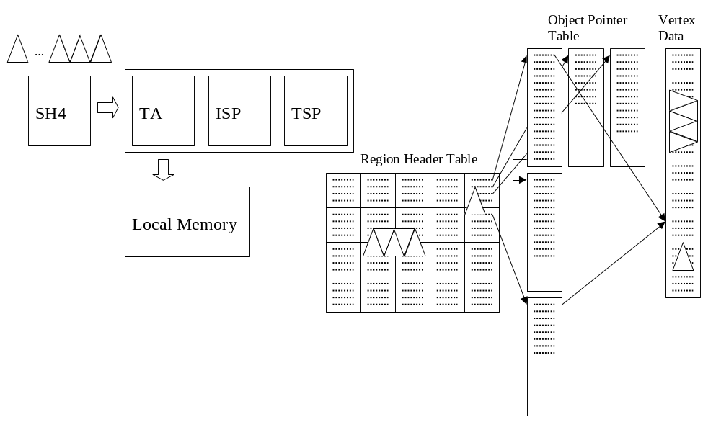
TA Operation - Overview

Slide 11
TA Peak Rate
Bounding Box when polygon is delivered
TA generates & writes an Object Pointer a clock
Small strip of 6 flat shaded triangles
  8 vertices each with 4 32-bit word data
  Require 3 words for Object Instruction Headers
  Covers a small bounding box area so 1 Object Pointer word
8*4 + 3 + 1= 36 clocks per strip
(100MHz /36) * 6 triangles = 16.7 M triangles / sec

Slide 12
TA Typical Rate
Typical strip of 4 textured and shaded triangles
  6 vertices each with 8 32-bit word data
  Require 3 words for Object Instruction Headers
  Covers a typical bounding box area 2 Object Pointer words
6*8 + 3 + 2 = 53 clocks per strip
(100MHz/53) * 4 triangles = 7.5 M triangles / sec

Slide 13
TA Rate Factors
Using independent polygons is inefficient
Polygons that cover a larger number of Tiles
  1000 polygons that cover a quarter of the screen?
A large number of small polygons
    Heavy on the SH4 memory interface
    TA will be able to write out the data quickly
A small number of large polygons
    Light on the SH4 memory interface
    Many object pointers are written for each polygon
Correct balance matches a constant pixel output

Slide 14
ISP Operation
Tile by Tile it reads all the polygons for a Tile
Perform the Depth Compare
  Determine the top most polygon for each pixel in the 32x32 Tile
  Performed in parallel with a row of 32 Processing Elements, PE's
  Process the whole polygon - only for the rows it is in
Outputs spans of up to 32 results to Span Sorter
ISP Floating-Point Unit (ISP FPU)
  Calculates the adjoint and edge iterators directly from the vertices
  Results are sent to a 2048 byte FIFO that can hold 170 triangles
    Evens out the data delivery and pipelines the internal processing

Slide 15
ISP Operation - Passes
Mix of opaque and transparent polygons
  Polygons are sent to there own passes
ISP processes the opaque pass first
  Result is a pixel accurate depth of all the opaque parts of the scene
ISP then processes the transparent pass
  Depth used on the transparent polygons
    These would have been overdrawn in a traditional renderer
  Transparent polygons closer than opaque objects are drawn in submission order if not Auto-Sorted (See later)

Slide 16
ISP Operation - Clocks
ISP FPU takes 15 clocks per polygon
Set-up for all 32 PE's is done in 14 cycles
HSR takes a row per clock
All this is pipelined
  3 polygons that cover 32, 8 and 15 lines will be processed in 32+8+15 = 55 clocks + the initial set-up
  With more polygons the ISP approaches its optimal case of processing a row per clock
Spans are generated every clock

Slide 17
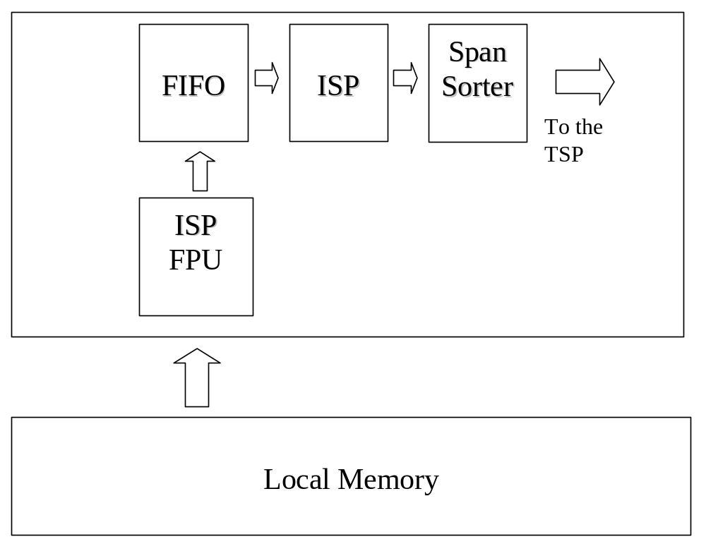
ISP Overview

Slide 18
Span Sorter
Texturing is best done on whole polygons
Span Sorter re-orders spans into whole polygons
ISP output rows of HSR results in spans
Sent to a Span Sorter for regrouping
  Uses a running window on up to 96 spans
  Sorts on the identifier of the polygon /strip
Output grouped by identifier with: (X, Y) length
Pipelined with a throughput of a span per clock
It also acts as the input FIFO to the TSP

Slide 19
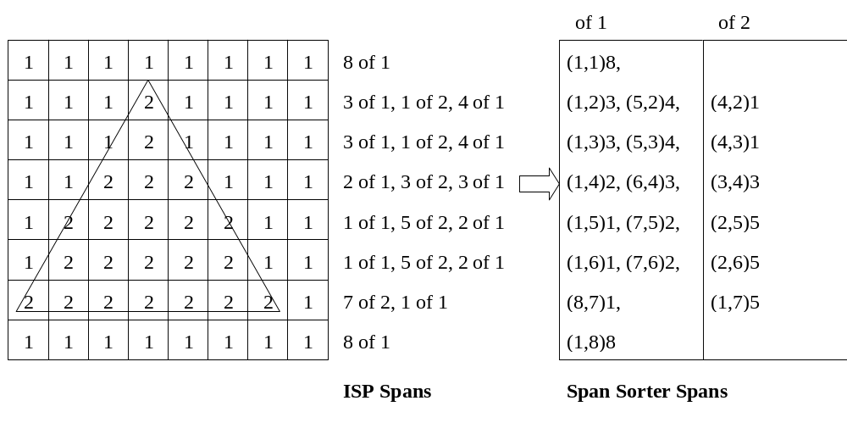
Span Sorter - Overview

Slide 20
ISP Peak Rate
Small polygons covering 15 or less rows in a Tile
Limiting factor is the ISP FPU
For over 100 polygons in a Tile set-up time is negligible
100MHz/15 = 6.7 Million Polygons/sec

Slide 21
ISP Typical Rate
Test cases of game images have a mix polygons
Still very close to 15 clocks (say 16)
Due to the pipelining and the depth of the FIFOs
100MHz/16 = 6.3 Million Polygons/sec

Slide 22
ISP Rate Factors
Many single pixel polygons
Still require a full 15 clocks for each triangle
  Not really an issue as the ISP is still operating at 6.7 Million Polygons/sec
Over 100 overlapping polygons with Auto-Sort
  TSP will become faster than the ISP span output
  Discussed later in the Translucency section

Slide 23
TSP Operation - Input Data
Span Sorter acts as the TSP's input FIFO
  Hold 256 spans of up to 32 pixels in length
TSP Floating Point Unit, TSP FPU
  Calculates the Parameter Data
    Depth values, MIP map D value and the RGB and UV iterators
  Only needs visible vertex data stored in Local Memory
TSP uses the Spans and Parameter Data
Fully associative cache for Parameter Data
  768 byte cache can hold 16 elements
  Cache is also used for polygon access across Tile boundaries

Slide 24
TSP Operation - Core
Like a traditional texturing and shading engine
  Independent iterators for all features
    Base RGB, offset RGB, UV, and vertex fog
  Perspective divide for each pixel
    Use for both texturing and the smooth shading
  Independent table fog, many texture formats including palletised, colour clamp, and trilinear D interpolation
Calculated in 32 bit RGBA on chip
Primary/secondary accumulation buffers
  Can be controlled to perform complex blends

Slide 25
TSP Operation - Clocks
SDRAM memory access
  4 independent 16 bit texture fetches in a clock
  512 byte cache for texture data
TSP FPU - Visible polygon set-up in 30-50 clocks
  Depends on the type of the polygon
  UV or RGB iterators for texturing or smooth shading
TSP core operates at a visible pixel per clock
  Bilinear, Vertex fog, Fog table, Additive (specular) lighting, SRC/DST Blending, Alpha Blending, Perspective correct texturing, Perspective correct shading

Slide 26
TSP Operation - Multi Clock
Multi pass operations take a clock per pass
  Trilinear - 2 Clocks
  Bump Map a Texture - 2 Clocks
    1 for the texture, 1 for the bump map
  Multi texturing - 1 clock per Layer
32 bit Palettes (8888) takes 2 clocks
Anisotropic Filtering takes 4 clocks, one for each of the samples

Slide 27
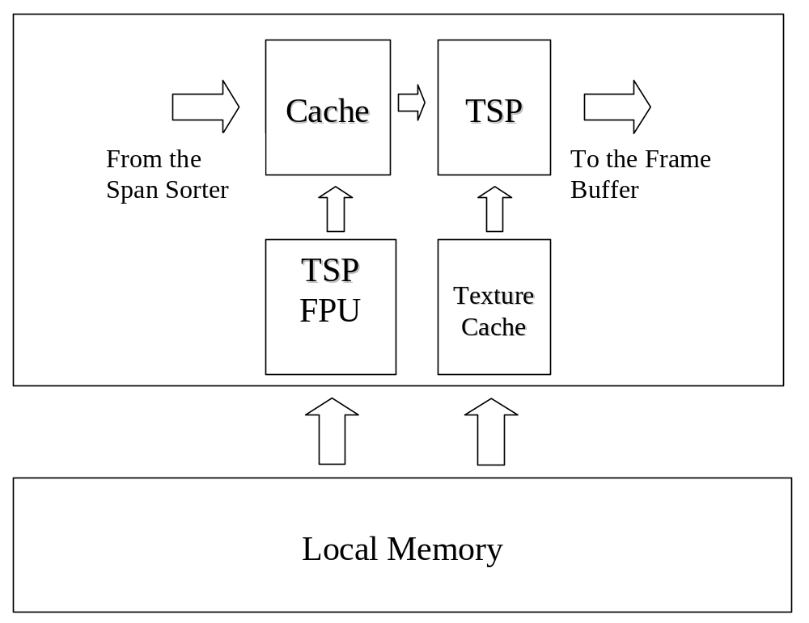
TSP Overview

Slide 28
TSP Peak Rate
TSP operates on visible polygons
Simple polygons and, say, half are obscured
  (100Mhz/30 clocks) * 1/(1-1/2) = 6.7 Million Polygons/sec
Fill rate is a pixel per clock
  100MHz * 1 pixel/clock= 100 MPixels/sec
Overdraw should be included
  For comparison to a traditional renderer
For a peak rate an overdraw of 10 results
  100MHz * 1 pixel/clock * 10 overdraw = 1000 MPixels/sec

Slide 29
TSP Typical Rate
Typical values are:
  50 clocks for the TSP FPU set-up for the visible polygons
  A third of the polygons are obscured in the scene
  A pixel overdraw of 2.5
  (100Mhz/50 clocks) * 1/(1-1/3) = 3 Million Polygons/sec
  100MHz * 1 pixel/clock * 2.5 overdraw = 250 MPixels/sec
Interaction between the polygon rate and the fill rate is complex
Pipelined with large FIFOs evens out the interaction

Slide 30
TSP Rate Factors
Optimum Fill Rate when the TSP is always busy
  Occurs when the TSP is operating on a large section of a Tile
  Sweet spot for TSP is around 100-500 pixel polygons
Twiddled textures are optimally stored
  Minimises the page breaks
Best when the texel to pixel ratio is close to 1
  Not using MIP mapping creates unnecessary page breaks
  MIP mapping hardware uses the correct level for a ratio near 1
The page breaks occur every 2048 bytes
  Thus a 32x32 sized texture will never page break

Slide 31
Translucency
2DC has 3 translucency modes
  Pre Sort Mode
  Auto Sort Mode
  Punch Through Pass
Selecting the mode based on:
  Type of translucency
  Visual effect required
  Performance

Slide 32
Translucency - Fill Rate
Translucent or blended polygons requires a second operation in the TSP
  Two pixels need to be combined
  Require an additional texture fetch
  Blending is done when writing to the accumulation buffer
Rule of thumb for the fill rate calculations
  Visible translucency is another pass consuming available fill rate
Hidden translucent surfaces still benefit from PowerVR 'Super Fill Rate’
  Does not consume fill rate due to the deferred texturing

Slide 33
Pre-Sort
Similar to translucency in traditional systems
Blending is done in submission order
Use CPU to sort the polygons
or
Use explicit sorting due to the model
  For example, additive blend (1, 1) with a weapon leaving a trail of missiles moving away from the camera is explicitly sorted

Slide 34
Pre-Sort - Performance
Determined from the polygon count and fill rate
Polygon rate is determined in the same way as opaque polygons
The Fill rate consumed corresponds to the visible, on-screen, translucent pixels

Slide 35
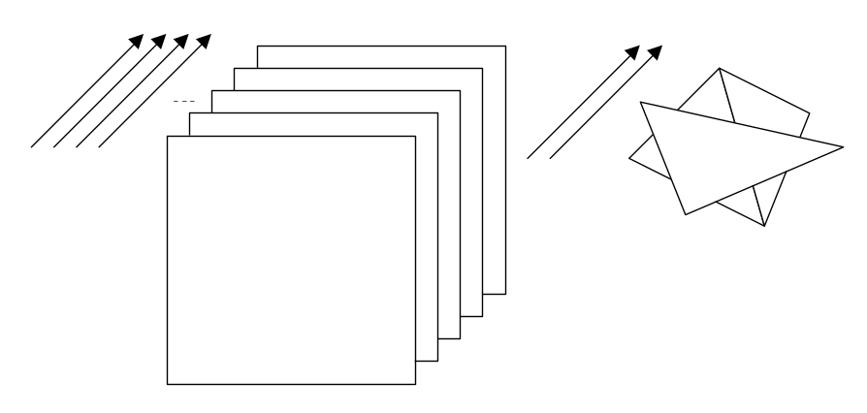
Auto-Sort
When too expensive to sort on the CPU
Or impossible due to cyclic or intersecting translucent polygons
Use 2DC hardware Auto-Sort
  Per pixel sort on the translucent polygons

Slide 36
Auto-Sort - Performance
During an Auto-Sort pass the ISP performs repeated HSR to determine the order of the pixels
  This is an order n² operation
Improvements over a naïve implementation
  Large cache so the ISP can cycle through polygons very quickly
  Terminate the sort early for any given pixel that is fully covered
  ISP can process 2 polygons per pass
Allows 100 overlapping translucent polygons
Overlap is determined on a per pixel basis
  Two adjacent polygons do not contribute to this count

Slide 37
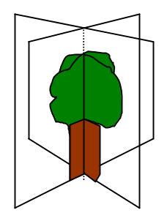
Punch Through
Deferred texturing performs HSR before
the texture lookup is performed
There are cases when the depth buffer
should not to be updated
  The colour key texels in a traditional system do not update the depth buffer
  EG. Using colour key for the intersecting polygons of a tree
The Punch Through pass updates the depth value when the texel is opaque and leaves it untouched when fully transparent

Slide 38
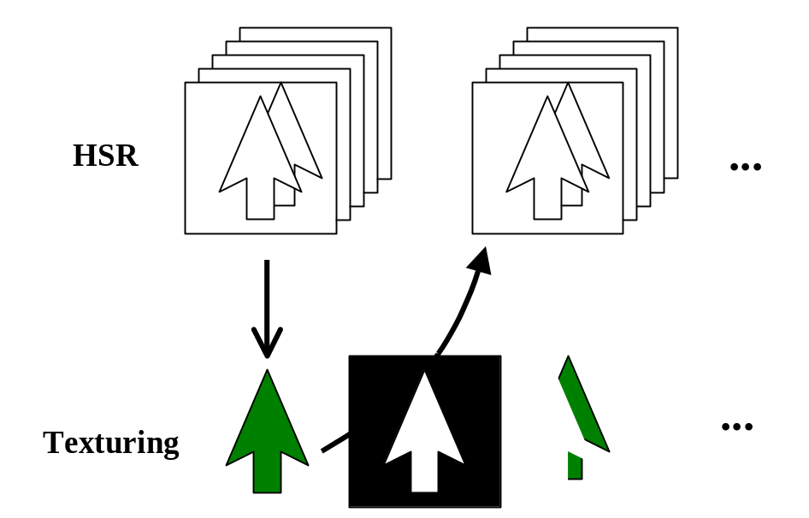
Punch Through - Overview
Mask feedback from the texturing allows the HSR to maintain the depth values
Hidden polygons are completely removed from the processing list based on the mask feedback

Slide 39
Punch Through - Algorithm
Use the Auto-Sort mode with a front to back sort
  Present to the TSP the next top most pixels of the polygons
TSP textures and also generates a mask
  Indicates where the depth buffer should not be updated
Mask is fed back into the next Auto-Sort pass
Polygons behind opaque pixels are removed
Super Fill Rate' on Punch Through Opaque pixels
Alpha threshold for bilinear rounds the texels
  Normally hard edged due to the on/off nature of the transparency

Slide 40
Punch Through - Performance
Increases the effective fill rate
  Normally all colour key pixels would consume the fill rate
Performance is between full opaque performance and Auto-Sort performance
Performance varies depending on the number of opaque texels
  More effective with a large percentage of opaque texels
  Use Auto-Sort for a small percentage of opaque texels

Slide 41
VQ Performance
Use an index as a texture and addresses into a block of 2x2 texels that is the code book
Normally two accesses to the memory
2DC has index and code book caches of 512 bytes each
Also pipelining
An average of 1 bilinear operation per clock
  The same performance as normal bilinear texturing

Slide 42
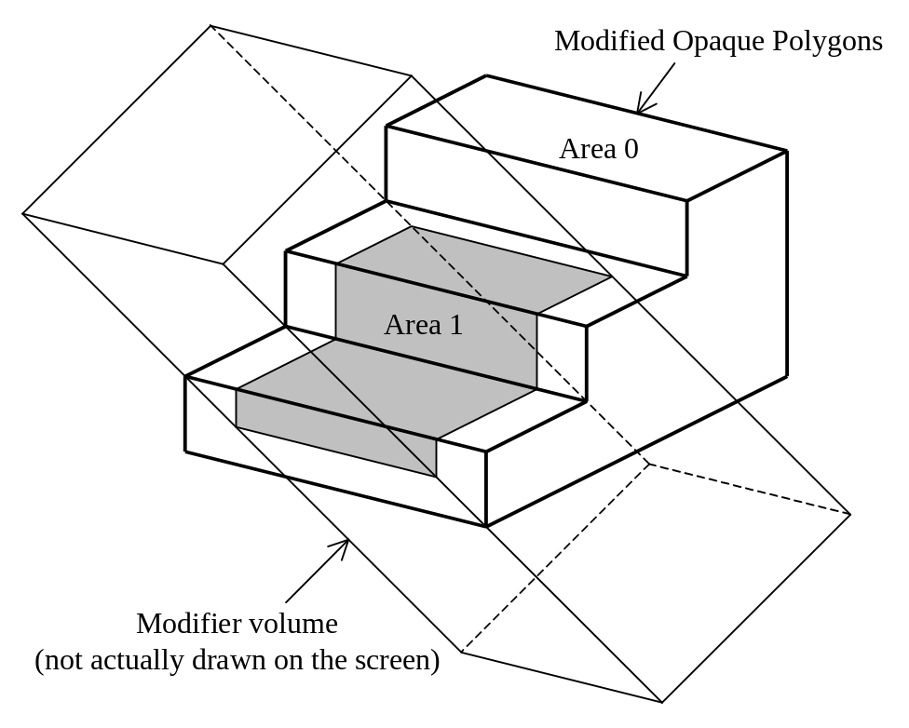
Modifier Volume Performance
Add the Modifier Volume model
Add Extra Texturing and Shading Data
No cost to determine which data to use
Not a two pass process

Slide 43
Feature Usage Hints
Bump Mapping Art
Accumulation Buffer
Z Bias
Cheap Shadows and Lights
Render to a Texture
VQ
MIP Mapping
Demos and Code

Slide 44
Performance Hints
Use the ‘Super Fill Rate’ of the PowerVR
Obscured translucent polys have ‘Super Fill Rate’
Use Punch Through for traditional Colour Key
Use MIP mapping for optimal texture fetch
Don’t perform XY clipping
Use Strips
Use a range of polygon sizes to let the HW pipelining work

Slide 45
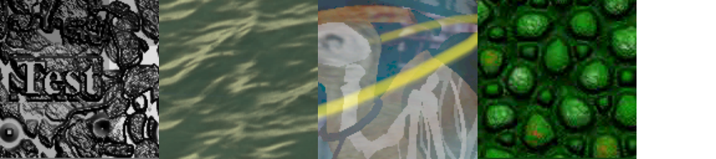
Summary
2DC is performance balanced
2DC is fast
Understanding the architecture helps during the final optimisation
Questions?

