Slide 1

CIM Utility
Steve Ramm
Product Development Manager
Cross Products Limited

Slide 2
Emulation → GD
How can GD Workshop fit into the GD Mastering Process?
  Create a script from GD Workshop and use GD Craft
  Create a CIM file directly from a GD Workshop Project
Enter CIM Utility

Slide 3
CIM Utility
CIM Utility can:
  Create a CIM file from a Workshop project
  Compare two CIM files
  Examine the contents of a CIM or HCD file
  Emulate from a CIM or HCD file
  Burn a GD from a CIM or HCD file

Slide 4
Create CIM file
Run CIMUtility
  Select your .HCD file as your source file
  Select CIM as your destination
  Select your target disk
  Press play
  Edit or accept filename
  Wait 20 minutes
Notes:
This can only be done from a working emulation.

Slide 5
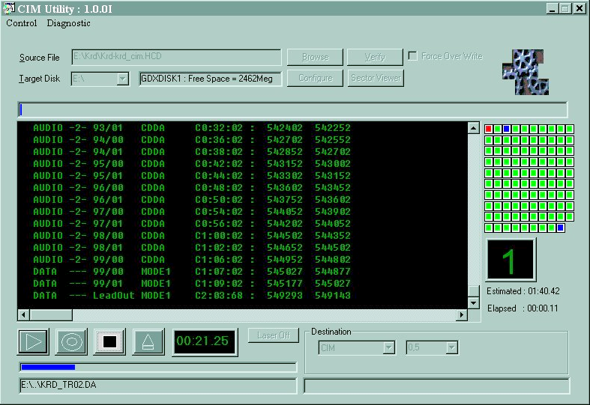
Creating a CIM file
Notes:
This screen show shows CimUtility creating a CIM from a .HCD file. You can see the source file box, the places to select the target disk and destination, the Configure, Verfy and sector Viewer buttons, and the Play , Record, and STOP buttons. Other items show the progress of the current operation.

Slide 6
File Verify
Run CIMUtility
  Select .CIM as your source file
  Press the Verify button
  Create TOC with the TOC button
  Show File System
  Compare two CIM files
    Enter Second File name
    Select Items to compare
    Press Check button
Notes:
The Verify Button gives three possibilities:
Create a TOC. Just press the TOC button and it appears in the window; this can be saved to a file with the Save Log button, or cut and pasted. This offers an alternative to creating a TOC with GD Workshop.
Show File system. Pressing this button brings up another window with the file system details in it.
File Compare. To use this you must enter a second file name, and select the items that you wish to compare in the check boxes, before pressing the Check button.

Slide 7
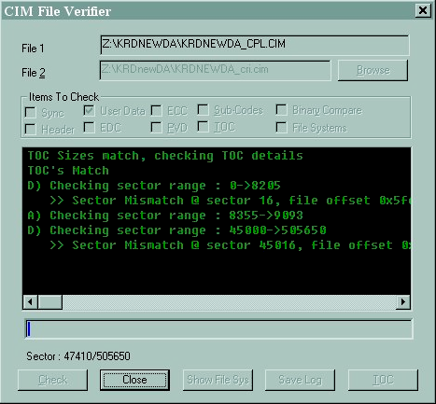
File Compare
Notes:
This slide shows the file compare after two CIMs were selected and the User Data was checked. Note that sectors 16 and 45016 differ because the two CIMs were created with different tools.

Slide 8
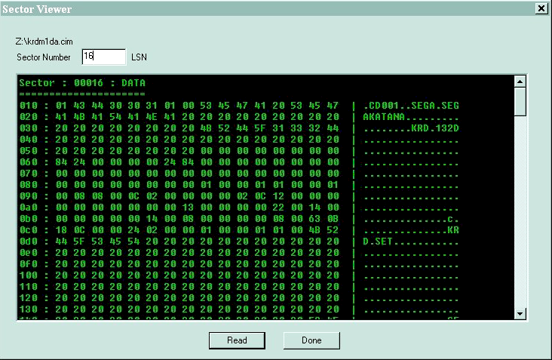
Sector Viewer

Slide 9
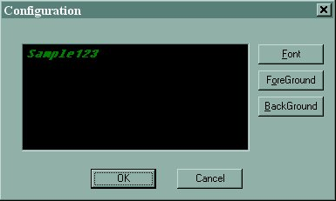
Configuration dialog
Notes:
Here is the configuration dialog in which you can set up the font and foreground and background colours.

Slide 10
Emulating Disks
  Select your .CIM or .HCD file as your source file
  Select GDM as your destination
  Select correct SCSI Id for Set 5
  Select correct target disk
  Press PLAY
Notes:
CIM utility can be used to start emulation of either a .HCD (GD Workshop project file) or a CIM

Slide 11
Burning Disks
  Select your .CIM or .HCD file as your source file
  Select GDM or GDX as your destination
  Select correct SCSI Id for Set 5 or GDX
  Select correct target disk
  Select either laser on or off (depending whether you want a test burn or not)
  Press RECORD
  Wait (speed depends on burner)
Notes:
CIM Utility can be used to burn GD’s from either a .HCD (GD Workshop project file) or a .CIM file. The burner can be either attached to a GDM (Set 5) or to a GDX (Duplicator).
Using CIM files you can have added confidence when burning multiple GDs, because you know that if your CIM file hasn’t changed (which it won’t have), then your disks will be identical.

Slide 12
Be Careful!
Use a working emulation project
Make sure you have enough disk space
  At least 2GB recommended
CIM files may differ in sectors 16 and 45016
Notes:
When using a .HCD file, make sure all your emulation files are present and haven’t changed since you last emulated.
CIM files are large – the same size as GDs, ie 1.2GB. We recommend that you have at least twice this disk space free.
When comparing CIM files generated by CIMUtility to those generated by GDCraft, sectors 16 & 45016 do not match, this is because of the vendor strings in the PVD

Slide 13
CIM Utility
Any Questions?

