Slide 1

CodeScape 3
Steve Ramm
Product Development Manager
Cross Products Limited

Slide 2
New Features
Dwarf 2.0 compatibility
Integrated Development Environment
Script controlled region
Trace Region
Command Region
Many Other Improvements

Slide 3
Dwarf 2.0 Compatibility
Smaller files than Dwarf1.0
More generally adhered to
Compatible with GNU and Hitachi
Possibility of other compiler vendors
Notes:
The Dwarf2.0 debug format produces smaller files than Dwarf1.0, and is able to represent all the information required to debug C++ programs. Dwarf1.0 was deficient in some areas, so that compiler manufacturers tended to invent their own extensions to the standard, and to read all the information the CodeScape file loader has separate special pieces of code used for reading files from different compilers. These aren’t required with Dwarf2.0, consequently the Dwarf2.0 output of compilers from different manufacturers may be read in its entirety with the same file loader. So not only will CodeScape support both GNU and Hitachi Dwarf2.0 output, there is the possibility of using compilers from other manufacturers in the future.

Slide 4
I D E
Projects
Project Management
Full Build Control
Revision Control System Management
Editor Improvements

Slide 5
Projects
Projects consist of
  Source files
  Dependencies
  External Dependencies
  Other files
Notes:
Projects consist of
Source Files – files to be compiled
Dependencies – source file dependencies i.e. header files. These files are included in the project.
External Dependencies – other dependencies which are not necessarily part of the project but on which the source files are dependent upon. i.e. system headers.
Other Files - any other files (i.e. binary files etc)

Slide 6
Project Management
Templates for easy setup
Multiple configurations
Batch build
Rebuild all
Compile
Touch files
Open in Explorer
Notes:
Projects
When creating new projects, users have the option to use tool templates for a quick and easy setup. These contain the tool information such as command lines, and mappings between file extension and tools. Alternatively the user can opt to create their own templates.
Multiple Configurations – supports debug/release configurations for a project.
Batch Build – Build any combination of configurations in one easy step.
Rebuild All – Rebuild the current project completely
Compile – Compile single/multiple files easily.
Touch files – Update a files timestamp to force a file to be rebuild
Open in Explorer – Open a new instance of windows explorer at the location of the selected file.

Slide 7
Full Build Control
Tool Command Lines
Build Exclusions
Mappings
Dependency Scanning
Configurable Environments
Notes:
Tool Command Lines – These are configurable down to individual files if required.
Build Exclusions – Temporarily exclude files from being rebuilt
Mappings – Files are mapped to tools, which in addition to identifying which tool is required to compile a given file(s), intermediate files can processed again with other tools (such as a dwarf converter) automatically after creation, without the user having to initiate this second operation.
Dependency Scanning – Configurable regular expressions are used to determine how to search for dependencies.
Configurable Environments – Where some tools may need system environment variables to operate, rather than having to add all of the variables to the users computer, they can be read in from a user generated environment script file.

Slide 8
Revision Control
Supports all standard RCS features
  Get Latest Version, Check In, Check Out, Undo Check In, Add and Remove Files.
Connectivity
  Using a generic command line interface it can connect to many of the leading RCS/VCS applications.

Slide 9
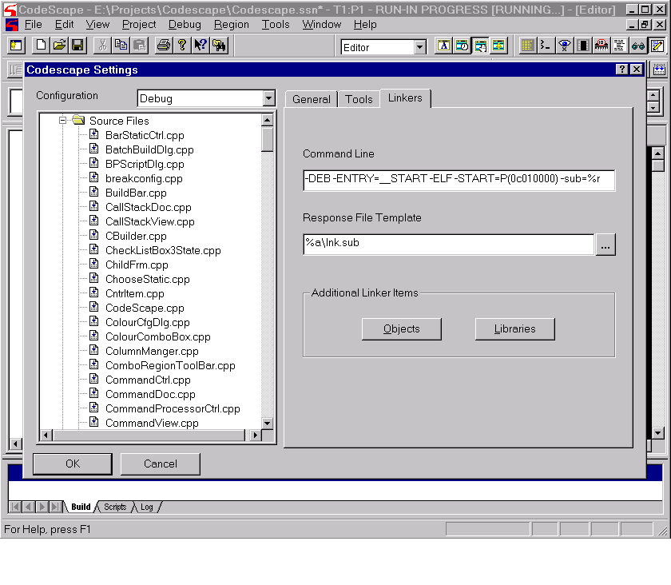
Configuration
Notes:
This slide shows one of the tabs on the build configuration settings dialog

Slide 10
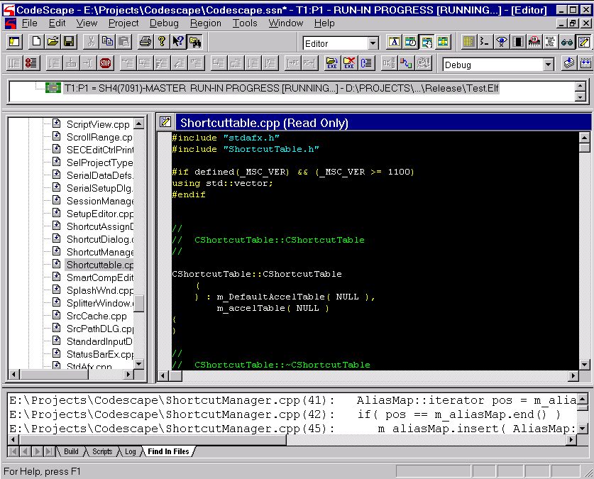
Project window
Notes:
This slide shows the project window on the left, with an editor open to edit the highlighted file

Slide 11
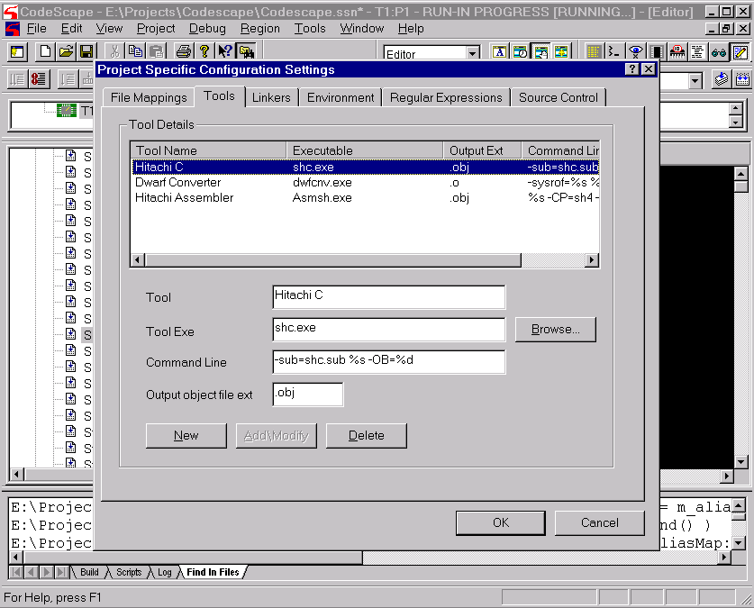
Project specific configuration
Notes:
Here is a slide of the dialog to edit project specific configuration settings

Slide 12
Editor Improvements
Bracket and quote matching
Automatic indenting and bracket positioning
Keyword expansion
Keyboard macros
Search and replace across files
Notes:
The CodeScape editor is based upon the latest version of the Stingray Editor class.
Those of you that use the CodeScape editor will have noticed marked improvements over the last year, with syntax colouring, bookmarks, and many other features found in mainstream editors. CodeScape 3 extends the functionality further, with some more features aimed specifically at the programmer. With this level of functionality there really is no longer any need to use an external editor.

Slide 13
Script Region
Java Script and VB Script Supported
Region type selected as usual
All normal script commands supported
Special script region commands
  - display at (x,y)
  - name the region
Notes:
CodeScape supports both Java script and VB script. Scripts can be called from a breakpoint, from a menu, or bound to a keystroke. The Script region takes it one step further, giving the script its own area of the screen to operate in. The region type is selected as usual, so to make a script region, create a new region or re-use an old region and just change its type.
All the script commands that are supported by CodeScape, I.e. read and write memory, registers, load programs, full access to the expression evaluator and symbols, etc. can be used in the scripts in a script region, PLUS extra commands – display at (x,y) coordinates in the script region, and put a name on the title bar.

Slide 14
Script Region
Script can be bound to events
  On Setup
  Region update
  Key press
  Mouse left click
  Mouse double left click
Notes:
The script can be bound to events. You can specify that the script is run upon Window Setup, on Region Update, on a Key press, or on a left mouse click or double-click.

Slide 15
Script Region
For Example:
  Custom register window
  Display of video statistics
  Retrieval and formatting of program data
  Sanity checks on program data
Notes:
The Script region is a particularly powerful tool and it can be used to customise CodeScape and implement many useful features. For example, you can make a custom register window showing just those registers in which you are interested, labelling them with more informative names, and displaying their values each in individual formats.
You could make a window that displayed program statistics that are stored at a particular location in memory
Or takes data from program variables and formats it in a certain way or calculates new values to show the data or information from the data in a more meaningful way.
Or you could write scripts that check that the values of data lie within limits and display warnings when they go outside.
The possibilities are endless.

Slide 16
Trace Region
Shows recent control flow events
‘=>’ shows current execution point
Triangle shows a previous point
Click on triangle to show source or disassembly for previous point
Can show events in list or tree form
The tree form can collapse or expand events between call/return pairs
Makes use of SH hardware trace buffer
Notes:
Trace History Region
a.. shows recent control flow events (branch, call, return, exception)
b.. shows current execution point with => marker
c.. can select a previous point, shown by triangle marker, source/disass keep step with this
d.. can show events in list or tree form
e.. tree form can collapse or expand events between call/return pairs
f.. makes use of SH hardware trace buffer

Slide 17
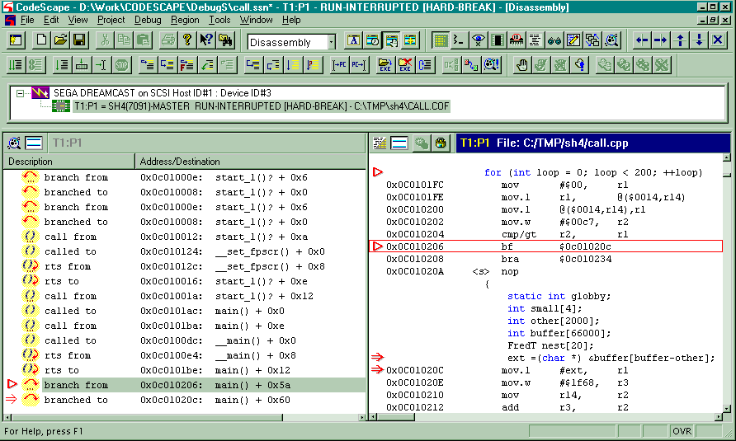
Trace List View
Notes:
This slide shows a list view in a Trace region, and a mixed source / disassembly view of a previous branch point.

Slide 18
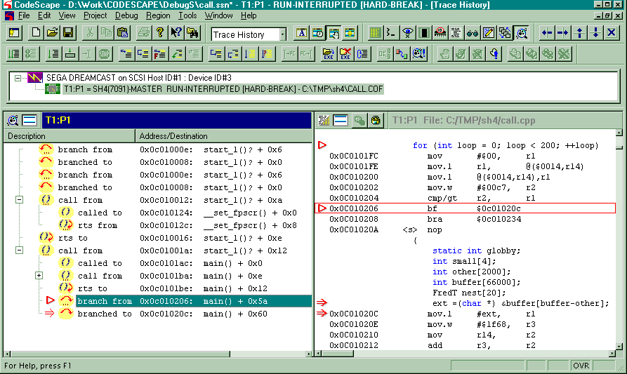
Trace Tree View
Notes:
This slide is similar to the previous one; but this time the history is shown as a tree; one collapsed branch is visible.

Slide 19
Command Region
‘GDB’-like Console region
Creates jScript routines executed by the debugger
The region supports:
  A history of commands
  Keyword completion
  Cut / Copy / Paste
Notes:
The command region is a 'gdb like' console region permitting the user to
enter control commands directly into the CodeScape debugger. These commands
are parse and converted in small jScript routines which are then executed by
the debugger.
The region supports:
a.. History of commands, this is accessed via the up/down arrow keys.
b.. Keyword completion is available via the tab key.
c.. Cut / Copy / Paste.

Slide 20
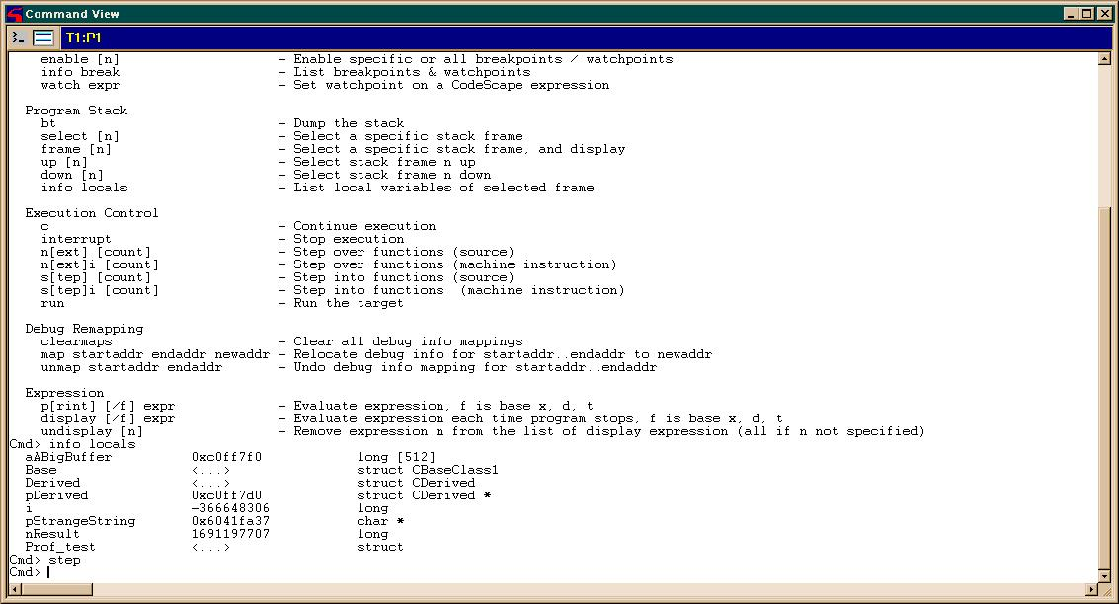
Command Region
Notes:
The region currently supports the following commands:
GDB like Command Description
file filename - Load symbols and binary from file
unload - Unload symbol information
cd dir - Change directory
pwd - Print working directory
help - Display this help
show commands [n] [+] - Display command history
b[reak] expr - Set breakpoint on a CodeScape
expression
clear expr - Remove breakpoint at CodeScape
expression
delete [n] - Delete specific or all breakpoints /
watchpoints
disable [n] - Disable specific or all breakpoints
/ watchpoints
enable [n] - Enable specific or all breakpoints /
watchpoints
info break - List breakpoints & watchpoints
watch expr - Set watchpoint on a CodeScape
expression
bt - Dump the stack
select [n] - Select a specific stack frame
frame [n] - Select a specific stack frame, and
display
up [n] - Select stack frame n up
down [n] - Select stack frame n down
info locals - List local variables of selected
frame
c - Continue execution
interrupt - Stop execution
n[ext] [count] - Step over functions (source)
n[ext]i [count] - Step over functions (machine
instruction)
s[tep] [count] - Step into functions (source)
s[tep]i [count] - Step into functions (machine
instruction)
run - Run the target
clearmaps - Clear all debug info mappings
map startaddr endaddr newaddr - Relocate debug info for
startaddr..endaddr to newaddr
unmap startaddr endaddr - Undo debug info mapping for
startaddr..endaddr
p[rint] [/f] expr - Evaluate expression, f is base x, d,
t
display [/f] expr - Evaluate expression each time
program stops, f is base x, d, t
undisplay [n] - Remove expression n from the list of
display expression (all if n not specified)

Slide 21
Other Improvements
Many more improvements including:
  Breakpoints stored as symbol + offset
  Breakpoint support for in-line functions
  Search in memory region
  Subranges for arrays in Watch region
  Promote to root function for nested structures

Slide 22
Other Improvements
Many more improvements including:
  Concurrent loading of the binary and debug information
  ‘Load and run program’ option while the debug information is still loading
  Edit op-code in the disassembler region
  Run Script from the target via the file server
  Drag and drop of binary and text files

Slide 23
CodeScape 3
Any Questions?

