Slide 1
Codescape
John Byrd
Sega of America
Notes:
Your notes here.

Slide 2
Codescape 1
Running a program
Debugging
Building a program
Setting up your own editor

Slide 3
Codescape 2
Optimizing your programs
Scripting Codescape

Slide 4
Running a program
File/Load Program File…
  Unlock Program File checkbox copies the file, which makes rebuilding the target possible while debugging it
  Run to main()

Slide 5
Running a program
Program control
  Run (F9)
  Restart (Ctrl-Shift-R)
Resetting a lost target
  Soft: resync communication only
  Hard: reset Set5 but not the debug adapter

Slide 6
Debugging
Regions
Breakpoints
Sessions
Configuring the debug adapter

Slide 7
Regions
Strongly-typed views into the memory and processor in the development system
You create a blank region (Ctrl-N) , then specify its type

Slide 8
Region types 1
Source
  Can be viewed as source, disassembly, or both simultaneously
  Set cursor to PC (Ctrl-Shift-P)
  Go to a specific source file (Ctrl-Shift-S)

Slide 9
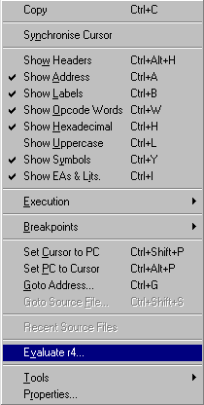
Region types 2
Disassembly
  Headers, Address, Labels, Opcode, Symbols...
Field visibility can be toggled

Slide 10
Region types 3
Memory and registers
  Red highlights changes since last step
  Show floating point registers (Ctrl-L)
  Show banked registers (Ctrl-B)

Slide 11
Region types 4
Local watch
Call stack
Editor

Slide 12
Working with regions
ToolTips
  Hover the cursor over a variable or function for its value or address
Drag and drop
  Example: a variable may be dragged from a source region into a watch region

Slide 13
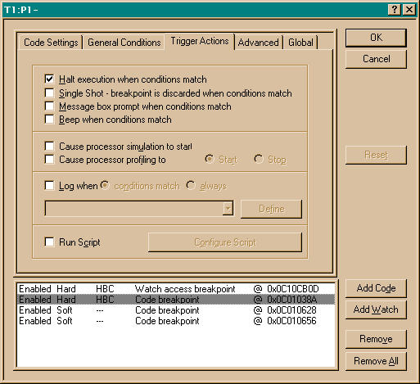
Breakpoints
Toggle (F5)
Configure (Ctrl-F5)

Slide 14
Configuring breakpoints
General conditions
Trigger actions

Slide 15
General conditions
Breakpoint can be active if
  breakpoint has been passed trigger times
  a boolean expression is true
Useful for finding bugs that only occur after nth iteration

Slide 16
Trigger actions
Tells what to do when breakpoint conditions are met
  Beep, show a dialog box, or halt
  Log a message to the log window

Slide 17
Trigger actions
Logging program execution
  In Advanced tab in Configure breakpoints, set Location Mask Selector to All
  Log expression:
    “Executed 0x%08x -> %i “,pc,pc

Slide 18
Sessions
Contain build options, breakpoints, and region information
  Accessed via the File menu
A loaded session will reset the target back to the previous working state

Slide 19
Configuring the debug adapter
OS Mode
CPU Mode

Slide 20
OS Mode
Runs the boot ROM on startup
Thus the GD-ROM loader program starts in OS Mode
Useful for testing GDs that you burn

Slide 21
CPU Mode
Does not run the boot ROM on startup
Useful for testing your executable (.elf) file

Slide 22
Building a program 1
Can be done from within Codescape or via command line
Project/Setup project
  Environment (.env) file format:
    var1=setting1
    var2=setting2
    …

Slide 23
Building a program 2
mymake1.bat:
  %comspec% /e:8192 /p /c
mymake2.bat:
  call c:\katana\setpaths.bat
  gmake -f scanner.mak

Slide 24
Building a program 3
Project file:
  c:\katana\sample\kmdemo\
  scanner\scanner.mak
Build program:
  c:\katana\sample\kmdemo\
  scanner\mymake1.bat

Slide 25
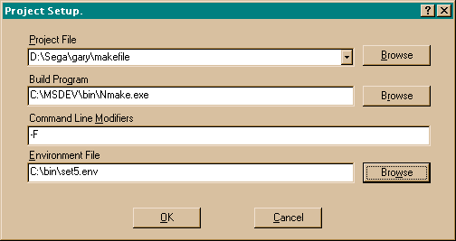
Setting up your own editor
Project/Setup Editor…
Make output redirected to log window
Double-clicking on an error launches your editor

Slide 26
Optimizing your programs
Profiling
Simulating the processor

Slide 27
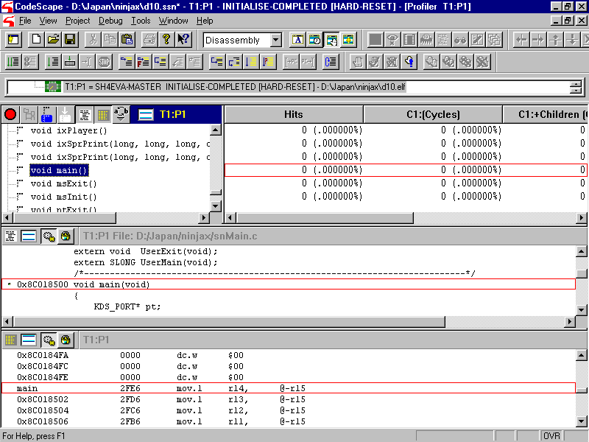
Profiling
Tools/Profiler

Slide 28
Using the profiler
Start your program
Stop your program (at a breakpoint?)
Start the profiler (press the green button)
Stop your program (at a breakpoint?)
Read or export the profile

Slide 29
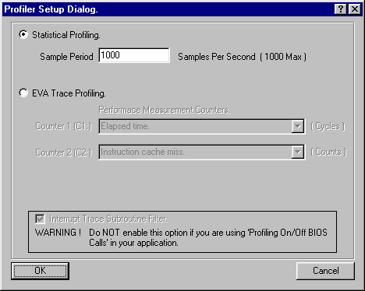
Profiling methods
Statistical profiling
EVA trace

Slide 30
Statistical profiling
Samples the current function at a rate of 1Hz-1kHz
Negligible effect on execution time

Slide 31
EVA trace
Produces accumulative totals and a function call tree
Slows execution time considerably
Depends on two performance counters (C1 and C2)

Slide 32
Exporting a profile
Context menu: File/Save Profile…
Use prfdump to make human readable
  c:\katana\utl\dev\prfdump\prfdump.exe

Slide 33
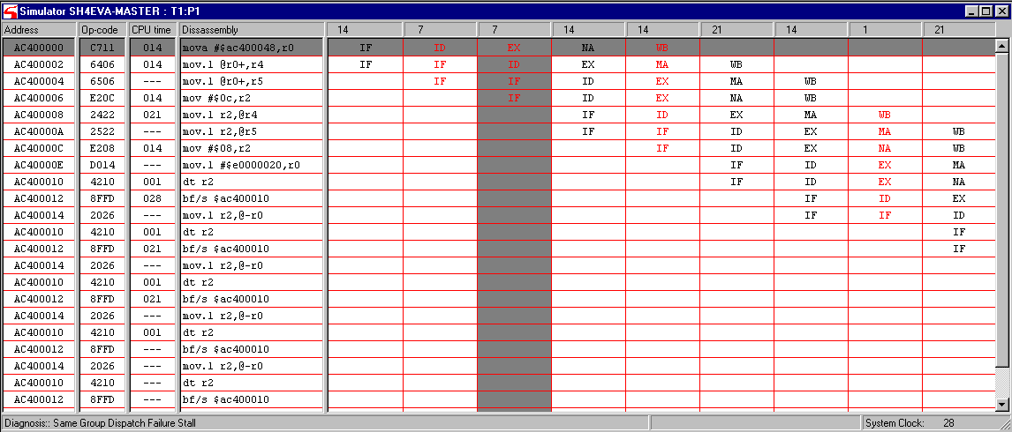
Simulating the processor
Tools/Simulate Processor

Slide 34
Simulating: limitations 1
MMU is not modeled
No on-chip peripherals are modeled
Does not model operand cache block instructions
  No OCBI, OCBP, OCBWB

Slide 35
Simulating: limitations 2
Will not run when profiler is running

Slide 36
Scripting
In-program macro support
  Jscript and VBScript
Some example commands
  Load Program File
  Read / write memory or registers
  Reset

Slide 37
How to run a script
Bind to a key stroke
Tools/Scripts/Run Script…
Run when a breakpoint is hit
As a command-line parameter to codescape.exe
  N.B. “Load and run a program” can be done without scripting

Slide 38
Example Jscript
// Example Jscript StoreQueue.js
function ReadStoreQueues()
{
Write( "Dumping Store Queue 0" );
Write( " Value of SQ0_0 = " + ReadRegister( ”SQ0_0" ));
//
// Remaining Write Commands . . .
//
Write( " Value of SQ0_7 = " + ReadRegister( " SQ0_7 " ));
}
if ( IsRunning() == 0 )
{
ReadStoreQueues();
}

