Slide 1
KAMUI Low-Level Graphics API
Gary Lake
Sega of America
Confidential
Notes:
Your notes here.

Slide 2
KAMUI Graphics API
Introduction
  KAMUI Overview
  New SET 5 Functionality
  Performance Issues
  Optimization and Hacking
  Unique CLX2 Features and Goodies
Confidential
Notes:
Your notes here.

Slide 3
KAMUI Graphics API
KAMUI Overview
Confidential
Notes:
Your notes here.

Slide 4
KAMUI Graphics API
KAMUI Overview
  What is KAMUI?
  System Architecture
  Process Flow
  Scene Parameters
  Vertex Render States
Confidential
Notes:
Your notes here.

Slide 5
KAMUI Graphics API
Low-Level Device Driver
  Hardware register abstraction
  Pipelined process/data flow
  Triangle-strip primitive interface
  List-based rendering
  Interrupt callbacks
Confidential
Notes:
Your notes here.

Slide 6
System Architecture
Bus Speed Block Diagram
  Bus from SH-4 to CLX2
    64-bit @ 100 MHz
  Bus from CLX2 to texture memory
    64-bit (4 X 16-bit) @ 100 MHz
Confidential
Notes:
Your notes here.

Slide 7
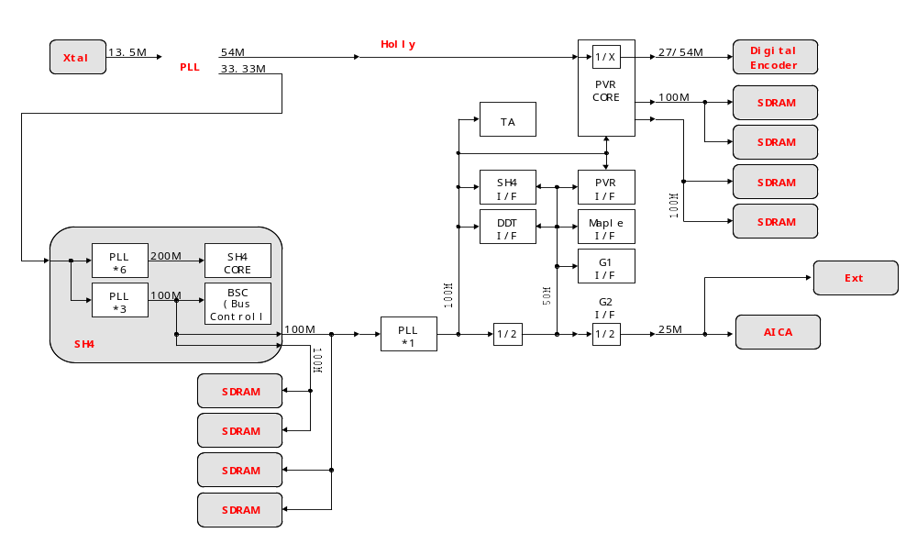
Bus Speed Block Diagram

Slide 8
System Architecture
Graphics Data Flow
  Texture loads / DMA (800 MB/s peak)
  Vertex registration
    DMA or Store Queue vertex data and control parameters to Tile Accelerator
  Scene render / CLX2 texture bus
Confidential
Notes:
Your notes here.

Slide 9
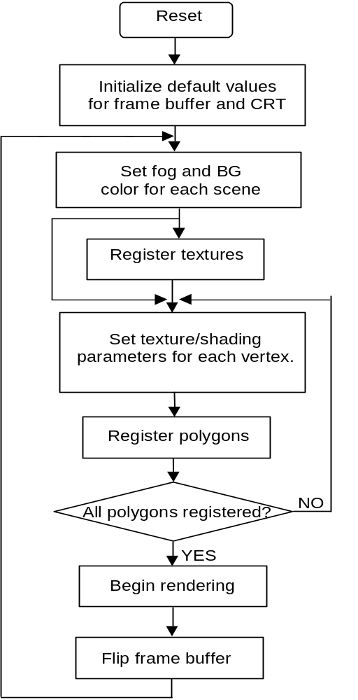
KAMUI Process Flow Diagram

Slide 10
KAMUI Process Flow
KAMUI Process Flow Diagram
  System and graphics initialization
    sbInitSystem(), kmInitDevice(), kmSetDisplayMode()
  Rendering system initialization
    kmGetVersionInfo(), kmSetSystemConfig(), kmProcessVertexRenderState()
Confidential
Notes:
Your notes here.

Slide 11
KAMUI Process Flow
  Global scene parameters
    kmSetFogTableColor(), kmSetUserClipping()
  Texture loading
    kmLoadTexture(), kmQueryFinishLastTextureDMA()
  Vertex and control parameter registration
    kmSetVertex(), kmSetVertexRenderState()
Confidential
Notes:
Your notes here.

Slide 12
KAMUI Process Flow
  Render and page flip
    kmRender(), kmFlipFrameBuffer(), kmRenderTexture()
  Callbacks
    kmSetEORCallback(), kmSetVSyncCallback()
Confidential
Notes:
Your notes here.

Slide 13
KAMUI Display Modes
Display Generator
  VGA / NTSC / PAL
  Display modes
    320x240, 320x480, 640x240, 640x480
    Interlace (30 Hz), non-interlace (60 Hz), pseudo-NI (60 Hz fields), flicker-free (60 Hz averaged)
Confidential
Notes:
Your notes here.

Slide 14
KAMUI Display Modes
Frame Buffer
  Color depth
    16-bit (RGB 565 / 555), 24-bit (RGB 888)
  Render options
    16-bit dither
    Antialiasing filter (4X scene render and scale)
Confidential
Notes:
Your notes here.

Slide 15
KAMUI Scene Parameters
Global Scene Render State
  Culling register
  Color clamp (min / max)
  Fog settings
    Vertex/table fog color, fog density
    Set fog table
Confidential
Notes:
Your notes here.

Slide 16
KAMUI Scene Parameters
  Global palette settings
    Palette mode/bit-depth
    Palette table
  Border color
  Translucent autosort mode
  Texture stride width
Confidential
Notes:
Your notes here.

Slide 17
KAMUI Scene Parameters
  Clipping regions
    Global tile clipping
    Pixel unit clipping
  Vsync count
  Pseudo-global settings
    Cheap shadow mode
    User tile clip
Confidential
Notes:
Your notes here.

Slide 18
KAMUI Vertex Render State
Vertex Render State
  ParamType
    polygon, modifier volume, sprite
  ListType
    opaque, opaque modifier, translucent, translucent modifier, punchthrough
Confidential
Notes:
Your notes here.

Slide 19
KAMUI Vertex Render State
  ColorType
    packed ARGB, floating, intensity, prev.intensity
  UVFormat
    packed 16-bit, floating-point
  DepthMode
    ignore, <, <=, =, !=, >=, >, always
Confidential
Notes:
Your notes here.

Slide 20
KAMUI Vertex Render State
  CullingMode
    small polygons, CW, CCW, none (CW/CCW also cull small polygons)
  ShadingMode
    flat shaded, Gouraud, flat shaded & textured, Gouraud & textured
  bZwriteDisable
Confidential
Notes:
Your notes here.

Slide 21
KAMUI Vertex Render State
  SRCBlendingMode, DSTBlendingMode
    zero, one, src alpha/color, dest alpha/color, inv src alpha/color, inv dest alpha/color, both src alpha, both inv src alpha
  FogMode
    table, table 2 (color & alpha), vertex, no fog
  bUseSpecular
Confidential
Notes:
Your notes here.

Slide 22
KAMUI Vertex Render State
  bUseAlpha, bIgnoreTextureAlpha
  ClampUV, FlipUV
    U, V, both, none
  FilterMode
    point sample, bilinear, trilinear (1 or 2 pass)
  bSuperSample [anisotropic filter]
Confidential
Notes:
Your notes here.

Slide 23
KAMUI Vertex Render State
  MipMapAdjust (0.25 - 3.75, default 1.0)
  TextureShadingMode
    decal (tex + offset), decal alpha, modulate (tex * shade + offset), modulate alpha
  bColorClamp
  PaletteBank (0 - 63, 8-bit = 0, 16, 32, 48)
Confidential
Notes:
Your notes here.

Slide 24
KAMUI Vertex Render State
  fFaceColor[4]
    alpha, R, G, B, specified for intesity vertex type
  fOffsetColor[4]
    alpha, R, G, B, for specular highlight intensity
  fBoundingBox[4]
    xmin, xmax, ymin, ymax, bounds modifer volume
Confidential
Notes:
Your notes here.

Slide 25
KAMUI Vertex Render State
New Set 5 Render States
  bDCalcExact (performance vs. quality)
  StripLength
    internal strip length = 1, 2, 4, 6 (default)
  UserClipMode
    inside, outside, disabled
Confidential
Notes:
Your notes here.

Slide 26
KAMUI Vertex Render State
Defining Vertex Render States
  kmProcessVertexRenderState()
    Pre-process operation
    Complex switch-case statement
    Generates 4 control words (Global parameter, ISP, TSP, Texture parameter)
Confidential
Notes:
Your notes here.

Slide 27
KAMUI Vertex Render State
Switching Vertex Render States
  kmSetVertexRenderState()
    Switches state of global KAMUI render context
  kmStartVertexStrip()
    Apply vertex render state to new strip
    Global parameter inserted in vertex buffer
Confidential
Notes:
Your notes here.

Slide 28
KAMUI Graphics API
New SET5 Functionality
Confidential
Notes:
Your notes here.

Slide 29
KAMUI Graphics API
New SET5 Functionality
  2V vs. 3V Latency Models
  Macro Optimizations
  System Configuration / Memory Usage
  Texture Management
  Callbacks
Confidential
Notes:
Your notes here.

Slide 30
2V vs. 3V Latency Models
Normal Operation 3V Latency
  Vertex Data Registration
    Opaque, opaque modifier, translucent, translucent modifier, punchthrough vertex data sorted by KAMUI driver (Vperiod 1)
    Requires vertex buffers in system memory
Confidential
Notes:
Your notes here.

Slide 31
2V vs. 3V Latency Models
  3V Latency Model
    Transfer of vertex data to TA native buffer takes advantage of high speed burst mode DMA transfer (Vperiod 2)
    Scene is rendered (Vperiod 3), Total latency 3V
    Yields potentially slow user input response time, 1V for joystick input + 3V = 4V response
Confidential
Notes:
Your notes here.

Slide 32
2V vs. 3V Latency Models
Direct Mode 2V Latency
  Vertex Data Registration
    Vertex data and control parameters passed directly to TA using Store Queue (Vperiod 1)
    Data must be sent in sorted order
    No system memory required
Confidential
Notes:
Your notes here.

Slide 33
2V vs. 3V Latency Models
  2V Direct Latency Model
    Optimal vertex size 32 bytes
    Potential render pipeline stalls
    Scene is rendered (Vperiod 2)
    Total latency is 2V, good user response, requires optimization
Confidential
Notes:
Your notes here.

Slide 34
2V vs. 3V Latency Models
2V Latency Combination
  Vertex Data Registration
    Choose a vertex data type to send directly to TA (using Store Queue).
    Or batch up a vertex data type and periodically kmFlushVertexBuffer to TA (using DMA)
    All other data types buffered in system memory
Confidential
Notes:
Your notes here.

Slide 35
2V vs. 3V Latency Models
  2V Latency Combination
    Remaining vertex buffers DMA’d to TA native buffer (Vperiod 1)
    Potential render pipeline stall for DMA transfer
    Scene is rendered (Vperiod 2)
    Total latency is 2V/3V, good user response, not optimal performance, less memory than 3V
Confidential
Notes:
Your notes here.

Slide 36
KAMUI Macro Optimizations
KAMUI multi-level macros
  _KM_USE_VERTEX_MACRO_
    < kamuix.h >
    kmSetVertex, kmStartVertexStrip
  _KM_USE_VERTEX_MACRO_L2_
    kmxSetVertex_0, 1, … (kmxGetDstAddress)
Confidential
Notes:
Your notes here.

Slide 37
KAMUI Macro Optimizations
  _KM_USE_VERTEX_MACRO_L3_
    kmxxGetCurrentPtr, kmxxReleaseCurrentPtr
    kmxxStartVertexStrip, kmxxSetVertx_0, 1, ...
  _KM_USE_VERTEX_MACRO_L4_
    L3 ((PKMVERTEX0)(pkmCurrentPtr))->fX
    L4 *(PKMFLOAT)pkmCurrentPtr++ = x;
    Use of Prefetch()
Confidential
Notes:
Your notes here.

Slide 38
KAMUI System Configuration
Video Mode Initialization
  syCblCheckCable()
    Composite/S-Video NTSC/PAL, VGA
  sbInitSystem()
    Display mode, interlace, framebuffer dimension
    Color depth
    Vsync count
Confidential
Notes:
Your notes here.

Slide 39
KAMUI System Configuration
kmSetSystemConfiguration()
  Replaces KAMUI functions
    kmCreateFrameBufferSurface()
    kmCreateVertexBuffer()
    kmCreateTABuffer()
    kmActivateFrameBuffer()
Confidential
Notes:
Your notes here.

Slide 40
KAMUI System Configuration
System Configuration Parameters
  Flags (KM_CONFIGFLAG_*)
    _ENABLE_CLEAR_FRAMEBUFFER, _ENABLE_STRIP_BUFFER, _ENABLE_2V_LATENCY, _USEDIRECTMODE, _NOWAITVSYNC, _NOWAIT_FINISH_TEXTUREDMA
Confidential
Notes:
Your notes here.

Slide 41
KAMUI System Configuration
  ppSurfaceDescArray
    KMSURFACEDESC Front, Back ppSurfaceDescArray[2] = {&Front, &Back}
  nNumOfFrameBuffer
  nWidth, nHeight, nBpp
    RGB555, RGB565, ARGB1555, RGB888, ARGB8888
Confidential
Notes:
Your notes here.

Slide 42
KAMUI System Configuration
  nTextureMemorySize
    Specified in DWORDs
    Multiple of 32 bytes
    Determines size of TA native buffer (Video memory - framebuffers - texture heap)
  pBufferDesc
    Vertex buffer descriptor, for kmSetVertex()
Confidential
Notes:
Your notes here.

Slide 43
KAMUI System Configuration
  pVertexBuffer
    User allocated in system memory (syMalloc())
    32-byte alignment for DMA transfer
    Mapped to SH-4 P2 non-cached memory region
  nVertexBufferSize
    Specified in DWORDs
    Multiple of 32 bytes
Confidential
Notes:
Your notes here.

Slide 44
KAMUI System Configuration
  nBufferSize[5]
    Percent of vertex buffer allocated for opaque, opaque modifier, translucent, translucent modifier, and punchthrough data (totals 100%)
  VbufModel
    normal (3V), no buffer opaque, translucent, etc. (2V), flush opaque, translucent, etc. (2V)
Confidential
Notes:
Your notes here.

Slide 45
KAMUI System Configuration
Direct Mode Considerations
  SystemConfiguration
    KM_CONFIGFLAG_USEDIRECTMODE
    VertexBufferDesc.fActiveList = KM_ACTIVE_OPAQUE_POLYGON | TRANS_POLYGON, etc.
Confidential
Notes:
Your notes here.

Slide 46
KAMUI System Configuration
  Direct-mode functions
    kmStartVertexStripDirect()
    kmSetVertexDirect()
    kmSetEndOfListDirect()
    kmSetUserClippingDirect()
    kmRenderDirect()
Confidential
Notes:
Your notes here.

Slide 47
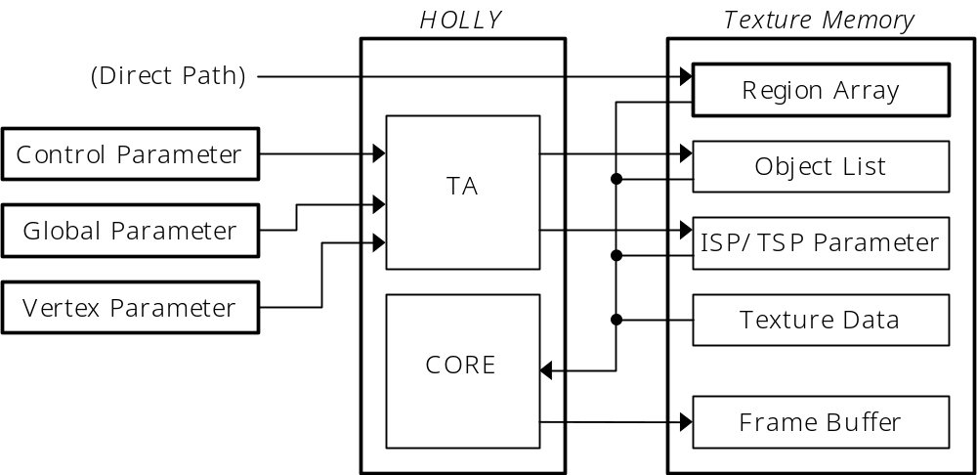
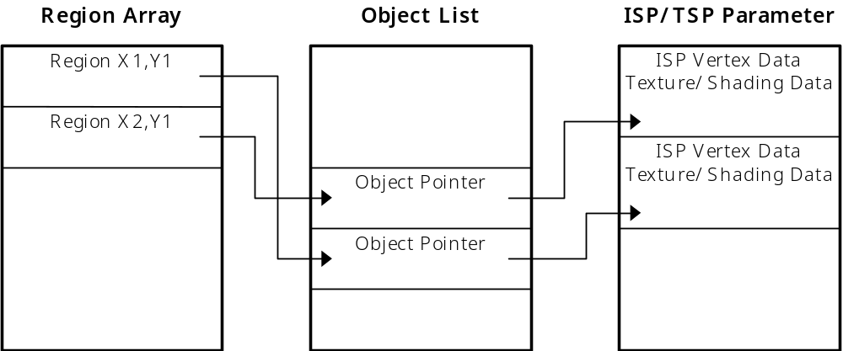
Display List Details

Slide 48
KAMUI Memory Configuration
Definition of Terms
    Region Array = Array of 32x32 tiles, containing head Object Pointers for each of the 5 list types
    Object Pointer List = Linked lists of pointers to objects ‘potentially’ in each tile (generated by TA bounding box algorithm)
Confidential
Notes:
Your notes here.

Slide 49
KAMUI Memory Configuration
    Objects = ISP/TSP parameter words and vertices that define an internal triangle strip
    Global Parameter = Render state information
    Control Parameter = User clip & object settings
    ISP = Image Synthesis Processor
    TSP = Texture and Shading Processor
    Texture Parameter = Texture surface description
Confidential
Notes:
Your notes here.

Slide 50
KAMUI Memory Configuration
Estimating Memory Requirements
  Framebuffers [video memory]
    Width * Height * Bit-depth (double-buffered)
    Example: 640x480, 16-bit 640 * 480 * 2 * 2 = 1,228,800 bytes (1.17 MB)
  Strip buffer option
Confidential
Notes:
Your notes here.

Slide 51
KAMUI Memory Configuration
  Strip buffers [video memory]
    60 Hz execution required
    Width * 32 * Bit-depth (double-buffered)
    Example: 640x480, 16-bit 640 * 32 * 2 * 2 = 81,920 bytes (80 kB)
Confidential
Notes:
Your notes here.

Slide 52
KAMUI Memory Configuration
  Vertex buffers [system memory]
    Roughly equivalent to TA native buffer
    Total size of opaque + opaque modifier + translucent + translucent modifier + punchthrough lists (double-buffered)
    Each list consists of vertices + global parameters + control parameters + endoflist
Confidential
Notes:
Your notes here.

Slide 53
KAMUI Memory Configuration
    Total vertices = vertex size (32 bytes / 64 bytes) * num vertices
    Global parameters = num kmStartVertexStrip * 32 bytes (64 bytes for intensity-offset types)
    Control parameters = num kmSetUserClipping * 32 bytes
    Endoflist = 32 bytes
Confidential
Notes:
Your notes here.

Slide 54
KAMUI Memory Configuration
    Example: 20,000 opaque triangles, avg. strip = 2
    (20,000 / 2) * 4 verts per strip = 40,000 * 32 bytes = 1,280,000 bytes
    Global parameters = 1000 kmStartVertexStrip * 32 bytes = 32,000 bytes
    Total = 1,312,064 * 2 = 2,624,128 byte (2.5 MB)
Confidential
Notes:
Your notes here.

Slide 55
KAMUI Memory Configuration
  Native buffer [video memory]
    Total size equivalent to vertex buffers plus overhead for region arrays and object lists
    Region array size = (framebuffer width / 32) * (framebuffer height / 32) * 5 * 4 bytes
    Object pointer list = (total internal strips) * (avg. regions per strip) * 16/15 * 4 bytes
Confidential
Notes:
Your notes here.

Slide 56
KAMUI Memory Configuration
    Objects = (total internal strips) * (TSP data) + (total vertices) * (ISP vertex data)
    ISP = vertex size - padding, TSP = 12 - 24 bytes
    Example: 20,000 opaque triangles, internal strip length = 2, avg. regions per strip = 3
    Region array size = (640 / 32) * (480 / 32) * 20 bytes = 6,000 bytes
Confidential
Notes:
Your notes here.

Slide 57
KAMUI Memory Configuration
    Object pointer list = (20,000 / 2 tris per strip) * (3 regions per strip) * 16/15 * 4 = 128,000 bytes
    Objects = (20,000 / 2 tris per strip) * 12 + (20,000 / 2 * 4 verts) * 24 = 1,080,000 bytes
    Total video memory for native buffer = (6,000 + 128,000 + 1,080,000) * 2 = 2,428,000 (2.32 MB)
Confidential
Notes:
Your notes here.

Slide 58
KAMUI Memory Configuration
Texture Memory
  Video memory left for textures [Example]
    Video memory = 8 MB
    Framebuffers = 1.2 MB (640x480, 16-bit)
    Native buffer = 2.3 MB (1.2 million/s)
    Texture memory = 4.5 MB
Confidential
Notes:
Your notes here.

Slide 59
KAMUI Texture Management
Loading Textures
  kmLoadTexture() requirements
    DMA transfer from system to video memory
    No mechanism for loading textures directly from GD-ROM to video memory
    32-byte alignment (including 16 byte PVRT chunk header)
Confidential
Notes:
Your notes here.

Slide 60
KAMUI Texture Management
Partial Texture Loads
  Simulate GD-ROM to video mem. load
  kmLoadTextureBlock()
    Fixed block size of 32 bytes
  kmLoadTexturePart()
    Variable size sections (multiple of 32 bytes)
Confidential
Notes:
Your notes here.

Slide 61
KAMUI Texture Management
WaitForDMA vs. Asynchronous DMA
  Normal Operation WaitForDMA
  Asynchronous DMA
    System Configuration = KM_CONFIGFLAG_ NOWAIT_FINISH_TEXTUREDMA
    kmQueryFinishLastTextureDMA()
Confidential
Notes:
Your notes here.

Slide 62
KAMUI Texture Management
Texture Allocation
  kmCreateTextureSurface()
    Video memory allocated by KAMUI driver
  kmCreateContiguousTextureSurface()
    New linear video memory addressing of CLX2 guarantees contiguous texture allocation
Confidential
Notes:
Your notes here.

Slide 63
KAMUI Texture Management
Reducing Fragmentation
  Minimize calls to kmFreeTexture()
  Use kmLoadTexture() to same surface (or kmReLoadMipmap())
  kmGarbageCollectTexture()
  kmGetFreeTextureMem() bytes/blocks free
Confidential
Notes:
Your notes here.

Slide 64
KAMUI Interrupt Callbacks
Callback functions
  End of render
    Safely modify border color, palette banks, etc.
  VSync interrupt
  KAMUI WaitVSync period
    Perform small operations while render pipeline is stalled
Confidential
Notes:
Your notes here.

Slide 65
KAMUI Interrupt Callbacks
  HSync interrupt on an individual scan line
    Useful for split-screen applications
  End of vertex data transfer
  Error Conditions
    Texture memory overflow
    Strip buffer overrun
Confidential
Notes:
Your notes here.

Slide 66
KAMUI Graphics API
QuikTest - Start here
/********************************************************************************************/
/* Name: QuikTest.c */
/* Title: QuickTest Example */
/* */
/* Platform: Dreamcast | Set5.24 | Shinobi | Kamui */
/* */
/* Description: */
/* The purpose of this example is to provide an extremely simple test program */
/* that also demonstrates some basic Kamui optimizations. */
/* */
/* History: */
/* 11/06/98 - Added extra goodies to demonstrate Set5.24 functionality (Gary Lake). */
Confidential
Notes:
Your notes here.

Slide 67
KAMUI Graphics API
Performance Issues
Confidential
Notes:
Your notes here.

Slide 68
KAMUI ARC1 vs. CLX2
SET4 Problems
  66 MHz bus to ARC1
  COSMOS TA separate chip
  Inefficient bus control
  Poor translucency performance
  ARC1 render bugs
Confidential
Notes:
Your notes here.

Slide 69
KAMUI ARC1 vs. CLX2
  Video memory banked
  KAMUI not using DMA or Store Queue
  KAMUI not optimized
    kmSetVertex() ~50 cycles
    Note: multiple setting of vertices using kmSetVertex() no longer allowed on SET 5
  KAMUI hardware abstraction
Confidential
Notes:
Your notes here.

Slide 70
KAMUI ARC1 vs. CLX2
CLX2 Performance
  General 2.5X render performance vs.ARC1
  4X translucency sorting improvement
  Punchthrough mode
  100 MHz bus matches CLX2 clock speed
  Holly unifies render/TA/bus controller
Confidential
Notes:
Your notes here.

Slide 71
KAMUI ARC1 vs. CLX2
CLX2 Performance
  CLX2 owns SH-4 channel 2 burst DMA
  KAMUI uses DMA and Store Queue
  Optimized KAMUI functions & macros
  Reduced need for hardware abstraction
Confidential
Notes:
Your notes here.

Slide 72
KAMUI ARC1 vs. CLX2
CLX2 New Features
  Additional texture formats
    Bump mapping
    Paletted textures
    Small VQ support
  Linear address space for texture memory
Confidential
Notes:
Your notes here.

Slide 73
KAMUI ARC1 vs. CLX2
  Trilinear filtering
  New callback functions
  User tile clipping
  Cheap shadow mode
  Table fog
Confidential
Notes:
Your notes here.

Slide 74
KAMUI Performance
System Bottlenecks
  Inefficient SH-4 code
    Operand cache coherency
    Instruction cache coherency
    SH-4 pipeline stalls
  Data flow / render stalls
Confidential
Notes:
Your notes here.

Slide 75
KAMUI Performance
  Data flow
    Feeding the TA
    VBlanks
  Pixel fill rate / translucency
  Bus bandwidth
  KAMUI functions
Confidential
Notes:
Your notes here.

Slide 76
KAMUI Graphics API
Optimization & Hacking
Confidential
Notes:
Your notes here.

Slide 77
KAMUI What to Optimize?
SH-4 Matrix Transformations
  4x4 matrix multiplier [FTRV]
    12 cycle (goal)
  Inner product [FIPR]
  Sin-cos approximation [FSCA]
  1/square-root approximation [FSRRA]
Confidential
Notes:
Your notes here.

Slide 78
KAMUI What to Optimize?
SH-4 Pipeline
  Codescape simulator
SH-4 Instruction Cache
  Keep loop size under 8 kbytes
  Avoid jumping around in memory (i.e. excessive function calls)
Confidential
Notes:
Your notes here.

Slide 79
KAMUI What to Optimize?
SH-4 Operand Cache
  Codescape functional profiler & prfdump
  Prefetch
    28 cycle latency
  OCRAM mode - use as work area
    8 kbyte memory-mapped cache RAM
Confidential
Notes:
Your notes here.

Slide 80
KAMUI What to Optimize?
Keeping the TA Fed
  Fastest possible transformation loop 30 cycles @ 200 MHz = 6 Million / s (!)
    Prefetch = 28 cycle latency
    Transform = 12 cycles
    Light, etc.
    Store Queue
Confidential
Notes:
Your notes here.

Slide 81
KAMUI What to Optimize?
KAMUI Latency Model
  3V optimal at first
    DMA burst transfer interferes with mem access
  2V Direct may outperform
    32 byte vertex size / optimal use of Store Queue
    Re-write Direct functions into transform loop
Confidential
Notes:
Your notes here.

Slide 82
KAMUI What to Optimize?
Bus Bandwidth
  Strips
    Reduce the amount of vertex data sent to TA
  Small vertex formats
    Packed data vs. SH-4 load trade-off
    Intensity vertex formats -> Global parameter
    Sprites
Confidential
Notes:
Your notes here.

Slide 83
KAMUI What to Optimize?
Context Switches
  Avoid unnecessary render state changes
    Call kmStartVertexStrip() only when strip type changes
  Previous face color for intensity
  Cheap shadow mode vs. modifier volumes
Confidential
Notes:
Your notes here.

Slide 84
KAMUI What to Optimize?
Translucency Issues
  Translucent polygon sorting
    Hardware auto-sort slows down with excessive overlap (common in 2D sprite applications)
  Translucent vs. punchthrough mode
kmTrees sample
Confidential
Notes:
Your notes here.

Slide 85
KAMUI What to Optimize?
Texture Performance
  Use mip-maps
    Guarantees best texture-fit is used
    Equivalent to smaller textures (2K page size)
  Use bilinear filtering (64-bit bus)
Confidential
Notes:
Your notes here.

Slide 86
KAMUI What to Optimize?
Other Graphics Performance Issues
  Full-screen anti-aliasing (fill rate)
  24-bit mode
  Trilinear and anisotropic filtering
  Mip-map exact D calculation
  Internal strip size
Confidential
Notes:
Your notes here.

Slide 87
Optimizing & Hacking KAMUI
Hacking KAMUI
  Modifying KAMUI macros
    Replace individual member access of vertex structure with memcpy() operation
    Incorporate kmxxGetCurrentPtr, kmxxReleaseCurrentPtr, and kmxxStartVertexStrip into user code
Confidential
Notes:
Your notes here.

Slide 88
Optimizing & Hacking KAMUI
  Rewriting KAMUI Direct functions
    Destination address of Store Queue = TA input
    ‘Check’ kmSetVertexDirect()
  Replacing kmProcessVertexRenderState()
    Use kmChangeContext..() functions
    Change texture parameter directly
    Read and record Global parameter, ISP/TSP
Confidential
Notes:
Your notes here.

Slide 89
Optimizing & Hacking KAMUI
  Inverse KAMUI
    Codescape config to aid and abet
    Linker and MAP file
    Librarian splits modules for linker
Confidential
Notes:
Your notes here.

Slide 90
KAMUI Graphics API
CLX2 Features & Goodies
Confidential
Notes:
Your notes here.

Slide 91
CLX2 Features and Goodies
Paletted Textures
  1024 entry super-palette (16-bit / 32-bit)
    64 banks
  4-bit textures, banks 0 - 63
  8-bit textures, banks 0, 16, 32, 48
  Palette updates once-per-scene
Confidential
Notes:
Your notes here.

Slide 92
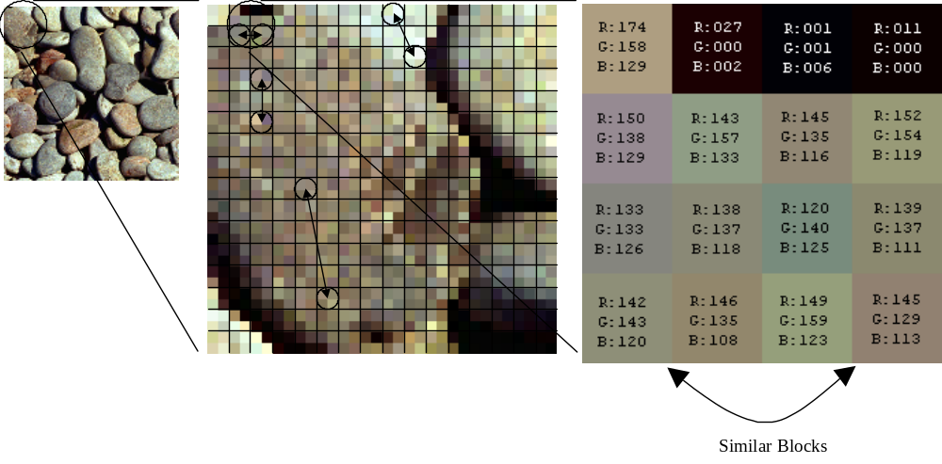
VQ Compression

Slide 93
CLX2 Features and Goodies
VQ Compression
  Partition texture into 2x2 blocks
    Texture dimensions reduced to 1/4
  Select 256 most common blocks
    Form a VQ table with 4 16-bit texels per index
  Replace texture with 8-bit indices
Confidential
Notes:
Your notes here.

Slide 94
CLX2 Features and Goodies
Using VQ Format as 8-bit Palette
  Copy palette from 8-bit texture to VQ table
    Each table entry repeats 16-bit color 4 times
    Equivalent to 8-bit texture with bloated palette
  Describe texture to KAMUI as 4X size
    Maximum texture dimensions 512x512
Confidential
Notes:
Your notes here.

Slide 95
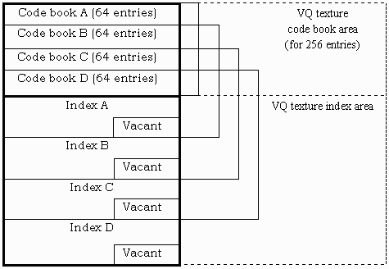
Small VQ Format

Slide 96
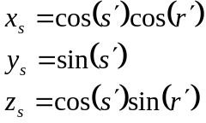
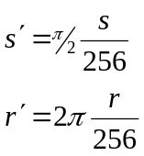
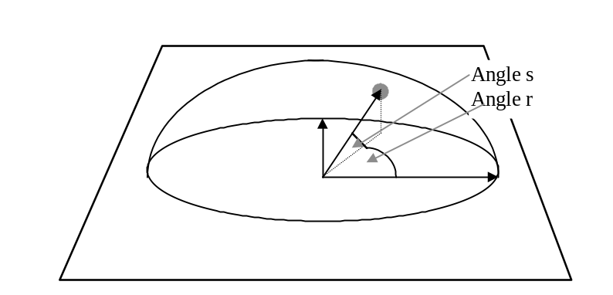
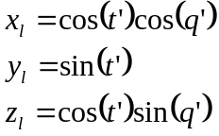
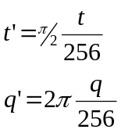



Bump Mapping
where
8-bit s and r values stored in texture
Lighting
where
8-bit k₁, k₂, k₃, and q’ values supplied as offset color

Slide 97
CLX2 Features and Goodies
Bump Mapping
  Specular must be ON
  Lighting value supplied in color offset
  Bump map appears as greyscale image
  Blend with texture in to produce bump-mapped texture
Confidential
Notes:
Your notes here.

Slide 98
CLX2 Features and Goodies
Modifier Volumes
  Specify a volume
    Surround vertices with KM_MODIFIER_INCLUDE/EXCLUDE_ FIRST_POLY and LAST_POLY
  All polygons with KM_MODIFIER_A set are affected by intersection with volume
Confidential
Notes:
Your notes here.

Slide 99
CLX2 Features and Goodies
Cheap Shadow Mode
  Special case of modifier volume
    All polygons with KM_MODIFIER_A set intersecting shadow volume have luminance modified
    No need to specify 2 parameter polygons
Confidential
Notes:
Your notes here.

Slide 100
CLX2 Features and Goodies
  kmSetCheapShadowMode
    Specify 8-bit intensity value 0 - 255
    Intensity of -1 turns off
  Turn on/off cheap shadows surrounding kmProcessVertexRenderState()
Confidential
Notes:
Your notes here.

Slide 101
CLX2 Features and Goodies
Clipping
  Global tile clipping
    Defines size of region array
  User tile clipping
    Set on a strip basis
    Generates control words
  Pixel clipping
Confidential
Notes:
Your notes here.

Slide 102
CLX2 Features and Goodies
Split Screen
  User tile clipping
    Register polygons inside or outside clip region
  Adjusting the screen
    kmSetUserClipLevelAdjust
    Shifts screen by half a tile to put boundary at center of display
Confidential
Notes:
Your notes here.

Slide 103
CLX2 Features and Goodies
Sprites
  Limited data type (fixed strip length = 2)
    KM_VERTEXPARAM_ENDOFSTRIP always specified
    16-bit packed UV
    Packed ARGB
    Flat-shaded only
Confidential
Notes:
Your notes here.

Slide 104
CLX2 Features and Goodies
Other Features
  Anti-aliasing / image scaling
    kmSetDisplayMode() - bAntiAlias
  Flicker-free interlacing
    KM_DSPMODE_NTSCNI640x480FF
  Strip Buffers
Confidential
Notes:
Your notes here.

