Slide 1
KAMUI2 Low-Level
Graphics API
Gary Lake
Sega of America

Slide 2
KAMUI2 Graphics API
KAMUI2 Presentation
  API Overview
  New Functionality (vs. KAMUI)
  Performance Issues
  Optimization and Hacking
  Unique CLX2 Features and Goodies

Slide 3
KAMUI2 Graphics API
Low-Level Device Driver
  Hardware register abstraction
  Pipelined process/data flow
  Triangle-strip primitive interface
  List-based rendering
  Interrupt callbacks

Slide 4
System Architecture
Bus Speed Block Diagram
  Bus from SH-4 to CLX2
    64-bit @ 100 MHz
  Bus from CLX2 to texture memory
    64-bit (4 X 16-bit) @ 100 MHz

Slide 5
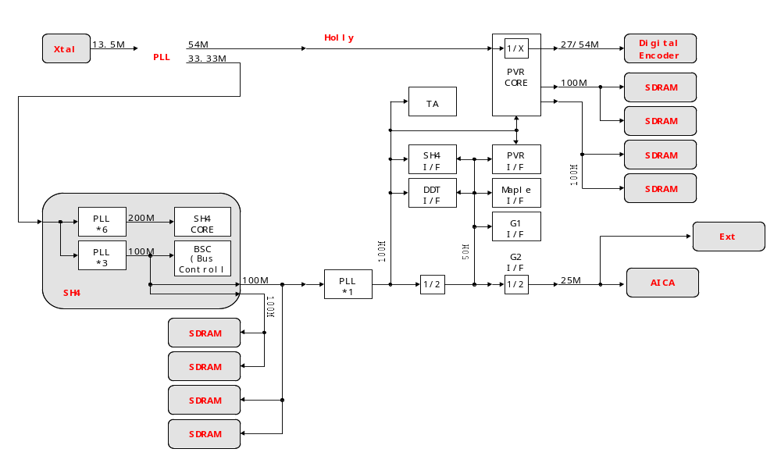
Bus Speed Block Diagram
Bus Speed Block Diagram

Slide 6
System Architecture
Graphics Data Flow
  Texture loads / DMA
    800 MB/s peak (8 bytes @ 100 MHz)
  Vertex registration
    DMA or Store Queue vertex data and control parameters to Tile Accelerator
  Scene render / CLX2 texture bus

Slide 7
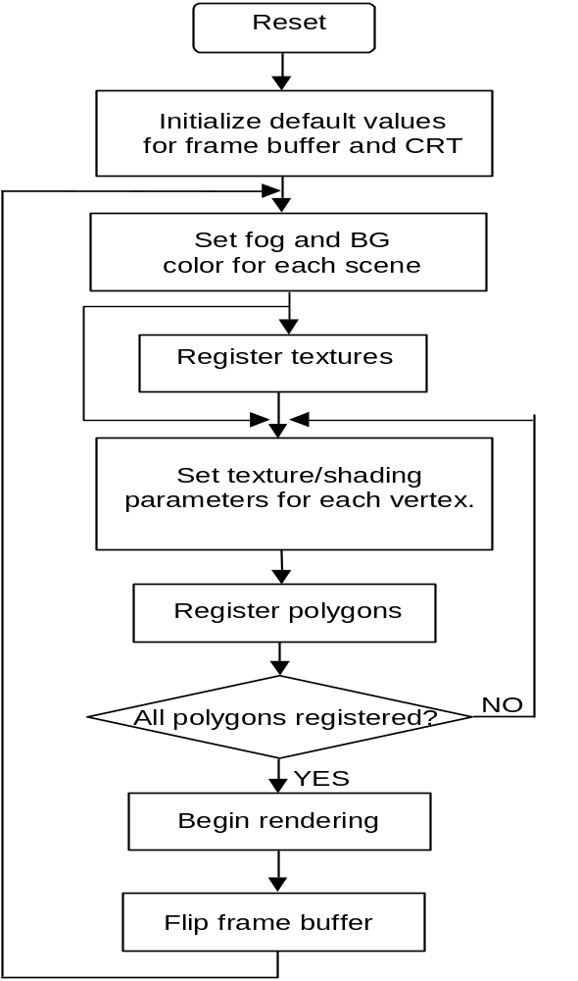
KAMUI2 Process Flow Diagram
KAMUI2 Process Flow Diagram

Slide 8
KAMUI2 Process Flow
KAMUI2 Process Flow Stages
  System and graphics initialization
      syCblCheckCable(), sbInitSystem(), kmInitDevice(), kmSetDisplayMode()
  Rendering system initialization
      kmGetVersionInfo(), kmSetSystemConfiguration(), kmGenerateStripHead()

Slide 9
KAMUI2 Process Flow
  Global scene parameters
      kmSetFogTableColor(), kmSetPixelClipping()
  Texture loading
      kmLoadTexture(), kmQueryFInishLastTextureDMA()
  Scene / multi-pass setup
      kmBeginScene(), kmBeginPass()

Slide 10
KAMUI2 Process Flow
  Vertex / control registration
      kmSetVertex(), kmStartStrip(), kmSetUserClipping()
  Render and page flip
      kmEndPass(), kmRender(),
      kmRenderTexture(), kmEndScene()
  Callbacks
      kmSetEORCallback(), kmSetHSyncCallback(), syChainAddHandler()

Slide 11
KAMUI2 Display Modes
Display Generator
  VGA / NTSC / PAL
  Display modes
    320x240, 320x480, 640x240, 640x480
    Extended PAL (512+ lines)
    Interlace (30 Hz),
    non-interlace (60 Hz),
    pseudo-non-interlace (60 Hz fields),
    flicker-free (60 Hz fields averaged)

Slide 12
KAMUI2 Display Modes
Frame Buffer
  Color depth
    16-bit (RGB 565 / ARGB 1555), 24-bit (RGB 888), 32-bit
  Render options
    16-bit dither
    Antialiasing filter
      4X scene render and scale
  Display offset (for split screen)

Slide 13
KAMUI2 Scene Parameters
Global Scene Settings
  Vsync count
  Culling register
  Color clamp (min / max)
  Punchthrough threshold
  Texture stride width
  Border color

Slide 14
KAMUI2 Scene Parameters
  Fog settings
    Vertex/table fog color, fog density
    Set entire fog table
  Global palette settings
    Palette mode / bit-depth
    Palette table

Slide 15
KAMUI2 Scene Parameters
Pseudo-Global Settings
  Background plane
  Translucent auto-sort
  Cheap shadow mode
  User tile clipping

Slide 16
KAMUI2 Strip Render State
Strip Head / Context Structure
  StripControl
    nListType
      opaque, modifier volume, translucent, translucent modifier, punchthrough
    nUserClipMode
      inside, outside, disable
    nShadowMode
      normal, cheap shadow

Slide 17
KAMUI2 Strip Render State
    nIntensityMode
      packed color, floating point color, intensity, previous face intensity
    bOffset (use offset color / specular)
    bGouraud
  ObjectControl
    nDepthCompare
      ignore, <, <=, =, !=, >=, >, always
    bZWriteDisable

Slide 18
KAMUI2 Strip Render State
    nCullingMode
      small polygons, clockwise, counter-clockwise (CW/CCW also cull small)
    bDCalcControl (mip-map quality)
    dwModifierInstruction
      include/exclude first/last, normal
  Base (Color)
      ARGB specified for intensity type vertices
  Offset (Color)
      ARGB for specular highlight (intensity)

Slide 19
KAMUI2 Strip Render State
  ImageControl
    nSRCBlendingMode, nDSTBlendingMode
      zero, one, src alpha/color, dest alpha/color, inv src alpha/color, inv dest alpha/color, both src alpha, both inv src alpha
    bSRCSelect, bDSTSelect
      2nd accumulation buffer
      typically used for trilinear filtering and polygons that are bump mapped and textured

Slide 20
KAMUI2 Strip Render State
    nFogMode
      table, table 2 (color & alpha), vertex, no fog
    bColorClamp
    bUseAlpha
    bIgnoreTextureAlpha
    nFlipUV, nClampUV
      U, V, both, none
    nFilterMode
      point sample, bilinear, trilinear

Slide 21
KAMUI2 Strip Render State
    bSuperSampleMode (anisotropic)
    dwMipmapAdjust
      0.25 - 3.75, default 1.0
    nTextureShadingMode
      decal (tex + offset), decal alpha, modulate (tex * shade + offset), modulate alpha
    dwPaletteBank
      Index: 4-bit = 0 - 63, 8-bit = 0, 16, 32, 48
    pTextureSurfaceDesc

Slide 22
KAMUI2 Strip Render State
Defining Strip Render State
  kmGenerateStripHead()
    Pre-process operation
    Convert StripContext into StripHead
    Generates 4 control words
      Parameter Control
      ISP/TSP Instruction
      TSP Control
      Texture Control

Slide 23
KAMUI2 Strip Render State
Switching Strip Render State
  kmChangeStripXX()
    [i.e. kmChangeStripBlendingMode]
  kmStartStrip()
    Apply strip render state to new strip
    Control words inserted into vertex buffer
    No need to call for every strip

Slide 24
2V vs. 3V Latency Models
Normal Operation 3V Latency
  Vertex Data Registration
    Opaque, opaque modifier volume, translucent, translucent modifier, punchthrough vertex data sorted by KAMUI2 driver (Vperiod 1)
    Requires vertex buffers in system memory

Slide 25
2V vs. 3V Latency Models
  3V Latency Model
    Transfer of vertex data to TA Native Buffer takes advantage of high speed burst mode DMA transfer (Vperiod 2)
    Scene is rendered (Vperiod 3),
    Total latency 3V
    Yields potentially slow user input response time,
    1V joystick input + 3V = 4V response

Slide 26
2V vs. 3V Latency Models
2V Latency [Combination]
  Vertex Data Registration
    Choose a vertex data type to send directly to TA using Store Queue (usually opaque polygons)
    Or batch up a vertex data type and periodically call kmFlushVertexBuffer() to TA using DMA transfer
    All other data types are buffered in system memory

Slide 27
2V vs. 3V Latency Models
  2V Latency
    Remaining vertex buffers DMA’d to TA Native Buffer (Vperiod 1)
    Potential render pipeline stall for DMA transfer
    Scene is rendered (VPeriod 2)
    Total latency is 2V (potentially 3V), better user response, initially performance may be non-optimal, less system memory than 3V

Slide 28
KAMUI2 System Configuration
Video Mode Initialization
  syCblCheckCable()
    Composite/S-Video NTSC/PAL, VGA
  sbInitSystem()
    Display mode, interlace, framebuffer dimension
    Color depth
    Vsync count

Slide 29
KAMUI2 System Configuration
kmSetSystemConfiguration()
  Flags (KM_CONFIGFLAG_...)
    _ENABLE_CLEAR_FRAMEBUFFER
    _ENABLE_STRIPBUFFER
    _ENABLE_2V_LATENCY
    _NOWAITVSYNC
    _SEPARATE_EACH_PASS
    _ALIGN_TEXTURE_2K_BOUNDARY
    _NOWAIT_FINISH_TEXTUREDMA

Slide 30
KAMUI2 System Configuration
  ppSurfaceDescArray
    KMSURFACEDESC Front, Back
    ppSurfaceDescArray[2] =
    { &Front, &Back }
  fb.nNumOfFrameBuffer
  fb.nStripBufferHeight

Slide 31
KAMUI2 System Configuration
  nTextureMemorySize
    Multiple of 32 bytes
    Determines size of TA Native Buffer [Video memory - frame buffers - texture heap]
  nNumOfTextureStruct
  nNumOfSmallVQStruct
  pTextureWork
    Texture (24 bytes) SmallVQ (76 bytes)

Slide 32
KAMUI2 System Configuration
  pBufferDesc
    Vertex buffer descriptor, for kmSetVertex()
  nNumOfVertexBank
  pVertexBuffer
    User allocated in system memory
    32-byte alignment for DMA transfer
    Mapped to SH-4 P2 non-cached memory region (0xA..)

Slide 33
KAMUI2 System Configuration
  nVertexBufferSize
    Multiple of 32 bytes
  nPassDepth
Pass[nPassDepth]
  nDirectTransferList
    Set for 2V latency mode
  fBufferSize[5]
    Percent of vertex buffer allocated for each polygon type (totals 100%)

Slide 34
KAMUI2 System Configuration
  dwRegionArrayFlag
    KM_PASSINFO_AUTOSORT
    KM_PASSINFO_PRESORT
    KM_PASSINFO_ENABLE_Z_CLEAR
    KM_PASSINFO_DISABLE_Z_CLEAR
    KM_PASSINFO_USE_ANOTHERLIST

Slide 35
KAMUI2 Macro Optimizations
KAMUI2 Multi-level Macros
  Source provided in “km2Kamui.h”
  _KM_USE_VERTEX_MACRO_
    kmStartStrip, kmSetVertex
  _KM_USE_VERTEX_MACRO_L2_
    kmxSetVertex_0, 1, ...
    kmxGetDstAddress++

Slide 36
KAMUI2 Macro Optimizations
  _KM_USE_VERTEX_MACRO_L3_
    kmxxGetCurrentPtr, kmxxReleaseCurrentPtr
    kmxxStartStrip, kmxxSetVertex_0, 1 ..
  _KM_USE_VERTEX_MACRO_L4_
    Level 4 provides best optimization
    Uses Store Queue
    Level 3: (pkmCurrentPtr)->fX = x;
    Level 4: (pkmCurrentPtr)++ = x;

Slide 37
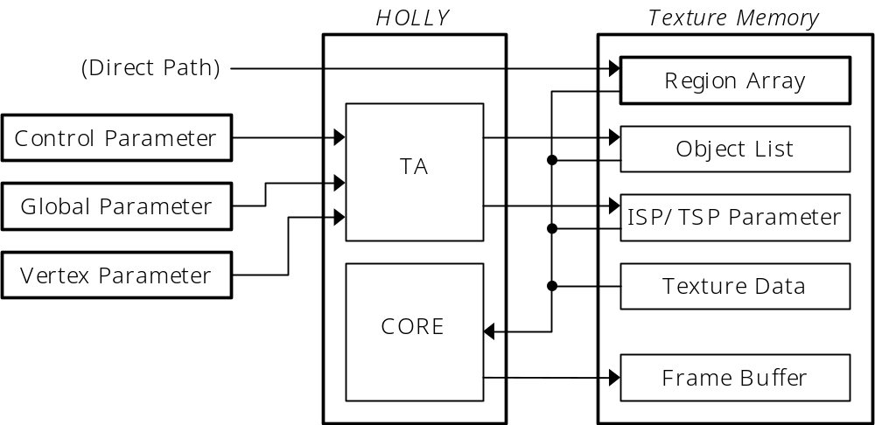
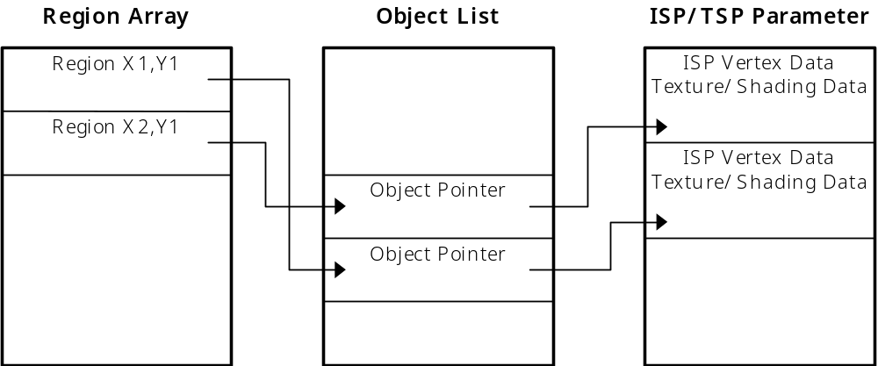
Display List Details
Display List Details

Slide 38
Display List Details
Definition of Terms
    Region Array
      Array of 32x32 tiles, containing head Object Pointers for each of the 5 list types
    Object Pointer List
      Linked list of pointers to objects ‘potentially’ in each tile (generated by TA bounding box algorithm)
    Object
      ISP/TSP parameter words and vertices that define an internal triangle strip

Slide 39
Display List Details
    Global Parameter
      Render state information
    Control Parameter
      User clip and object settings
    ISP
      Image Synthesis Processor
    TSP
      Texture and Shading Processor
    Texture Parameter
      Texture surface description

Slide 40
KAMUI2 Memory Configuration
Estimating Mem Requirements
  Frame buffers [video memory]
    Width * height * bit-depth (double-buffered)
    Example: 640x480, 16-bit
    640 * 480 * 2 * 2 = 1,228,800 bytes (1.17 MB)
  Strip buffer option

Slide 41
KAMUI2 Memory Configuration
  Strip buffers [video memory]
    60 Hz execution required
    Width * 32 * bit-depth (double-buffered)
    Example: 640x480, 16-bit
    640 * 32 * 2 * 2 = 81,920 bytes (80 kB)

Slide 42
KAMUI2 Memory Configuration
  Vertex buffers [system memory]
    Roughly equivalent to TA Native Buffer
    Total size of opaque + opaque modifier + translucent + translucent modifier + punchthrough lists (double-buffered)
    Each list consists of vertices + global parameters + control parameters + endoflist

Slide 43
KAMUI2 Memory Configuration
    Total vertices = vertex size (32 bytes or 64 bytes) * num vertices
    Global parameters = num kmStartVertexStrip * 32 bytes (64 bytes for intensity-type vertices)
    Control parameters = num kmSetUserClipping * 32 bytes
    Endoflist = 32 bytes

Slide 44
KAMUI2 Memory Configuration
  Example:
    20,000 opaque triangles, avg. strip = 2
    (20,000 / 2) * 4 verts per strip = 40,000 * 32 bytes = 1,280,000 bytes
    Global parameters = 1000 kmStartVertexStrip * 32 bytes = 32,000 bytes
    Total = 1,312,064 * 2 = 2,624,128 bytes (2.5 MB)

Slide 45
KAMUI2 Memory Configuration
  Native buffer [video memory]
    Total size equivalent to vertex buffers plus overhead for region arrays and object lists
    Region array size = (frame buffer width / 32) * (frame buffer height / 32) * 5 types * 4 bytes
    Object pointer list = (total internal strips) * (avg. regions per strip) * 16/15 * 4 bytes

Slide 46
KAMUI2 Memory Configuration
    Objects = (total internal strips) * (TSP data) + (total vertices) * (ISP vertex data)
    ISP vertex data = internal vertex size 24 bytes, TSP = 12 bytes (*2 intensity)
  Example:
    20,000 opaque triangles, internal strip length = 2, avg. regions per strip = 3
    Region array size = (640 / 32) * (480 / 32) * 20 bytes = 6,000 bytes

Slide 47
KAMUI2 Memory Configuration
    Object pointer list = (20,000 / 2 tris per strip) * (3 regions per strip) * 16/15 * 4 = 128,000 bytes
    Objects = (20,000 / 2 tris per strip) * 12 + (20,000 / 2 * 4 verts) * 24 = 1,080,000 bytes
    Total video memory for Native Buffers = (6,000 + 128,000 + 1,080,000) * 2 = 2,428,000 (2.32 MB)

Slide 48
KAMUI2 Memory Configuration
Texture Memory
  Video memory left for textures [example]
    Video memory = 8 MB
    Frame buffers = 1.2 MB (640x480)
    Native buffers = 2.3 MB (1.2 million/s)
    Texture memory = 4.5 MB

Slide 49
KAMUI2 Texture Management
Loading Textures
  kmLoadTexture() requirements
    DMA transfer from system to video memory
    No mechanism for loading textures directly from GD-ROM to video memory
    32-byte alignment (must account for 16 byte PVRT chunk header)

Slide 50
KAMUI2 Texture Management
Partial Texture Loads
  Simulate GD-ROM to video mem transfer
  kmLoadTextureBlock()
    Transfer a number of 32-byte texture blocks to video memory
  kmLoadTexturePart()
    Transfer variable size sections to video memory (multiple of 32 bytes)

Slide 51
KAMUI2 Texture Management
WaitForDMA vs. Asynchronous
  Normal operation WaitForDMA
  Asynchronous DMA
    System configuration
      KM_CONFIGFLAG_
      NOWAIT_FINISH_TEXTUREDMA
    kmQueryFinishLastTextureDMA()
      Determines if previous texture load finished

Slide 52
KAMUI2 Texture Management
Texture Allocation
  kmCreateTextureSurface()
    Video memory allocated by KAMUI2
  kmCreateContiguous
  TextureSurface()
    Create two or more contiguous texture allocations

Slide 53
KAMUI2 Texture Management
Reducing Fragmentation
  Minimize calls to kmFreeTexture()
  Use kmLoadTexture() to same surface (or kmReLoadMipmap)
  kmGarbageCollectTexture()
  kmGetCurrentTextureStatus() bytes/blocks free

Slide 54
KAMUI2 Interrupt Callbacks
Callback Functions
  End of Render
    Safely modify border color, palette bank, etc.
  VSync interrupt
    syChainAddHandler()
  KAMUI2 WaitVSync period
    Perform small operations while render pipeline is stalled for VBlank

Slide 55
KAMUI2 Interrupt Callbacks
  HSync interrupt on an individual scan line
    Useful for split-screen applications
  End of Vertex data transfer
  Error Conditions
    Texture memory overflow
    Strip buffer overrun
    Fatal error (vertex buffer overrun, etc.)

Slide 56
KAMUI2 Graphics API
QuikTst2 - Start Here
/********************************************************************************************/
/* Name: QuikTst2.c */
/* Title: QuickTest Kamui2 Example */
/* Author: Gary Lake */
/* Created: June 4, 1999 */
/* */
/* Version: 1.0 */
/* Platform: Dreamcast | Set5.24 | Shinobi | Kamui2 */
/* */
/* Description: */
/* The purpose of this example is to provide an extremely simple test program */
/* that also demonstrates some basic Kamui2 optimizations. */
/* */
/* History: */
/* 06/04/99 - Ported QuikTest to Kamui2 (Gary Lake). */
/* 02/24/99 - Modified memory allocation routines for 32-byte alignment. */
/* 11/06/98 - Added extra goodies to demonstrate Set5.24 functionality (Gary Lake). */
/* */

Slide 57
KAMUI vs. KAMUI2
Differences
  Compare QuikTest vs. QuikTst2
  “Kamui2.h”, “km2xx.h”
  Vertex buffer and texture memory size in bytes (not DWORDs)
  StripContext replaces VertexContext
    VertexContext supported for backwards compatibility

Slide 58
KAMUI vs. KAMUI2
  Texture work area
    User allocated
    Supply maximum number of textures
  kmGenerateStripHead()
    Replaces ProcessVertexRenderState()
  kmSetBackGround()
    Replaces kmSetBackGroundPlane()

Slide 59
KAMUI vs. KAMUI2
  Multi-pass support
    kmBeginScene(), kmBeginPass(), kmEndPass()
  kmStartStrip()
    Replaces kmStartVertexStrip()
  kmRender(), kmEndScene()
    Page flip / no page flip option
    Eliminates kmFlipFrameBuffer()

Slide 60
KAMUI2 Performance
System Bottlenecks
  Inefficient SH-4 code
    Operand cache coherency
    Instruction cache coherency
    SH-4 pipeline stalls
  Data flow / render stalls
    Feeding the Tile Accelerator
    VBlanks

Slide 61
KAMUI2 Performance
  Pixel fill rate / translucency
  Bus bandwidth
  KAMUI2 function overhead

Slide 62
KAMUI2 What to Optimize?
SH-4 Matrix Transformations
  4x4 matrix multiplier [FTRV]
    Goal: 12 cycles (4 cycle min. X 3)
  Inner product [FIPR]
  Sin-cos approximation [FSCA]
  1/square-root approximations [FSRRA]

Slide 63
KAMUI2 What to Optimize?
SH-4 Pipeline
  Codescape Simulator
SH-4 Instruction Cache
  Keep loop size under 8 kbytes
  Avoid jumping around in memory (i.e. excessive function calls)
  Link order
    Future: Optimizing linker

Slide 64
KAMUI2 What to Optimize?
SH-4 Operand Cache
  Codescape EVA Trace Profiler
  Prefetch
    28 cycle latency
  OCRAM mode
    8 kbyte memory-mapped cache RAM

Slide 65
KAMUI2 What to Optimize?
Keeping the TA Fed
  Fastest possible transformation loop: 30 cycles @ 200 MHz = 6 Million / s (input side)
    Prefetch = 28 cycle latency
    Transform = 12 cycles
    Lighting, etc.
    Store Queue to TA / vertex buffers
  Good samples from Elite..

Slide 66
KAMUI2 What to Optimize?
  Sample Prefetch and Store Queue
      pkmCurrentPtr = 0xE.. destination address
      prefetch((void *)(pkmCurrentPtr + 8));
      *pkmCurrentPtr++ = pcw;
      *(PKMFLOAT)pkmCurrentPtr++ = x;
      *(PKMFLOAT)pkmCurrentPtr++ = y;
      *(PKMFLOAT)pkmCurrentPtr++ = invw;
      *(PKMFLOAT)pkmCurrentPtr++ = fu;
      *(PKMFLOAT)pkmCurrentPtr++ = fv;
      *pkmCurrentPtr++ = bcol;
      *pkmCurrentPtr = ocol;
      prefetch((void *)pkmCurrentPtr);
      pkmCurrentPtr++;

Slide 67
KAMUI2 What to Optimize?
  Use 64-bit access to load matrix
      frchg ; change register bank
      fschg ; swap to 64 bit access
      fmov @r4+,dr0 ;load x,y row 1 into fr0/fr1
      fmov @r4+,dr2 ;load z,t row 1 into fr2/fr3
      fmov @r4+,dr4 ;load x,y row 2 into fr4/fr5
      fmov @r4+,dr6 ;load z,t row 2 into fr6/fr7
      fmov @r4+,dr8 ;load x,y row 3 into fr8/fr9
      fmov @r4+,dr10 ;load z,t row 3 in fr10/fr11
      fmov @r4+,dr12 ;load x,y row 4 in fr12/fr13
      fmov @r4+,dr14 ;load z,t row 4 in fr14/fr15
      fschg ; swap to 32 bit access
      frchg ;change register bank

Slide 68
KAMUI2 What to Optimize?
Sample use of FTRV
      fschg ; swap to 64 bit access
      fmov @r4+,dr0 ;load x,y from src into fr0/fr1
      add #16,r5 ;increment destination
      fmov @r4+,dr2 ;load z,t from src into fr2/fr3
      ftrv xmtrx,fv0 ; second register bank
      fmov dr2,@-r5 ;write z,t result from fr2/fr3
      fmov dr0,@-r5 ;write x,y result from fr0/fr1
      fschg ; swap to 32 bit access

Slide 69
KAMUI2 What to Optimize?
Organize Model Data Storage
  Example: source vertex data
      xyzw (location), ijk (normal)
      uv (model texture coordinates)
      argb (pre-lit vertex color)
    = 2 cache lines/source vertex
  After transform and lighting
      xyzw (projected), uv, uv, ...
      argb (lit color)
    = 1 or 2 cache lines/vertex

Slide 70
KAMUI2 What to Optimize?
KAMUI2 Latency Model
  3V could be optimal at first
      Redundant memory copy
      DMA transfer and memory access contention
  2V outperforms if optimized
      32 byte data alignment and vertex size
      Use of km2Kamuix macros
      Use of Store Queue directly to TA
      Roll into transform loop

Slide 71
KAMUI2 What to Optimize?
Bus Bandwidth
  Strips
    Reduce the amount of vertex data sent to TA
  Small vertex formats
    Packed data vs. SH-4 load trade-off
    Intensity vertex formats
      Offloads the data to strip head
  Use Cheap shadow mode

Slide 72
KAMUI2 What to Optimize?
Render State Switches
  Avoid unnecessary state changes
    Call kmStartStrip() only when strip type has changed
  Previous face color for intensity

Slide 73
KAMUI2 What to Optimize?
Translucency Issues
  Translucent polygon sorting
    Hardware audio-sort slows down with excessive overlap (common in particle systems)
  Translucent vs. punchthrough mode
kmTrees sample

Slide 74
KAMUI2 What to Optimize?
Texture Performance
  Use mip-maps
    Guarantees best texture-fit
    Equivalent to smaller textures
    (2k page size)
  Twiddled vs. rectangular
  Use bilinear filtering (64-bit bus)

Slide 75
KAMUI2 What to Optimize?
Other Graphics Performance Issues
  Full-screen anti-aliasing (fill rate)
  24-bit mode
  Trilinear and anisotropic filtering
  Mip-map exact D calculation
  Internal strip size

Slide 76
CLX2 Features and Goodies
Modifier Volumes
  Specify a volume
    Surround vertices with KM_MODIFIER_INCLUDE/EXCLUDE_FIRST_POLY and LAST_POLY
  2 Parameter vertex types to be modified
    Specify vertex color, texture, etc. inside volume vs. outside volume

Slide 77
CLX2 Features and Goodies
Cheap Shadow Mode
  Special case of modifier volume
    nShadowMode set to KM_CHEAPSHADOW_POLYGON
    Applies to all vertex types, not just 2 parameter polygons
    kmSetCheapShadowMode()
      Specify 8-bit intensity value 0 - 255

Slide 78
CLX2 Features and Goodies
Clipping
  Global tile clipping
    Defines size of Region Array
  User tile clipping
    Set on a strip basis
    Generates control words
    Specify inside/outside clip region on tile boundaries
  Pixel clipping

Slide 79
CLX2 Features and Goodies
Split Screen
  User tile clipping
    Adjust clip region for each split window
  Adjust the screen
    kmSetUserClipLevelAdjust()
    Shift screen by half a tile to put split screen boundary at center of display

Slide 80
CLX2 Features and Goodies
Using Multiple Renders
  Example: 4-player split screen
    kmBeginScene();
    kmBeginPass();
    kmSetUserClipping(WIN1_TILES);
    kmSetPixelClipping(WIN1_PIXELCLIP);
    RenderScene(Player1);
    kmEndPass();
    kmRender(KM_RENDER_NOFLIP);
    kmEndScene();

Slide 81
CLX2 Features and Goodies
    kmBeginScene();
    kmBeginPass();
    kmSetUserClipping(WIN4_TILES);
    kmSetPixelClipping(WIN4_PIXELCLIP);
    RenderScene(Player4);
    kmEndPass();
    kmRender(KM_RENDER_FLIP);
    kmEndScene();

Slide 82
CLX2 Features and Goodies
Multi-pass Uses
  Switch translucent auto-sort on/off
    Allows Z comparison mode changes
  Translucency grouping
    Split the render of translucent objects to prevent overflow of auto-sort buffer
  Z clipping plane
    Render a transparent plane with ALWAYS flag set to clear Z buffer

Slide 83
CLX2 Features and Goodies
VQ Compression
  Partition texture into 2x2 blocks
    Texture dimension reduced to 1/4
  Select 256 most common blocks
    Form a VQ table with 4 16-bit texels per block
  Replace texture with 8-bit indices
Small VQ Format

Slide 84
CLX2 Features and Goodies
Using VQ Format as 8-bit Palette
  Copy palette from 8-bit texture to VQ table
    Each table entry repeated 4 times
    Equivalent to 8-bit texture with bloated palette
  Describe texture as 4X size

Slide 85
CLX2 Features and Goodies
Bump Mapping
  Specular must be on
  Lighting value supplied in offset color
  Bump map appears as greyscale
  Blend with texture to produce bump-mapped texture

Slide 88
KAMUI vs. KAMUI2
Changes
  Direct mode removed
  kmSetAlphaThreshold() removed
  kmSetStripLength() removed
  VertexContext
    ParamType
      Interpreted from ListType
    UVFormat
      Interpreted from vertex type
    ScreenCoordination
      never worked
    ShadingMode
      Interpreted from vertex type and Gouraud flag
    SelectModifier
      Interpreted from vertex type
    bUseSpecular
      Replaced by bOffset
    StripLength
      Internal strip length
    Modifier bounding box
  SystemConfiguration
    Framebuffer width, height, and BPP removed
      Interpreted from display mode
    VbufModel
      Interpreted from Flags member

