Slide 1



High performance on Dreamcast with D3D
Sebastian Wloch
Development Service Manager
Kalisto Entertainment

Slide 2
Overview
1. The Dreamcast’s 3D chip
2. Some high level tips & tricks
3. Geometry & performance
4. Let's optimize a game

Slide 3
1. The Dreamcast’s 3D chip
Tile based hardware
Tile size: 32*32
Primitives are clipped into each tile
Scene rendered at endscene()

Slide 4
Features
Fillrate not a problem anymore
Transparency sorted by hardware
Viewport clipping done by hardware
Drawback: Transparency a little slower
But 5551 mode as fast as opaque mode
SH4 native operations (intrinsic)
  void __fsca(float *sin_apprx, float *cos_apprx, int input);
  float _Dot3dVW0(float *vector1, float *vector2);
  float _InvSqrtA(float input);

Slide 5
2. Some high level tips & tricks
Eliminate as many meshes as possible before rendering
But elimination tests have a cost
Elimination test algorithm must be very fast
Only test on potentially eliminated objects
Existing tests:
  View frustrum elimination
  Backface culling
  Objects hidden by other objects

Slide 6
Pyramid removal
Bspheres faster than Bboxes
  For all objects
  For large primitives

Slide 7
Backstrip culling
Only for large strips (10 triangles or more) use tolerance for curvature
Make sure you're not visiting individual vertices (D3D can do a better job)
  Use float _Dot3dVW0(*vector1, *vector2);

Slide 8
Subdivide very large objects
Very large objects:
  Often touch one of the clipping planes
  You're going to test or to send lots of primitives for nothing
Subdivide them into smaller objects
Octree works well for those cases
Don't create too small objects
  Object visibility tests are costly

Slide 9
3. Geometry & performace
Strips have ( nbtriangles + 2 ) vertices
Up to 3x smaller and FASTER
But vertices must share everything:
  States, textures & coordinates
  Colors, illumination & normal vector
3D mesh quality is important
18
8
5
17
2
6
10
4
2
11
6
7
4
16
9
14
3
1
7
3
12
5
15
1
8
13

Slide 10
IndexedPrimitive vs. Primitive
DrawPrimitive:
  Don’t use D3DPT_TRIANGLELIST; switch to DrawIndexedPrimitive
  Very fast with D3DPT_TRIANGLESTRIP for very large strips
DrawIndexedPrimitive:
  Best solution if you don’t have very large strips

Slide 11
D3D_TLVERTEX vs. D3D_LVERTEX
DONOTCLIP vs. 0
Generally D3D_LVERTEX is faster than D3D_TLVERTEX
Use D3D_TLVERTEX for:
  Generated geometry (Bezier patches)
  2D graphics (OSD)
Viewport clipping done by the hardware
But near clipping done by D3D:
  Turn DONOTCLIP on if possible
  Do tests for objects and primitives to see if clipping is needed
  But not if you are visiting individual vertices

Slide 12
Data locality
Align vertices to 32 bytes
  Misaligned data is slower
  D3D will have to do a memcpy to align
  Be careful: malloc() aligns to 4
Avoid generating primitives on the fly
  If possible, store everything in the final format
  Compute the lighting in real time (or better, use D3D_VERTEX)
Localize your data access
  Group primitives into a larger block

Slide 13
4. Let’s optimize a game
Windows CE performance viewer
Monitors drop down menu in DCTool to activate once the game launched
Helps find out exactly what is taking time:
  Grey: Game code
  Red: Direct3D, opaque polygons
  Blue: Direct3D, transparency
  Green: Direct3D, Punch through

Slide 14
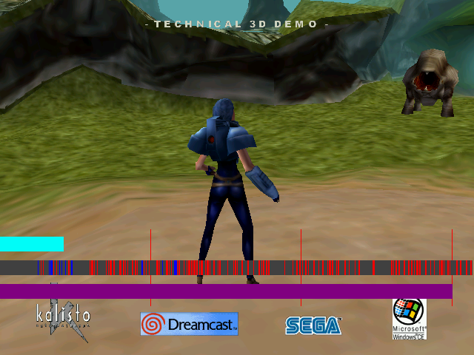
Not optimized game

Slide 15
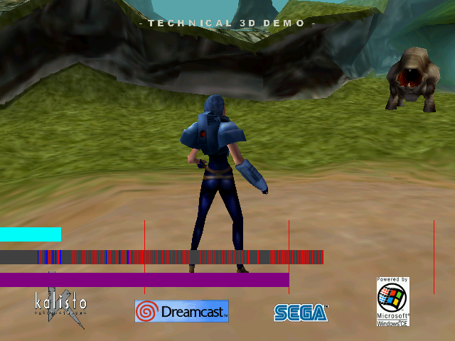
Aligned to 32 and lined up

Slide 16
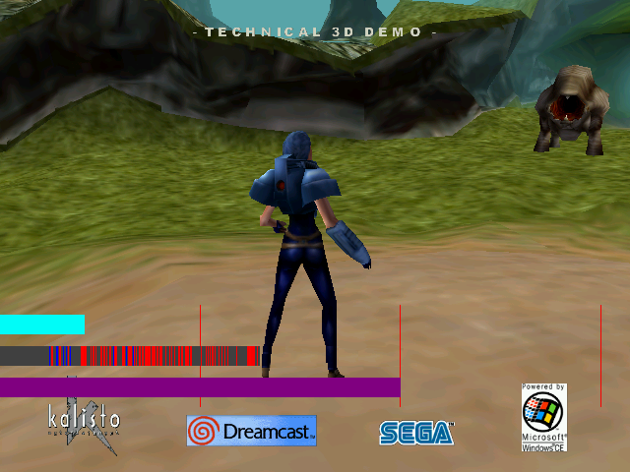
Use large lists to reduce calls

Slide 17

Generate strips

