Slide 1

Audio and Manatee
Thomas Szirtes
Senior Software Engineer
Sega Europe
Szirtest@soe.sega.co.uk
Dts@soe.sega.co.uk

Slide 2
This presentation
The Hardware
Structure
Tools Overview
Focus on DSP
API Overview
Q&A

Slide 3
The Hardware
Notes:
Somewhat convoluted procedure

Slide 4
Hardware
Texture/
Frame Buffer
8MB
CPU
SH4
NTSC/PAL
Encoder
NTSC/ PAL
Smart
Card I/F
Graphics
Holly
CLX1
+
DMA/
Bus, etc
Program/
Data
16MB
Wave
2MB
RTC
Sound
Modem
EIDE
CDROM
ROM
2MB
4 Game Port
Notes:
Somewhat convoluted procedure

Slide 5
Hardware
Yamaha ACIA Chip
  64 hardware Channels, each with
    PCM/ADPCM Playback with forward loop
    LFO controllers for pitch and amplitude
      saw, triangle, sine, square
    12dB resonant low pass filter
    Envelopes for filter and amplitude
    Volume, direct and effect send
    Effect select
    64K sample limit

Slide 6
Hardware
Yamaha ACIA Chip
  DSP Processor
    128 step
    Dynamically loadable
    Multiple effects
      Reverb, Chorus, Flange
      Delay, Parametric EQ., etc.
      Q-Sound
  18 channel digital mixer
    level and pan

Slide 7
Hardware
Also in there
  ARM7 Embedded Processor
    32bit
    25 MHz/17 MIPS
  2 MB Memory
    shared by
      Sound driver
      PCM/Tone Data
      DSP Program and Work RAM
      Streaming Buffers
      Sequence Data

Slide 8
Structure
Notes:
Somewhat convoluted procedure

Slide 9
System Modules
One-Shot
MIDI
Streaming
GDDA

Slide 10
One-Shot
For Sound Effects
  Sound effects referenced by number
  All sounds resident in sound memory
  Can still use all of hardware functionality
    e.g. filters, oscillators, DSP effects
  explicit voice management

Slide 11
MIDI
For musical applications
  Very compact format
  Runs entirely on ACIA/ARM7 side
  All sounds resident in sound memory
Can also be used for sound effects
  Sound effects are treated like instruments
    slightly cumbersome
    no explicit voice priority management

Slide 12
Streaming
For sounds larger than 64K
  Allocate a ring buffer in sound memory
  Store stream fully or partially in system memory
  Sound library automatically transfers data to ring buffer (via DMA or SH4)
If using streaming from GDROM consider ADX

Slide 13
GDDA
Playback of pre-recorded audio (Redbook)
Uses all GDROM resource
Uses no additional system resources
  no CPU, DMA or ACIA channels used
No compression available

Slide 14
Sharing Resources
Need to sharing audio resources between modules
  Memory
    use “static” memory map
    can change maps
    can change items in map
  Voices
    Decide at initialisation allocation for each module

Slide 15
Conceptual Diagram
Uses host interface buffer to communicate with SH4
SH4
Manbow
Audio
RAM
2Mb
ACIA
G2 Bus
ARM7
manatee
Interrupt line
Notes:
Somewhat convoluted procedure

Slide 16
Tools
Notes:
Somewhat convoluted procedure

Slide 17
Tools
Host
  Mac PowerPC with OS 8.5
Software = S.C.A.T.
  Sound Data Converter
  Midi Program Editor
  Sound Project Manager
  FX Program Editor

Slide 18
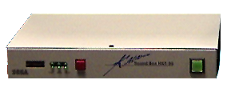
Tools
Katana Sound Box
  Dreamcast Sound Hardware
  SCSI2 interface
  MIDI In/Out
  Audio Out
Notes:
Somewhat convoluted procedure

Slide 19
One-Shot Bank
Use Sound Data Convertor
  Add .AIFF, .WAV sounds
    mono, 8/16 bit
    up to 64K size (samples not bytes)
  Edit Parameters
  Link files if you want to use the sample data but with different parameters
  Convert
  Outputs One Shot Bank (.OSB)

Slide 20
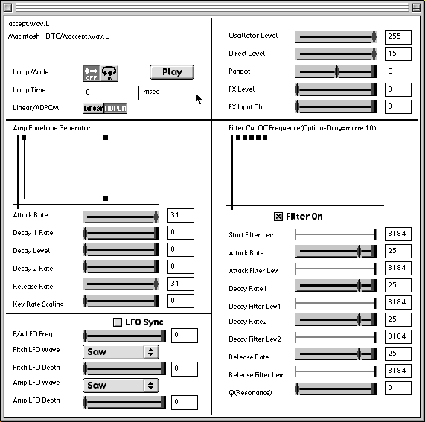
One-Shot Parameters
Volume and Panpot
DSP Input Select and Level
Looping parameters and conversion to ADPCM
Amplitude Envelope Generator
Low Pass Filter Envelope and Resonance (Q) Factor
Pitch and Amplitude Low Frequency Oscillators
Notes:
Somewhat convoluted procedure

Slide 21
Midi Sequences
Use Sound Data Convertor
  Add desired Standard Midi Files
    type 0 or 1
  Convert & Collate
  Output Sequence Bank
Add Bank & Program Changes for each channel to original sequence

Slide 22
MIDI Programs
Use MIDI Program Editor
  Input
    .aiff, .wav
  Outputs
    .mpf
      Midi Program bank for use in the editor
    .mpb
      resultant binary for use in the sound project manager and Dreamcast.

Slide 23
Midi Program Bank
Bank Hierarchy (Bottom up)
  Tones
    the wave data + envelopes, filters
  Split (max 128 splits per layer)
    the range over which the tone plays
    pan, effect and direct sends
  Layer (4 layers per program)
    splits layered to play together simultaneously
  Program (max 128 programs per bank)
    a voice or instrument

Slide 24


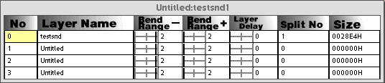
Midi Program
Notes:
Somewhat convoluted procedure

Slide 25
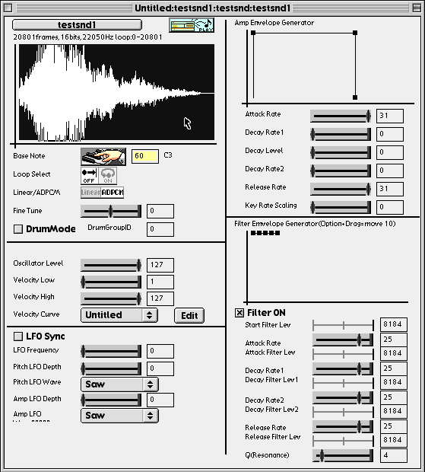
Midi Program
tone
MIDI Velocity Curve

Slide 26
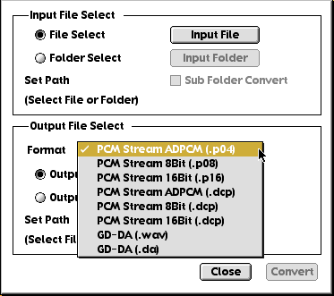
Streams & GDDA
Use Sound Data Converter
  Input AIFF, SD2 or WAV
  Separate into separate left and right streams
  Source data can be 4,8 or 16-bit; 11.025, 22.5, or 44.1KHz
    Output raw or ADPCM
Notes:
Somewhat convoluted procedure

Slide 27

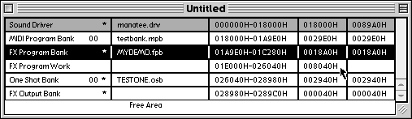
Project Manager
Map Bank
Data type
Filename
Address Range
Area size
File size
Notes:
Somewhat convoluted procedure

Slide 28
Final Step
Project Manager
  Output multi-unit file (.MLT)
    All data memory map and all data concatenated into one file
    quick and clean
  Or output map and separate files
    more flexible
    takes longer to set-up
Take these to your PC

Slide 29
Using the DSP
Notes:
Somewhat convoluted procedure

Slide 30
Using the DSP
You cannot create DSP programs from scratch only modify/link existing “modules”
Need space in map for minimum of three data items
    FX Program Bank
    FX Work RAM
    FX Output Mixer
Notes:
Somewhat convoluted procedure

Slide 31
FX Program Editor
FX Program Editor
  Select your input blocks (channels)
  Add your effect modules
  Select your outputs
  Join them together in sequence
Notes:
FX Program Editor
Select your input blocks (channels)
correspond to your FX Select parameter
Add your effect modules
reverb, delay, flange, chorus, Q-sound etc...
Select your outputs
these are routed to the FX Output Mixer
Join them together in sequence

Slide 32
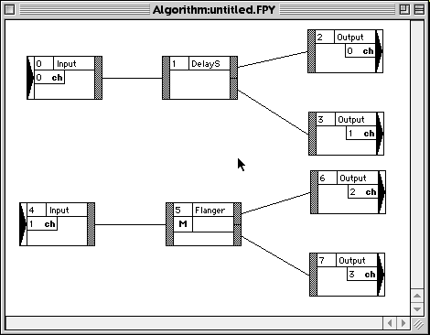
FX Program Editor
Notes:
Somewhat convoluted procedure

Slide 33
FX Program Editor
Link
  note down the WorkRAM required
Download
  You need to have allocated an area in your map for the DSP Program.
Save
  It should create a .FPY (for the editor)
  AND a .FPD (for the Project Manager)
    only if the download was successful!

Slide 34
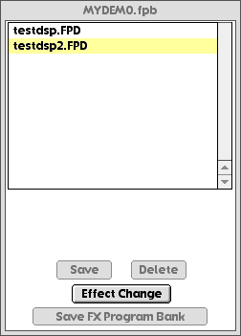
Creating FX Banks
Use Project Manager
  double click on FX Program
  Click on “Save”
  “Save FX Program Bank”
  Use resultant .FPB as file for this data item
  use “Effect Change” to swap between active programs

Slide 35
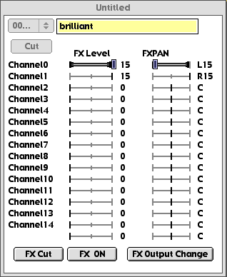
FX Output Mixer
Before you can hear it…
  Double click on FX Output Mixer item
  Turn up FX Level for the outputs of your DSP
  Pan Stereo pairs
  “FX Output Change”
  “FX ON”

Slide 36
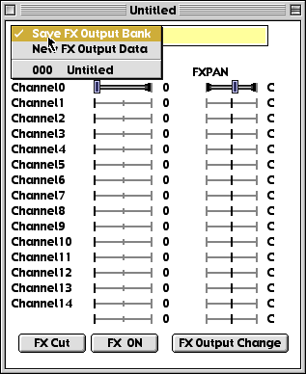
FX Output Mixer
To get a bank of mixers
  You can create several mixer settings (numbered 000 up)
  Click on button at top left
  Use “Save FX Output Bank”
  Results in .FOB file

Slide 37
DSP Summary
Use FX Editor to link modules and download.
    Output .FPD
Use Project Manager to create bank file from .FPD
    Output .FPB (can be used by Audio64)
Use Project Manager to create/edit FX output mixer bank
    Output .FOB (can be used by Audio64)

Slide 38
DSP Extra
GDDA
  comes in on DSP channels 16 and 17

Slide 39
API Overview
Sound Lib 2
Notes:
Somewhat convoluted procedure

Slide 40
Components
Sound System API
Global Sound Control API
Memory Block/Control API
MIDI API
One Shot API
PCM Stream API
GDDA API
Notes:
Sound System
Initialisation etc...
Global Sound
Master Volume, FX Mixer Control
Mem block
Transfer of data to sound memory

Slide 41
Basic Operation
Initialisation (the new easy way)
  Initialise the sound library
    sdLibInit();
  Download the driver
    sdDrvDownloadFromFile();
  Download your .MLT
    sdMultiUnitDownloadFromFile();

Slide 42
Basic Operation
  Allocate your hardware resources among the modules
    sdSysSetSlotMax();
    Sets the maximum number of hardware slots available for each module (excluding GDDA)
  Install the server function into VSync handler
    sdSysServer();
Notes:
MIDI Polyphony (was fixed at 48)
Oneshot FX (was fixed at 8)
Streams (was fixed at 8)
should add up to 64!

Slide 43
Basic Operation
Open port(s) to your module
Send your commands to the port(s)
Close the port(s)
Finishing
  Stop any playing sounds
  Remove server function from VSync
  Shut down sound system
    sdSysFinish();

Slide 44
Oneshot Operation
Open a Oneshot port
  sdShotOpenPort( SDSHOT *handle);
Set any initial parameters for the sound
  use sdShotSetxxxx();
Start the sound
  sdShotPlay( handle, bank_num, data_num, priority )
Notes:
Set any initial parameters for the sound
use sdShotSetxxxx();
Pan, Pitch, Play Time, Release Mode, Volume, FX Select/Level, Direct Level

Slide 45
Oneshot Operation
Make any parameter adjustments
  sdShotSetxxxx() functions again
Can check sound’s play status
  sdShotGetStat(handle,*shotstat);
Stop the sound
  sdShotStop(handle);
Close the port
  sdShotClosePort(handle);
Notes:
Can check sound’s play status
sdShotGetStat(handle,*shotstat);
all parameters, current sample address, flags

Slide 46
MIDI Operation
Open a port
  sdMidiOpenPort(*handle);
For sequence play
  Start a sequence
    sdMidiPlay(handle, bank, sequence, priority);
  Can check the status
    sdMidiGetStat(handle,*midi_stat);
  Stop
    sdMidiStop(handle);

Slide 47
MIDI Operation
For “note by note” control
  Done by sending midi direct to driver
    sdMidiSetMes() sdMidiSendMes()
  Select Sound Voice
    Send Bank & Program Number changes
  Set up initial midi parameters
  Start Sound (Send NOTE ON)

Slide 48
MIDI Operation
  Send dynamic control changes
  Stop sound (Send NOTE OFF)
Can change global parameters per port
  sdMidiSetxxxx();
    Direct&FX Level, Pan, Pitch, Speed, Volume
Close Port
  sdMidiClosePort(SDMIDI handle);

Slide 49
MIDI Messages
Consist of three items
  MIDI Channel
  MIDI Command
  2 Data Items
Control/Program changes affect all sounds on that MIDI channel
  MIDI channel not mapped to hardware slot
Notes:
Consist of three items
MIDI Channel
MIDI Command
2 Data Items
Extended commands use first data item as command extension (e.g. control changes)

Slide 50
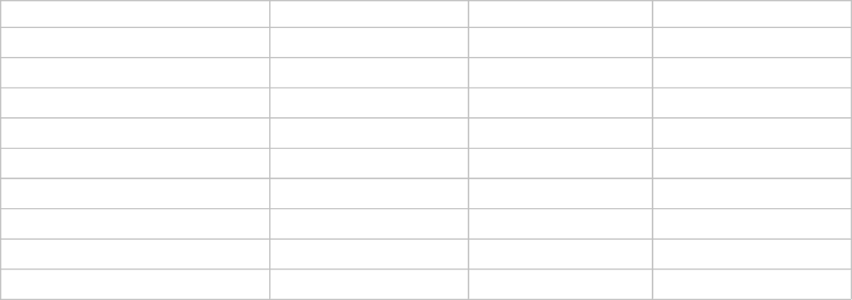
MIDI Messages
Useful MIDI Messages

Slide 51
Streaming
Maximum 16 slots available for streaming
  Examples of configurations
    Sixteen ports, one sound each, total 16 sounds
    Eight ports, two sounds each, total 16 sounds
    Four ports, four sounds each, total 16 sounds
    Four ports with two sounds and two ports with four sounds, total 16 sounds

Slide 52
Streaming
Streaming from memory
  Create a memory block for sample data
    sdMemBlkCreate(handle)
    sdMemBlkSetPrm(handle, source, size, callback, arg)
  Open a port
    sdPstmOpenPort(handle, channels, ringbuf,...)
Notes:
Open a port
sdPstmOpenPort(handle, channels, ringbuf,...)
number of channels
each ring buffer index (in your memory map)

Slide 53
Streaming
  Point the port to your memory blocks
    sdPstmOnMemSetWaveData(handle, channel, block)
  Set any stream parameters
    sdPstmSetxxxxxx()
    volume, pan, FX levels, filter control

Slide 54
Streaming
  Start stream
    sdPstmOnMemPlay( handle, type, freq, transfer_size, loop_flag)
    ADPCM, 8/16bit PCM
    transfer size divisor of ring buffer & 32 byte boundary
  Can change parameters mid-stream
  Stop + Close Port
    remember to destroy memory block

Slide 55
Streaming
Difference when streaming from files
  Set memory block to mid-buffer
  Use sdPstmPlay() instead
  Transfer wave data manually
    sdPstmTransferWaveData(handle, chan, block)
  Poll stream system periodically and transfer/load new data when required
    sdPstmIsTransferWaveData(handle, channel, size, *flg)
Notes:
Difference when streaming from files
Set memory block to mid-buffer
wave data must pass through system memory
Use sdPstmPlay() instead
Transfer wave data manually
sdPstmTransferWaveData(handle, chan, block)
Poll stream system periodically and transfer/load new data when required
sdPstmIsTransferWaveData(handle, channel, size, *flg)

Slide 56
GDDA
Pump up the volume
  sdGddaSetVol(left_vol,right_vol)
Pan the channels
  sdGddaSetPan(left_pan,right_pan)
  Check bootrom STEREO/MONO setting
    if MONO Pan both to centre (0,0)
    if STEREO Pan hard left & right (0x80,0x7f)
Use GDFS to instigate GDDA
  gdFsDaPlay, gdFsDaStop, etc..

Slide 57
DSP
Set the FX program and mixer
  sdSndSetFxPrg( prg_num, out_num )
    prg_num is the FX program within the bank
    out_num is the index of the mixer bank
Realtime adjustments
  sdSndSetFxOutPrm(channel, out_pan, out_lev);
    Current output mixer - change the pan and level of each channel

Slide 58
DSP
Q Sound (Enhanced Stereo effect)
  DSP module has 4/8 inputs, stereo output
  each input has its own position
  Control the position via
    API
      sdQsndSetPos(*pos)
      pos = an array of 4/8 positions
    MIDI
      Command = 0xc0, 0x50, <qsound>
      Controller on channels 1-4/8 specifies which input position to change

Slide 59
Q&(hopefully)A
Notes:
Somewhat convoluted procedure

