Slide 1
Andrew Flavell
Microsoft
Windows®CE for Dreamcast
Direct3D Performance

Slide 2
Talk Overview
Direct3D Goals
Basic Usage
Features on Dreamcast
Performance
Texture Memory

Slide 3
Direct3D Goals
Dreamcast/PC compatibility
Provide maximum performance
  Stay out of the way !
Highlight hardware features
Provide high quality development environment
Provide programmers
maximum freedom
Notes:
Ccompetition among IHVs is a good thing. You benefit.

Slide 4
Direct3D Basic Usage
Create DirectDraw & D3D Objects
Create and load textures
Main Loop
  Clear, and BeginScene
  For each object (mesh):
    Set Render-states (minimize these)
    DrawPrimitive / DrawIndexedPrimitive
  EndScene, and Flip
  Maintain textures
  Perform input & game processing

Slide 5
Direct3D Object Model
DirectDrawEnumerate
CLX2
DDrawCreate
DirectDraw
Surface
DirectDraw
Surface
DirectDraw
Surface
DirectDraw
Object
CreateSurface
QueryInterface
Direct3D
Object
Direct3D
Device
CreateDevice

Slide 6
Create 3D Device & Buffers
Use CreateDevice
  Instead of QueryInterface
  Only HAL GUID defined
  You don’t need to use EnumDevices
    suggested for desktop compatibility
CreateDevice returns a IDirect3DDevice3
Create Front buffer
Create Back buffer
Z buffer - Dummy on Dreamcast. Necessary for compatibility only

Slide 7
Viewports
Great for alternate views
  Multi-player Games
  Rearview mirror
  Map
  Reflection textures
Must be on 32-pixel boundaries
(specific to Dreamcast)
May overlap (these will interact in 3D)
For more general case (non-rectangular) use an off-screen render target (see Portal.exe, RearViewMirror.exe)

Slide 8
Loading Textures
Create system memory texture
Init system memory surface
Create video memory texture
Download texture
Get texture handle (optional)
Use texture

Slide 9
State Control
SetRenderState()
SetLightState()
SetTransform()/MultiplyTransform()
SetTextureStageState()
GetXXX() versions of all of the above
Note: states are persistent between frames

Slide 10
Supported Primitives
3
4
2
4
6
4
6
2
2
5
5
3
5
1
1
3
1
Triangle fan
(Not Recommended)
Triangle strip
Triangle list
2
3
4
2
4
3
5
1
3
1
2
6
1
Line list
Line strip
Point list
Notes:
No hardware support for fans, but still faster than lists.

Slide 11
Direct3D Vertex Types
x
y
z
Nx
Ny
Nz
u
v
D3DVERTEX
D3DLVERTEX
D3DTLVERTEX
x
y
z
RGBA
RGBF
u
v
sx
sy
sz
rhw
RGBA
RGBF
u
v
Flexible Vertex Format (New V2!)
x
y
z
Nx
Ny
Nz
RGBA
u
v
u
v
Strided Vertex Format (New V2!)
x
y
z
Nx
Ny
Nz
u
v
x
y
z
Nx
Ny
Nz
u
v
Notes:
Dragon driver uses D3DTLVERTEX directly.
?Not sure about other formats. ?

Slide 12
Features on Dreamcast
Tile-by-tile, each pixel drawn once
Pixel-accurate translucent sorting
Punch through pass
Modifier Volumes
Bump mapping

Slide 13
Features on Dreamcast
Tri-linear MipMapping & Table fog
Anisotropic Texture Filtering
Hardware clipping to viewport
Strip support
SH4 native matrix operations
Store Queue to bypass cache

Slide 14
Modifier Volumes (New V2!)
Shadow Volumes
  All objects in scene with D3DRENDERSTATE_SHADOWENABLE are darkened when inside an include volume
Complex Modifier Volumes
  Objects inside modifier volume select second set of textures, colors, and alpha value
  Can be used with multi-stage translucent objects
Note – either Shadow OR Complex / Frame

Slide 15
D3D Performance
Refer to Optimal.exe sample
Transformation best done by D3D
Some lighting best done by D3D
Recommend indexed triangle lists

Slide 16
Avoid these:
Unnecessary clip tests
Vertex fog (use table fog)
Small meshes / frequent state changes
Multiple large layers of translucency
Complex lighting of entire scenes
Pre-transforming vertices
D3DRENDERSTATE_WRAPU (or V)
Vertex pools not aligned to 32-bytes
Non-indexed lists

Slide 17
Indexed List Optimizer
Re-orders index lists in place
Use list optimizer at author time
D3D Driver detects special-case
Faster for CPU
Smaller in Command Buffer (33%,50%,66%)
Index List:
(2,0,1),(4,2,3),(5,6,7),(2,1,3),(8,7,6)
(0,1,2),(1,3,2),(2,3,4),(5,6,7),(6,8,7)
1
3
0
2
4
Vertices in Command Buffer:
2,0,1’,4,2,3’,5,6,7’,2,1,3’,8,7,6’
0,1,2,3,4’,5,6,7,8’ (40% smaller)
5
6
7
8

Slide 18
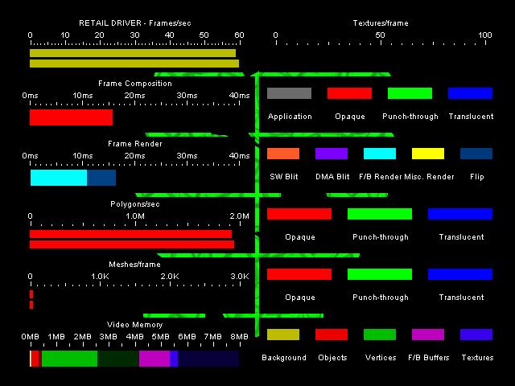
Performance Monitor (Improved V2!)

Slide 19
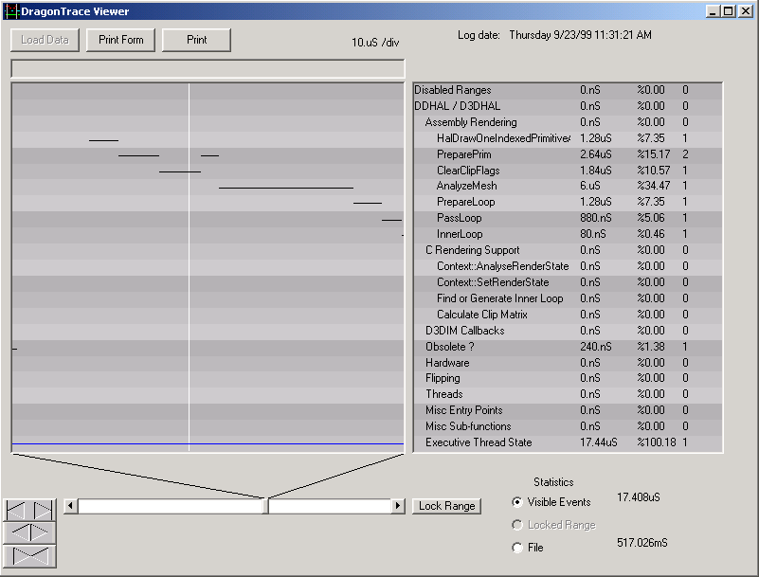
DTrace Profiler / Analyzer (New V2!)

Slide 20
Texture/Surface
Storage Flags
Video memory / System memory
Twiddled
MipMap
Texture
VQ-compressed

Slide 21
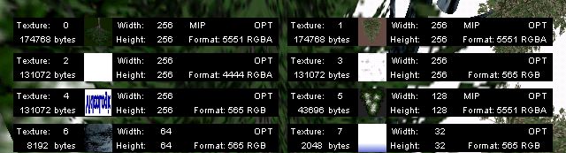
Texture Detail Monitor (New V2!)
Shows texture format & dimensions
Scrollable for large # of textures
Displays video memory usage

Slide 22
Texture/Surface
Pixel Formats
RGBA5551
RGBA5650
RGBA4444
YUV422
YUV420 (stored as 422)
Bump map
8bpp Palettized
4bpp Palettized

Slide 23
Palette Storage
Create and associate palettes and surfaces
Up to 1024 simultaneous entries in palette per scene
e.g:
4 x 256-entry palette
64 x 16-entry palette
2 x 256-entry + 32 x 16-entry palettes
Automatically loaded/unloaded as used

Slide 24
VQ Textures
RGBA0
RGBA1
RGBA2
RGBA3
256-entry
2K Byte
Codebook
RGBA0
RGBA1
RGBA2
RGBA3
RGBA0
RGBA1
RGBA2
RGBA3
One Byte
0
2
1
3
Texture Data
8:1 compressed + 2KB overhead
Compressed at author time
Can compress 16bpp twiddled format

Slide 25
Bump Map
Non-standard D3D
Can achieve excellent results for minimal video memory
May use D3D(T)LVERTEX, or
D3DLIGHTSTATE_BUMPINTENSITY and
D3DLIGHTSTATE_BUMPDIRECTION
Render as multi-stage e.g using bump-map for stage #1 and texture map for stage #2
Can be used with translucent or opaque (see bumpmapping.exe)

Slide 26
Demonstrations
& Questions

