Slide 1
Windows®CE for Dreamcast
Networking
Andrew Flavell
Microsoft

Slide 2
Overview
Networking architecture
HTML Control
DirectPlay
WinSock
RAS

Slide 3
Networking Architecture
Desktop OS
WinCE for DC
WinSock
WinSock
TDI
TCP/IP
TCP/IP
PPP
PPP
TAPI
Modem Driver
Unimodem
Serial Driver
Serial Driver

Slide 4
Networking with WinCE
WinCE for Dreamcast Applications
HTML Control
DirectPlay
WinInet
WinSock
TCP/IP
RAS
PPP
Modem Driver
Serial Driver

Slide 5
HTML Control (new for V2!)
IE 4.0 web browser as a control
No JavaVM or VBScript
Examples:
  Internet Lobby Clients
  Web enhanced games
  HTML help files

Slide 6
Using HTML Control
Web content stored using VMU File System
  Examples: HTML, GIF, game characters, sound files
Memory Management with HTML Components
  Dynamically load/unload HTML control
  OS must be configured to support HTML control
Notes:
Memory management with HTML Components
A game may dynamically load and unload the HTML comp as needed.
OS Image must be configured to use the HTML control. (Easily done with the Config Tool)

Slide 7
Game Lobby Client using the HTML Contol
Dynamically load the HTML Control
Connect to the Network Game Lobby Server Website
Join a network game
Dynamically unload the HTML control
Start the game
Notes:
API support for…. Concern is that the .dlls are not very explanatory of what features are supported….

Slide 8
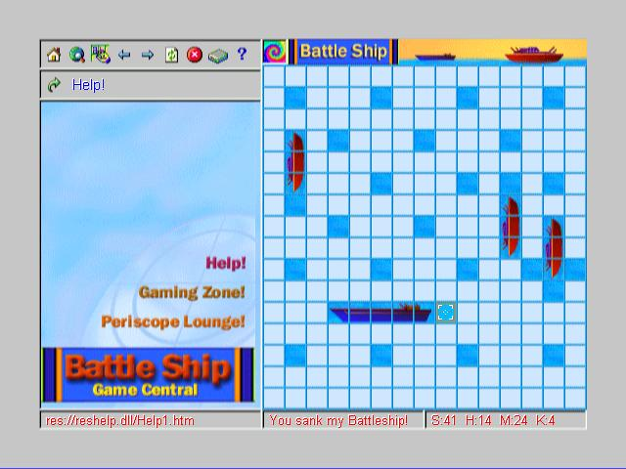
Games and Web browsing
Notes:
I would expect that this slide would show an example of how to add web browsing to a game. The screen capture should be more clear with obvious web content on the left and game content on the right. The url dialog is blocking and doesn’t look that good. MOVE TO THE END

Slide 9
DirectPlay on Dreamcast
Desktop DirectPlay 6.0 compatible
No IPX support
No Secure connection support

Slide 10
DirectPlay on Dreamcast Cont’d
TCP/IP Service Provider
  Internet peer-to-peer
Modem Service Provider
  Point-to-point over phone line
Serial Service Provider
  Point-to-point over serial line
Network Server Service Provider

Slide 11
WinInet
Updated for V2.0 to support HTML control
All features to support IE 4.0
Similar to desktop except:
  InternetReadFile and InternetQueryDataAvailable are the only functions that support async on Dreamcast.
  Windows CE on Dreamcast uses Unicode but WinInet functions do not necessarily return only Unicode.

Slide 12
WinSock on WinCE for DC
A subset of WinSock 1.1
Non-blocking I/O added for V2.0
No Microsoft extensions are supported except limited error handling
  Most can be implemented with supported APIs
Name resolution through DNS
Secure connection is supported

Slide 13
RAS Support
Subset of NT 4.0 RAS
RAS entries are stored in Registry
  Only the necessary fields are stored to save space
  RAS entry created at boot time by copying Network provider info from flash
Support for multiple phone numbers

Slide 14
Demonstrations
& Questions

