Slide 1

Windows CE for Dreamcast Overview
John Smith
Consumer Console Evangelist
Microsoft

Slide 2
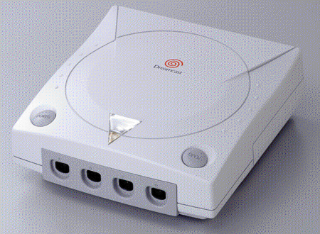

What is WindowsCE for Dreamcast
Optimized OS for Dreamcast
Win32 and DirectX based
Internet enabled
Visual Dev Studio
Royalty Free!
Notes:
Optimized OS for Dreamcast – light weight, SH4 specific optimizations, componentized
Win32 API compatible
No fees for use

Slide 3
Small, Fast,Flexible
Small
  Only APIs required for Games
  No GUI, No MFC
Fast
  Uses SH4 assembly for critical loops
  Uses SH4 and Dreamcast specific features
Flexible
  Componentized architecture enables custom configurations
Notes:
Flexible meaning you only load the modules you need.

Slide 4


Architectural
Comparison
Game
Game
DirectX
DirectX
Windows
HAL
Win CE
PC Hardware
Dreamcast HW

Slide 5
Windows API
Compatibility
Win32® programming model
  Familiar .exe/.dll files, processes, threads
Support for most of the popular Win32 APIs
Applications built with Visual Studio IDE
  Large base of programmers know how to write Windows CE applications already

Slide 6
Application Model
Single Game
DirectX Full-Screen Exclusive
Game provides ALL UI
  No visible windows/controls support
Game developer chooses components
  Many of the components are optional
  Developer are free to mix and match optional components
Notes:
Single Game – OS Distributed on game CD (avoids versioning issues)

Slide 7
Loading of Executables
Executables (.exe & .dll) completely loaded into RAM
  DLLs loaded implicitly or explicitly
Paging
  No paging of .exe and .dll from GD
  Paging support for memory mapped files

Slide 8
TCP/IP & DPLAY
Lightweight TCP/IP protocol stack
TCP/IP support
  Support through Winsock and RAS APIs
  Compliant with Winsock 1.1 spec
Modem support through the Win32 serial communications API

Slide 9
Tools Components
Visual C++ 6.0
  VC design environment: provides host for integrated SH4 compiler, linker, and remote debugging support
Windows CE Toolkit for Visual C++
  Provides SH4-specific tool set
WinCE SDK for Dreamcast
  Provides libs, headers, runtimes, samples & docs for building Dreamcast games

Slide 10
SH4 Compiler Features
Extensive experience with SHx family on Windows CE
Integrated as package with Visual C++ IDE
Optimized
  Exploits SH4 features (e.g., dual instruction pipeline, floating point)
  Intrinsics to take advantage of graphics optimizations

Slide 11
Debugging Support
Integrated Visual C++ debugger for applications
  Supports remote debugging of Dreamcast
Debug APIs exposed to support 3rd party tools

Slide 12
What Is New In 2.0
DirectX 6.1 (+)
Improved tools
⬆ 3D Performance
SCSI transfer speed ⬆ 14x
2200 more pages of docs
New & Better samples
Feature Pack 1 & 2 Available
  24bpp, 60Hz PAL, Stretched PAL
Notes:
DX6.1 + means extensions were added to take advantage of non standard features
Improved tools – more robust, & better integrated
3D Performance – varying results depending on ISVs. We’ve seen increases 50%+ over 1.1
SCSI transfer speed 14x faster than 1.0

Slide 13
DirectX Components
DirectDraw
Direct3D Immediate Mode
DirectInput
DirectSound
DirectSound3D
DirectPlay
DirectShow
DirectMusic

Slide 14
Direct 3D
Custom implementation optimized for SH4 & PowerVR
DX6 adds - flexible vertex format, multi texturing
Specifically supports modifier volumes, punch through and bump mapping

Slide 15
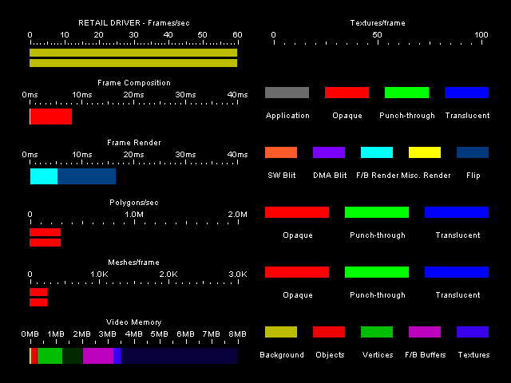
Tools
Notes:
Real Time Perf – learn to use this – very powerful. Easily brought up in dctools
Dtrace – very good for final performance tuning – can expose things you wouldn’t normally catch
View application performance in real time
View the size of various buffers allocated within video memory
View textures currently loaded into video memory

Slide 16
HTML Control
Simultaneous running of a 3-D game and browser!
IE 4.0 HTML control
UL/DL to VMU flash device
Create custom HTML containers
Sample browser provided

Slide 17
DMusic
Full DX7 DMusic API support
Supports DLS & MIDI
Same authoring tool as PC

Slide 18
Where to get it
CD - Contact Sega DTS
Support @ edts@soe.sega.co.uk
Active on Elite mailing list
Questions?
johnsmit@microsoft.com
wce4dc@microsoft.com
Notes:
Today we’re providing you with the final release RC2. Final CD will include both English and Japanese.

