Slide 1
The Mysterious VMU
By Alexander Villagran
villagra@sega.com

Slide 2
The Mysterious VMU
Overview
What is the VMU?
VMU use when connected to the Sega Dreamcast
VMU as a stand alone game system
Q & A

Slide 3
What is the VMU?
Name (US and Japanese name differences)
  Japanese unit is called Visual Memory System (VMS)
  US unit is called Visual Memory Unit (VMU)
  VMS name owned by Digital Equipment Corporation

Slide 4
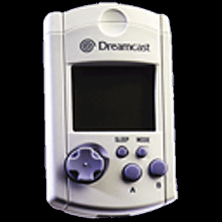
What is the VMU?
Specifications
  Display Size
    48 by 32 Pixels
  Speaker
  Controls
    Joystick & 4 buttons
  Battery
    2 CR 2032’s
    Life ~ 130 Days

Slide 5
VMU use when connected to the Sega Dreamcast
Usage under Shinobi and Windows CE
  Memory Card
  Additional Game Screen
  Sound Capabilities

Slide 6
VMU Connected to Sega Dreamcast
Usage under Shinobi
Shinobi treats VMU as one device with multiple functions
Accessed using the following maple interface headers
  sg_bup.h
  sg_lcd.h
  sg_pdtmr.h

Slide 7
VMU Connected to Sega Dreamcast
Usage under Windows CE
Windows CE treats VMU as three separate non-input devices
Accessed using maple interfaces
  ILcd
  IFlashDevice
  IFlashFile
  ITmr

Slide 8
VMU Connected to Sega Dreamcast
Memory Card
Capacity
  Currently 200 Blocks
    512 bytes per block
3 File Types
  Save game file
  Stand alone game executable
  Icon File

Slide 9
VMU Connected to Sega Dreamcast
Usage under Shinobi sg_bup.h
Allows you to format the device, find files, query for file info, query for number of free blocks, and load, save and delete files.
  buInit
  buExit
  buAnalyzeBackupFileImage
  buMakeBackupFileImage
  buCalcBackupFileSize
  buFormatDisk
  buDefragDisk
  buMountDisk
  buUnmount
  buFindExecFile
  buFindFirstFile
  buFindNextFile
  buGetDiskInfo
  buGetDiskFree
  buIsReady
  buGetFileInfo
  buGetFileSize
  buIsExistFile
  buIsFormat
  buLoadFile
  buLoadFileEx
  buSaveFile
  buSaveExecFile
  buDeleteFile
  buSetFileAttr
  buGetLastError
  buStat
  buSetProcessCallback
  buSetCompleteCallback

Slide 10
VMU Connected to Sega Dreamcast
Usage under Windows CE IFlashDevice
Allows you to format the device, enumerate files, query for block size and number of free blocks, and create and open files.
  CheckFormat
  CreateFlashFile
  DoFormat
  EnumFlashFiles
  Flush
  GetDeviceDesc
  OpenFlashFile
  OpenFlashFileByName
  SetVolumeIcon

Slide 11
VMU Connected to Sega Dreamcast
Usage under Windows CE IFlashFile
Allows you to read from, write to, and delete a file, and to retrieve information about the file.
  Delete
  Flush
  GetFileDesc
  Read
  Write

Slide 12
VMU Connected to Sega Dreamcast
Additional Game Screen
Sega Standards
  Game Logo
  Display Load/Save Status
Orientation of the Display
Data Structure of the Display
Refresh Rate

Slide 13
VMU Connected to Sega Dreamcast - Additional Game Screen
Sega Standards
15. Backup
  15.1 Save File
  15.1.1 Save File Name
  15.1.2 VMU Comments
  15.1.3 Boot ROM Comments
  15.1.4 Sorting Rules
  15.1.5 Save File Icon
  15.1.6 Visual Comments
  15.1.7 File Size
  15.1.8 VMS Volume Icon
  15.2.3 A single VMU should be used when only data like high scores and key configurations are to be saved, or when a VMU selection screen is not provided because it does not suit the character of the game.
  15.3 Memory Card (Visual Memory) Initialization
  15.9 VM (Visual Memory) Displays
  15.11 Visual Memory Single Application Files
26. VM (Visual Memory) Illustration
  In illustrating Visual Memory, does it appear as it would appear when placed in front of the user?

Slide 14
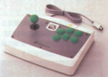
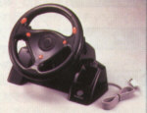
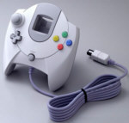
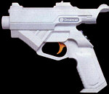
VMU Connected to Sega Dreamcast - Additional Game Screen Orientation of the
VMU LCD Display
Display is upside down
Display is same as in stand alone mode

Slide 15
VMU Connected to Sega Dreamcast - Additional Game Screen
Data Structure of the Display
Shinobi
Array of unsigned chars
  0x00 = pixel off
  0x80 = pixel on
Draw to screen like 256 color image
const unsigned char _splash[(48*32)] = {
0x00,0x08,0x08,0x08,
0x00,0x00,0x08,0x00,
.
.
.
0x00,0x08,0x08,0x08,
0x00,0x00,0x08,0x00,
};

Slide 16
VMU Connected to Sega Dreamcast - Additional Game Screen
Usage under Shinobi sg_lcd.h
Retrieves information about a LCD and sends images to it
  pdLcdGetDirection
  pdVmsLcdIsReady
  pdVmsLcdWrite

Slide 17
VMU Connected to Sega Dreamcast - Additional Game Screen Data Structure of the Display
Windows CE
Data is stored as 1 bit graphic
  Graphic is linear
  Bit 7 is leftmost pixel
  Bit 0 is rightmost pixel
const unsigned char _splash[((48/8)*32)] = {
0x55, 0x55, 0x55, 0x55, 0x55, 0x55,
0xAA, 0xAA, 0xAA, 0xAA, 0xAA, 0xAA,
.
.
.
0xAA, 0xAA, 0xAA, 0xAA, 0xAA, 0xAA,
0x55, 0x55, 0x55, 0x55, 0x55, 0x55,
};

Slide 18
VMU Connected to Sega Dreamcast - Additional Game Screen Usage under Windows CE ILcd
Retrieves information about a LCD and sends images to it
  IsStandardLcd
  GetLcdInfo
  GetLcdBuffer
  FreeLcdBuffer
  SendLcdBuffer
  SetLcdContrast

Slide 19
VMU Connected to Sega Dreamcast - Additional Game Screen Refresh Rate
LCD is always “On”
Maximum Maple Rate
  60 Frames per second (fps)
  Interferes with other Maple calls
Best viewable Rate
  15 fps - LCD Latency

Slide 20
VMU Connected to Sega Dreamcast
Sound Capabilities
VMU Hardware Specifications
  Various clocks
    Sounds designed for 32.768 kHz Rate
  Timer 1
How tone generator works
  Duration is handled manually

Slide 21
VMU Connected to Sega Dreamcast
Usage under Shinobi sg_pdtmr.h
This interface sends data to and retrieves information from a Sega Visual Memory timer
  pdTmrIsReady
  pdTmrSetTime
  pdTmrGetTime
  pdTmrAlarm

Slide 22
VMU Connected to Sega Dreamcast
Usage under Windows CE ITmr
This interface sends data to and retrieves information from a Sega Visual Memory timer
  TmrGetDeviceInfo
  TmrSetTime
  TmrGetTime
  TmrSoundAlarm

Slide 23
VMU as a stand alone game system
Hardware Specifications
LC86K Instruction Set
Programming Information
Compiling Code
Debugging Code
Downloading to a VMU

Slide 24

VMU as a Stand Alone Game System
VMU Hardware Specifications
Taken from vm_hardware documentation

Slide 25
VMU as a Stand Alone Game System
VMU Instruction Set
Arithmetic Operations
  ADD,ADDC,SUB,SUBC,INC,DEC,MUL,DIV
Boolean Operations
  AND,OR,XOR,ROL,ROLC,ROR,RORC
Data Transfer
  LD,ST,MOV,LDC,PUSH,POP,XCH
Jump Instructions
  JMP,JMPF,BR,BRF
Conditional Branching
  BZ,BNZ,BP,BPC,BN,DBNZ,BE,BNE
Subroutine Instructions
  CALL,CALLF,CALLR,RET,RETI
Bit Manipulation
  CLR1,SET1,NOT1
Others
  NOP, CHANGE

Slide 26
VMU as a Stand Alone Game System
VMU Programming Information
All Registers are in RAM
Reading Flash Memory
Program layout
  ghead.asm
  ifork.asm
LCD Memory layout

Slide 27
VMU as a Stand Alone Game System Compiling VMU Code
Use VMU tools supplied in \Katana\Utl\Dev\VMUTool\Dev
For complete information review vm_programmers document

Slide 28
VMU as a Stand Alone Game System Debugging VMU Code
Use VMU Simulator
  For more information review vm_simulator document
Allows for break points, watch points, memory dumps, and various other functions
Speed is not accurate
Audio is not correctly simulated

Slide 29
VMU as a Stand Alone Game System Downloading to a VMU
Hardware Required
  Set 5
  9 Pin Female to Female Serial Cable
  9 Pin Null Modem Connector
Software Required
  mem_util.elf run on the Set 5 (v 0.64.1)
  PC Terminal Program
    Recommend QmodemPro V2.1 from Mustang Software , Inc. www.mustang.com

Slide 30
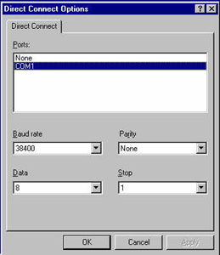
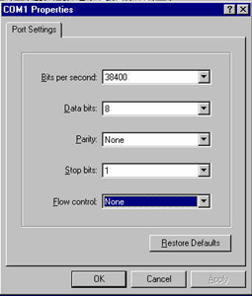
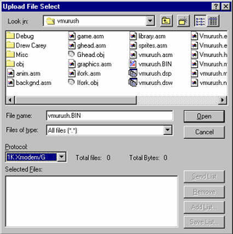
VMU as a Stand Alone Game System Downloading to a VMU
Prepare to send the data from the PC

Slide 31
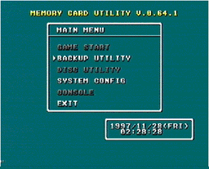
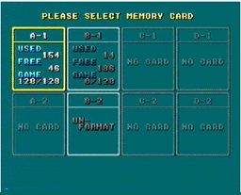
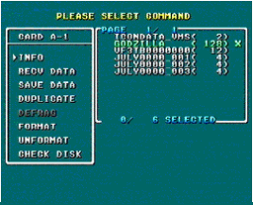
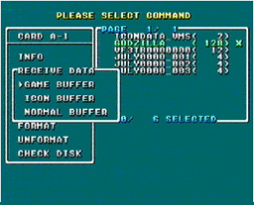
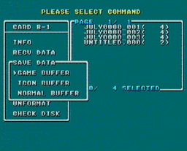
VMU as a Stand Alone Game System Downloading to a VMU
Transfer data from PC to Set 5

Slide 32
Questions & Answers
If you have any questions, feel free to send mail to me at:
VillagrA@sega.com

