Slide 1
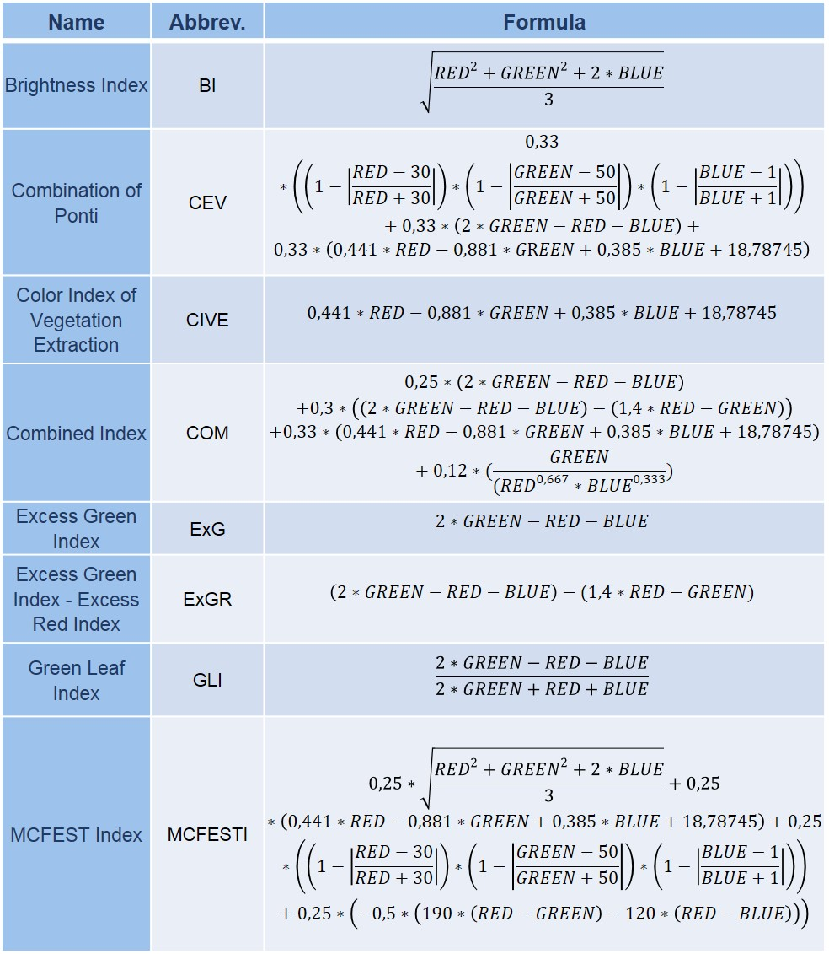
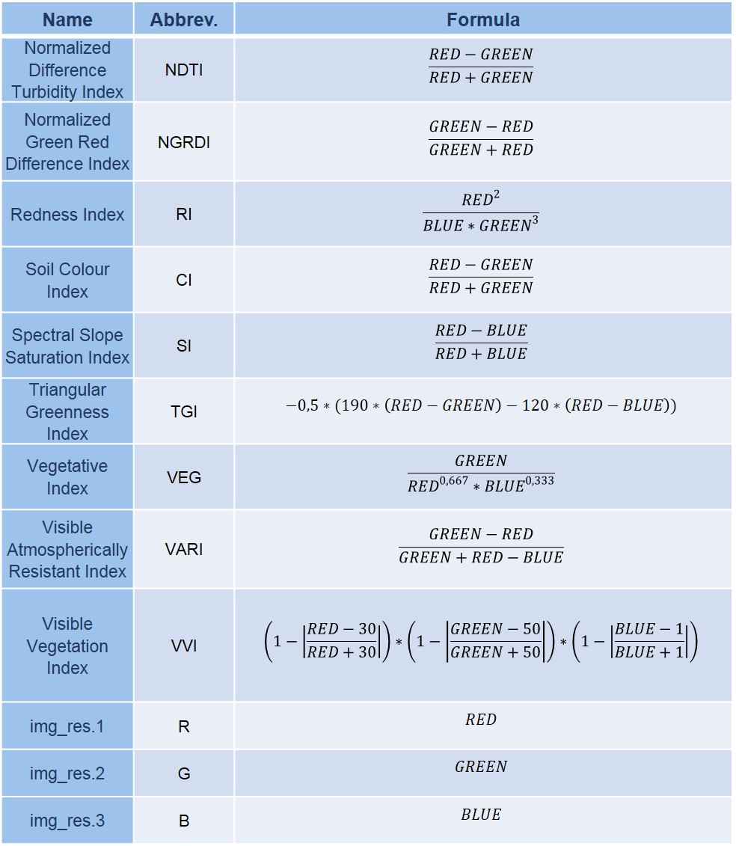
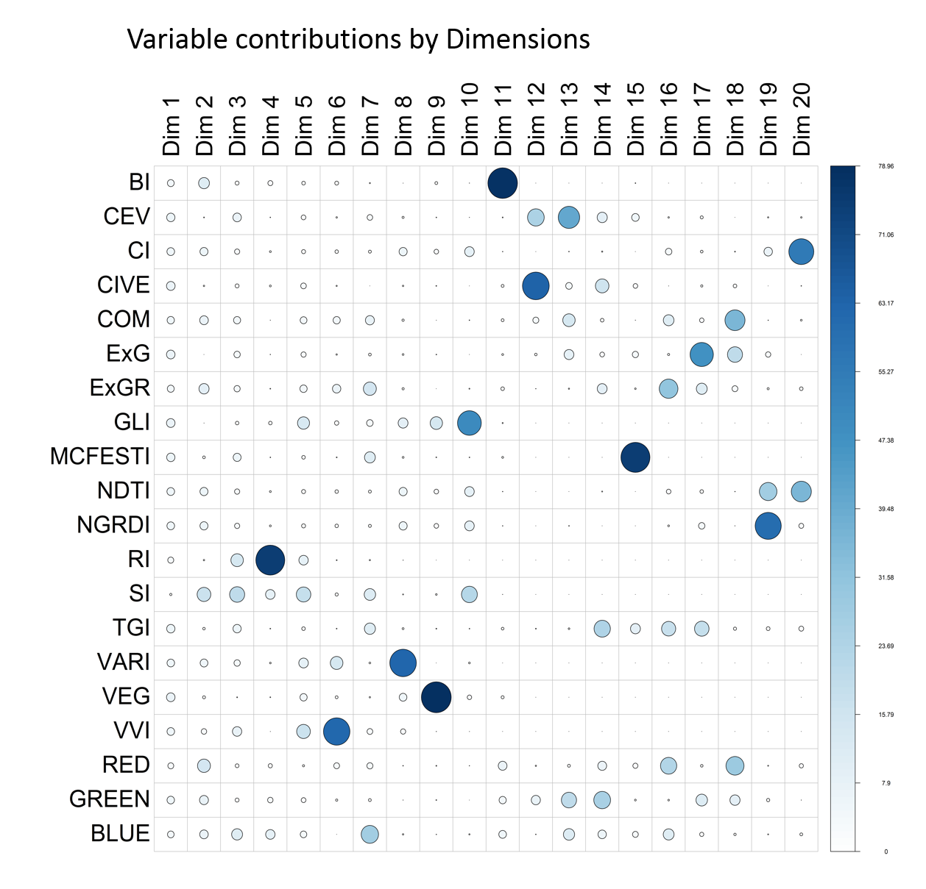
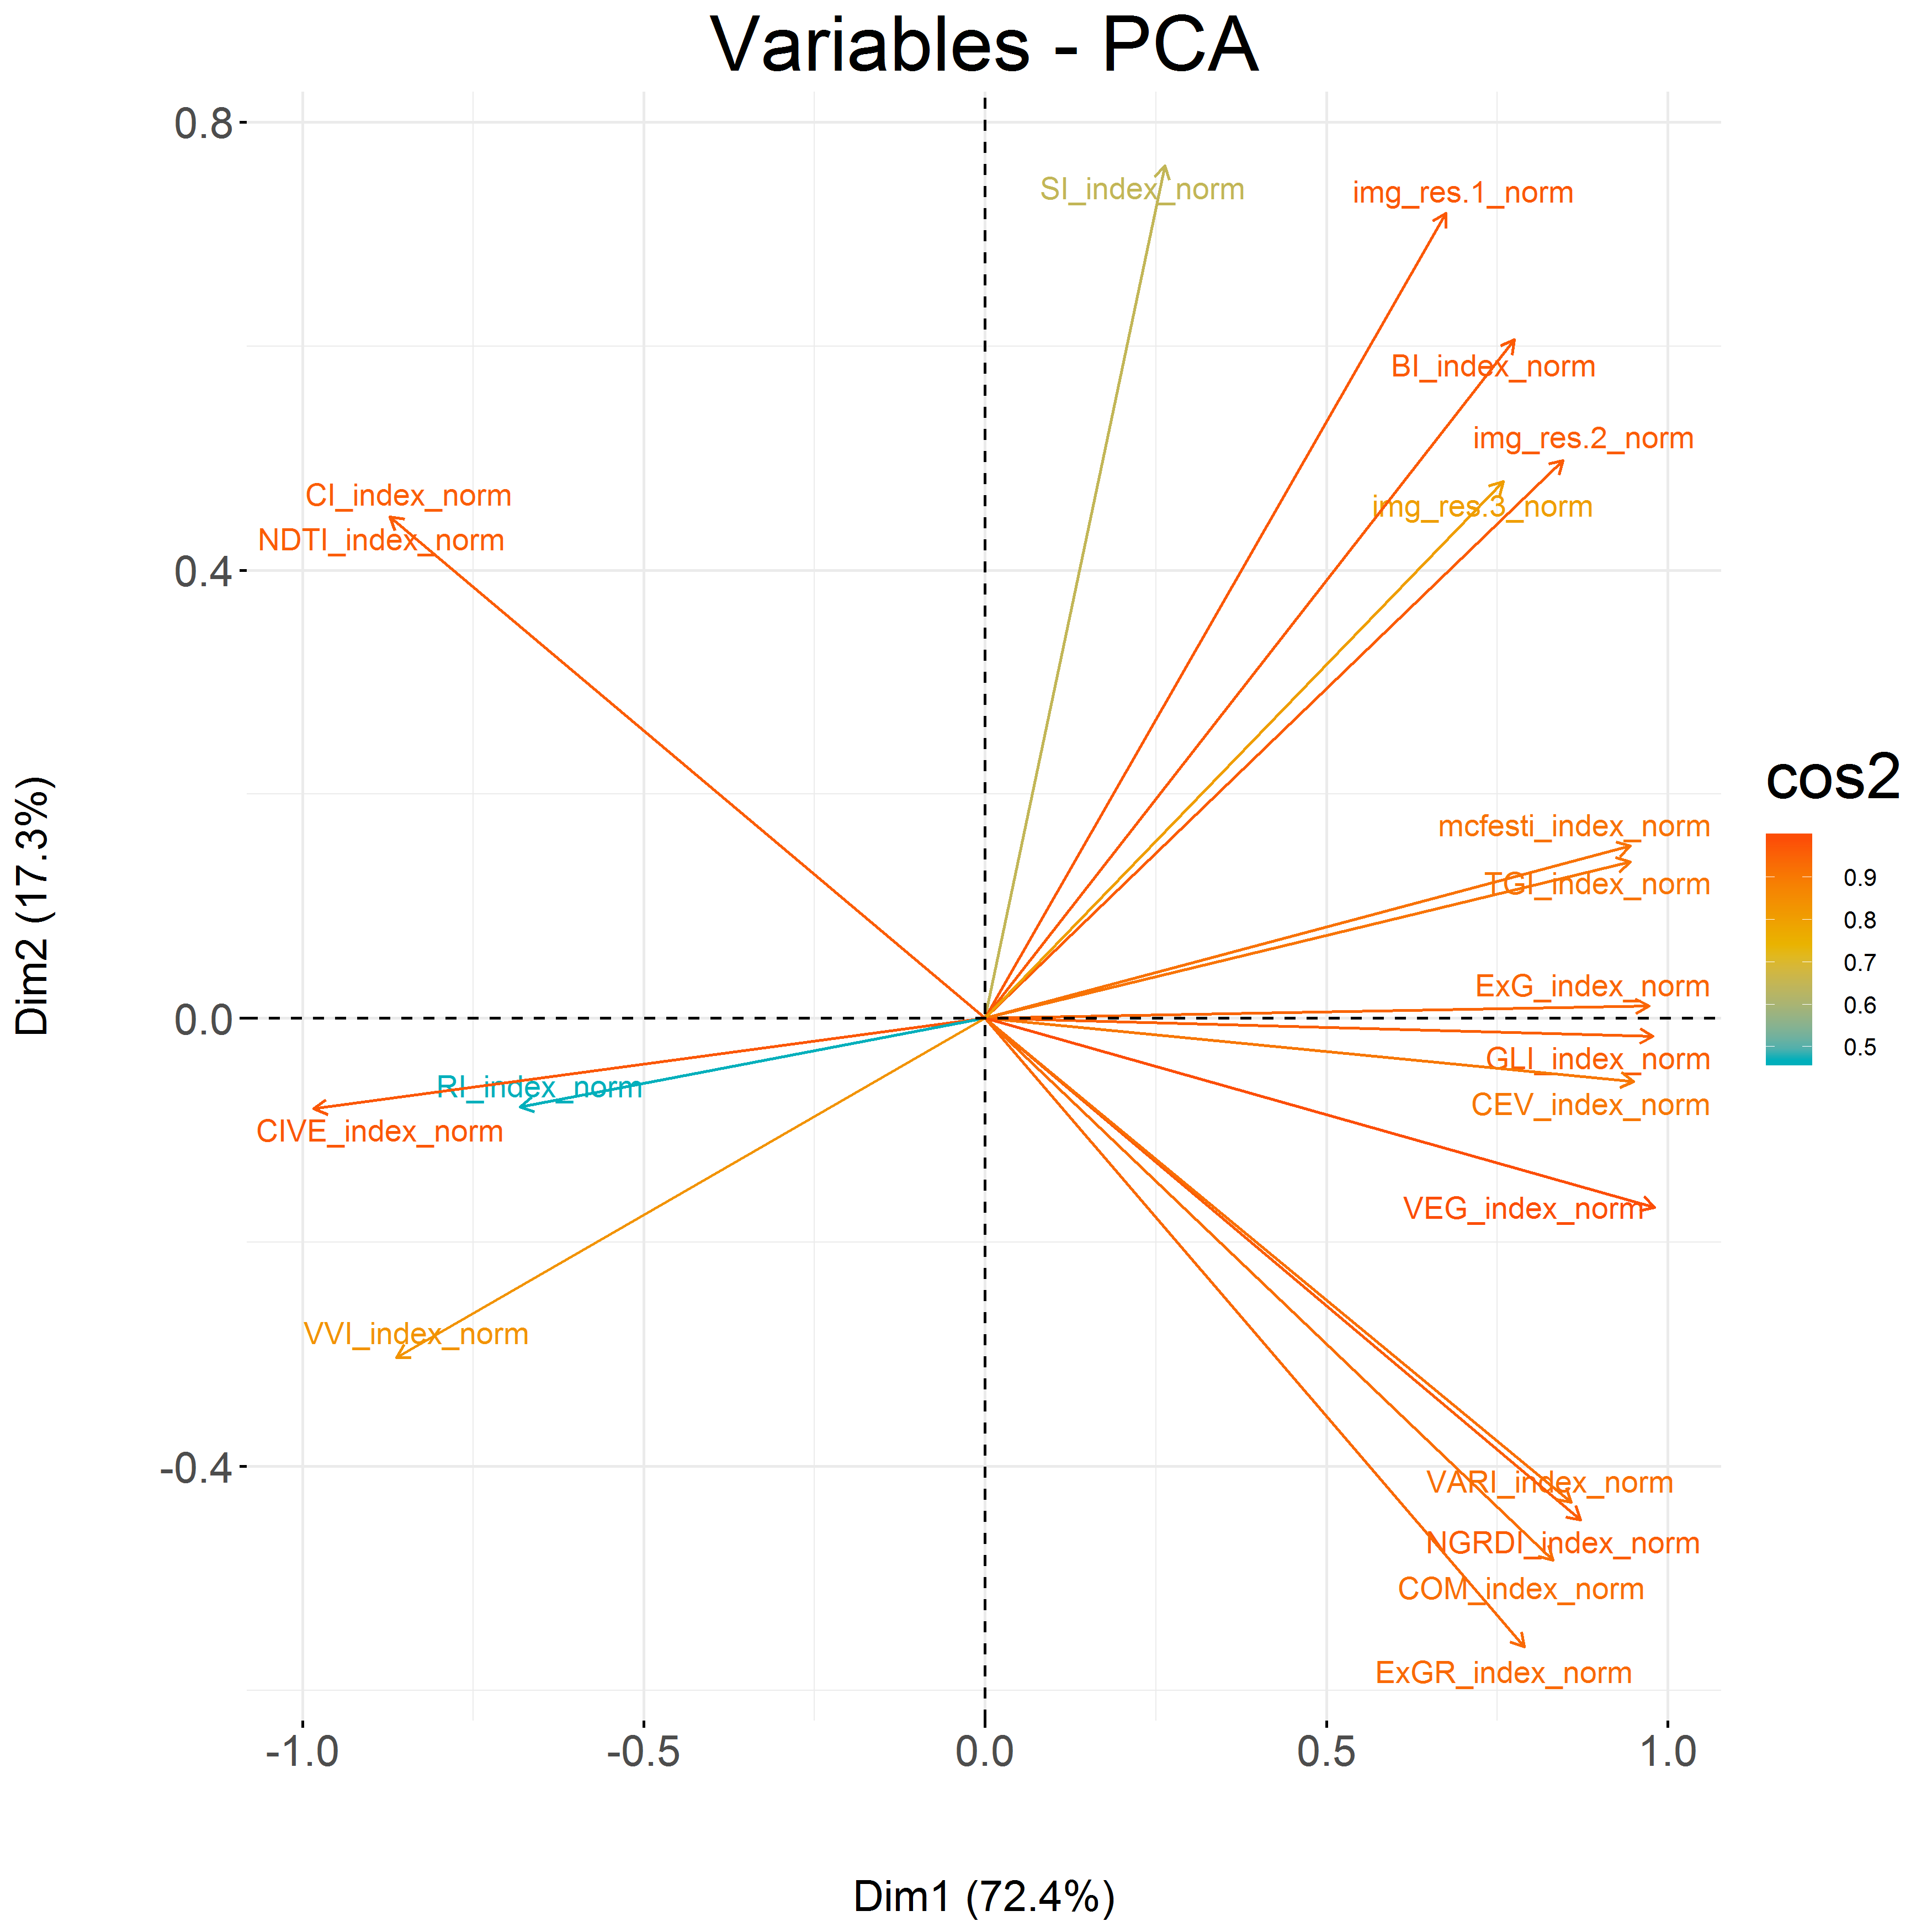
Project I
Names: Sarah Brüning, Tobias Koch, Marvin Müsgen, Eike Schott, Frauke von den Driesch
Umweltinformatik | Philipps-Universität Marburg
Background
The study area is located in the forest of Marburg University which is located southeast of Caldern in the west of Marburg. During the process the Marburg Open Forest will be established as an area for open research and education in the research field of environmental observation. Conservation of nature requires a detailed observation and assessment of landscape. This marks the starting point of the LOEWE Nature 4.0 project. With the combination of powerful data integration and data
analysis methods it builds a modular environmental monitoring system for the high-resolution observation of conservation-relevant species, habitats and processes. The research includes the work of scientists from several disciplines in order to achieve not only a more effective monitoring but also to develop early warning indicators. While the final objective of Nature 4.0 is to develop a sustainable biodiversity protection and securing ecosystem functions the primary focus of this project is to
build a comprehensive remote sensing dataset. First of all, the following project work provides information on spectral and structural properties as well as spatial patterns for the study area using multi-channel aerial datasets. Afterwards, the results will be used for further research of a comprehensive image collection for tree delineation, species prediction and heterogeneity mapping.
Methods
The provided RGB image was clipped to the extend of the Marburg Open Forest area. To match the spatial resolution of the LIDAR data the RGB image was resampled to a spatial resolution of .5 meter. Ein bis zwei sätze zu metadaten. The spectral channels (red, green and blue) were extracted in order to calculate sixteen indices as shown in table 1. As they provide additional information on spectral properties it’s on the principal components analysis (PCA) to reduce the amount of variables while preserving a large portion of information (Jolliffe, 2002).
RGB Indices
Mean filter
5x5
15x15
21x21
31x31
Sobel filter
5x5
15x15
21x21
31x31
Gauss filter
5x5
15x15
21x21
31x31
Laplacian of Gaussian filter
5x5
15x15
21x21
31x31
PCA
Filter
Applied filters
Results
Conclusion and outlook
The finalized product is a raster stack containing the first and second component of the principal component analysis. Which combined explain 89.8% of the variation in the data. Additionally all sixteen filters were applied to both components. Furthermore all sixteen indices as well as the three RGB channels are also included. In order to save computing resources the filters were not applied to every RGB index. This leaves us with a total of 53 single raster layers.
This project provides a comprehensive dataset consisting of spectral and structural properties. This was done by calculating several RGB indices, perform a principal components analysis, and apply numerous structural filters on the first and second component of the PCA.
For further projects such as the prediction of tree species and analysis of forest structures and tree competition this dataset will be essential.
Discussion
It’s up for discussion, if it’s necessary to include the already in the PCA processed indices. On one hand this approach hits harder on processing time and computing resources. Also the PCA already includes partially all sixteen indices. One the other hand the loss of information is minimized by including the original indices. Considering future goals of this project saving information has a higher priority than keeping processing time as short as possible.
Literature
Jolliffe, I. T.: Principal Component Analysis, Sprigner, 2002

