Slide 1
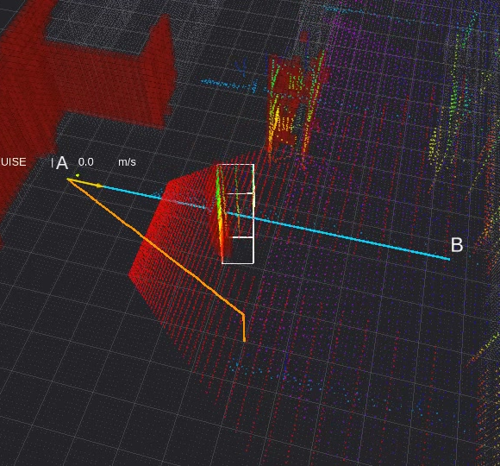
Assignment 2
FLYING ROBOTIC SYSTEMS · LRS-URK
Pick one topic: obstacle avoidance, drone localisation or find-and-follow.
10 points · tell us your topic in week 7 · deadline Fri 11 Dec 2026
Eduard Zelenay (D612) · Maroš Kocúr (D612 | D613)
Notes:
Assignment 2 in one sentence: one focused capability added to the node you already built for Assignment 1. Three topics, you pick one, 10 points, deadline end of week 12. The demo videos later in this deck are recorded in Gazebo with our own reference solutions.

Slide 2
Six weeks from topic choice to defence
ORGANISATION · DEADLINES
W1
21 Sep
W2
28 Sep
W3
5 Oct
W4
12 Oct
W5
19 Oct
W6
26 Oct
W7
2 Nov
W8
9 Nov
W9
16 Nov
W10
23 Nov
W11
30 Nov
W12
7 Dec
Assignment 1 · defended in week 6
Pick
Build Assignment 2 · consultations
Due
Lecture test · date announced in advance
WEEK 7 · 2–6 NOV
WEEKS 8–11 · 9 NOV – 4 DEC
WEEK 12 · FRI 11 DEC 2026
Tell your exercise teacher which topic you picked.
Build it. Bring questions to the exercises.
Push, send the commit hash on Teams, defend.
Switching later is possible. The deadline does not move.
Teams, exercise, or consultation hours in AIS.
Every started week late costs 10 % of the points you earned.
LRS-URK · Assignment 2
Notes:
Dates assume the semester started on Monday 21 September 2026. Week 6 is now: Assignment 1 defences and this presentation. Week 7: students tell their exercise teacher which topic they picked. Weeks 8 to 11: work and consultations; the lecture test is written somewhere in this window, the lecturer announces the date. Week 12: deadline at the end of the week, Friday 11 December, defence during the last exercise. The commit timestamp is what counts. Late penalty: every started week after the deadline costs 10 % of the points earned, applied before the 56 % threshold is checked.

Slide 3
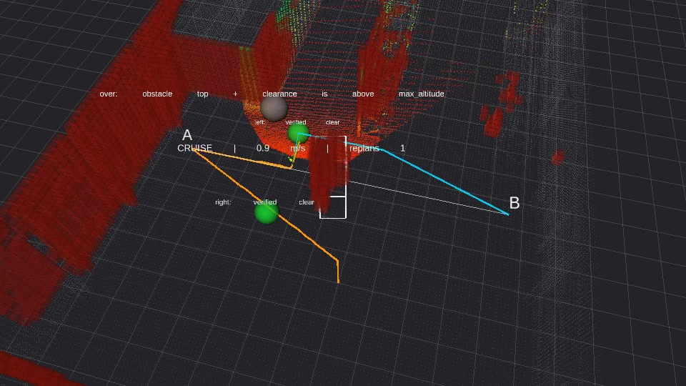
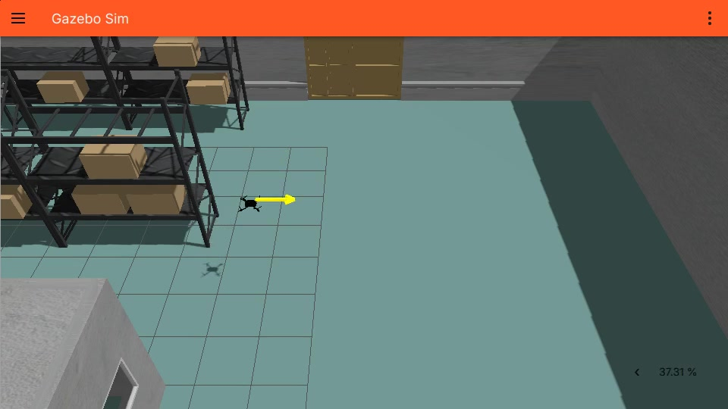
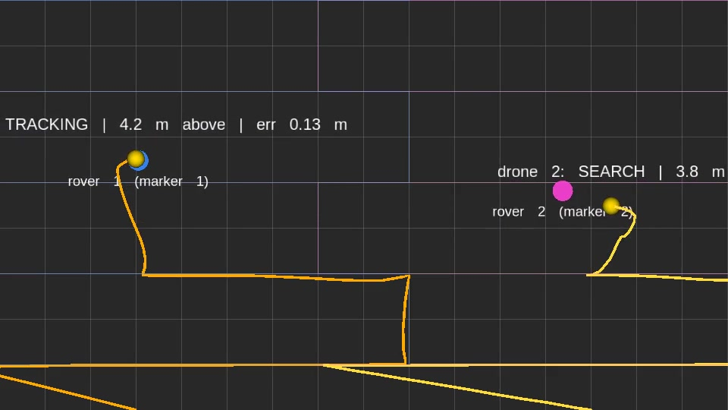
Three topics, you build exactly one
THE TOPICS
Obstacle avoidance
Drone localisation
Find-and-follow
See an unknown obstacle in the depth camera’s point cloud and fly around or over it on the way from A to B.
Fuse noisy GPS, drifting VO and a biased gyro in your own Kalman filter, then fly on it.
Two drones, each searching for its own ArUco-marked rover and following it as it moves.
New: perception + replanning
New: state estimation
New: multi-vehicle + vision
LRS-URK · Assignment 2
Notes:
All three are worth the same 10 points and all three extend the control node from Assignment 1: same node, same MAVROS setpoints, same position controller. Assignment 2 is deliberately smaller than Assignment 1. Only the topic you pick is scored; doing a second one earns nothing extra.

Slide 4
What each topic runs on
THE TOPICS
 | Obstacle avoidance | Drone localisation | Find-and-follow
World | fei_lrs_gazebo_depth | fei_lrs_gazebo_localization | fei_lrs_precision_landing
Vehicles | 1 drone | 1 drone | 2 drones + 2 rovers
Bring-up | 1 × SITL, 1 × MAVROS, ros_gz_bridge | 1 × SITL, 1 × MAVROS, localization_sensor_sim | 2 × SITL, 2 × MAVROS in namespaces, ros_gz_bridge, randomize_rovers.py
New input | depth-camera point cloud | GPS, VO and gyro on /localization/* | two down cameras
Load on your PC | heaviest: 800 × 800 RGB-D at 30 Hz, ~15 MB per cloud | lightest: no images or clouds for your code | heavy: 2 autopilots, 2 MAVROS, 2 cameras
Weak laptop? Localisation is the gentlest. For the other two, check in week 7 that your PC keeps Gazebo near real time.
LRS-URK · Assignment 2
Notes:
Worlds are in worlds/ (add .world). The load row is our own guidance, not part of the rules: obstacle avoidance makes Gazebo render an 800 by 800 colour plus depth image 30 times a second and push a 640 000 point cloud through the bridge; find-and-follow runs two full autopilot stacks and two camera pipelines; localisation only adds a small Python node that publishes the corrupted sensors.

Slide 5
Points come in stages
POINTS
10
10
10
A section only pays if every section before it is shown working.
7.5
8.0
7.0
6.0
5.0
5.0
No separate pass mark for Assignment 2.
Localisation is front-loaded: the filter (§2) alone is 4.5.
2.0
1.5
2.0
Find-and-follow pays most at the end: tracking with a real lost/found cycle is 3.0.
§1
+§2
+§3
all
§1
+§2
+§3
all
§1
+§2
+§3
all
Obstacle avoidance
Drone localisation
Find-and-follow
LRS-URK · Assignment 2 · cumulative points per demonstrated section
Notes:
The four sections of every topic are cumulative milestones. You cannot score section 3 if section 2 is not demonstrated. Bars show what you hold after demonstrating section 1 only, sections 1 and 2, sections 1 to 3, and all four.

Slide 6
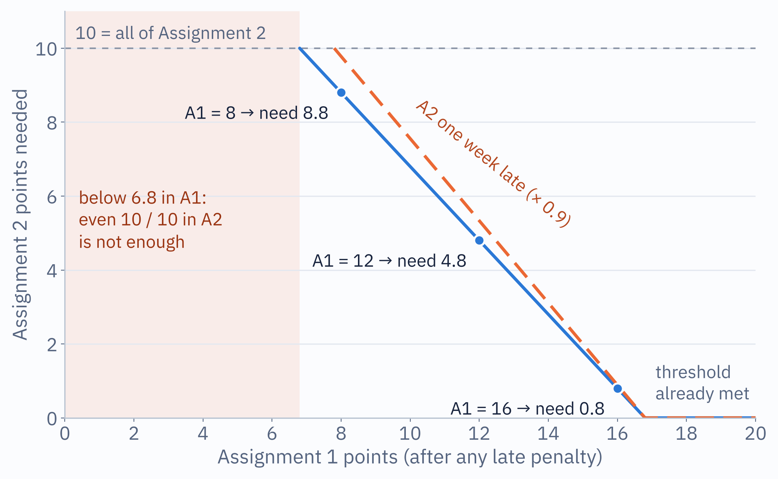
How much of Assignment 2 do you need?
POINTS
16.8 / 30
Assignment 1 + Assignment 2 combined (56 %) to sit the final test.
The late penalty is applied before this check: a late but good submission can still drop you below it.
The lecture test is not part of this threshold.
LRS-URK · Assignment 2
Notes:
Read the chart: find your Assignment 1 score on the x axis, the blue line gives the Assignment 2 points you still need. Below 6.8 in Assignment 1 even a perfect Assignment 2 is not enough. The dashed line is the same requirement if Assignment 2 is submitted one week late, because the 0.9 multiplier is applied before the threshold.

Slide 7
What is graded, and what you hand in
RULES FOR EVERY TOPIC
Rules
Deliverables
One topic, 10 points. A second topic earns nothing.
Points for what runs at the defence, on a clean checkout.
Later sections need the earlier ones shown first.
Documentation: what you chose, why, pros and cons, a diagram.
Teams are fine; the defence is individual.
An unreadable git history costs points.
Your ROS 2 package(s), building with colcon, extending your A1 node
README: build, bring-up of everything the topic needs, dependencies
Documentation in the repo, Markdown or PDF
Rosbag or screen recording of one complete, successful run
Submit: push before the deadline and send the commit hash on Teams. The commit timestamp counts.
LRS-URK · Assignment 2
Notes:
Documentation has the same expectations as A1.4, plus whatever each topic file adds. You must be able to explain everything you submit: using LLMs or libraries is not penalised, not being able to explain it is. Git: no points for using it well, but one commit dumped the night before, force-pushed history or no way to tell who did what leads to a deduction.

Slide 8
Obstacle avoidance
TOPIC 01 · 10 POINTS
Fly from A to B, notice an obstacle nobody told you about, get past it.
1 drone
depth camera
perception → decision → control

Slide 9

A new input feeding the node you already have
OBSTACLE AVOIDANCE · WHAT YOU BUILD
Cloud
Filter
Detect
Replan
Fly
PointCloud2, sensor-data QoS
corridor and range, drop noise
stable over several frames
a verified-clear 3D path
your A1 controller and setpoints
800 × 800
30 Hz
80°
0.02–300 m
colour + depth + cloud
update rate
horizontal field of view
clip, light Gaussian noise
# the world with the depth camera, then bridge the cloud (gz → ROS, one way)
scripts/run_gazebo.sh fei_lrs_gazebo_depth.world
ros2 run ros_gz_bridge parameter_bridge \
/fei_lrs_drone/stereo_camera/points@sensor_msgs/msg/PointCloud2[gz.msgs.PointCloudPacked
LRS-URK · Assignment 2 · obstacle-avoidance.md
Notes:
The drone flies a straight line from A to B. Somewhere on that line is an obstacle the mission did not know about. Same node, same MAVROS setpoints, same position controller as Assignment 1; the new part is a perception input feeding a decision back into the controller. You may assume the drone starts at A. Before writing code: rviz2, Fixed Frame fei_lrs_drone/fei_lrs_drone/stereo_cam_link/stereo_camera_depth, add a PointCloud2 display on the points topic. If you see the hangar in 3D you are ready. Yes, the frame name is doubled: gz sim builds it from model/link/sensor and the link name already contains the model name.

Slide 10
Four sections, accepted when…
OBSTACLE AVOIDANCE · REQUIREMENTS
Section | Points | Accepted when
§1 Point cloud subscriber | 2.0 | point count + coordinate range, any frame
§2 Obstacle detection | 3.0 | stable, correctly placed; silent on a clear path
§3 Path replanning in 3D | 2.5 | collision-free 3D path for the teacher’s situation
§4 Flight with replanning | 2.5 | full A → B, unattended, no collision
Sensor-data QoS
Hover first
Record, replay
Make it checkable
The default reliable QoS leaves your callback silently empty.
Static drone, obstacle in view: get detection and the replanned path right, then fly.
A rosbag of the cloud replays far faster than restarting Gazebo.
RCLCPP_WARN with (x, y, z), plus a Marker in RViz.
LRS-URK · Assignment 2 · obstacle-avoidance.md
Notes:
Section 1: subscribe with rclcpp::SensorDataQoS and iterate the cloud yourself; working out the message layout is part of the assignment (PointCloud2Iterator or raw bytes, both fine). Section 2: a single stray point must not trigger a replan, a real obstacle must not need ten attempts; some false positives are tolerated, flickering detections are not. Section 3 now needs a real 3D avoidance algorithm: a 3D planner (A*, Theta*, D* Lite, RRT*) on a voxel or octree map, or reactive 3D avoidance such as 3DVFH+ with a way out of dead ends. A preprogrammed sidestep or a potential field with no escape from a local minimum is not enough. It can still be demonstrated without flying: show the replanned path from a recorded or live cloud and show it is collision free. At the defence the teacher sets up one of four situations (pillar, low wall, wall with a gap, U-trap) and you explain how your algorithm works. Section 4: the drone must resume toward B after getting past the obstacle, not stop at the avoidance point. Documentation for this topic: the detection threshold and how you derived it, your 3D replanning algorithm, pros and cons, a perception to decision to control diagram.

Slide 11
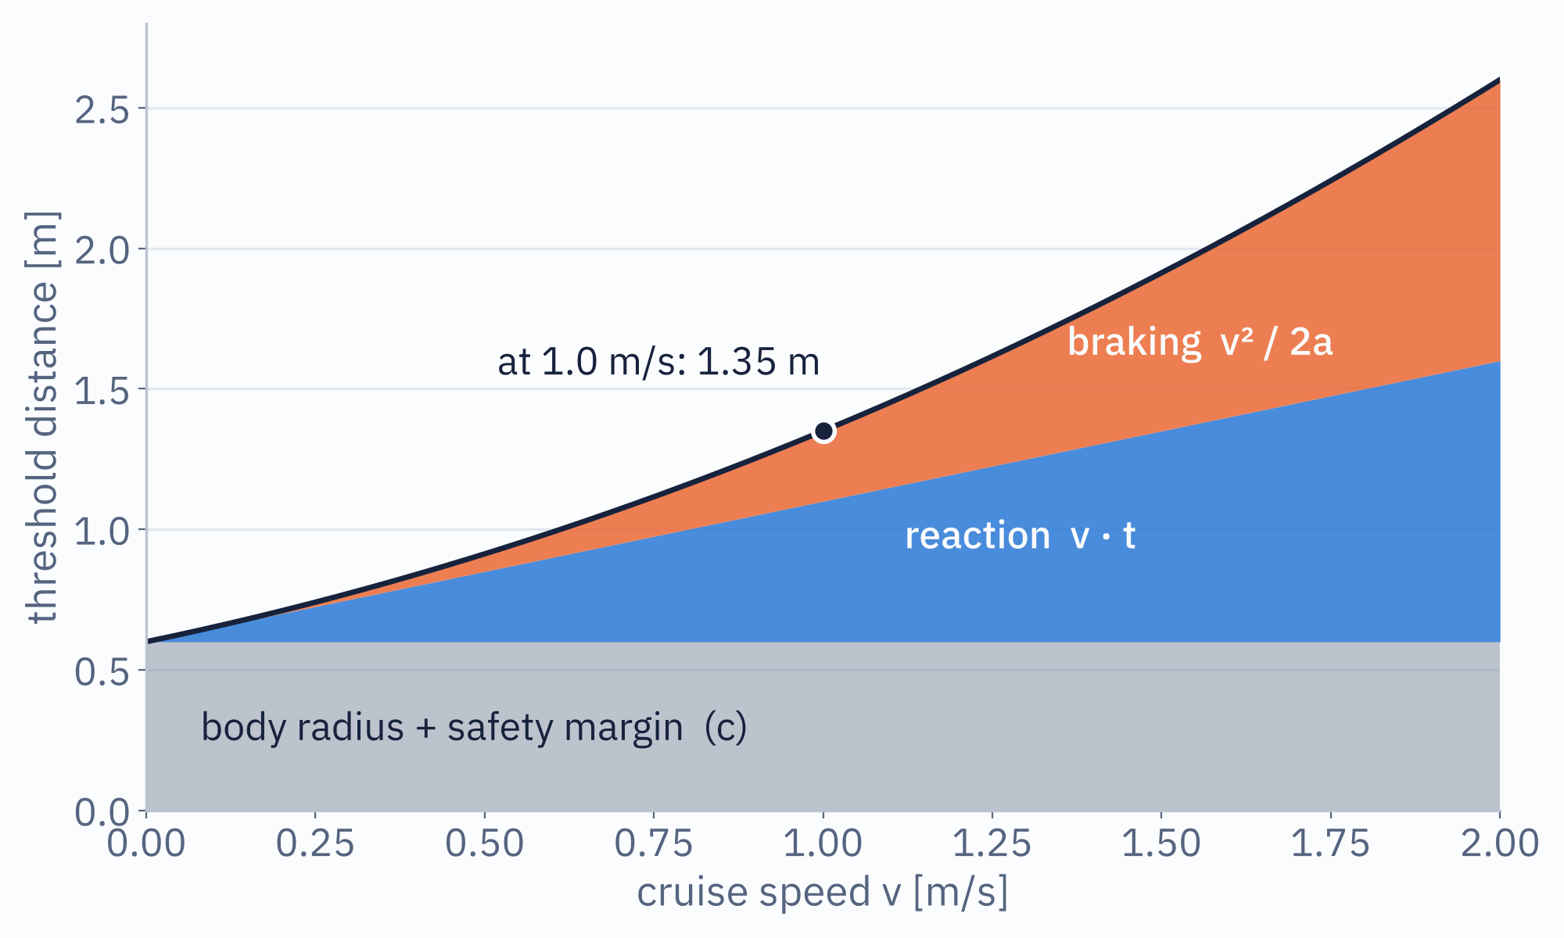
The threshold distance is derived, not picked
OBSTACLE AVOIDANCE · THEORY
d = v·t + v²/2a + r + m
v: your cruise speed
t: everything between the photons and the brake: rendering, bridge, your processing, the frames you wait to confirm, the control loop
a: the deceleration the drone really achieves; measure it
r + m: body radius plus safety margin, as in A1.1
Chart values are illustrative (t = 0.5 s, a = 2 m/s², r + m = 0.6 m). Derive yours and write the derivation down.
LRS-URK · Assignment 2 · obstacle-avoidance.md §2
Notes:
The spec asks for an obstacle threshold distance, the point where "something is ahead" becomes "stop and replan", derived from cruise speed and the distance you need to react and turn, the same way A1.1 derives its inflation radius. The chart splits it into three parts: what must remain when you stop, what you fly before you even start braking, and the braking itself. Two takeaways: the braking term grows with v squared, and anything that adds latency (waiting for more confirmation frames, a slow pipeline) pushes the threshold out linearly.

Slide 12
Stable detection: same region, frames in a row
OBSTACLE AVOIDANCE · THEORY
frame
1
2
3
4
5
6
7
8
9
10
Filter first: keep points inside your flight corridor and a plausible range; drop the implausibly close noise.
Bin what is left into regions (voxels, for example) and count returns per region.
Act only after N consecutive occupied frames. N is your parameter: it also adds to t on the previous slide.
The depth noise is real, not your bug. Don’t tune to a noise-free frame.
Stray return
never acted on
Noise flicker
never acted on
Real obstacle
confirmed at frame 5
occupied this frame
confirmed (N = 3 in a row)
LRS-URK · Assignment 2 · obstacle-avoidance.md §2
Notes:
The spec's own suggestion: require the same region to read occupied across several consecutive frames before you act. The picture shows one region over ten frames. A single stray return never reaches the count, a flickering region resets every time it misses a frame, a real obstacle gets confirmed after N frames. Trade-off to discuss: bigger N means fewer false positives but more latency, so a larger threshold distance.

Slide 13
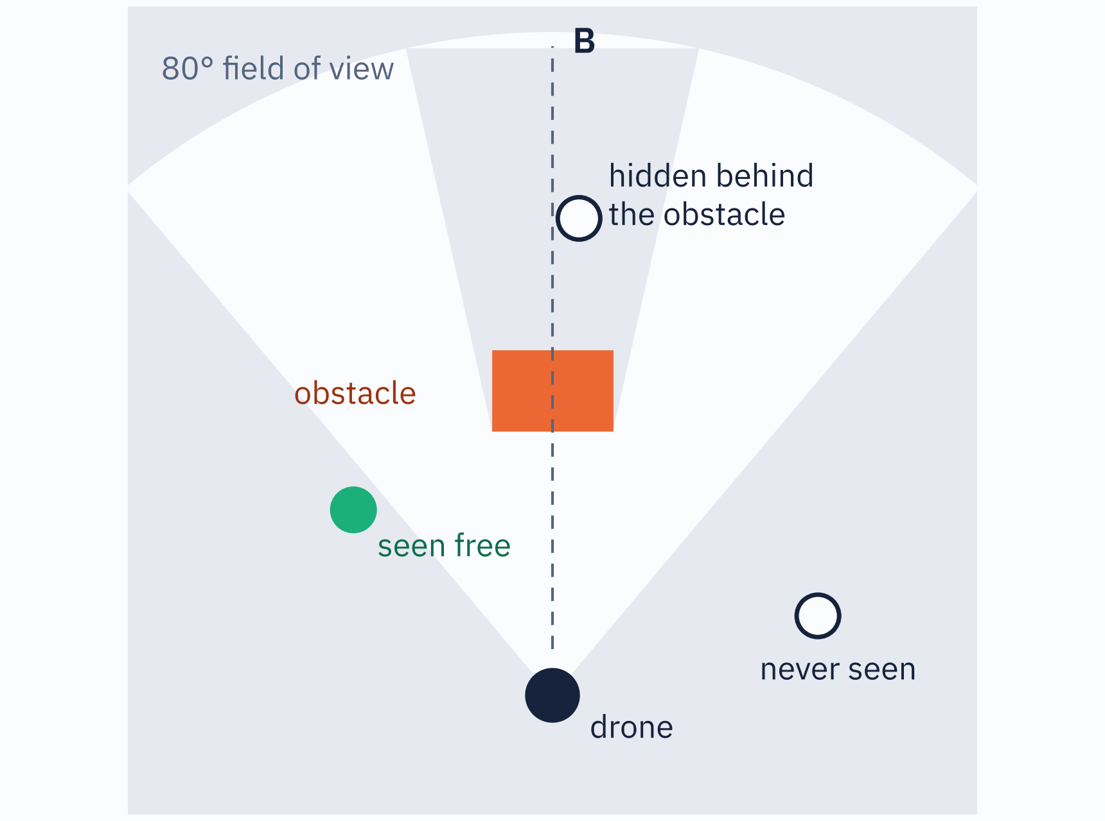
Not detected is not the same as free
OBSTACLE AVOIDANCE · THEORY
Three states, not two: occupied, free, unknown.
Free: a ray went through the point in a recent frame.
Unknown: outside the 80° view, or in the obstacle’s shadow.
The new path must be verified clear, not just undetected, like the racks in A1.1.
A fixed sidestep or potential field is no longer enough: use a 3D planner (A*, D* Lite, RRT*) on a voxel map, or 3DVFH+.
LRS-URK · Assignment 2 · obstacle-avoidance.md §3
Notes:
A point that merely looks clear because nothing was detected there yet is not verified clear. With an 80 degree field of view, a sidestep at 90 degrees to the path is outside the camera's view when you brake facing the obstacle, and the space right behind the obstacle is in its shadow. The camera only looks forward, so fly nose-first and turn to look before moving sideways. Section 3 now requires a real 3D avoidance algorithm: map-based (voxel grid or octree plus A*, Theta*, D* Lite, RRT*, replanned whenever the path becomes blocked) or reactive (3DVFH+ or motion primitives, with memory to escape a dead end). Around and over are both legal; when there is no way around, go over. Minimum and maximum altitude are parameters, and the roof (5.9 m in the middle, 4.6 m at the side walls, beams down to 4.2 m) counts as an obstacle. Section 3 can still be shown without flying: show the replanned path from a recorded or live cloud and show it is collision free.

Slide 14
Four situations your planner must handle
OBSTACLE AVOIDANCE · TEST SITUATIONS
Situation | What it forces | Example: X Y WIDTH DEPTH HEIGHT (m)
Pillar | around, either side; almost reaches the roof | pillar 13.5 6 0.6 0.6 5.5
Low wall | over: spans the hangar wall to wall | low_wall 8.75 5 0.3 19 2
Wall with a gap | around, through the only opening | gap_wall 7.25 8 0.3 15.5 5.5
U-trap | out of a cup open toward A; walls 5.5 m tall | u_back 13.5 8 0.3 3.3 · u_left 12 7 2 0.3 · u_right 15 7 2 0.3
# fly to A first, then place the obstacles: some stand where the drone spawns
scripts/spawn_obstacle.sh pillar 13.5 6 0.6 0.6 5.5 # NAME X Y [W] [D] [H] [YAW]
scripts/spawn_obstacle.sh --remove pillar # names are unique; to move, remove + respawn
scripts/spawn_obstacle.sh --help
Route A (13.5, 1.5, 1.5) → B (13.5, 11, 1.5), in Gazebo world coordinates, not MAVROS ENU.
LRS-URK · Assignment 2 · obstacle-avoidance.md §3 · scripts/spawn_obstacle.sh

Slide 15
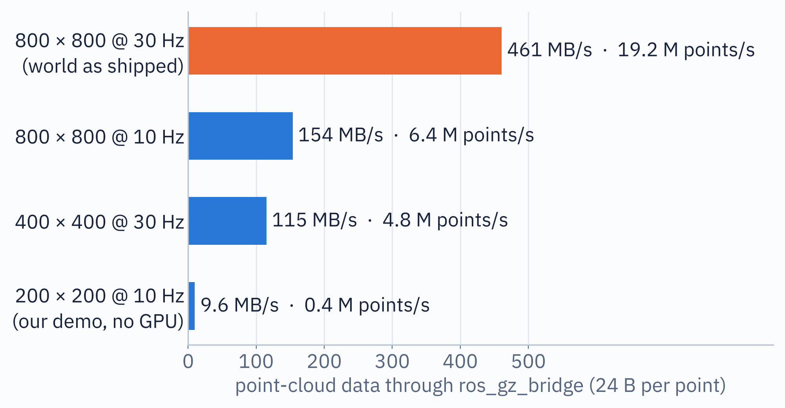
A point cloud is heavy: plan your PC for it
OBSTACLE AVOIDANCE · KNOWN ISSUE
On a weak PC
800 × 800 RGB + depth, rendered 30× a second, wants a real GPU.
Our demo PC had none: 200 × 200 @ 10 Hz, still 0.01–0.9× real time.
Clouds come in bursts, wall-clock timeouts fire, setpoints stall.
What helps
Sensor-data QoS, keep_last(1): drop stale frames
Every n-th point, in its own callback group
No full-rate cloud in RViz unless debugging
Record one bag, iterate on the replay
Test on the world as shipped before defending
One frame = 640 000 points ≈ 15 MB. Skipping points in your node saves CPU in your callback, not traffic through the bridge.
LRS-URK · Assignment 2 · 24 B per point is the gz rgbd point layout on a 64-bit PC; check point_step yourself
Notes:
Numbers: the world's rgbd_camera is 800 by 800 at 30 Hz, so 640 000 points per frame, 19.2 million points per second. At 24 bytes per point that is about 15 MB per message and about 460 MB per second through ros_gz_bridge, before your node sees anything. Our own demo recording was made on a machine without a GPU: we had to reduce the camera to 200 by 200 at 10 Hz and Gazebo still ran at 0.01 to 0.9 times real time. Symptoms students will see: real-time factor far below 1, clouds arriving in bursts, timeouts measured in wall-clock time firing, and if the cloud callback shares a callback group with the setpoint timer, the setpoint stream stalls and ArduPilot may leave GUIDED. A lower-resolution local copy of the world is fine while developing, but test on the world as shipped before the defence.

Slide 16
What to watch for in the demo
OBSTACLE AVOIDANCE · BEFORE THE VIDEO
0:00 Arm and take off at the spawn point.
0:30 Cruise to A; the hangar fills the cloud.
0:55 At A: turn to face B, let the map settle.
1:05 Obstacle on the path, 3.8 m ahead: logged and marked, no braking yet.
1:15 Inside the threshold: brake. Left, right and over are checked; over is rejected as too high.
1:25 A sidestep turns green, verified clear. Detour, replan count 1.
1:45 Back on the way to B. 2:25 Landed at B: FINISHED.
Ask yourself while it plays
Does it stop before the threshold? Does it carry on to B? Note: one sidestep like this no longer passes §3.
LRS-URK · Assignment 2 · times are positions in the video
Notes:
The recording predates the stricter section 3: its single verified sidestep around one box is no longer enough on its own, students need a real 3D planner that handles the pillar, low wall, gap wall and U-trap situations. The recording is the RViz view of our reference run with a randomly placed obstacle on the A to B line. Point out the order of events: detection is reported well before braking, braking happens at the threshold, the candidate points are checked before the drone commits, and the drone continues to B instead of stopping after the detour.

Slide 17
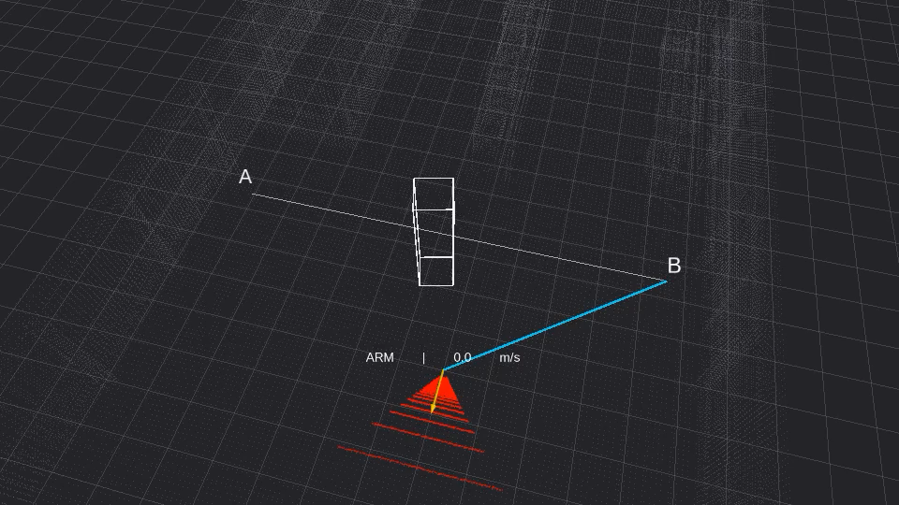
One replan, then on to B
OBSTACLE AVOIDANCE · DEMO
LEGEND
confirmed obstacle voxels
live depth cloud
flown track
route still to fly
candidate verified clear
candidate not yet verified
candidate rejected
true obstacle position
Click the video to pause. RViz view, about 2.5 min.
Notes:
Plays automatically when the slide is presented; a click pauses it. Points to stop on: 1:05 detection reported while still far away; 1:15 brake inside the threshold and the three candidates; 1:25 the green, verified sidestep; 2:25 FINISHED at B with one replan.

Slide 18
Drone localisation
TOPIC 02 · 10 POINTS
Build your own Kalman filter from three bad sensors, then fly on its estimate.
1 drone
GPS + VO + gyro
no MAVROS pose allowed

Slide 19
Your filter replaces MAVROS’s position
DRONE LOCALISATION · WHAT YOU BUILD
GPS · 5 Hz
Your KF / EKF
Controller
MAVROS
VO · 30 Hz
x, y, z, vx, vy, vz, yaw, gyro bias
your A1 node, fed by x, y, z, yaw
arming, mode, setpoints only
IMU gyro z · 100 Hz
Allowed
Forbidden as feedback
Estimator: /localization/gps, /vo, /imu (gyro z only)
Controller: /mavros/state, arming and mode services, setpoints
Eigen in C++, NumPy in Python
Ground truth and Gazebo pose topics
MAVROS position, odometry, IMU, attitude, heading
robot_localization or a copied filter
LRS-URK · Assignment 2 · localization.md
Notes:
This is a simplified localisation filter, not a full inertial navigation system: eight states, only the gyro's Z axis, no accelerometer integration. MAVROS still arms the drone and receives setpoints, but its local position is no longer fed back to your controller. The teacher will check your ROS graph and your source for any truth path into the submitted system. A separate plotting or evaluation node may read ground truth, but must not send anything back. IMU orientation and linear acceleration are forbidden too, including the MAVROS IMU topics.

Slide 20
Know your sensors before you filter
DRONE LOCALISATION · THE SENSORS
Topic | Rate | What you get
/localization/gps | 5 Hz | position in map (ENU), σ ≈ 0.6 / 0.6 / 0.9 m, no orientation
/localization/vo | 30 Hz | Odometry: pose and yaw drift (vo_odom), twist in body frame
/localization/imu | 100 Hz | only angular_velocity.z is valid, and it has a static bias
/evaluation/ground_truth | 100 Hz | Odometry, for a separate plotting process only
# the teacher’s tests at the defence: try them on yourself first
ros2 service call /localization/set_gps_enabled std_srvs/srv/SetBool "{data: false}"
ros2 service call /localization/set_vo_enabled std_srvs/srv/SetBool "{data: false}"
ros2 service call /localization/inject_gps_outlier std_srvs/srv/Trigger "{}"
Gazebo and the sensor node share a seed. The teacher may use another one: never tune to one noise trace.
LRS-URK · Assignment 2 · localization.md · localization_sensor_sim
Notes:
Bring-up: gz sim with --seed 42 on fei_lrs_gazebo_localization.world, run_sitl.sh, run_mavros.sh, then colcon build and launch localization_sensor_sim with seed:=42. Defaults for rates, noise, drift and outages are in localization_sensor_sim/config/sensors.yaml. The drone starts at about (-7, 13, 0) in ENU with yaw pi/2, but do not hard-code that into the filter. The assessed GPS outage lasts 15 seconds; the outlier service corrupts the next GPS sample with one large outlier.

Slide 21
Four sections, accepted when…
DRONE LOCALISATION · REQUIREMENTS
Section | Points | Accepted when
§1 Sensors, characterised | 1.5 | right stamps, frames, rates; plots of noise, drift, bias
§2 Eight-state KF / EKF | 4.5 | finite x and P, tracks the flight, wraps yaw, explained
§3 Missing, bad data | 2.0 | survives GPS and VO outages, gates the outlier
§4 Flight on the estimate | 2.0 | two laps, 15 s GPS outage, lands, no MAVROS pose
Look first
One update at a time
Replay, no autopilot
Two seeds
topic hz, echo the headers, a short bag while hovering. Then pick Q and R.
Predict + GPS, then yaw and bias, then VO. Plot after every step.
Feed a recorded sensor bag to the estimator; test control at a hover.
Same seed, same corruption; another seed changes it. Show both in §1.
LRS-URK · Assignment 2 · localization.md
Notes:
Section 1 also needs a stationary and a moving recording: measured rates, GPS noise, VO drift against truth (in a separate plotting process), gyro bias while not turning. Section 2 is assessed on correct behaviour and your explanation, not on one brittle error threshold. Section 3: continue through a 15 second GPS outage and a short VO loss without reset, freeze or NaN; reject the injected outlier with an innovation-based gate; resume smoothly. Log rejections and timeouts, but not at the sensor rate. Section 4: capture the first valid estimate as the origin, take off to 2 m, two laps of (0,0), (0,-4), (2.5,-4), (2.5,0), (0,0) at about 0.5 m/s, return and land; about 60 to 90 seconds. Deliverables add: README with estimate topic and frame, Q, R, initial covariance, gate parameters, equations and how you treat the body velocity.

Slide 22
Eight states, predict and correct
DRONE LOCALISATION · THEORY
x = [x, y, z, vx, vy, vz, yaw, b]^T
# predict, Δt from the header stamps
p ← p + v·Δt
v ← v
yaw ← wrap(yaw + (ω_z − b)·Δt)
b ← b
P ← F·P·F^T + Q
# update, each sensor at its own stamp
r = z − h(x) S = H·P·H^T + R
K = P·H^T·S^-1 x ← x + K·r
P ← (I − K·H)·P Joseph form if P loses symmetry
VO body velocity
Nonlinear in yaw: EKF Jacobian, or rotate it with the yaw estimate and document it.
Be ready to explain
How does b become observable when no sensor measures it?
No shortcuts
Solve, never invert S. Initialise from the first GPS and VO, not from truth.
LRS-URK · Assignment 2 · localization.md §2
Notes:
The state and its order are mandatory. Prediction: constant-velocity position model, yaw propagated with the measured gyro rate minus the estimated bias, elapsed time from message stamps. Keep P, Q and R meaningful and configurable; P is predicted and corrected with the state. Updates are asynchronous: fuse each sensor when it arrives, do not wait for matching timestamps. Fuse GPS position plus a documented selection of VO pose, yaw and body velocity; your choice must constrain every state you fly on. The bias question is part of the acceptance criteria, so every student must be able to answer it at the defence.

Slide 23
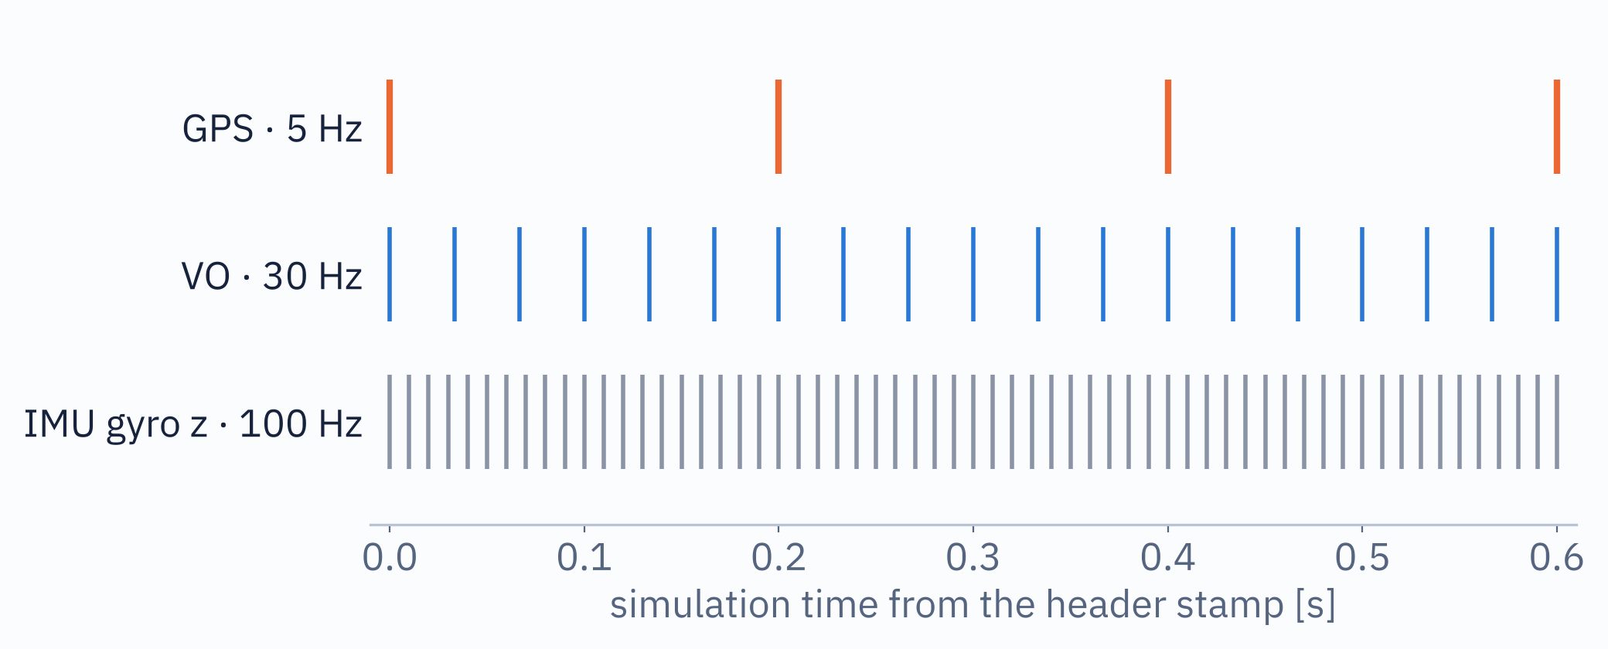
Three clocks that never line up
DRONE LOCALISATION · THEORY
Use each message’s header stamp, never its arrival time or a timer period.
Predict to the measurement’s stamp, then update it.
Duplicates and out-of-order stamps: drop or handle them safely.
The IMU is the fastest: predicting on each IMU message is a practical design.
Wrap every yaw innovation, and the yaw state, to [−π, π).
A 15 s GPS outage is 75 missing fixes. Keep predicting, let P grow, never reset.
LRS-URK · Assignment 2 · localization.md §1–§3
Notes:
Nominal rates: GPS 5 Hz, VO 30 Hz, IMU 100 Hz, all stamped in simulation time. A filter that waits for all three to share a timestamp never runs. Bring the state to each measurement's stamp, correct it, carry on. Also check frames on the first message of each sensor: GPS in map, VO pose in vo_odom with child_frame_id base_link, so its twist is body-frame velocity.

Slide 24
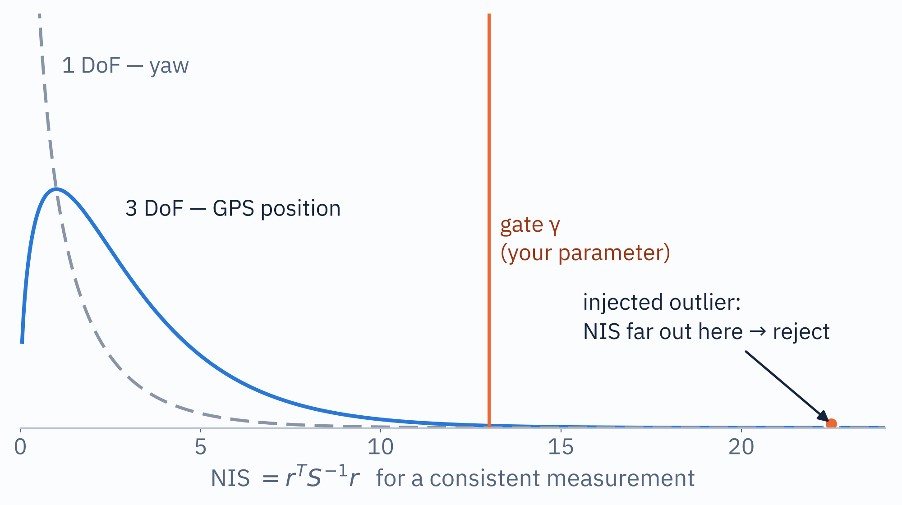
Reject outliers statistically, not by distance
DRONE LOCALISATION · THEORY
NIS = r^T · S^-1 · r
The innovation r measured in its own expected covariance S = H·P·H^T + R.
A fixed “metres from the estimate” rule fails both ways: after an outage P is large and good fixes look far; when P is small, a bad fix can still look close.
γ comes from the χ² distribution with the right degrees of freedom. Make it a parameter and justify it.
Log each rejection with r, NIS and γ. Never print at the sensor rate.
LRS-URK · Assignment 2 · localization.md §3
Notes:
The spec explicitly says a fixed distance from the current estimate is not enough. For a consistent filter the normalised innovation squared follows a chi-square distribution with as many degrees of freedom as the measurement has dimensions: 3 for a GPS position, 1 for a yaw. Pick the gate from that distribution and the false-rejection rate you are willing to accept, and be ready to say why. The injected outlier lands far in the tail. After a sensor returns, resume smoothly: no snap to one raw measurement, no reset, no restart of the estimator.

Slide 25
Where this topic usually goes wrong
DRONE LOCALISATION · KNOWN ISSUES
VO twist is body frame
No hard-coded start
Stamps, not arrival
child_frame_id is base_link: rotate it before treating it as ENU.
The start is about (−7, 13, 0), yaw π/2 in ENU, but GPS is noisy: initialise from data.
Simulation time from each header; a fixed callback period is not a substitute.
Tune for any seed
No truth path
Outages are tested
The defence may use another seed: no bias or noise trace baked into Q, R or code.
Your ROS graph and source are checked for ground truth or MAVROS pose.
15 s GPS off mid-leg, a short VO loss, one outlier: no NaN, no reset, no jump.
LRS-URK · Assignment 2 · localization.md
Notes:
Each of these is stated in the specification. The start pose: Gazebo spawns the drone at (13, 7, 0) with yaw 0; the sensor simulator rotates that into the MAVROS ENU convention, about (-7, 13, 0) with yaw pi/2. Use the first GPS and VO samples and the known initial yaw, with uncertain velocity and bias. The graph check is real: the teacher looks at ros2 node info and the code for any path from truth or MAVROS localisation into the estimator or the controller. Good news for weaker laptops: this topic has no images or point clouds for your code.

Slide 26
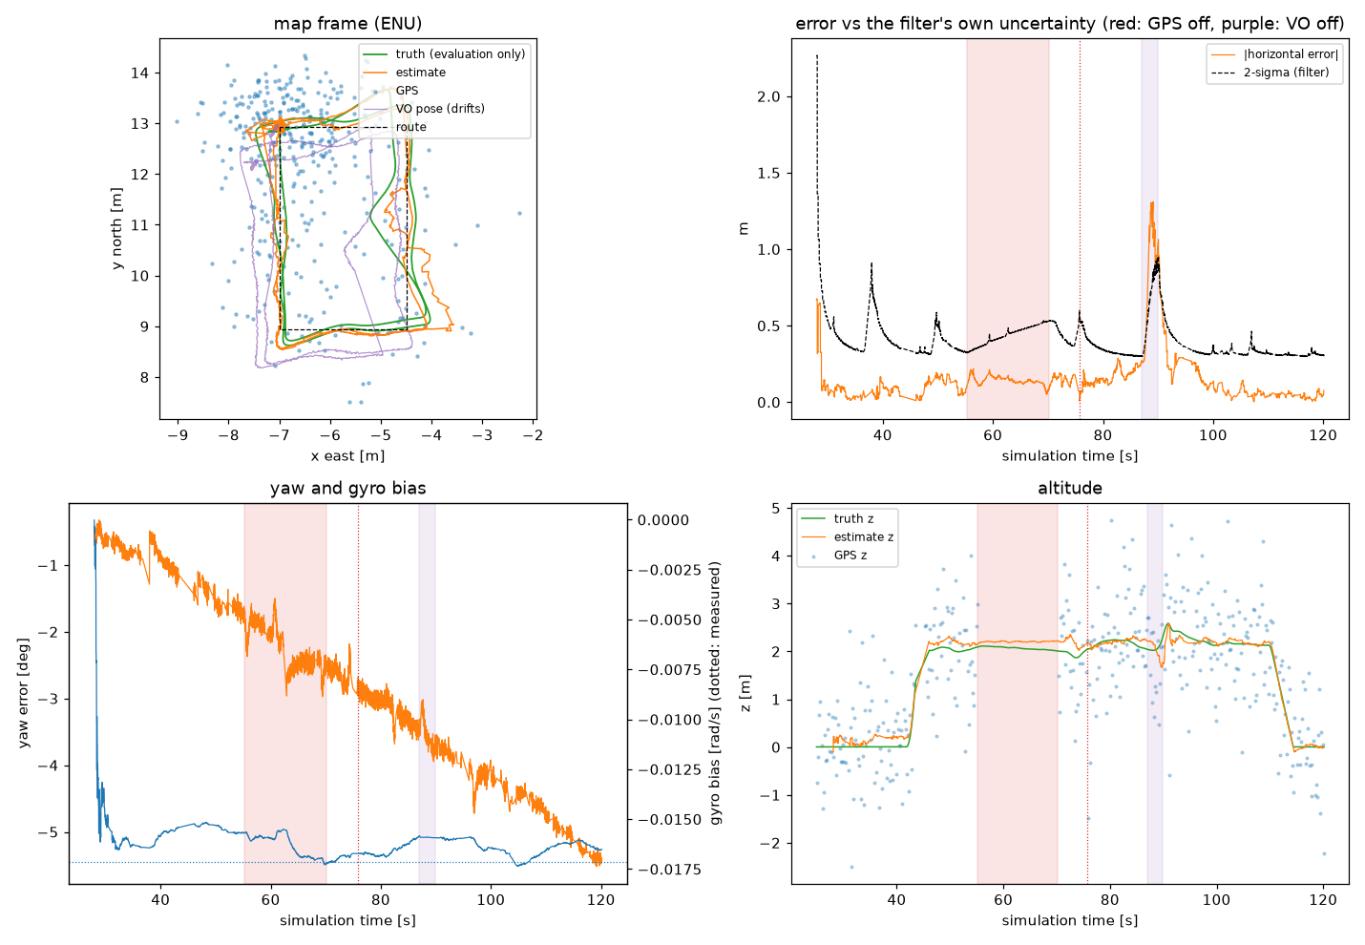
Plots that make the defence easy
DRONE LOCALISATION · EVIDENCE
Top left: truth (evaluation only), estimate, raw GPS and VO drifting away.
Top right: error against the filter’s own 2σ. A consistent filter stays under it.
Bottom: yaw error, the estimated gyro bias, altitude.
Shaded: red = GPS off, purple = VO off. Truth only ever in a separate plotting process.
LRS-URK · Assignment 2 · from our demo run
Notes:
This is the analysis figure from the reference run shown in the next video. Students do not have to produce exactly this, but section 1 requires plots that clearly show GPS noise, VO drift and gyro bias, and a plot of the error against the filter's own uncertainty is the quickest way to show at the defence that Q and R are sensible. Note the spike in the top-right panel: during the VO loss at a corner the error grows, the filter's 2-sigma grows with it, and both come back when VO returns.

Slide 27
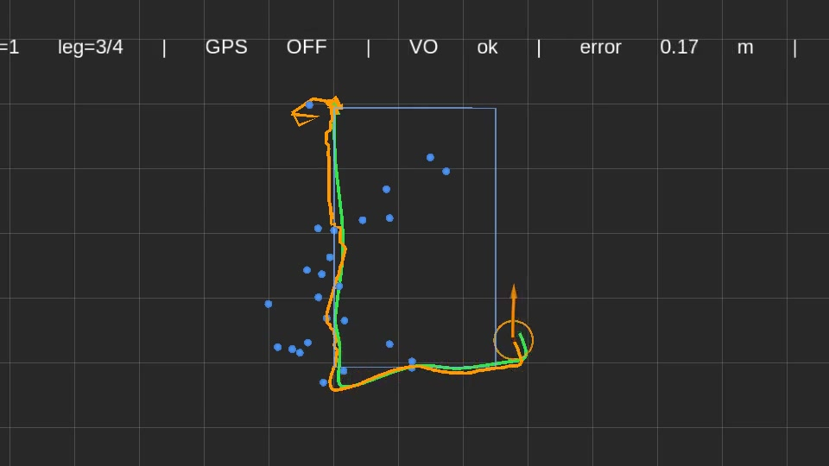
What to watch for in the demo
DRONE LOCALISATION · BEFORE THE VIDEO
0:00 Take off to 2 m; the first valid estimate becomes the origin.
0:15 Lap 1. Blue dots: raw GPS. Orange: estimate. Green: truth.
0:25 GPS off for 15 s: no blue dots, the estimate rides on VO and the model.
0:47 GPS back: the orange line does not jump.
1:00 One injected outlier, a lone dot far off the track: gated.
1:18 VO off for 3 s at a corner: error grows to about 1 m, then recovers.
1:35 Back at the origin, land, DONE.
Ask yourself while it plays
Does anything jump when a sensor returns? Does the square stay a square while GPS is off?
LRS-URK · Assignment 2 · times are positions in the video
Notes:
Left half of the video is Gazebo from above, right half the top-down plot with the status line on top: lap, leg, GPS ok or OFF, VO ok or OFF, current error. The teacher's tests are scripted in this recording: GPS off during lap 1, one outlier early in lap 2, VO off for 3 seconds at a corner in lap 2. The controller only ever sees the estimate.

Slide 28
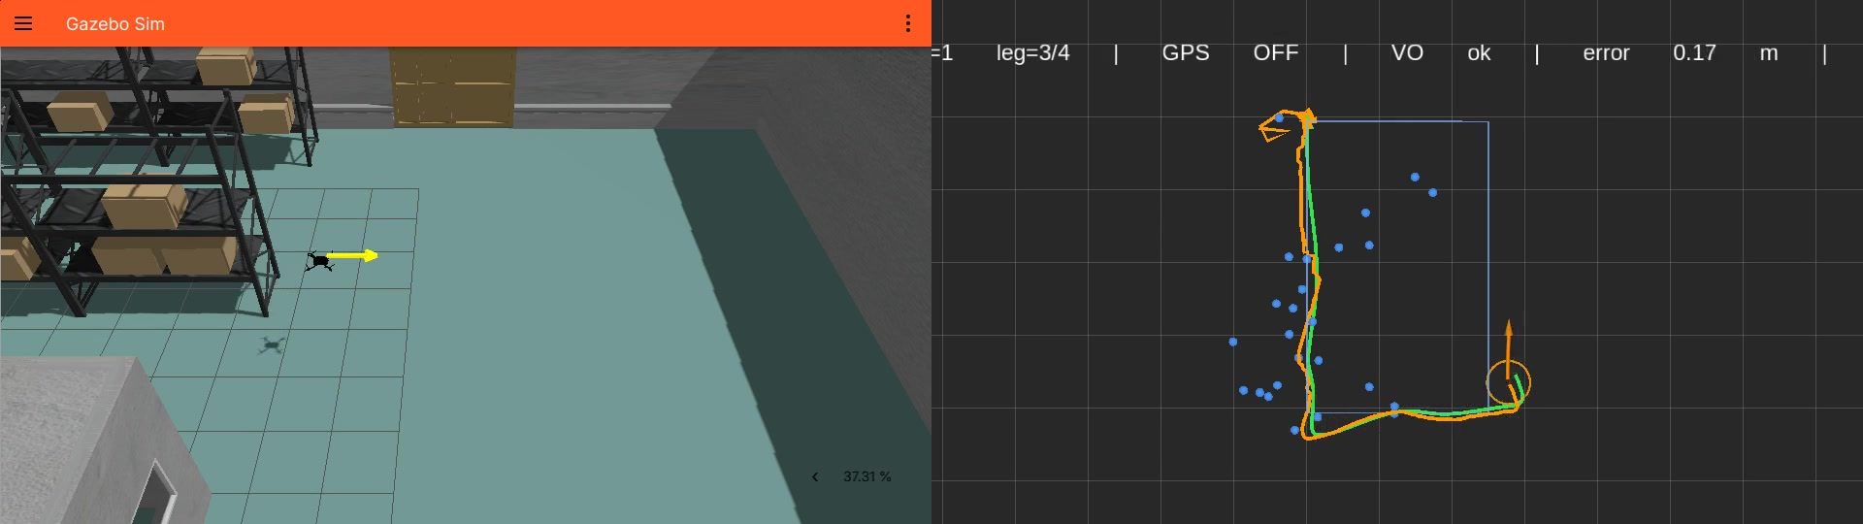
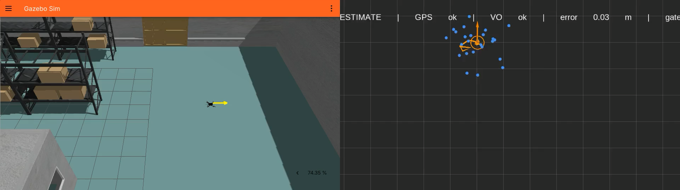
Two laps on the estimate alone
DRONE LOCALISATION · DEMO
truth (plot only)
estimate, with its 2σ circle
raw GPS fixes
planned route
Click to pause · about 2 min
Notes:
Plays when the slide is presented. Stop at 0:25 (GPS OFF in the status line), at 0:47 (GPS back, no jump), at 1:00 (the lone outlier dot, rejected) and at 1:18 (VO OFF, error briefly about 1 m).

Slide 29
Find-and-follow
TOPIC 03 · 10 POINTS
Two drones, two moving rovers: each drone finds its own and stays above it.
2 drones + 2 rovers
down cameras + ArUco
search ⇄ track

Slide 30
Two full stacks, side by side
FIND-AND-FOLLOW · WHAT YOU BUILD
gz sim · fei_lrs_precision_landing.world
THE PAIRING RULE
drone_1, drone_2, aruco_rover_1, aruco_rover_2 (randomize_rovers.py)
marker id = SYSID_THISMAV
SITL instance 0
MAVROS
Your node
sysid 1 · FDM 9002 · UDP 14550
namespace /drone_1
follows marker id 1
The other rover’s marker must be ignored, not chased.
SITL instance 1
MAVROS
Your node
Down camera: 640 × 480, 60° horizontal FOV, 30 Hz
sysid 2 · FDM 9012 · UDP 14560
namespace /drone_2
follows marker id 2
ArUco DICT_4X4_50 on a white pad on each rover
ros_gz_bridge
Never land: search and track until you abort
both down cameras (image_raw, camera_info) to ROS; rover motion comes from the supplied randomizer
LRS-URK · Assignment 2 · rover-find-and-follow.md
Notes:
The world already contains both drones with nadir cameras, both rovers driving a fixed circle with their markers, and two SITL FDM ports wired in. Each SITL is started with sim_vehicle.py, its own --instance and --sysid, its own working directory, and the -l home location from the topic file: SITL's JSON backend does not know where in the world the model was placed, so the home location must already account for it. Instance 0 and 1 pick FDM ports 9002 and 9012 and MAVLink ports 14550 and 14560 automatically. Getting two MAVROS instances onto the right vehicle in the right namespace is part of the assignment, so is the camera bridge. The rovers' random motion is now supplied: run scripts/randomize_rovers.py --seed 42; it changes each rover's speed and yaw rate every few seconds and keeps it within about 5 m of its circle's centre. The teacher picks the seed at the defence, so develop against more than one.

Slide 31
Four sections, accepted when…
FIND-AND-FOLLOW · REQUIREMENTS
Section | Points | Accepted when
§1 Two vehicles, bridged | 2.0 | both MAVROS stacks and both cameras live at once
§2 Search, marker id | 3.0 | each finds its own marker, ignores the other one
§3 Detection → position | 2.0 | accurate to about the marker’s size, not metres
§4 Tracking, lost/found | 3.0 | random rover motion, a real lost/found per drone
One drone first
Ask the world
Listed ≠ live
Script the bring-up
It finds its own marker and ignores the other rover. Then add the second.
gz topic -l and gz topic -i -t <topic> give the real names and types.
ros2 topic info --verbose must show a real publisher.
SITL ×2, MAVROS ×2 and bridge as scripts or a launch file.
LRS-URK · Assignment 2 · rover-find-and-follow.md
Notes:
Section 2 needs a real search: no flying to a coordinate computed from the circle the rover starts on, and a wrong-id marker must be ignored with both drones running. Section 3: intrinsics from camera_info, the marker's physical size and the camera's mount pose, checked against the drone's own altitude while hovering over a rover. Section 4: configurable altitude above the rover, the rovers randomised by scripts/randomize_rovers.py with a seed the teacher picks, a configurable timeout after which the drone goes back to search, and a genuine lost then reacquired cycle per drone, not staged. Documentation adds: intrinsics, extrinsics and marker-size derivation and how you verified them, the altitude and timeout parameters with defaults, and a perception to decision to control diagram for one drone.

Slide 32
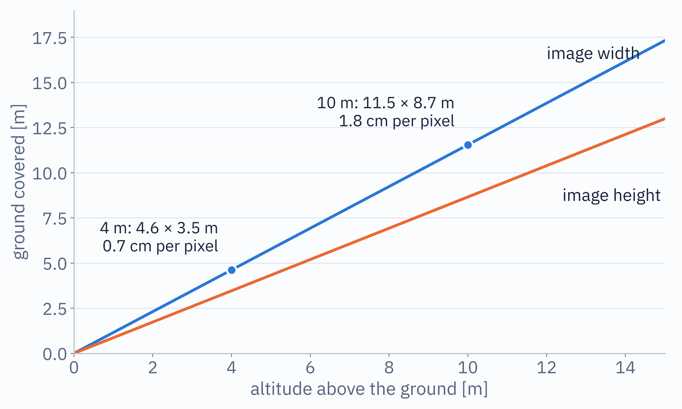
From a pixel to a point on the ground
FIND-AND-FOLLOW · THEORY
Detect
solvePnP
Mount
World
marker corners in pixels, check the id
marker pose in the optical frame
optical frame to drone body
attitude + position to local ENU
Intrinsics from camera_info, never hard-coded. Sanity check: fx = W / (2·tan(HFOV/2)) ≈ 554 px for 640 px and 60°.
Search lanes closer than the footprint width, with overlap. Higher sees more ground, with fewer pixels on the marker.
Full attitude, not yaw alone: 10° of tilt at 8 m moves the ground point by 1.4 m.
LRS-URK · Assignment 2 · rover-find-and-follow.md §2–§3
Notes:
The chain from a detection to a target in the drone's local ENU frame: pixel corners from the ArUco detector, a pose from solvePnP using intrinsics from camera_info and the marker's physical size, then the camera's mount transform into the body frame, then the drone's attitude and position into the world. The chart helps designing the search pattern: at altitude h the 60 degree camera sees a strip about 1.15 h wide. The tilt example is plain geometry, 8 m times tan 10 degrees: a drone accelerating after a rover is tilted, so using yaw only puts the target metres away.

Slide 33


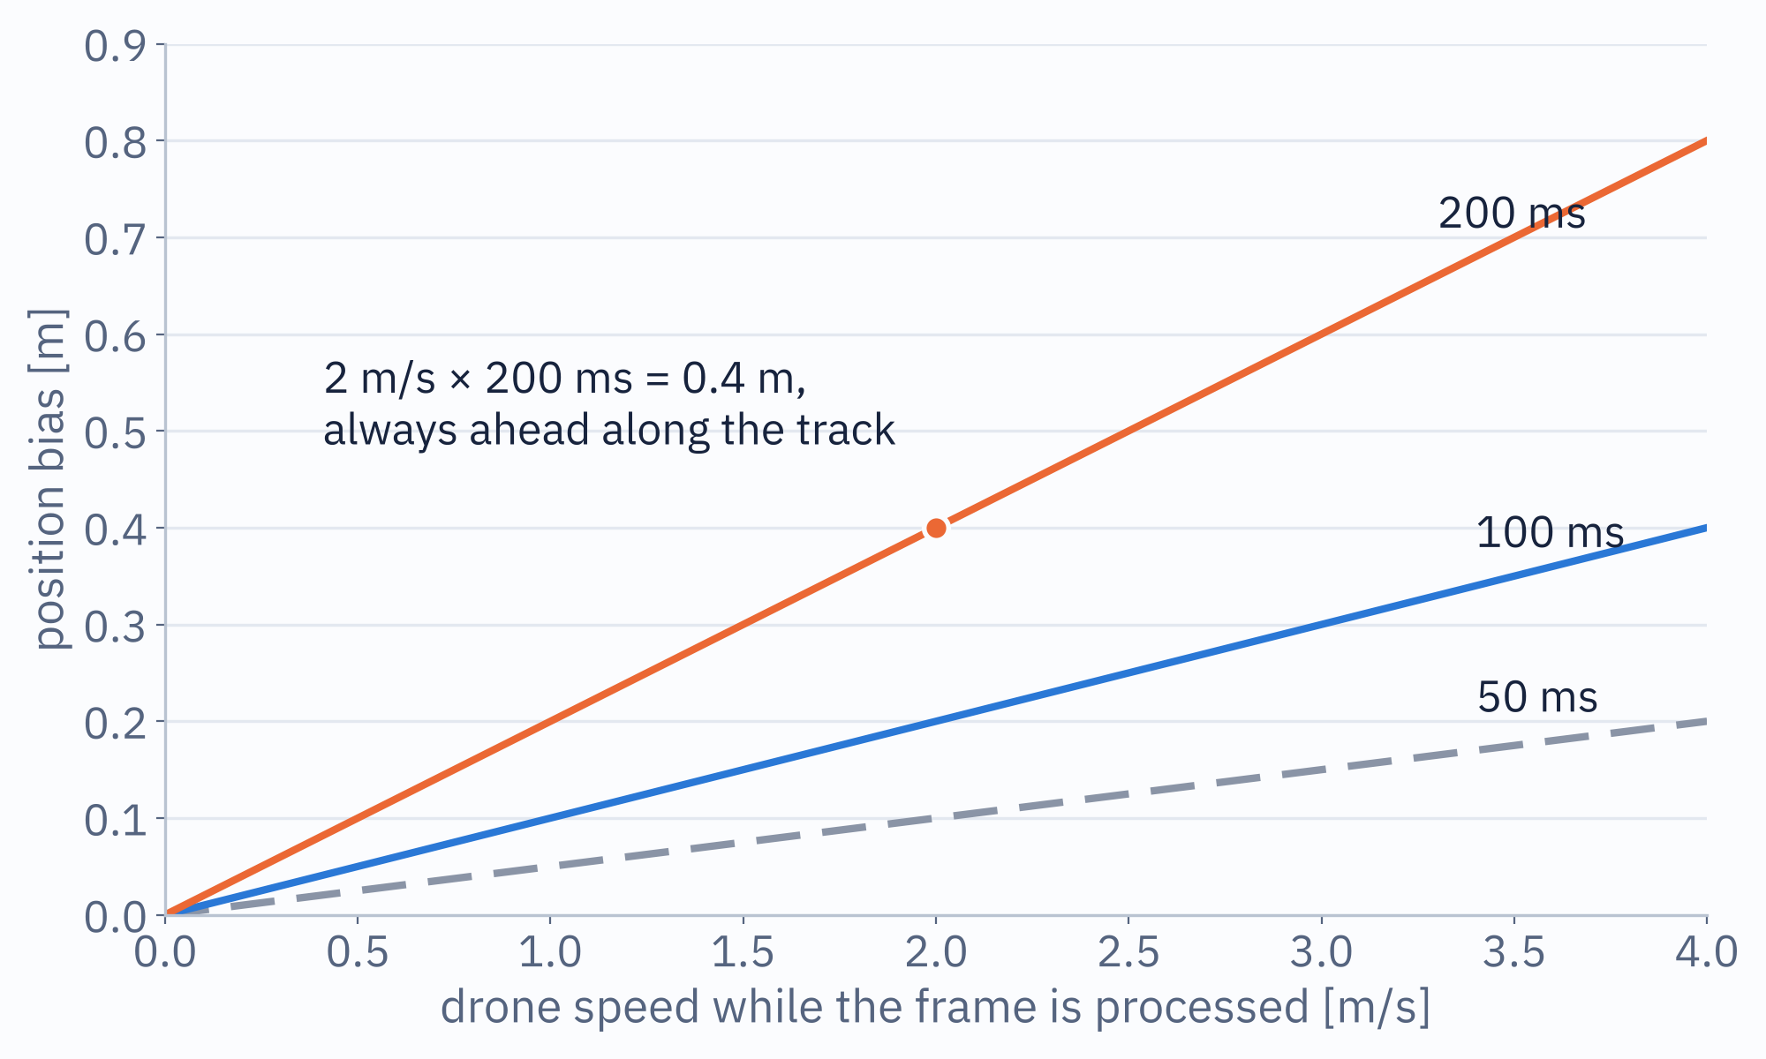
Search, track, lose it, search again
FIND-AND-FOLLOW · THEORY
SEARCH
own marker confirmed
TAKEOFF
TRACKING
to search altitude
your pattern, any start position
hold a set altitude above it
lost > timeout
Fast search + slow vision = a bias, not noise: the detection lands ahead by speed × latency, always in the direction of travel.
Simplest fix: cap search and track speed. The other: match stamps, which means bridging /clock and use_sim_time everywhere.
Any state → ABORT: hold or RTL, never land. The altitude above the rover and the lost timeout are parameters.
LRS-URK · Assignment 2 · rover-find-and-follow.md §4
Notes:
The state machine is the decision part of this topic. Search does not assume where the rover starts. A detection only becomes a target when the id matches the drone's own SYSID_THISMAV. If the marker is out of view for longer than a configurable timeout, go back to searching instead of flying to a stale position. There is no landing state; the abort path holds or returns to launch. On timing: ros_gz_bridge topics carry Gazebo's simulation-clock stamps, MAVROS stamps do not unless you bridge /clock and run every node with use_sim_time, so reading the current pose when a frame finishes processing gives a bias proportional to speed times latency.

Slide 34
Where this topic usually goes wrong
FIND-AND-FOLLOW · KNOWN ISSUES
Camera mount
Marker size
OpenCV API
Two SITL builds
Not simply “−Z down”. Derive the optical frame, verify over a rover.
What the detector’s corners span, not the 1 m pad. Measure it.
estimatePoseSingleMarkers is deprecated or gone: use solvePnP.
Two sim_vehicle.py building at once race on ardupilot/build. Build once.
MAVProxy + TTY
Rovers can tip
Never land
Heavy bring-up
Backgrounded it exits at once. Looks like “no heartbeat”, isn’t.
The randomizer ramps safely; raising --speed-max or --yaw-rate-max can flip one.
No landing state. A working abort, hold or RTL, like ~/abort in A1.
2 SITL, 2 MAVROS, 2 cameras: vision in its own callback group.
LRS-URK · Assignment 2 · rover-find-and-follow.md
Notes:
All of these come from the topic file. Camera mount: work out the optical-frame convention and check it empirically by logging a detection's position against the drone's own altitude while hovering over a rover. Marker size: the rover carries a 1 m white pad with a smaller printed marker; what the detector reports corners for may not even be the nominal printed size if the texture has margin baked in, and a wrong size silently scales every distance. Rovers: their wheels are cosmetic, motion comes from a body-frame twist; the supplied randomize_rovers.py ramps its commands so it does not tip them; raising --speed-max or --yaw-rate-max can. The model/aruco_rover_N/pose topic of each rover is ground truth for debugging only, never for the follow controller.

Slide 35
What to watch for in the demo
FIND-AND-FOLLOW · BEFORE THE VIDEO
0:00 Both drones arm and take off.
0:42 Each at its own search altitude: the sweep starts (yellow track).
1:31 Drone 2 confirms marker 2: TRACKING, it descends to hold above the rover.
1:38 Drone 1 locks on to marker 1.
1:52 Rover 2 dashes off: drone 2 loses it and goes back to SEARCH.
2:20 Drone 2 re-acquires: one lost/found cycle. Drone 1 has its own around 2:15–2:27.
3:09 Abort: both climb and return to launch.
Ask yourself while it plays
Does a drone ever chase the other marker? Does it give up a stale position after the timeout?
LRS-URK · Assignment 2 · times are positions in the video
Notes:
Top-down RViz view of both drones at once. The rovers get random speed and yaw-rate changes, and occasionally dash faster than the drone may follow, which is what produces genuine, unstaged lost and found cycles. The status line next to each drone shows its state, the height above its rover and the distance error.

Slide 36
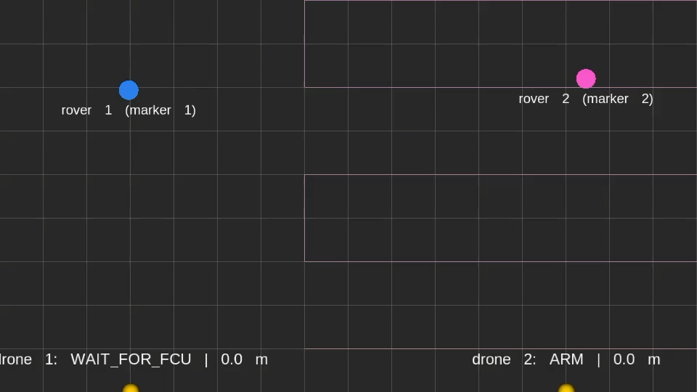
Two drones, two lost/found cycles
FIND-AND-FOLLOW · DEMO
LEGEND
rover 1, marker 1
rover 2, marker 2
drone
flown track: sweep, then follow
Status line per drone: state, height above its rover, err = distance to the rover.
Click to pause · about 3.5 min
Notes:
Plays when the slide is presented. Rover positions are drawn from ground truth for the video only; the drones never use them. Stop at 1:31 (drone 2 locks on), 1:52 (rover 2 escapes, drone 2 back to search), 2:20 (re-acquired) and 3:09 (abort, climb, return to launch).

Slide 37
Four things to do before week 8
WHERE TO START
1 · Read all three topic files
2 · Make sure your A1 node flies
At least “What you are building” and the staging table. Pick the one whose new part you want to learn.
All three topics extend it. A shaky position controller costs you time in any of them.
3 · Look at raw data first
4 · Separate callback groups
The cloud in RViz, ros2 topic hz on /localization/*, gz topic -l in the rover world. Then write code.
Perception or estimation must never stall your setpoint publisher. mt_executor_demo shows how.
WEEK 7 · 2–6 NOV
Tell your exercise teacher which topic you picked.
LRS-URK · Assignment 2 · assignments/assignment2/README.md
Notes:
Straight from the Assignment 2 README. Bring up the topic's world and look at the raw data before writing a line of code: the point cloud in RViz for obstacle avoidance, ros2 topic hz and echo on the localisation topics, gz topic -l on the rover world's cameras. Keep perception or estimation and flight control in separate callback groups from the start.

Slide 38
Questions?
Repo github.com/KocurMaros/LRS-URK → assignments/assignment2/
Topics obstacle-avoidance.md · localization.md · rover-find-and-follow.md
Help ask at the exercise · Teams · consultation hours in AIS
Eduard Zelenay (D612) · Maroš Kocúr (D612 | D613)
Notes:
A five-minute question on Tuesday is worth more than five hours of guessing on Sunday. Next week: tell us your topic.

