Slide 1
Houghova Transformácia
FEI
Eduard Zelenay
Maroš Kocúr

Slide 2
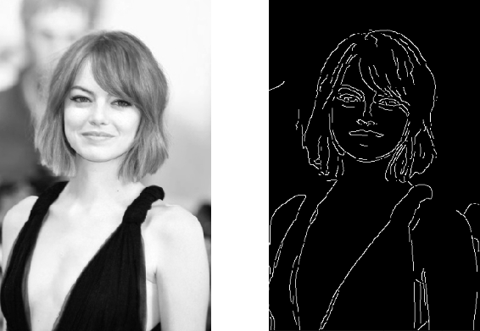
Cannyho detektor hrán

Slide 3
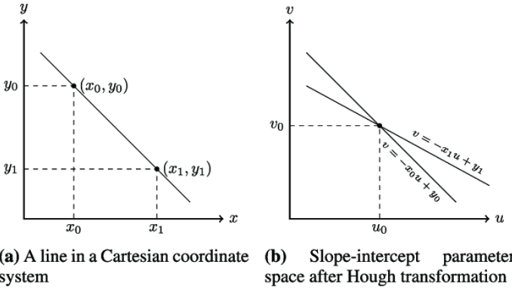

Parametrický priestor a)
$$y=ux+v$$

Slide 4
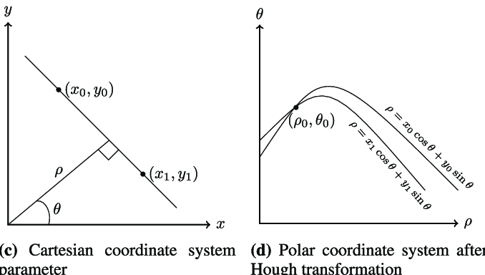

Parametrický priestor b)
$$ρ=xcos(Θ)+ysin(Θ)$$

Slide 5





Akumulačná matica
$$dim=n$$
$$n=2$$
${\text{ρ}}_{max}$ $=\sqrt{h^{2}+w^{2}}$
𝝧$=(0,180)$
$$A=(2{\text{ρ}}_{max},{\text{Θ}}_{max})$$

Slide 6







Hlasovanie
$$A=zeros()$$
$$for y=\left(0,h\right):$$
$$for x=\left(0,w\right):$$
$$if canny\left[x,y\right] !=0:$$
$$for Θ=\left(0,180\right):$$
$$ρ=int(xcos\left(Θ\right)+ysin\left(Θ\right))$$
$$A\left[ρ+{\text{ρ}}_{max},Θ\right]+=1$$

Slide 7





Výber priamok
$$lines=[]$$
$$for ρ=(size(A(1)):$$
$$for Θ=\left(size(A(2)\right):$$
$$if A\left[ρ,Θ\right]>threshold:$$
$$lines.append(ρ−{\text{ρ}}_{max},Θ)$$

Slide 8
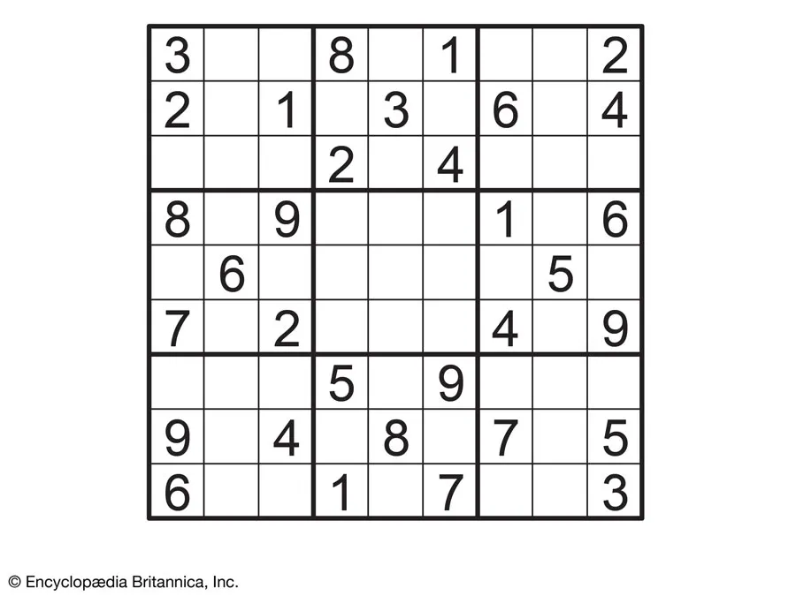
Example

Slide 9
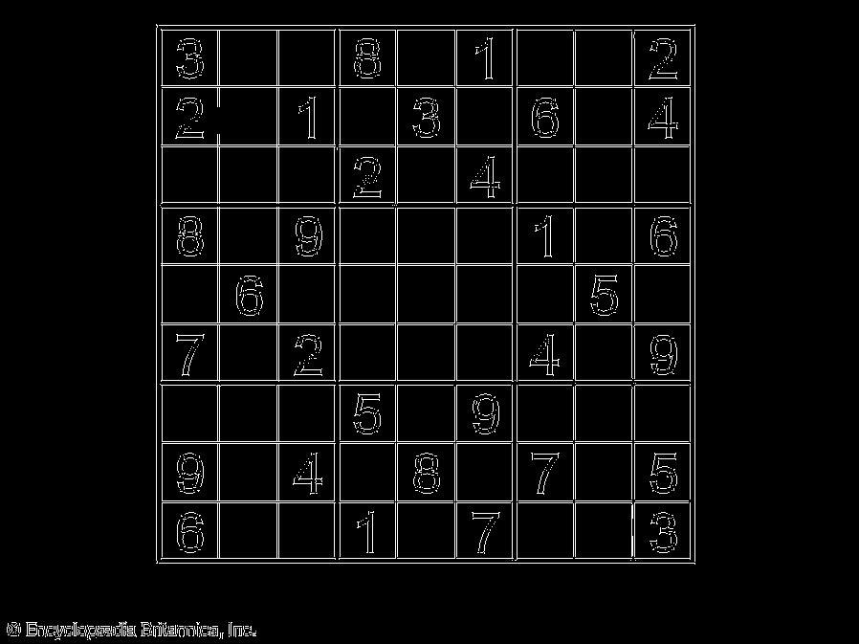
Example

Slide 10
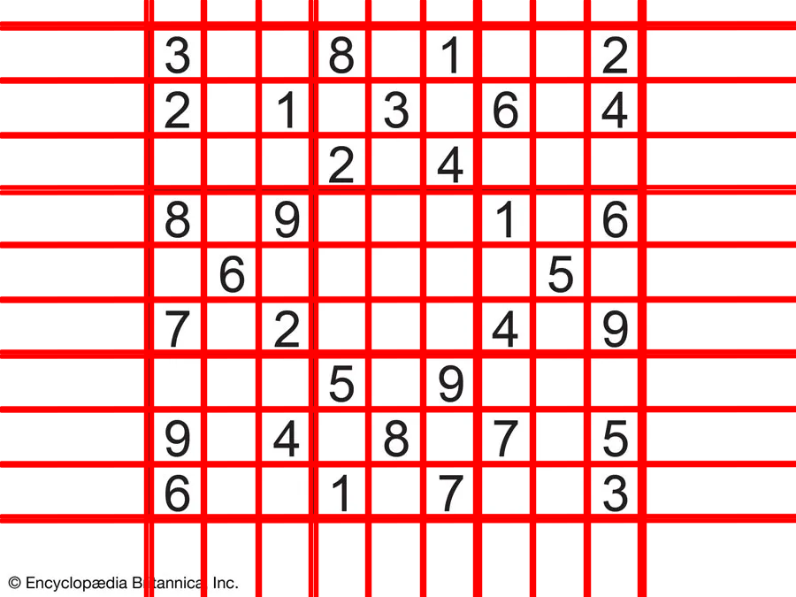
Example

