Slide 1

Inter-State Portability Transactions under ONORC Plan during Jul 2024
Reference URL of Resource: https://nfsa.gov.in/portal/Ration_Card_State_Portals_AA
Sourced Webservices/APIs: One Nation One Ration Card (ONORC) Plan
Note: State-wise Inter-State Portability data. txn_count : Transaction count
Name: Kodadhala Vikas
RollNo: 2211CS010292
College: Malla Reddy University
Gmail: Kodadhalavikas@gmail.com
Github:https://github.com/KodadhalaVikas
LinkedIn: https://www.linkedin.com/in/kodadhala-vikas-a42136290

Slide 2
Introduction:
This report analyzes transaction data between different Indian states. The dataset consists of 329 rows and 7 columns, including home state, sale state, transaction count, and timestamps (month, year). The columns in our dataset is homestatecode, salestatecode, month, year, txn_count, salestatename, homestatename.The dataset is complete with no null values and the dataset id very clean.Duplicates were removed, maintaining data integrity.

Slide 3
Data Cleaning & Processing:
Handled missing values using 'fillna’.Then Processed categorical data for analysis.Ensured data consistency before insights generation. 'salestatename' value distribution provides geographical trends.Missing values in 'homestatecode' were replaced.Identified significant variations across states.

Slide 4
Visualizations Used in our data analysis:
Bar Charts: Top 10 home and sale states by transaction volume.
Pie Charts: Distribution of transactions by state.Comparison between states like Delhi vs. Uttar Pradesh.
Box Plots: Transaction spread across different states.
Scatter Plot: Relationship between home states and transaction volume. Histograms: Frequency distribution of transaction counts.

Slide 5
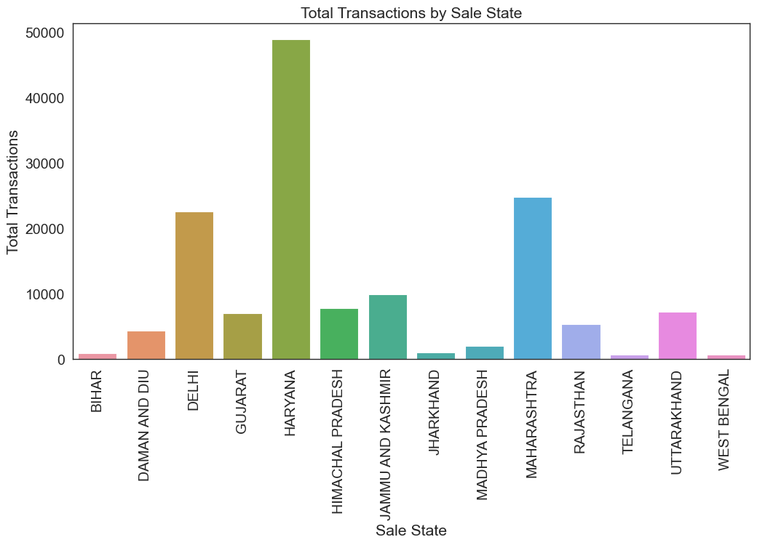
Visualization: Top State Pairs by Transactions

Slide 6
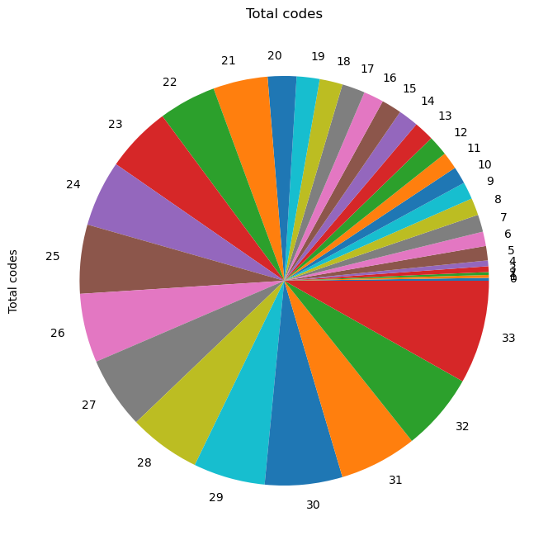
Pie chart

Slide 7
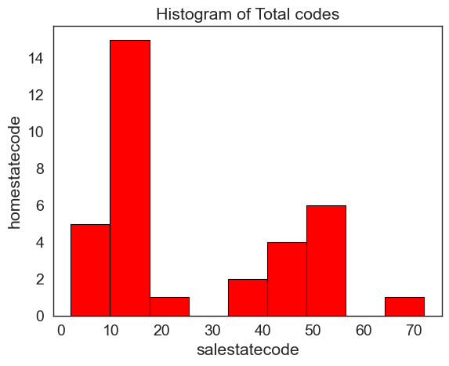
Plot Repesentation by using seaborn

Slide 8
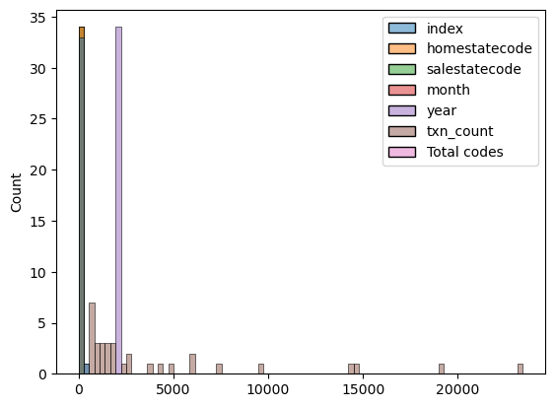
Histplot using seaborn

Slide 9
Conclusion & Observations :
Data cleaning improves reliability of analysis. State-wise trends highlight policy impacts. Further analysis needed for deeper insights. Delhi and Uttar Pradesh dominate in terms of transactions. Although there are variations by state, there was no statistically significant difference between the major states.

