Slide 1


AI-POWERED SYSTEM FOR RIPENESS DETECTION & ADVICE
Sk. Mahimud 22KN1A6134
A. Sulochana Kumari 22KN1A6103 K. Suchitra Kamala 22KN1A6145
Ch. Phanindra Babu 22KN1A6115
Guided By: Dr. T. Manasa Veena

Slide 2
Project Agenda
Comprehensive overview of automated post-harvest solutions using Deep Learning architectures and Streamlit deployment.

Slide 3

Abstract
This project presents an AI-powered system for automated fruit and vegetable ripeness detection and post-harvest storage guidance using deep learning and computer vision techniques. The system classifies produce into Unripe, Ripe, and Overripe stages by analyzing visual features such as color, texture, and shape through a transfer learning–based CNN model using EfficientNetB0. An interactive web application built with Streamlit enables users to upload or capture images and receive real-time predictions with confidence scores. The proposed approach aims to reduce post-harvest losses by providing accurate ripeness assessment and suitable storage recommendations for farmers and vendors.

Slide 4




OVERVIEW & OBJECTIVES
Core Objective
Loss Prevention
To develop a real-time detection tool utilizing EfficientNetB0 to minimize subjective human judgment in agriculture.
Reduce massive post-harvest losses by providing data-driven storage recommendations to farmers and vendors.

Slide 5

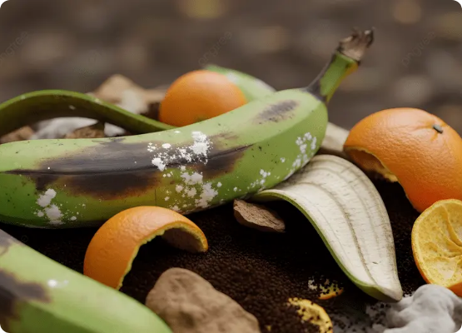
MOTIVATION: THE GLOBAL CRISIS
Post-Harvest Challenges
Annual Loss: Nearly ₹29,000 crore lost annually in India alone due to spoilagae.
Manual Methods: Traditional visual inspection is time-consuming and prone to 20% inaccuracy.
Economic Impact: Significant revenue drops for small-scale farmers due to improper storage.

Slide 6

FRUIT LOSS DISTRIBUTION (INDIA)
Tomato (24%)
Apple (22%)
Mango (20%)
Orange (20%)
Banana (14%)
Percentages normalized to 100% group share (Data Source: 2020-2024 Tropical Agriculture region stats).

Slide 7
LITERATURE SURVEY
Model Family | Implementation Type | Advantages | Trade-offs
YOLO Series (v5,v8) | Single-Stage Object Detection | High speed, real-time bounding boxes | High computational demand
SSD-MobileNetV1 | Lightweight Backbone | Fastest inference (102 FPS) | Significant mAP drop (71.7%)
Transformer-based | Attention-based Vision | Excellent global context | Heavy resource consumption
EfficientNetB0 | Proposed CNN Backbone | High accuracy (99.4%) with low parameters | Classification focused
Table 1: Literature Survey on Ripeness detection

Slide 8




EXISTING METHODOLOGY
LEGACY MODELS
FEATURE EXTRACTION
ACCURACY CAP
Utilization of YOLO (v5, v6, v7) and SSD-MobileNet frameworks for real-time fruit localized detection.
MobileNetV2 backbone for lightweight computation with a focus on binary and multi-class classification.
Achieved peak overall accuracy of 99.3%, though performance drops significantly in complex lighting.

Slide 9

PROPOSED METHODOLOGY
EfficientNetB0 Backbone
We leverage Transfer Learning to adapt pre-trained weights for specialized agricultural tasks.
Stem Convolution: Initial visual encoding of RGB channels.
MBConv Blocks: Captures complex cues like texture degradation and dullness.
Softmax Head: Normalized probabilities across mutually exclusive classes.

Slide 10
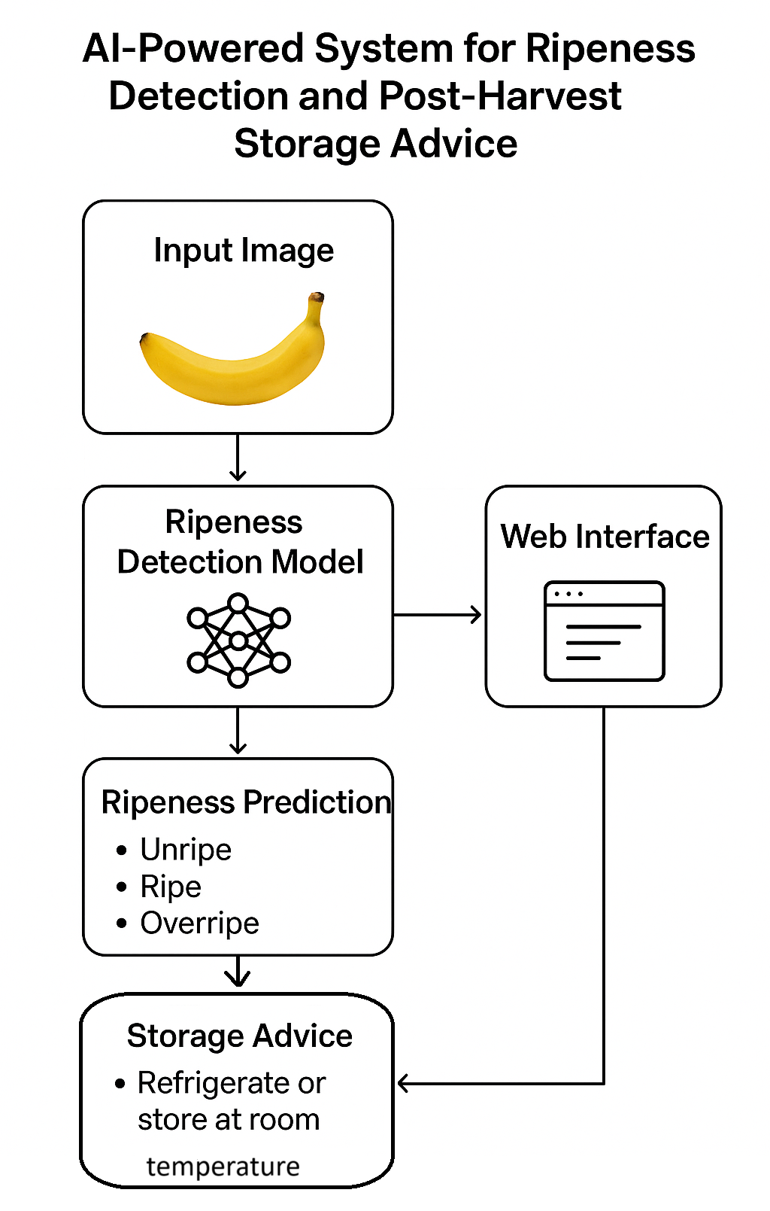
Block Diagram
Figure 1: The image is block diagram of the system working

Slide 11
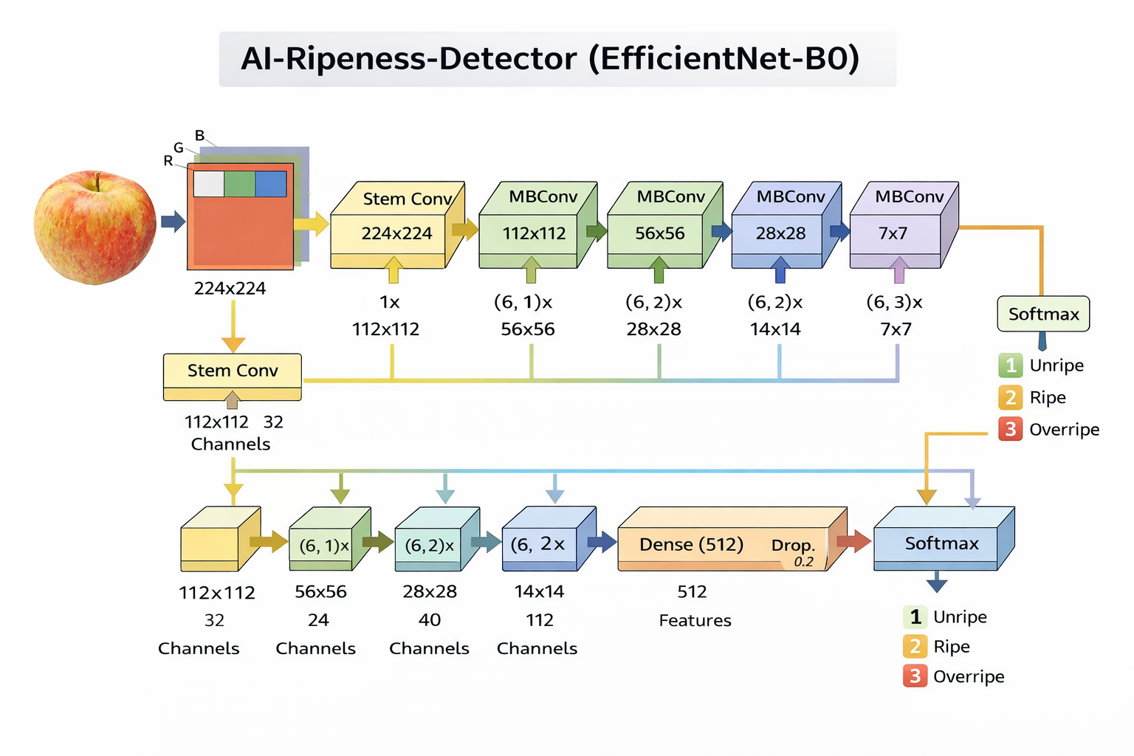
Architecture
Figure 2: The architecture of the EfficientNetB0 which is used in the model training.

Slide 12



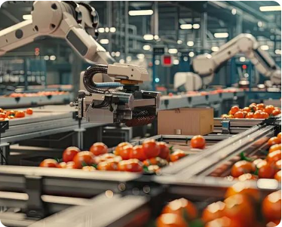
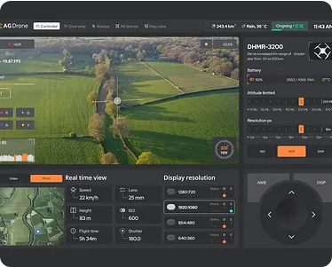
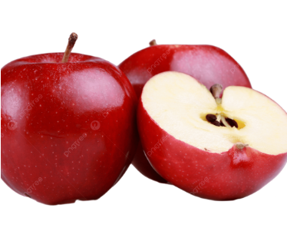
SYSTEM WORKFLOW
1. Image Acquisition
2. AI Processing & Analysis
3. Ripeness Output & Advice

Slide 13




MATHEMATICAL PRE-REQUISITES
Image Conditioning (Preprocessing):
EfficientNetB0 Feature Extraction (Transfer Learning):
Global Average Pooling (Spatial Evidence Consolidation):
$$I_{cond}=Ψ(Ω\left(I\right))$$
$$F_{ripeness}=Φ_{B0}(I_{cond})$$
$$e_{c}=\frac{1}{HW}\sum_{x=1}^{H}{\sum_{y=1}^{W}{f_{c}\left(x,y\right)}}$$
Resizes images to 224×224
Normalizes pixel values to ImageNet Distribution
Ensures compatibility with EfficientNetB0
Extracts color, texture, maturity cues
Uses Pre-trained EfficientNetB0
Only upper layers are fine-tuned for ripeness
Agregates ripeness evidence across entire fruit
Removes dependence on exact fruit position
Produces global feature representation

Slide 14


MATHEMATICAL PRE-REQUISITES
Softmax Classification Function:
Categorical Cross-Entropy Loss
$$P\left(y_{i}\right)=\frac{e^{z_{i}}}{\sum_{j=1}^{C}{e^{z_{j}}}}$$
$$L_{CE}=−\sum_{i=1}^{C}{y_{i}\log\left(P\left(y_{i}\right)\right)}$$
Converts logits to probabilities
Ensures mutual exclusivity of ripeness status
Used to compute compute confidence Levels
Resizes images to 224×224
Normalizes pixel values to ImageNet Distribution
Ensures compatibility with EfficientNetB0

Slide 15
SYSTEM CONFIGURATION
Fruit | Class | Color | Texture | Size | Shape
Apple | Unripe | Green(somev arients) | Firm/ Smooth | Medium | Round
 | Ripe | Red/Green/ Yellow | Smooth/Firm
 | Rotten | Brown/Black patchs | Soft/Wrinkled | Medium (may SHrink) | Misshapen
Banana | Unripe | Green | Firm/ Smooth Skin | Medium | Curved cylindrical
 | Ripe | Yellow, sometimes flecked brown | Smooth to slight bruises
 | Rotten | Brown/ Black spots | Soft/Mushy | Medium (may shrink) | Curved irregular
Mango | Unripe | Green | Firm | Medium | Oval
 | Ripe | Yellow/Red/or mix | Slightly Soft
 | Rotten | Black/Brown | Soft/Moldy |  | Irregular
Orange | Unripe | Greenish/ Yellow | Firm/ Bumpy | Medium | Round
 | Ripe | Bright Orange | Slightly textured
 | Rotten | Dull/Moldy | Soft/Moldy |  | Misshapen

Slide 16
SYSTEM PERFORMANCE RESULTS
99.4%
Model Metrics
Precision: 99.5% (High reliability)
Recall: 99.4% (Broad coverage)
Inference: Suitable for edge devices and mobile deployment.
OVERALL ACCURACY

Slide 17
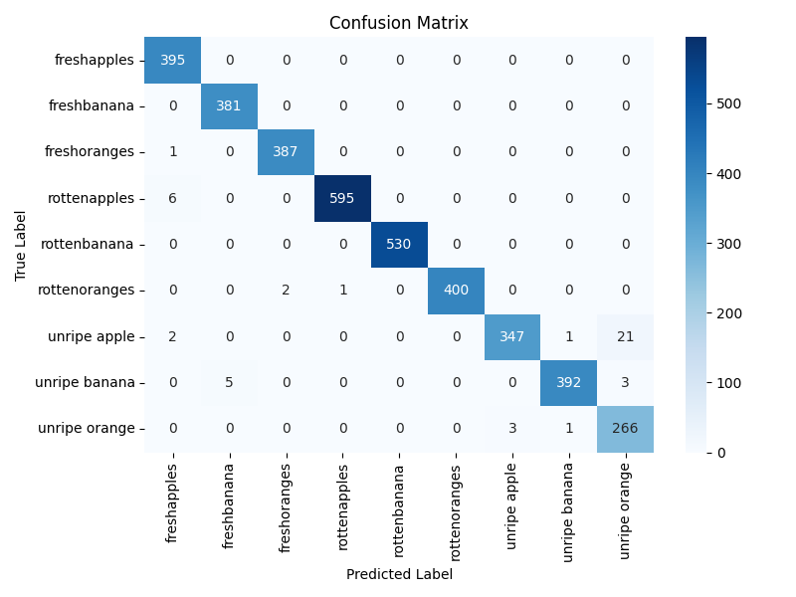
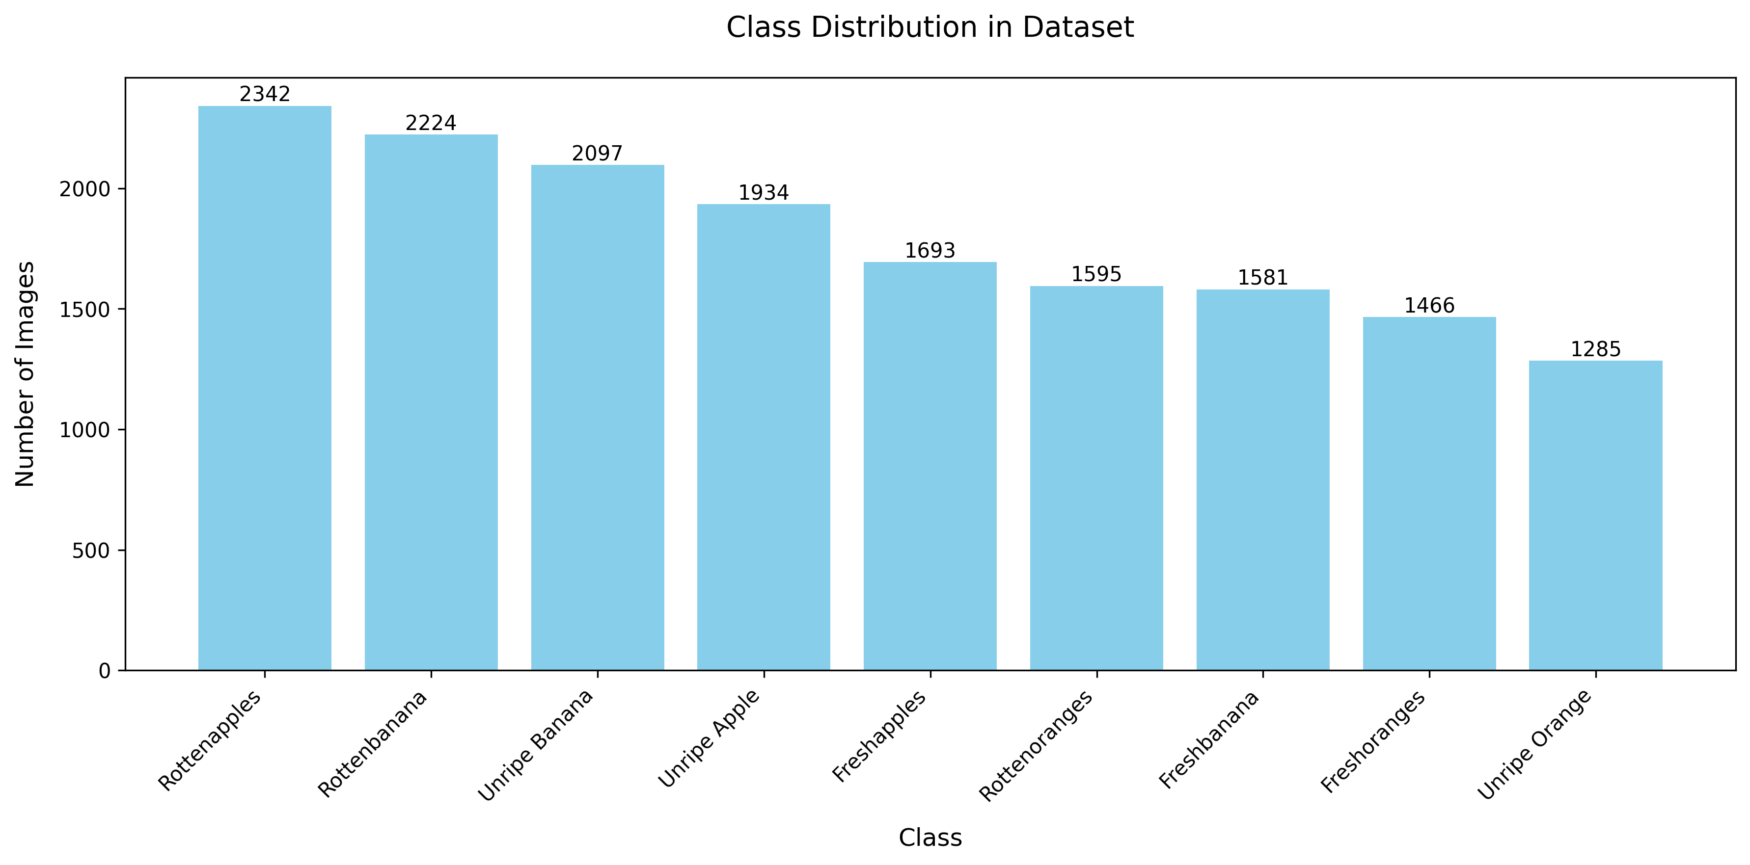
RESULTS
Figure 3: Confusion Matrix and Class-wise Precision-Recall Curve for Proposed EfficientNetB0 Ripeness Classification.
Figure 4: Class distribution of the dataset which is classified based on no.of images for different class.

Slide 18
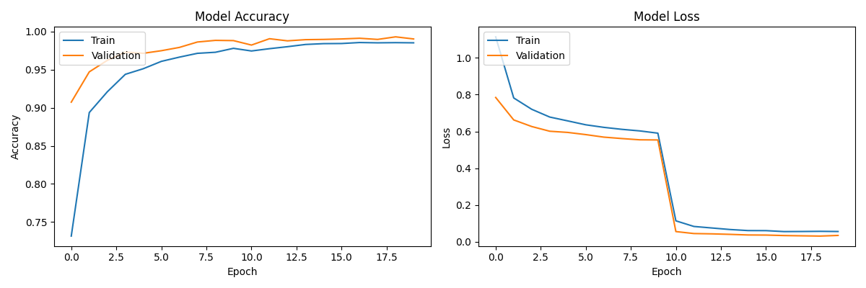
RESULTS
Figure 5: Accuracy and loss curves of the EfficientNetB0: Train and Validation sets.

Slide 19
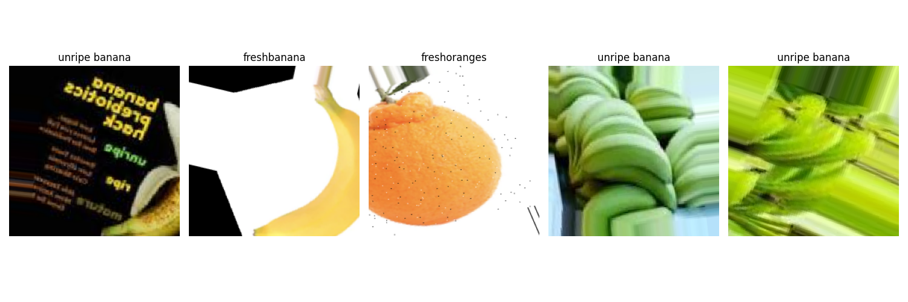
RESULTS
Figure 6: Sample Images while training the images.

Slide 20
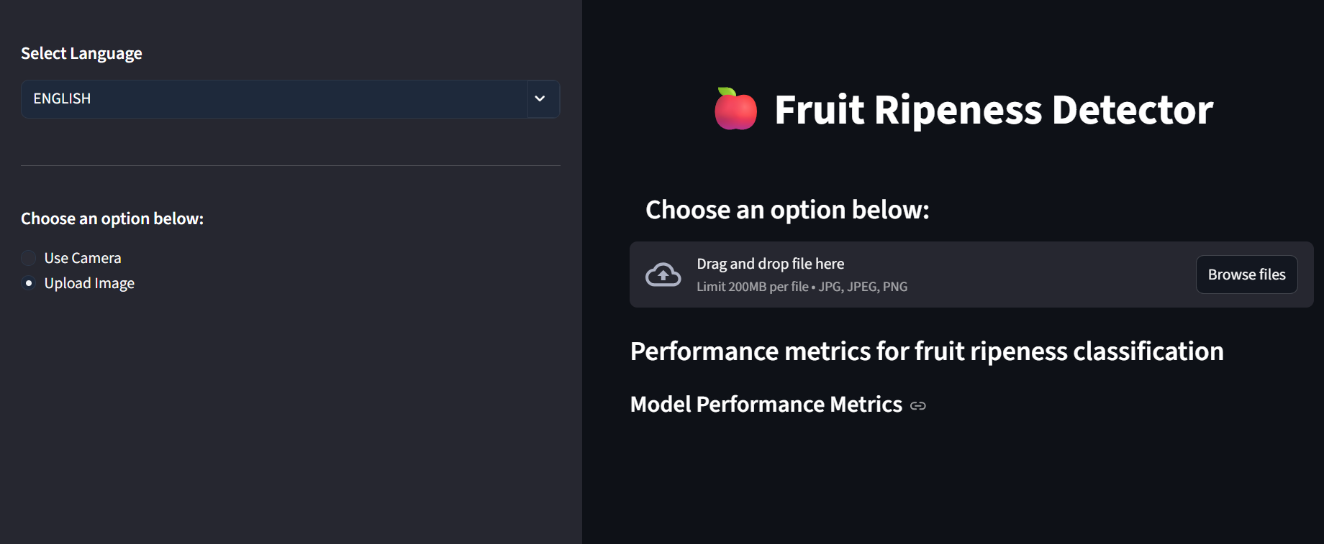
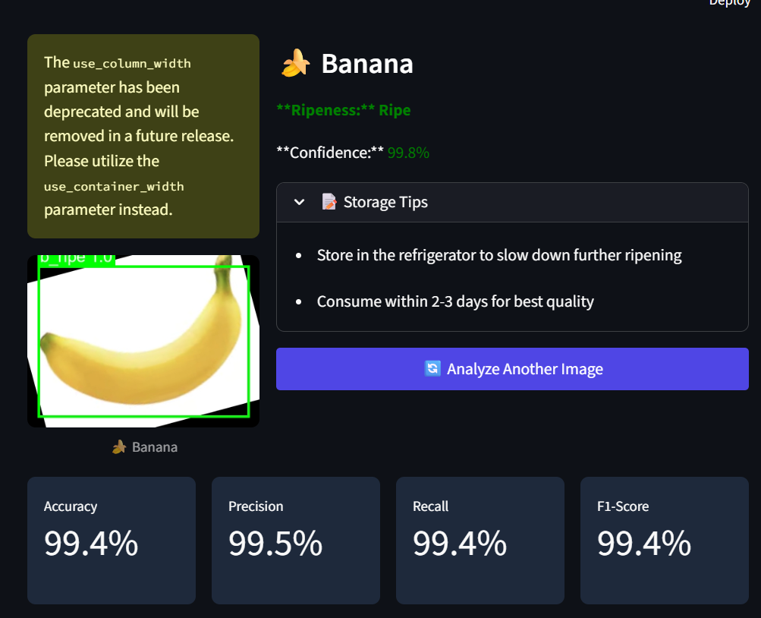
RESULTS
Figure 7: The interface first look of Fruit Ripeness Detector.
Figure 8: After analyzing the fruit it shows the Ripeness class, Confidence, Storage tips.

Slide 21
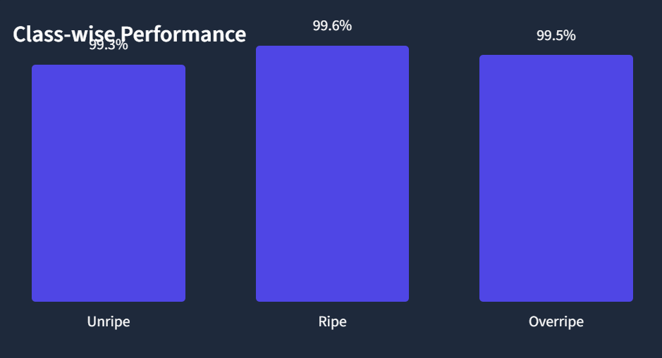
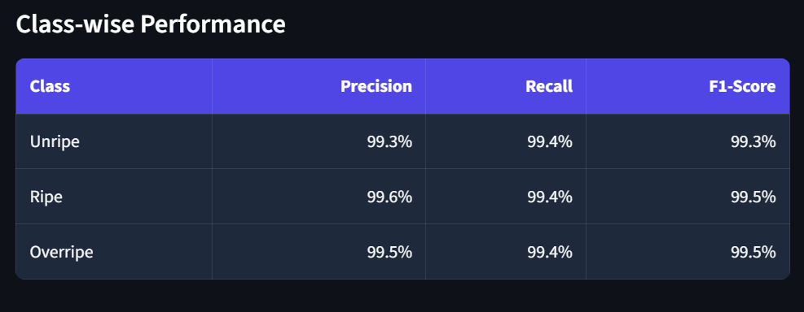
RESULTS
Figure 9: Class distribution for the fruit detection in a graph.
Figure 10: Performance metrics percentage of the fruit.

Slide 22
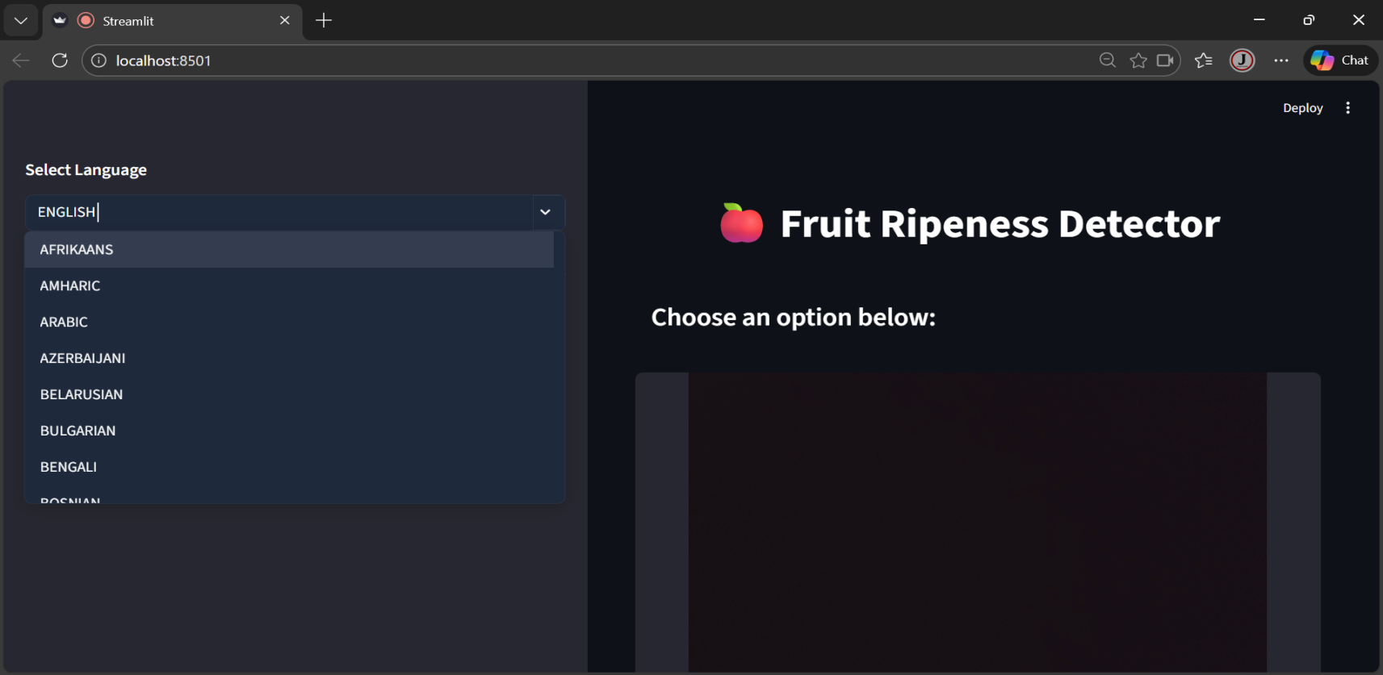
RESULTS
Figure 11: Multiple Languages can be used interact with user friendly.

Slide 23
Project Outcomes
The technology demonstrates a non-destructive means of quality evaluation capable of decreasing agricultural losses by up to 15-20%. This autonomous approach offers more efficiency and objectivity than traditional manual inspection.

Slide 24
Conclusion
The AI-powered system accurately identifies fruit ripeness using deep learning and image analysis techniques. Ripeness classification combined with proper storage guidance helps reduce fruit wastage and maintain quality after harvest. Automated analysis improves consistency and reduces human error in decision-making. The system can be easily applied across farms, markets, and storage facilities. Overall, the approach supports efficient and practical use of AI in real-world agricultural applications.

Slide 25
References
P. Kamat, S. Gite, H. Chandekar, L. Dlima, and B. Pradhan, “Multi-class fruit ripeness detection using YOLO and SSD object detection models,” Discover Applied Sciences, vol. 7, 2025.
A. Authors et al., “Deployment of an IoT and ML-driven platform for fruit ripeness evaluation and spoilage detection: A case study on bananas,” Journal of Food Quality, 2024.
H. Yu et al., “Ripe-detection: AI-lightweight method for strawberry ripeness detection,” Agronomy, vol. 15, no. 7, p. 1645, 2025.
A. Authors et al., “Deployment of CES-YOLO: An optimized YOLO-based model for blueberry ripeness detection on edge devices,” Scientific Reports, vol. 15, 2025.
A. Authors et al., “Hybrid attention transformer integrated YOLOv8 for fruit ripeness detection,” ScienceDirect, 2025.

Slide 26
Queries?
Thank you for your attention.

