Slide 1



To develop a CNN model to classify images of plastic waste
Exploring the development of a CNN model for effective classification of plastic waste images in waste management.
Kodali Suchitra Kamala

Slide 2
Project Description
An overview of the project, its objectives, and the problem it addresses. We will discuss the motivation behind the project and its anticipated impact.

Slide 3

Learning Objectives
Upon completing this project, learners will be able to design and implement a Convolutional Neural Network (CNN) model to classify images of plastic waste, understand the importance of data preprocessing and augmentation, and evaluate and optimize the model's performance. Additionally, learners will gain insight into the environmental impact of plastic waste and the applications of CNN models in real-world problems.
GOAL
Source :
www.freepik.com/

Slide 4
Week-1
Libraries, Data Import, and Setup
In the first week, we focused on importing the necessary libraries and frameworks crucial for our data analysis project. The project environment was set up to ensure all tools were functioning correctly. Additionally, we explored the dataset structure to understand the available data.
GOAL
Source :
www.freepik.com/

Slide 5
Week-2
TBD
Details for Week 2 will be determined based on progress from Week 1 and further project requirements.
GOAL
Source :
www.freepik.com/

Slide 6
Week-3
TBD
Details for Week 3 will also be established following the outcomes from the initial weeks and project advancements.
GOAL
Source :
www.freepik.com/

Slide 7
Tools and Technology used
An Overview of Essential Tools for Data Science and Machine Learning
Python: The Versatile Programming Language
Python is widely recognized for its simplicity and readability, making it an ideal choice for both beginners and experienced developers. It supports various programming paradigms and has a rich ecosystem of libraries and frameworks that enhance its capabilities.
TensorFlow/Keras: Powering Deep Learning
TensorFlow, paired with Keras, provides a powerful framework for developing machine learning models. These tools enable easy model construction, training, and deployment, thus accelerating the development of intelligent applications.
OpenCV: Computer Vision at Its Best
OpenCV is an open-source computer vision library that facilitates real-time image processing and analysis. It is extensively used in image recognition, motion tracking, and various other computer vision tasks.

Slide 8
Tools and Technology used
An Overview of Essential Tools for Data Science and Machine Learning
NumPy: The Foundation for Numerical Computing
NumPy is a fundamental package for scientific computing in Python. It provides support for large multidimensional arrays and matrices, along with a collection of mathematical functions to operate on these data structures.
Pandas: Data Manipulation Made Easy
Pandas is a powerful data analysis and manipulation library for Python. It offers data structures like DataFrames that make it easy to work with structured data, enabling efficient data cleaning and analysis.
Matplotlib: Visualizing Data Effectively
Matplotlib is a comprehensive library for creating static, animated, and interactive visualizations in Python. It allows developers to create high-quality plots and graphs to communicate data insights effectively.

Slide 9
Methodology
Waste Classification Overview
A Step-by-Step Guide to Developing a CNN for Plastic Waste Classification
01
02
03
04
Data Collection
The first step in developing a CNN model is to gather a comprehensive dataset of images depicting various types of plastic waste. This dataset serves as the foundation for training the model, ensuring it can learn to identify and classify different forms of plastic effectively.
Model Architecture Design
Next, you will design the architecture of the CNN model. This involves selecting the number of layers, types of layers, activation functions, and optimization algorithms that will be used to create a robust model capable of recognizing plastic waste patterns.
Training the Model
Once the model architecture is established, the training phase begins. During this phase, the model learns from the collected dataset by adjusting its internal parameters to minimize classification errors. This process often requires multiple iterations and fine-tuning to achieve optimal performance.
Model Evaluation
After training, the model's performance is evaluated using a separate validation dataset. This step is crucial to ensure that the model can generalize well to new, unseen data. Metrics such as accuracy, precision, and recall are commonly used to assess the model's effectiveness.

Slide 10
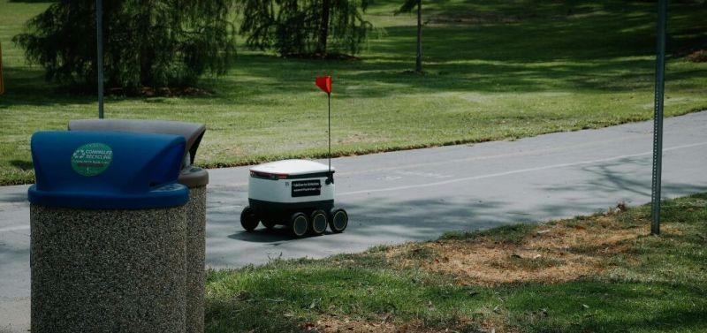
Future Scope
Exploring potential advancements in plastic waste management
1
Expanding the dataset to include more plastic waste categories
By diversifying the dataset, we can improve the accuracy and effectiveness of our plastic waste management model. This expansion will allow us to address various types of plastics, enhancing our understanding of their environmental impact and facilitating more targeted solutions.
Deploying the model as a web or mobile application for real-time use
Transforming the model into a user-friendly application will enable stakeholders to access real-time data and insights on plastic waste management. This accessibility will empower users to make informed decisions quickly, promoting timely interventions and sustainable practices.
Integration with IoT-enabled waste management systems
Leveraging Internet of Things (IoT) technology will facilitate smarter waste tracking and management. This integration will enhance operational efficiency, reduce costs, and provide valuable data for continuous improvement in waste disposal and recycling processes.
2
3

Slide 11
Training Parameters and Techniques
Exploring Key Components of Model Training
01
02
03
04
05
Optimizer: Adam
Loss Function: Categorical Cross-entropy
Configurable Epochs
Configurable Batch Size
Data Augmentation Techniques
The Adam optimizer is utilized for its efficiency in handling large datasets and its adaptability in learning rates, making it an ideal choice for complex model training.
Categorical Crossentropy is employed as the loss function, which is particularly effective for multi-class classification tasks, ensuring that the model's predictions align closely with the true class labels.
The number of training epochs is configurable, with a default set at 25. This flexibility allows for adjustments based on the model's performance during training, enabling optimization for better accuracy.
The batch size is also configurable, with a default of 32. This parameter influences the training speed and memory usage, allowing for fine-tuning based on the available computational resources.
To enhance model performance and generalizability, various data augmentation techniques were utilized. These techniques help to create diverse training examples from the existing dataset, reducing overfitting and improving model robustness.

Slide 12
Problem Statement
Waste management is a critical environmental challenge that requires efficient and accurate classification of waste materials. Traditional methods of waste segregation are often manual, time-consuming, and prone to errors. This project aims to develop a Waste Classification System using a Convolutional Neural Network (CNN) model to automate the process of identifying and categorizing waste into organic and recyclable classes. By leveraging deep learning techniques, this system seeks to enhance waste segregation efficiency, reduce environmental pollution, and promote sustainable recycling practices.

Slide 13
Solution
The waste classification problem is addressed using a Convolutional Neural Network (CNN) model, which automates the identification of waste into organic and recyclable categories. The solution involves preprocessing the dataset by collecting and labeling waste images, followed by applying image augmentation techniques to improve model generalization. The CNN model is built with multiple convolutional and pooling layers to extract key features from images. The architecture consists of three convolutional layers with ReLU activation and max pooling, followed by a fully connected layer with dropout for regularization. The final classification is achieved using a softmax activation function. The dataset is split into training and testing sets, with images resized to a uniform shape. TensorFlow and Keras are used for model development, and OpenCV processes image data. The model is compiled using the Adam optimizer and trained over multiple epochs, achieving high accuracy. The trained model is then validated on test data to ensure robustness. This automated waste classification system enhances efficiency, reduces manual labor, and promotes sustainable waste management by improving sorting accuracy, thereby supporting environmental conservation efforts.

Slide 14
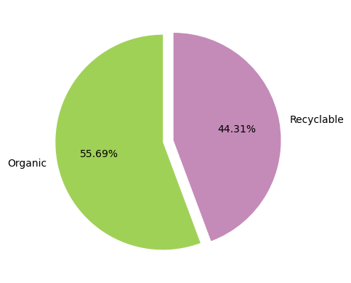
Screenshot of Output

Slide 15
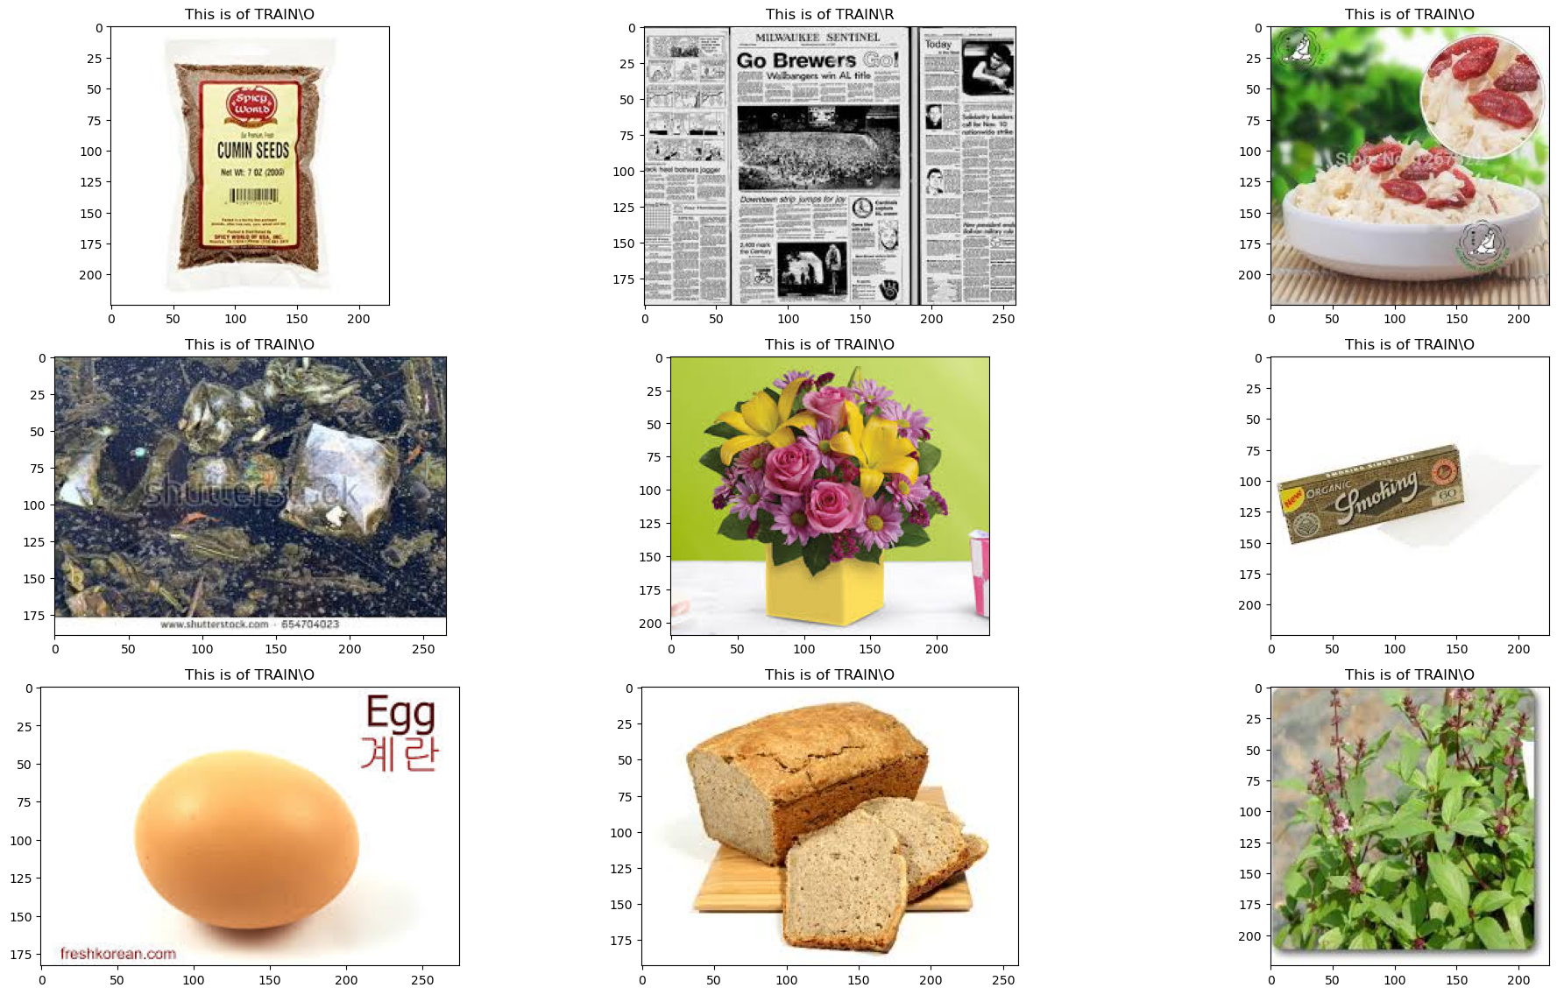
Screenshot of Output

Slide 16
Screenshot of Output
Model: "sequential_2"
Layer (type) | Output Shape | Param #
conv2d_6 (Conv2D) | (None, 222, 222, 32) | 896
activation_12 (Activation) | (None, 222, 222, 32) | 0
max_pooling2d_6 (MaxPooling2D) | (None, 111, 111, 32) | 0
conv2d_7 (Conv2D) | (None, 109, 109, 64) | 18,496
activation_13 (Activation) | (None, 109, 109, 64) | 0
max_pooling2d_7 (MaxPooling2D) | (None, 54, 54, 64) | 0
conv2d_8 (Conv2D) | (None, 52, 52, 128) | 73,856
activation_14 (Activation) | (None, 52, 52, 128) | 0
max_pooling2d_8 (MaxPooling2D) | (None, 26, 26, 128) | 0
flatten_2 (Flatten) | (None, 86528) | 0
dense_6 (Dense) | (None, 256) | 22,151,424
activation_15 (Activation) | (None, 256) | 0
dropout_4 (Dropout) | (None, 256) | 0
dense_7 (Dense) | (None, 64) | 16,448
activation_16 (Activation) | (None, 64) | 0
dropout_5 (Dropout) | (None, 64) | 0
dense_8 (Dense) | (None, 2) | 130
activation_17 (Activation) | (None, 2) | 0
Total params: 22,261,250 (84.92 MB)
Trainable params: 22,261,250 (84.92 MB)
Non-trainable params: 0 (0.00 B)

Slide 17
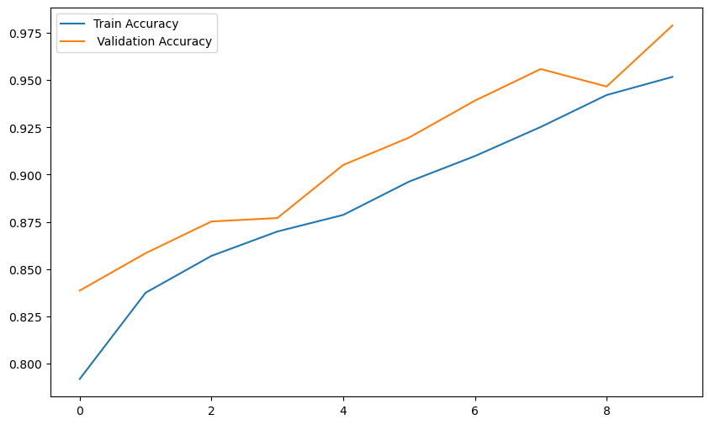
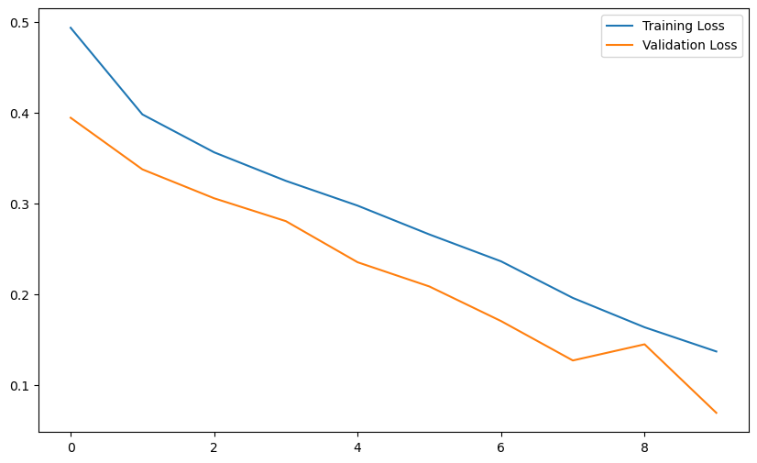
Screenshot of Output

Slide 18
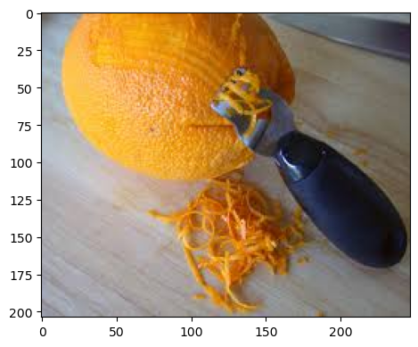
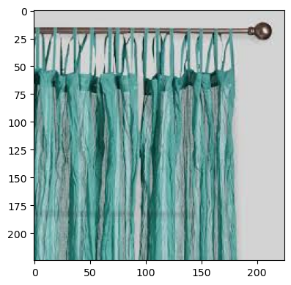
Screenshot of Output

Slide 19
Conclusion
The implementation of a Convolutional Neural Network (CNN) for waste classification has demonstrated significant potential in automating and improving the efficiency of waste segregation. By leveraging deep learning techniques, the model effectively classifies waste into organic and recyclable categories with high accuracy, reducing manual efforts and errors in waste management. The integration of image preprocessing, data augmentation, and a well-structured CNN architecture has contributed to the model’s robustness and effectiveness. The system’s ability to process and categorize waste images efficiently promotes sustainable recycling practices, environmental conservation, and enhanced waste disposal management. With further improvements in dataset diversity, model optimization, and real-world deployment, this approach can significantly contribute to smart waste management solutions, reducing pollution and fostering a cleaner, more sustainable environment.

