Slide 1
REVISED ARCHITECTURE ( MICRON )
By
SHAZAM

Slide 2
Tech involved:
Spark : An open source framework used for processing and analysing data.
TeraData: Open Source data management system.
NiFi: A powerful system for Data Routing.
Tableau/ Splunk : Tools used to convert Raw Data to Processed Data using Machine Learning.

Slide 3
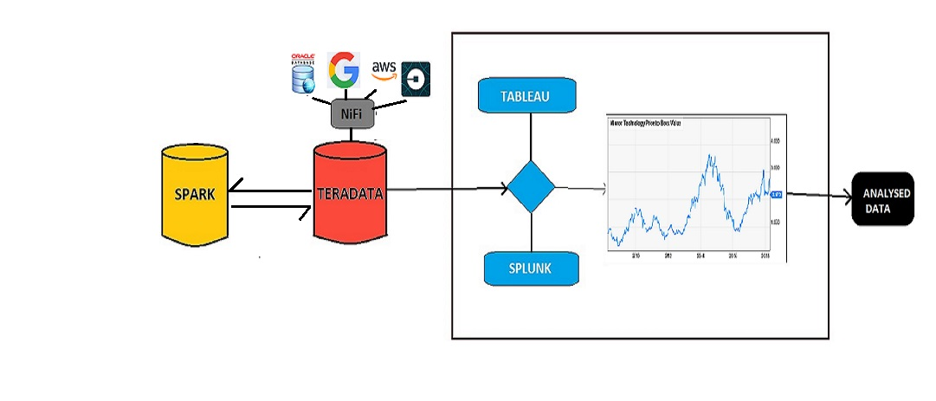
PROPOSED ARCHITECTURE

Slide 4
WORKING:
Raw Data is inserted into TeraData and using NiFi, the data is routed back to Spark where the data is analysed.
Later the analysed data is sent to Tableau and/or Splunk which convert the data into Data Visualised

Slide 5
Graphs and Tables using Machine Learning algorithms specifically designed for large sets of data.
Finally, structured data is formed at the end which is directly supplied to the desired end.

Slide 6
SPARK IS BETTER:
In-memory Processing: In-memory processing is faster when compared to Hadoop, as there is no time spent in moving data/processes in and out of the disk. Spark is 100 times faster than MapReduce as everything is done here in memory.
Stream Processing: Apache Spark supports stream processing, which involves continuous input and output of data.
Lazy Evaluation: Apache Spark starts evaluating only when it is absolutely needed.

Slide 7
Hope our Architecture will help in the betterment of your Company.

Slide 8
QQQueries?
Contact:
GitHub: https://github.com/KodandaRam66
Phone: 7989915889

Slide 9
THANK YOU!
Team Shazam:
Siddharth Malladi
Anurag Achanta
Kodanda Ram
Siva Krishna

