Slide 1
Lasso Regression
Fold | RMSE
1 | 0.1763
2 | 0.1622
3 | 0.1552
4 | 0.3002
5 | 0.1999
Average | 0.1987
Random Forest
Fold | RMSE
1 | 0.1693
2 | 0.1576
3 | 0.1532
4 | 0.2764
5 | 0.1937
Average | 0.1901
SVR
Fold | RMSE
1 | 0.1638
2 | 0.1677
3 | 0.1563
4 | 0.2886
5 | 0.2017
Average | 0.1956
3-model-ensemble
Fold | RMSE
1 | 0.1693
2 | 0.1622
3 | 0.1536
4 | 0.2879
5 | 0.1974
Average | 0.1941
total_model_loss = loss_svr + loss_rf + loss_lasso
w_svr = total_model_loss/loss_svr
w_rf = total_model_loss/loss_rf
w_lasso = total_model_loss/loss_lasso
$$y_{ensemble}=y_{SVR}×\frac{w_{SVR}}{w_{SVR}+w_{RF}+w_{Lasso}}+y_{RF}×\frac{w_{RF}}{w_{SVR}+w_{RF}+w_{Lasso}}+y_{Lasso}×\frac{w_{Lasso}}{w_{SVR}+w_{RF}+w_{Lasso}}$$

Slide 2
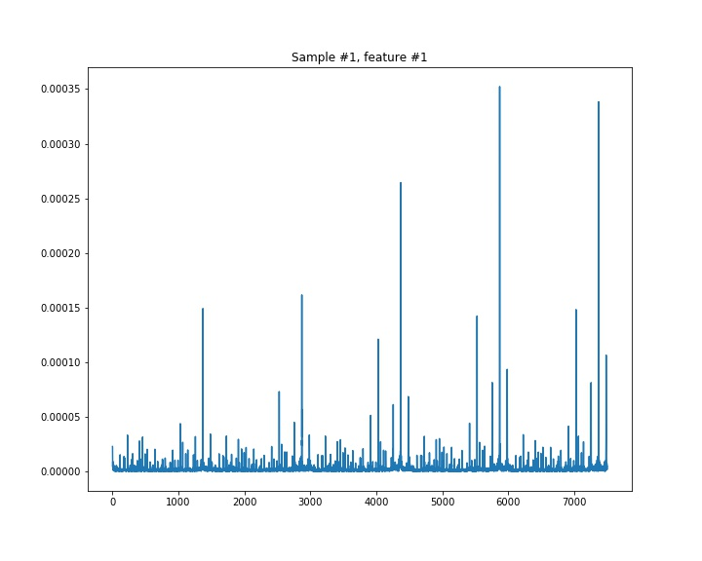
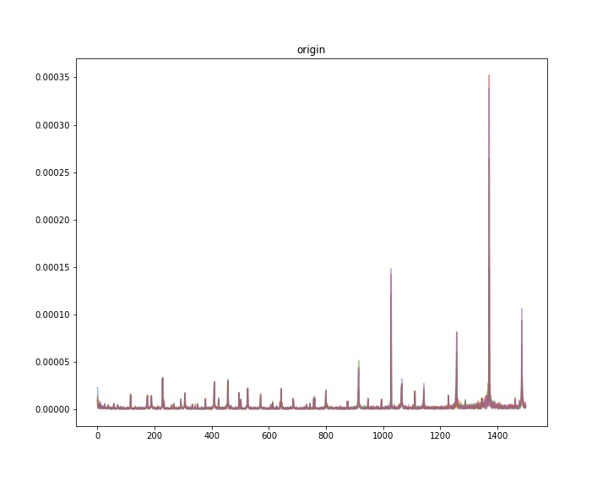
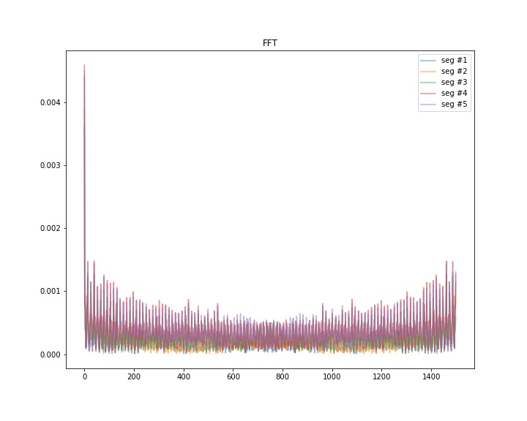
觀察7500個timesteps中，peak-to-peak的週期為1500。
我們將資料分為5個製成區段，取其統計值min、max、std、skew，發現模型均沒之前表現優異。
接著我們將各區段訓好進行FFT轉換，發現取其各區段量值的最大值，模型反應較為優異。而其中第1、4、5區段最能反映出來，故以此為Feature進行訓練。
1500

Slide 3
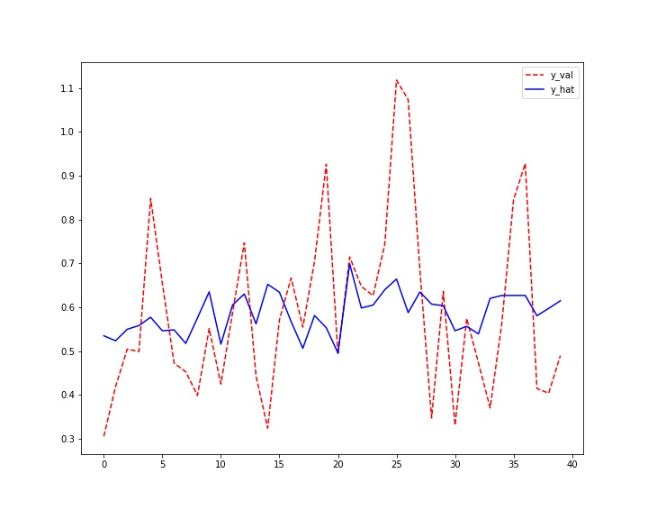
Lasso Regression
Fold | RMSE
1 | 0.1763
2 | 0.1622
3 | 0.1552
4 | 0.3002
5 | 0.1999
Average | 0.1987
Random Forest
Fold | RMSE
1 | 0.1316
2 | 0.1596
3 | 0.1921
4 | 0.2629
5 | 0.2140
Average | 0.1920
SVR
Fold | RMSE
1 | 0.1502
2 | 0.1540
3 | 0.1257
4 | 0.2550
5 | 0.1711
Average | 0.1712
3-model-ensemble
Fold | RMSE
1 | 0.1432
2 | 0.1525
3 | 0.1456
4 | 0.2669
5 | 0.1902
Average | 0.1797

