Slide 1
HATCH AND VENTILATION
OLAMIDE OLAYINKA

Slide 2
OVERVIEW
Introduction
Latch Mechanism
Hinge Motion
Latch Key
Ventilation Airflow Analysis
Fan Baffle designs
Hatch Flange
Summary

Slide 3
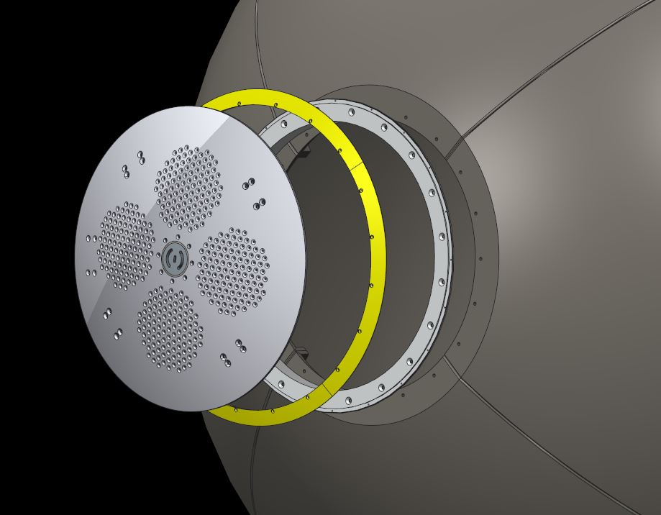
INTRODUCTION
Hatch plate
Hatch flange
Hatch ring
Figure 1 : Hatch components [3]

Slide 4
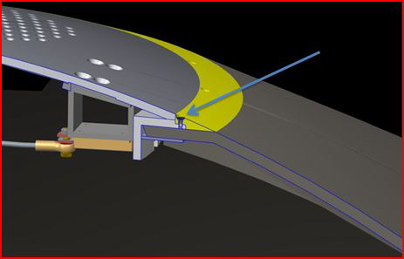
Hatch Interface
Figure 2: Hatch plate Interface with hatch flange and ring [2]

Slide 5
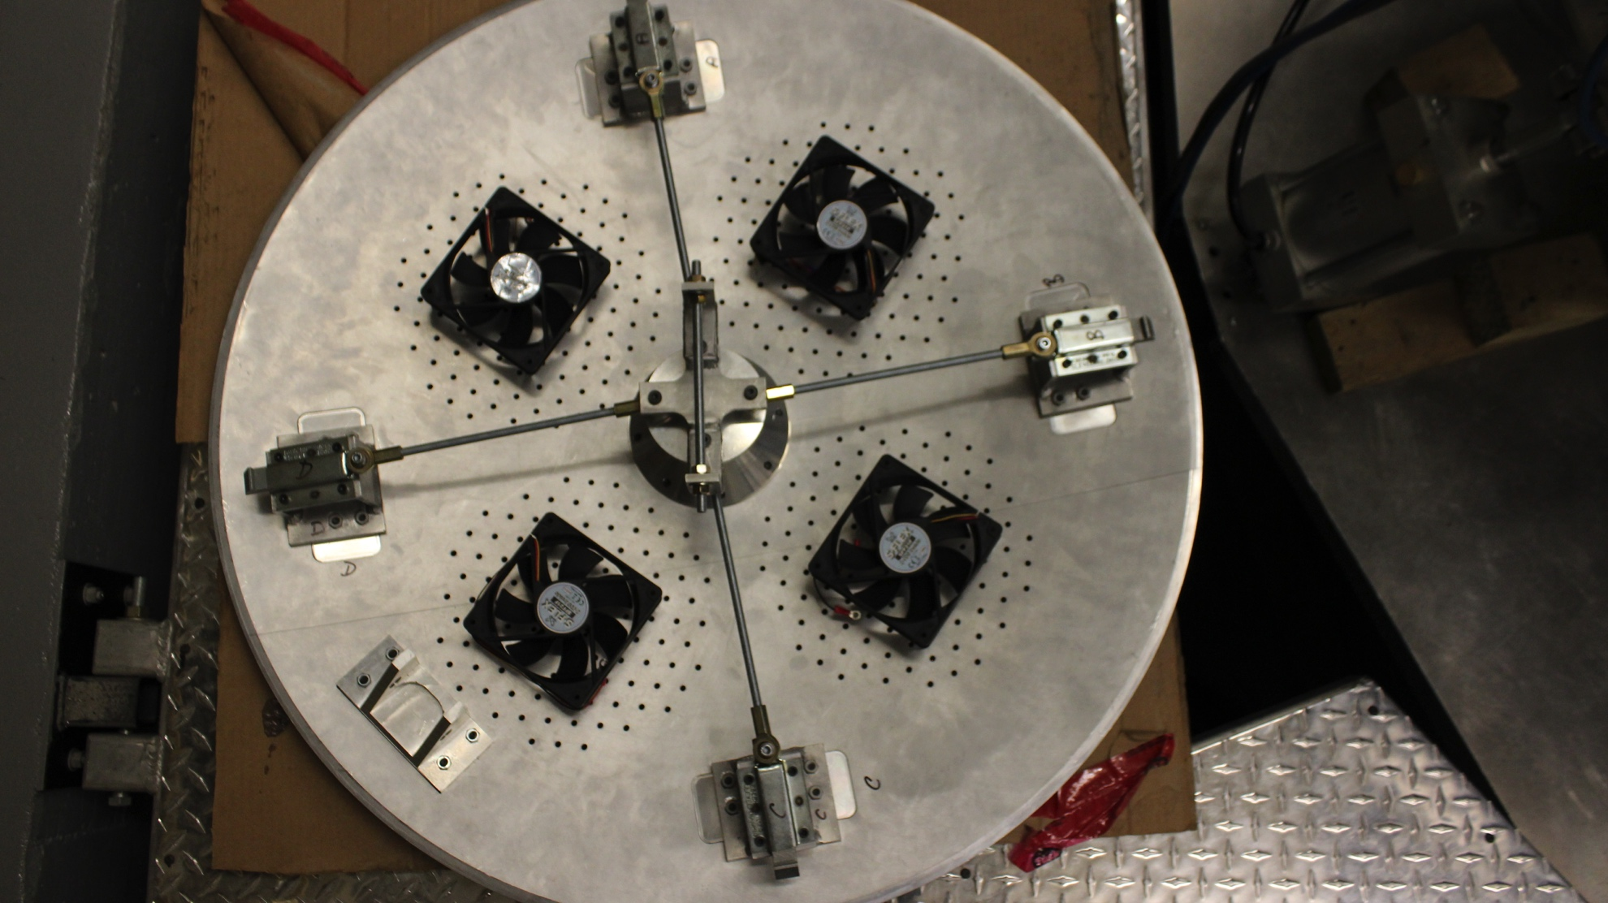
LATCH MECHANISM
Figure 3 : Latch Mechanism

Slide 6
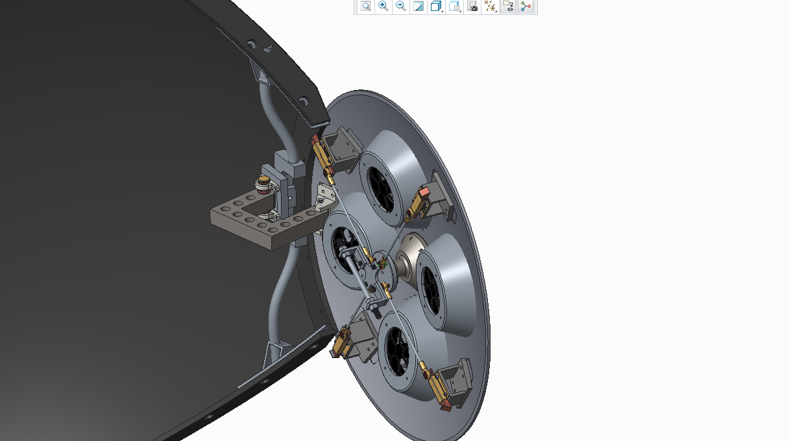
HINGE MOTION

Slide 7
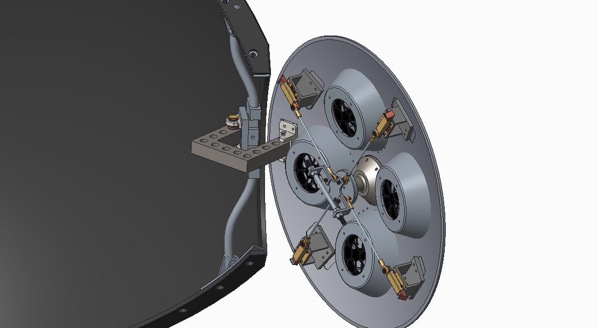

Slide 8
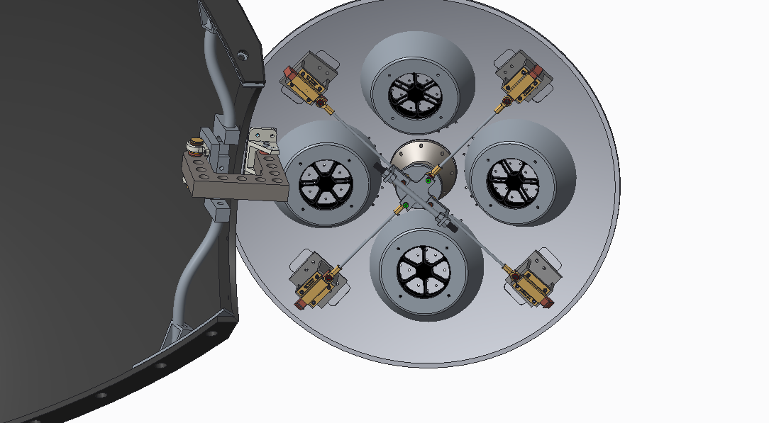

Slide 9
LATCH KEY
Overview
Used to Open the hatch system from outside of the sphere
Provides an anchor that helps hold onto the hatch while its pulled out.
Manufactured out of 1018 steel

Slide 10
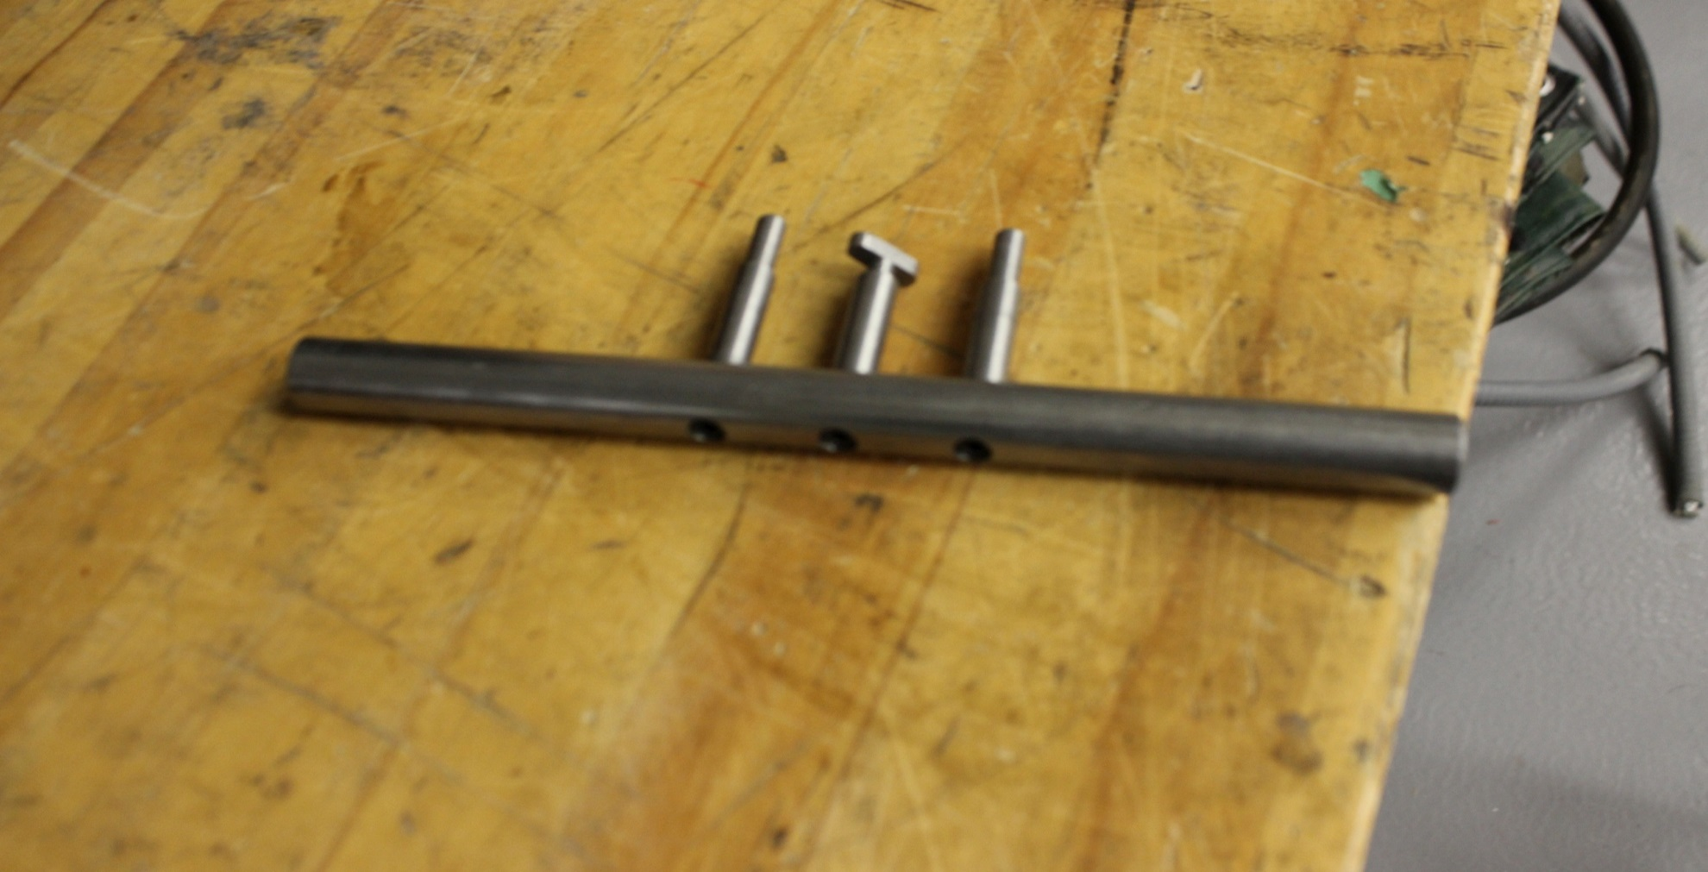
LATCH KEY

Slide 11
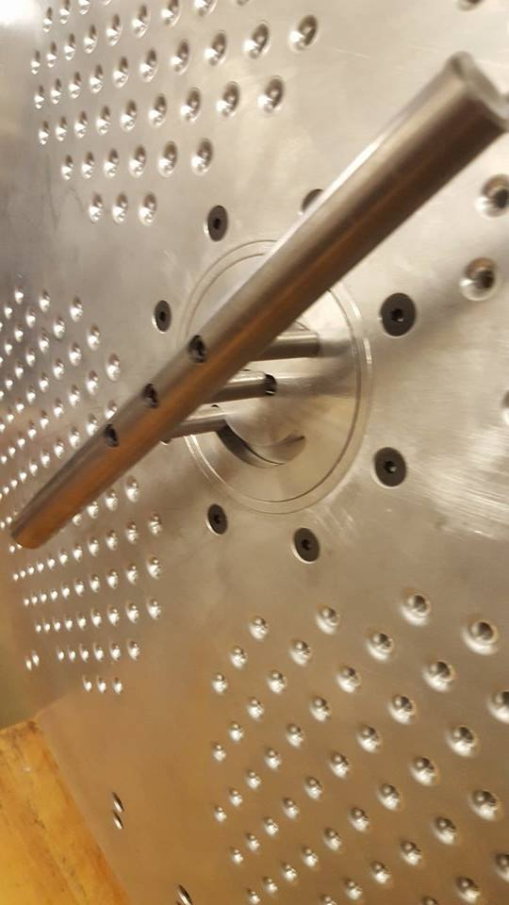
LATCH KEY

Slide 12
VENTILATION AIRFLOW ANALYSIS
Minimum ventilation rate to maintain acceptable levels of indoor environmental parameters, such as
Temperature
Relative humidity
Airborne pollutant concentration (CO2)

Slide 13
AIRFLOW ANALYSIS
Figure 4: Illustrates of a DC cooling fan equipment and air movement through sphere[1]
Ventilation for the CUSP Project would be achieved by 8 Sony S-flex fans, 4 of which would bring air into the sphere and the other 4 would take air out of the sphere
Notes:
[1] K. Shahin, “Hatch and ventilation,” Carleton University, Ottawa, ON, Design report. Rep. DR-STR-KS.11.Hatchandventilation.02, April 2011.

Slide 14
METHOD OF ANALSYS
The Principles of ventilation in this presentation are reviewed from the perspective of mass and energy balance
Mass balance for total air ventilation
Energy balance for sensible heat
Mass balance for moisture
Mass balance for specific pollutants

Slide 15
ASSUMPTIONS
No spatial gradient
Mass of air in equal mass of air out

Slide 16
Requirements
Sphere within a 5 degree increase in temperature
Relative humidity maintained between 30% and 60%
Co2 levels below 800 ppmv
Fan outputs
Total fan CFM output: 258.4 CFM
Relative humidity maintained at 40%
C02 levels do not exceed 700 ppmv
Notes:
[3] “Addendum a to standard 55 (2013)” ASHRAE. Retrieved 7 November 2015.
[4] Engineeringtoolbox.com, 'Met - Metabolic Rate', 2015. [Online]. Available: http://www.engineeringtoolbox.com/met-metabolic-rate-d_733.html. [Accessed: 12- Nov- 2015].

Slide 17
CONCLUSION
After analysis the CFM requirement is based on temperature control with 219 CFM
Based on analysis Fans meet requirements for ventilation

Slide 18
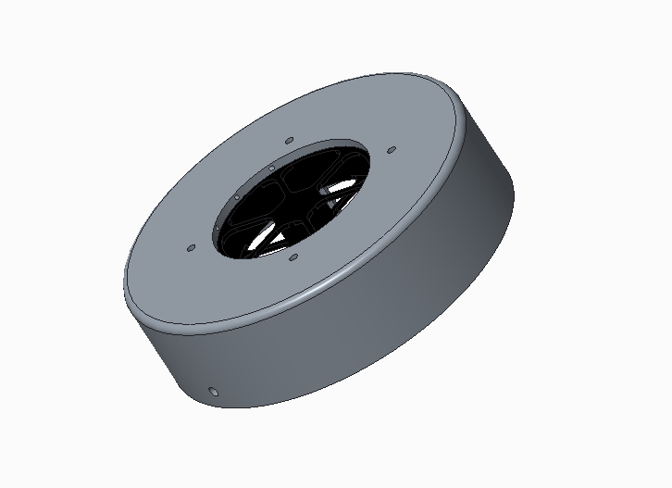
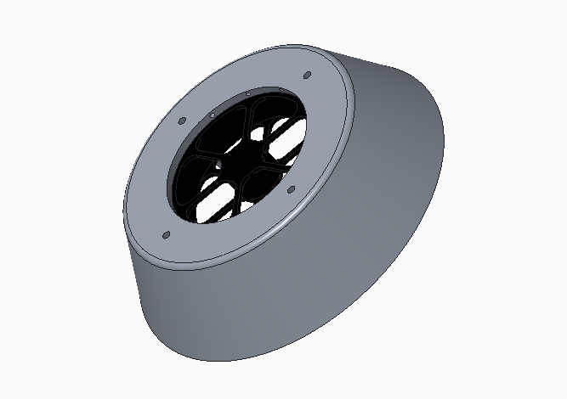
Fan Baffles
Figure 5: Fan Baffle Designs

Slide 19
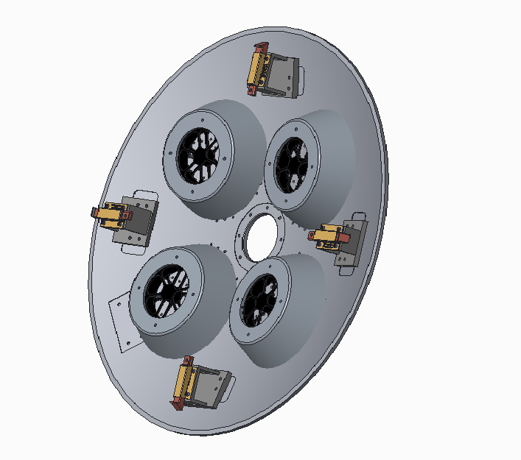

Slide 20
HATCH FLANGE
Overview
Provides rigidity to the sphere
Provides connection for the hatch plate in the lock position
Provides flat surface for the hatch to rest upon

Slide 21
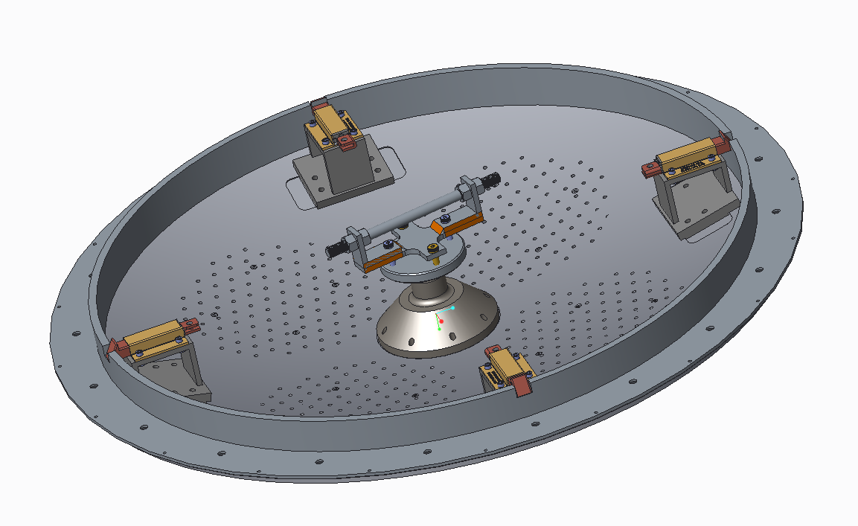
Flange & slam bolt connection

Slide 22
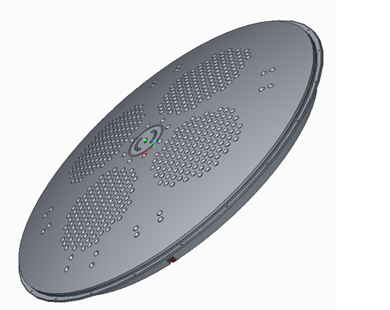
HATCH-FLANGE INTERFACE

Slide 23
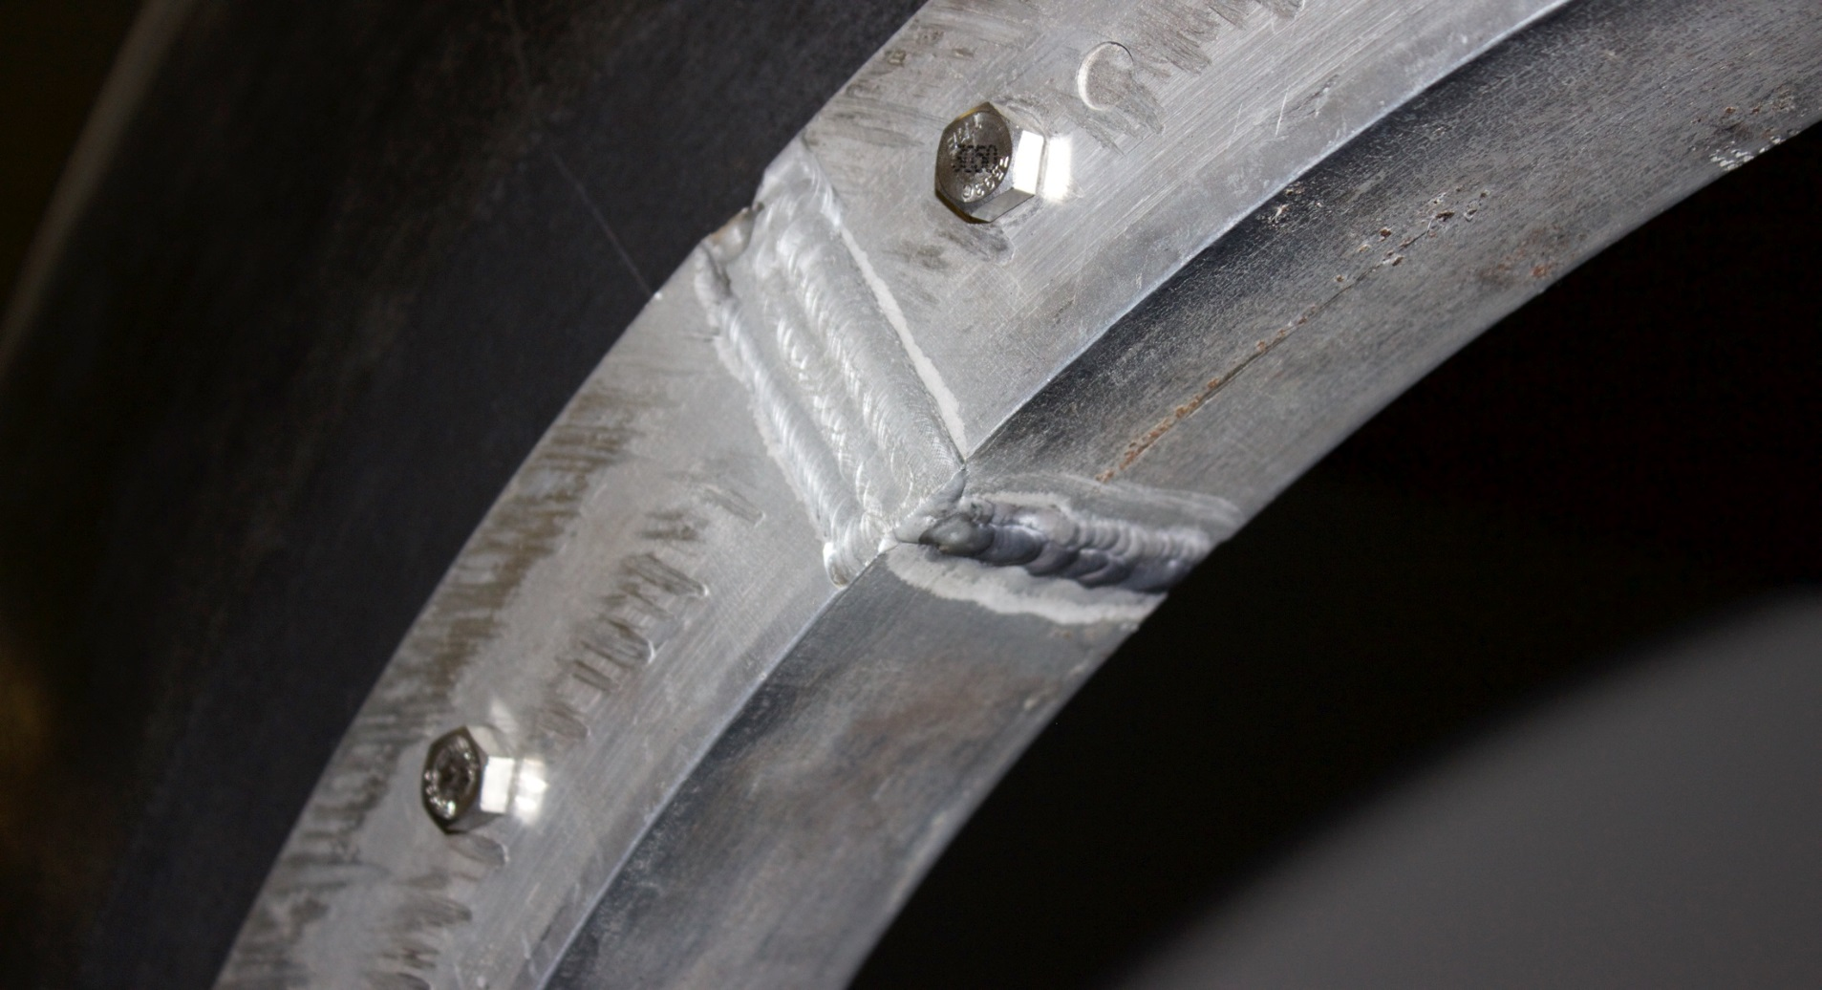

Slide 24
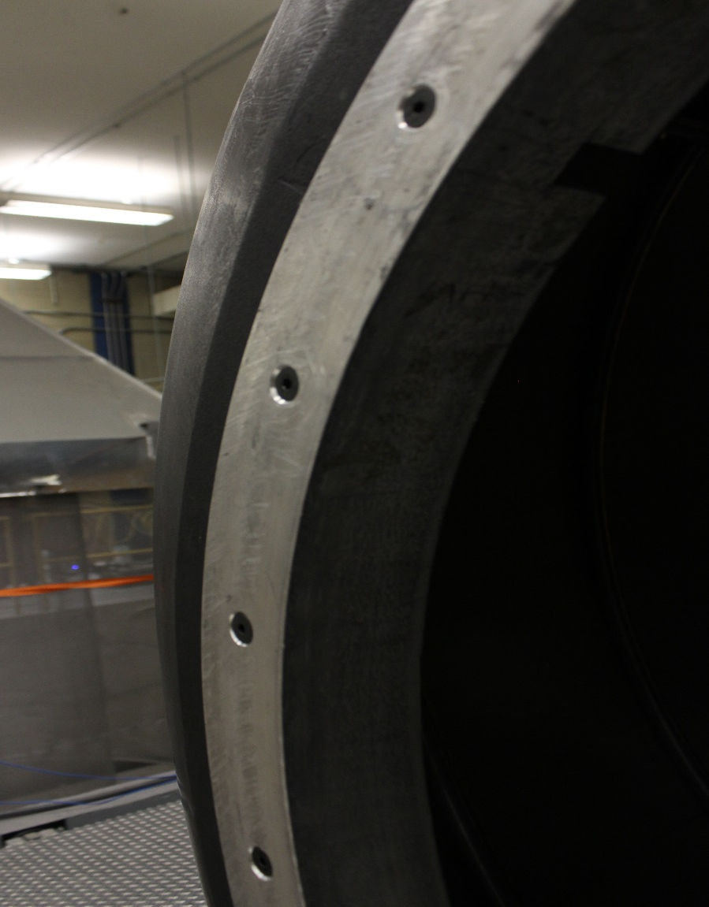
Hatch bolt holes Counter-sunk

Slide 25
Summary
Latch key was manufactured
Hatch system CAD files were updated
Air flow analysis was performed
Fan Baffles were designed
Slam bolts connection on hatch flange was machined
Hatch Flange bolt slots were counter sunk

Slide 26
References
[1] K. Shahin, “Hatch and ventilation,” Carleton University, Ottawa, ON, Design report. Rep. DR-STR-KS.11.Hatchandventilation.02, April 2011.
[2] Y. Zhang, ”Ventilation requirements and measurement”, in Indoor air quality engineering. Boca Raton, Fla.: CRC Press, 2005.
[3] William McNair. Hatch Design. Design Report, Carleton University, DR-STR-wm.14.HatchDesign.01 2014.

