Slide 1







Current Technologies adoption and prevalence
Olamide Olayinka
August 11th 2024

Slide 2



OUTLINE
Executive Summary
Introduction
Methodology
Results
Visualization – Charts
Dashboard
Discussion
Findings & Implications
Conclusion
Appendix

Slide 3

EXECUTIVE SUMMARY
The presentation includes charts and graphs of various metrics used to understand the current technology trends
Salary averages for programmers that adopt specific language's for their everyday task is explored with Swift winning out on the average annual salary metric, followed closely by python.
We explore the relationship between the respondents their gender and formal education and find that there are more men then women programmers at all levels of formal education.
We also visualize the geo location of respondents on a chart map and have respondents from 6 out of 7 continents on the map chart.

Slide 4

INTRODUCTION
As there are many languages in computer science of which different languages can perform similar task with some difference, it becomes a game of “what language to you code in”.
This reports presents current technologies and their current level of adoption by programmers and other emerging technologies that seem to be permeating the sector and becoming more sort after by programmers
In addition, the language adopted by programmers has some correlation to how much their potential earning will be. The more languages one is fluent in, the more potential opportunities.
This report can be useful for Programmer or technology experts following the current/upcoming trends, HR managers looking to understand what skill they need to be searching for when head hunting talent.

Slide 5

METHODOLOGY
Standard data science tools and statistical analysis were employed to graph various datasets.
Python and IBM cognos analytics were employed to dash boards for this presentation.
Null values were removed from the dataset.
It uses the Kaggle programmers survey 2023 to understand the current technologies being used and the future technologies being sort after.

Slide 6
RESULTS
Able to determine the most sort after languages programmers are currently using and future adoption of other languages that appear to be gaining popularity
Able to determine the databases being used the most and future adoption of other popular databases.
Linux platform appears to be the most desired platform next year.

Slide 7
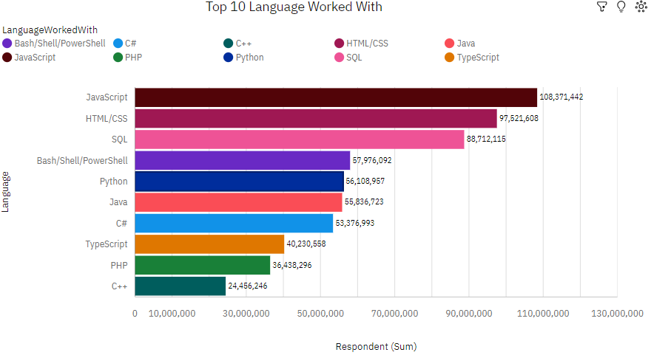
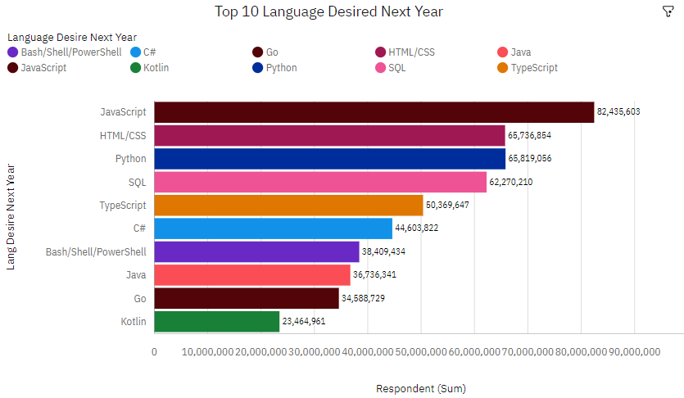
PROGRAMMING LANGUAGE TRENDS
Current Year
Next Year

Slide 8
PROGRAMMING LANGUAGE TRENDS - FINDINGS & IMPLICATIONS
Findings
JavaScript has the highest total Respondent for current users and future learners
Kotlin and GO don’t appear in top 10 Languages for this year
JavaScript is the most sort after language for next year
HTML/CSS and python are next most sort after for next year
Implications
JavaScript is as important this year as it is for future years
Kotlin and GO are emerging languages being sort after amongst programmers for next year.
Python is increasingly an important skill to have.
Kotlin and C++ appear to be the least sort after skills for future years - but Kotlin might likely see a bum in usage next year according to respondents.

Slide 9
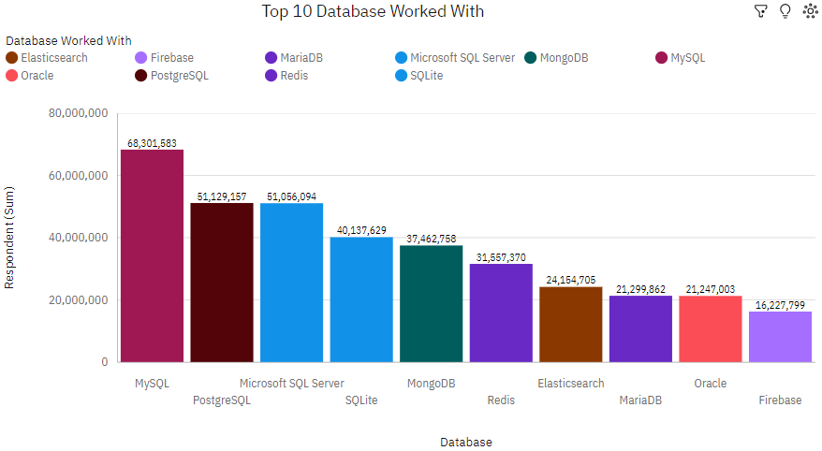
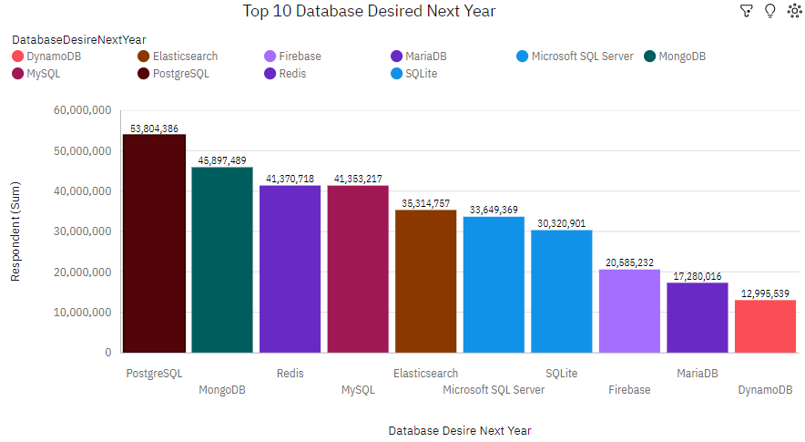
DATABASE TRENDS
Current Year
Next Year

Slide 10
DATABASE TRENDS - FINDINGS & IMPLICATIONS
Findings
Top current databases in use are MySQL, PostgreSQL and Microsoft SQL Server
Oracle and Firebase are the least worked with currently
PostgreSQL and MongoDB are the most desired databases for next year.
DynamoDB appears to be increasing in popularity.
Implications
There is an increase in popularity for PostgreSQL which could mean more adoption of the database
A bump in the adoption of Firebase and MongoDB for next year relative to current year
Sqlite appears less important for programmers in coming years
Oracle drops off the top 10 desired database for next year which would been less adoption by programmers

Slide 11

DASHBOARD
Dashboard Link
PDF-
https://github.com/KodeXL/Cognos-Dashboard/blob/main/New_dashboard_Cognos.pdf
Cognos link to Dashboard - https://us3.ca.analytics.ibm.com/bi/?perspective=dashboard&pathRef=.my_folders%2FNew%2Bdashboard&action=view&mode=dashboard&subView=model000001913c1c3a1e_00000000

Slide 12
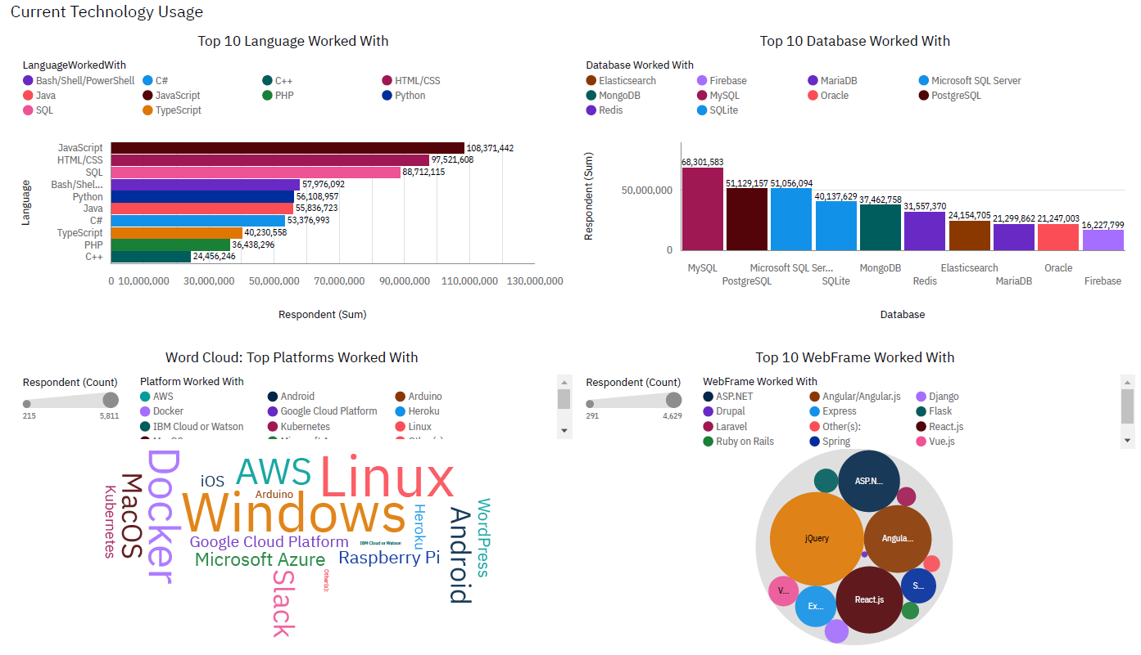
DASHBOARD TAB 1 – Current Technology

Slide 13
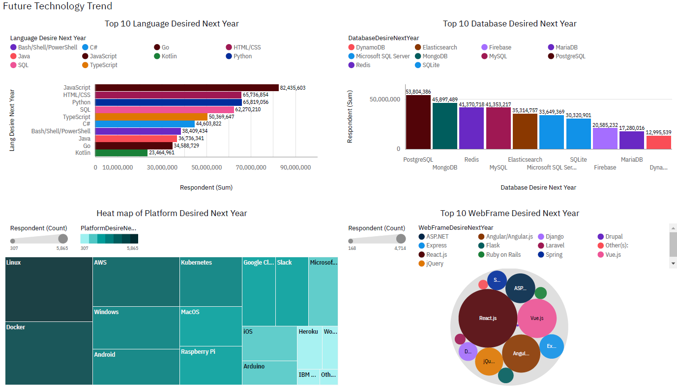
DASHBOARD TAB 2 – Future Technology

Slide 14
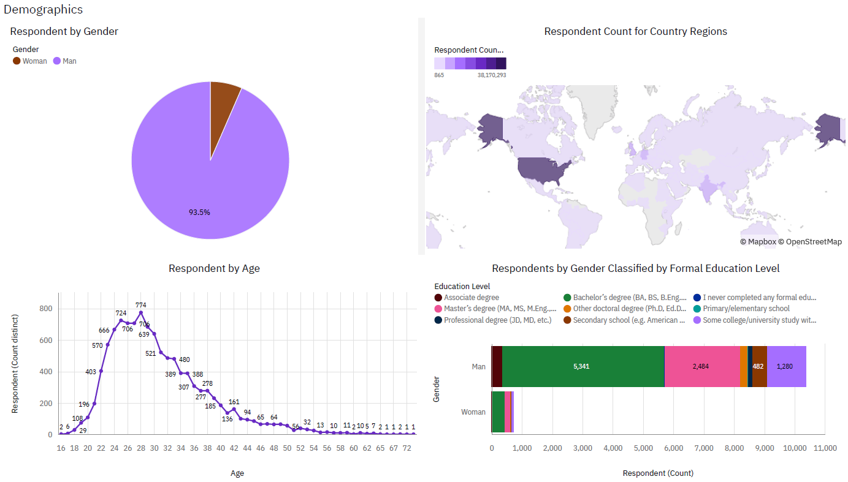
DASHBOARD TAB 3 – Demographics

Slide 15
DISCUSSION
There are more men programmers than women at all education levels which is something that could be addressed.
Respondents are from 6 out of 7 visible continents on the map chart – This is excluding Antarctica.

Slide 16
OVERALL FINDINGS & IMPLICATIONS
Findings
The vast majority of programmers have some type of degree(post secondary education)
Most people in the tech field have a Bachelors' degree.
Web development languages are the most popular tools in the tech field currently.
Majority of programmers are between the ages of 21 to 40
Being able to code with the swift language is very profitable. Apple seems to be paying their people well.
Implications
NoSQL databases are increasingly as important SQL databases.
Web development tools are very lucrative.
Less developed countries have a negligible share of the programmers contributing to the greater tech talents of world
Less developed countries are likely to need more access to tech trainings

Slide 17

CONCLUSION
JavaScript is the most sort after language to learn.
Closely followed by HTML/CSS then Python.
Web development languages such as JavaScript and HTML/CSS is also a very important and prevalent language.
Python, Swift, C++ and JavaScript offer the most returns for individuals that are proficient in them.
It would benefit a tech professionals to continually upskill and learn more tools that could bolster capabilities

Slide 18
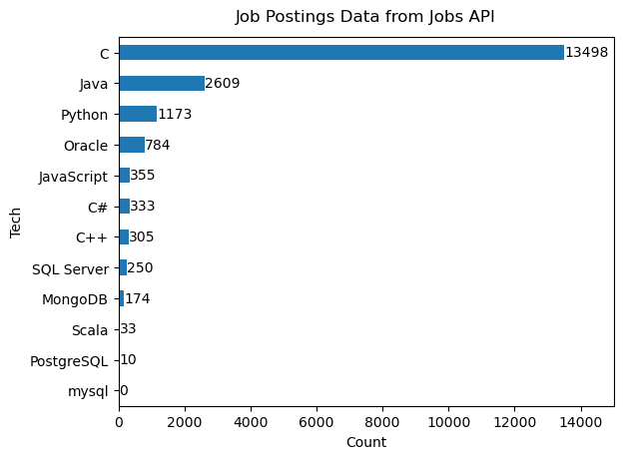

APPENDIX

Slide 19
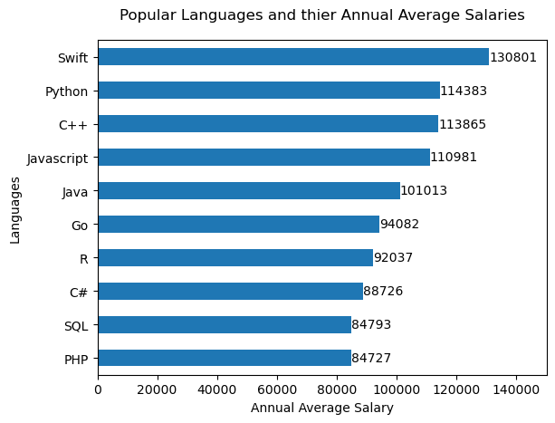
POPULAR LANGUAGES

