Slide 1
Sugar Twin: a real-time Digital Twin for Type 2 Diabetes
Predicting glucose spikes 2 hours ahead by fusing EHR + wearable data, for India
[FILL IN: team name] · [FILL IN: college / incubator]
Notes:
Hello, we are [team name] from [college / incubator]. This is Sugar Twin, a proof-of-concept digital twin for people with type 2 diabetes in India.
A digital twin here means a living virtual copy of one patient: it keeps their health record, it receives their wearable and glucose-sensor data every five minutes, and it carries a small physiological model of how their body handles sugar.
Our twin does one focused job well: every five minutes it predicts whether the patient's glucose will rise above 180 mg/dL within the next two hours, explains why in plain language, and lets the doctor and the patient try "what if" changes before they happen.
One important note before we start, and you will see it on every screen: everything in this project runs on synthetic, simulated patients. No real person's data is used anywhere, and this is not a medical device.
Over the next twenty minutes we will cover the problem, our design, how we built privacy-safe data, the models and the honest results, the doctor dashboard and the patient app, and what it would take to validate this in the real world.

Slide 2
Post-meal spikes: frequent, invisible, preventable
~101 M
3 months
1.9/day
people living with diabetes in India (ICMR-INDIAB study, 2023)
typical gap between HbA1c checks, which average away daily spikes
sustained spikes above 180 mg/dL per patient-day in our simulated cohort
Why it matters in India
Rice- and wheat-heavy meals, late dinners, a high-waist "thin-fat" phenotype and early onset make post-prandial spikes common. Spikes drive long-term complications, yet CGMs and smartwatches stream data that nobody turns into timely, explainable, personalised action for the patient or the doctor.
Notes:
Let's start with the problem. India has around 101 million people living with diabetes, according to the ICMR-INDIAB study published in 2023, and most of them have type 2 diabetes.
The usual way we track control is HbA1c, a blood test every three months. HbA1c is an average, so it hides the daily pattern: a person can have a reasonable average and still spike high after almost every lunch and dinner.
In India this pattern is especially common: meals are rich in rice and wheat, dinners are often late, many patients have the so-called thin-fat phenotype with a high waist circumference at a normal BMI, and diabetes starts earlier than in many other populations.
In our simulated cohort, patients have about 1.9 sustained spikes above 180 every day.
At the same time, continuous glucose monitors and smartwatches are becoming affordable and they stream rich data. But today that data mostly sits in an app. The gap we address is turning the record plus the stream into a timely, explainable, personalised warning, early enough that the patient can still do something about it.

Slide 3
Use case: warn 2 h before glucose exceeds 180 mg/dL
1
Spike risk
2
2-hour forecast
Calibrated probability of glucose > 180 mg/dL in the next 120 min, refreshed every 5 min
Glucose at +30 / 60 / 90 / 120 min with a P10–P90 uncertainty band
3
Alert level
4
Why + what if
GREEN / AMBER / RED with a "spike in ~X min" countdown; icon + text, never colour alone
Top factors in plain language, and counterfactual simulations of walks, meals, sleep and medication timing
Notes:
Our use case is narrow on purpose. The challenge allows one condition and one adverse event, so we chose type 2 diabetes and the hyperglycaemic spike: glucose above 180 milligrams per decilitre within the next two hours.
Every five minutes the twin produces four outputs.
One: a calibrated probability of a spike in the next 120 minutes. Calibrated means that when the model says 70 percent, about 70 percent of such cases really spike.
Two: a forecast of the glucose value at 30, 60, 90 and 120 minutes, with an uncertainty band.
Three: an alert level, green, amber or red, with a countdown such as "spike in about 40 minutes". The level is always shown with an icon and a word, never by colour alone, so it works for colour-blind users.
Four: an explanation of the top factors, such as a late heavy dinner or short sleep last night, and a what-if simulator that shows what a walk, a different meal or more sleep would do.
As secondary outputs we also flag predicted low glucose and night-time risk.

Slide 4
Two data streams, one twin, two role-based apps
Risk + forecast
Stream A
Synthetic EHR
labs · meds · SNPs · diet
Fusion model
GRU + EHR
cross-attention
Digital Twin
state · personal
simulator
Explanation
Stream B
CGM · HR · HRV
sleep · steps · logs
What-if
Doctor dashboard (/) and patient PWA (/patient/) are two clients of the same twin and the same 5-minute stream
Notes:
Here is the whole system on one slide.
On the left are the two data streams the challenge asks us to fuse. Stream A is the static record: demographics, lab results such as HbA1c and lipids, comorbidities, medications, simulated genetic risk markers, and India-specific context such as vegetarian diet and whether the staple is rice, wheat or millet. Stream B is the live stream: a glucose reading every five minutes, heart rate, heart-rate variability, sleep stages, steps, and meal and medicine logs.
Both feed the fusion model in the middle, a neural network that reads six hours of the wearable stream and conditions it on the health record.
The model's outputs, together with a personalised physiological simulator, make up the digital twin. The twin produces the three things the user sees: risk and forecast, the explanation, and what-if simulations.
A key design decision: the twin is the single source of truth. The doctor dashboard and the patient app are just two role-based views of the same twin and the same real-time stream, so they can never disagree.

Slide 5
Synthetic patients whose EHR drives their physiology
150
0.95
A
Indian T2D EHR generator
Correlated demographics, labs, comorbidities and Indian prescribing (metformin, gliptins, premix insulin). South-Asian BMI (23/25) and waist cut-offs, simulated TCF7L2 / SLC30A8 / KCNQ1 + polygenic score, diet and staple. FHIR R4 export.
patients × 30 days at 5-min resolution
correlation of sensor GMI with EHR HbA1c (the EHR shapes the signals)
72.9%
0
B
Physiological world simulator
Extended Bergman minimal model: idli, poha, dal-chawal and biryani meals, drug effects, dawn phenomenon, exercise, sleep debt, stress, plus CGM lag, noise, dropouts and compression lows.
time in range 70–180 mg/dL
real patients: every assumption is listed in docs/ASSUMPTIONS.md
Notes:
Real patient data is protected by India's DPDP Act and by HIPAA, so the rules of the challenge, and our own principles, say synthetic data only. We built two generators.
The first creates an Indian type 2 diabetes health record: age, sex, BMI with the South-Asian cut-offs of 23 and 25, waist circumference, family history, diabetes duration, HbA1c and other labs, comorbidities, typical Indian prescribing including metformin, gliptins and premix insulin, simulated genetic risk markers, and diet and staple food. Everything is correlated; for example, higher insulin resistance and lower beta-cell function lead to higher HbA1c. We also export it as FHIR, the interoperability standard.
The second is a physiological world simulator. It uses an extended Bergman minimal model of glucose and insulin. Each virtual patient eats Indian meals, takes or misses medicines, walks, sleeps well or badly, gets stressed, and wears a realistic glucose sensor with lag, noise, dropouts and false lows when lying on it.
Crucially, the record drives the physiology. We calibrate each patient so that the sensor's average matches their HbA1c: the correlation between the two is 0.95.
We generated 150 patients over 30 days. Every simplifying assumption is written down in the assumptions register, because synthetic realism is the main risk of this project.

Slide 6
LightGBM baseline vs multimodal deep fusion
6 h wearable window
17 channels, 5-min steps
GRU encoder
Spike head
EHR-conditioned
cross-attention
+ gated fusion
24-h summary features
(68 causal features)
MLP
Hypo head
Static EHR vector
(47 features)
EHR MLP
P10/P50/P90 ×4
Baseline: LightGBM on the same 118 causal features. Both are isotonic-calibrated on validation patients. Explanations: TreeSHAP / Integrated Gradients.
Notes:
We built two model families, as the challenge requires.
The baseline is LightGBM, a gradient-boosting model, trained on 118 engineered features. Every feature is strictly causal, meaning it only uses data from the past: rolling glucose statistics and slopes, time since the last meal, carbs on board, steps, heart-rate variability, sleep in the last 24 hours, what happened at this time yesterday, plus the encoded health record.
The main model is a multimodal deep network in PyTorch. The temporal branch is a GRU, a recurrent network, reading the last six hours of 17 wearable channels. A second branch reads the 24-hour summary features, and a third, an MLP, reads the static health record.
The fusion layer is where the streams meet. The health-record embedding is used as the query in a cross-attention over the six hours of wearable data, so the record decides which moments matter for this patient. Then a learned gate blends the temporal and static representations.
There are three heads: spike probability, low-glucose probability, and the 10th, 50th and 90th percentile of glucose at four horizons.
Both models are calibrated on validation patients, and we explain each prediction with TreeSHAP for the boosting model and Integrated Gradients for the deep model, grouped into clinical factors.

Slide 7
Evaluation built to avoid leakage and report honestly
1
Split by patient
2
Temporal hold-out
3
Cold start
105 train / 22 validation / 23 test patients; test patients are never used for tuning
Last 20% of days of the training patients; label windows never cross the cut-off
First monitoring day (6–24 h of history), where fusion should matter most
4
Live alert replay
5
Fairness
6
Robustness
Every 5 min, with a refractory period: lead time and false alerts per patient-day
Age group, sex, South-Asian BMI band, urban / rural
Extra CGM noise, 30% CGM dropout, 50% missing watch data, no meal logs
Notes:
Before the numbers, how we measured them, because evaluation is where health AI projects most often fool themselves.
First, we split by patient, not by row: 105 patients for training, 22 for validation and 23 for testing. Test patients are never used to tune anything, including the alert thresholds. Their data is also what the live demo streams, so the demo shows patients the model has never seen.
Second, a temporal hold-out: the last 20 percent of days, with label windows that never cross the cut-off.
Third, a cold-start test on each patient's first day, when the wearable history is short.
Fourth, a live replay of the alerting system, every five minutes, measuring lead time and false alerts per patient per day, which is what matters to a clinician.
Fifth, fairness across age, sex, BMI band and urban versus rural; and sixth, robustness to sensor noise, dropouts, missing watch data and patients who never log meals.
Every number in the next slides is computed by code in the repository and written to the evaluation report. Nothing is typed by hand.

Slide 8
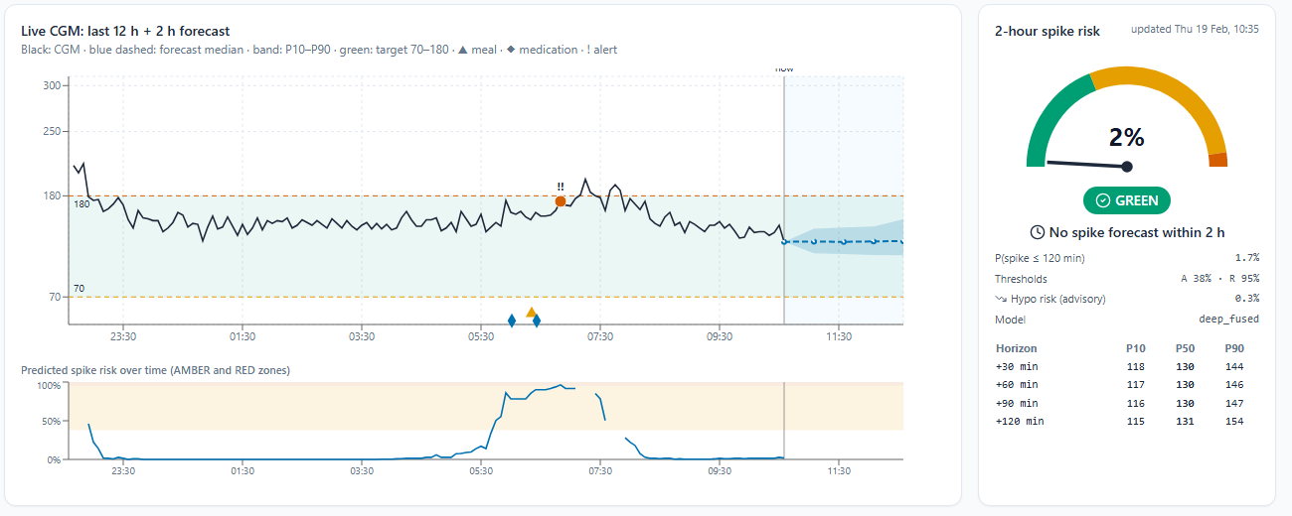
Headline results on unseen test patients
0.938
0.873
80%
45 min
ROC-AUC (deep fusion)
PR-AUC (random = 0.312)
of spikes caught at RED, 1.0 false alert / patient-day
mean warning before the spike at RED (≈85 min at AMBER)
Calibrated and honest
Brier score 0.092. Temporal hold-out ROC-AUC 0.950. Shown left: risk entered RED about 2 h before a breakfast spike.
Notes:
Here are the headline results on the 23 unseen test patients.
The deep fusion model reaches a ROC-AUC of 0.938 and a PR-AUC of 0.873. For comparison, a random model would have a PR-AUC of 0.312, the share of moments that are followed by a spike.
The more clinical numbers are on the right. At the RED notification level, which we tuned on validation patients to at most about one false alert per patient per day, the system catches 80% of all spikes, on average 45 minutes before they happen, with 1.0 false alerts per patient-day.
At the AMBER watch level it catches almost all spikes about 85 minutes ahead, which meets the "two hours ahead" goal, but with about four false flags a day. That is why AMBER is a visual watch level and only RED sends notifications.
The screenshot is the doctor dashboard for one test patient: overnight, the predicted risk rose into the red zone around 5:30 in the morning, well before the post-breakfast spike that followed. The probabilities are calibrated, with a Brier score of 0.092, and performance holds on the temporal hold-out.

Slide 9
Does fusion help? Not in steady state, but yes at cold start
Fusion gain: steady state +0.002 (deep) · cold start +0.020 (deep), +0.019 (GBM) · at RED: 80% vs 75% of spikes caught
Notes:
The challenge asks us to demonstrate fusion, so we ran a full ablation: wearable-only, EHR-only and fused, for both model families. We want to be honest about what it shows.
On the left, with at least a day of wearable history, the EHR-only model is clearly weaker, but wearable-only and fused are almost tied: the fusion gain for the deep model is 0.002. The reason is that 24 hours of continuous glucose already reveals most of what HbA1c and the prescription say about a patient's control.
On the right is the cold-start setting, a patient's first day, when that history does not exist yet. Here fusion helps both families by about two points of PR-AUC, because the record carries the patient-specific context.
Fusion also helps at the operating point that matters for alerts: at the same false-alert budget, the fused deep model catches 80% of spikes against 75% for the wearable-only model.
So our conclusion is not "fusion always wins", but "fusion matters when the stream is short and when you need high-specificity alerts". We think that is the more useful, and more honest, finding.

Slide 10
2-hour forecast beats "no change" at every horizon
+60 min
Deep RMSE 25.2 vs 33.9 mg/dL for "no change"
Uncertainty band
P10–P90 covers 71% of outcomes at +60 min (target 80%), slightly over-confident
Notes:
Besides the yes-or-no spike risk, the twin forecasts the glucose value itself, which is what is drawn as the blue dashed line and band on the dashboard.
The chart shows the error, in milligrams per decilitre, at four horizons, against the simplest possible baseline: assuming glucose will not change, which we call persistence.
Both models beat persistence at every horizon, and the gap grows with the horizon. At 60 minutes the deep model's error is 25.2 against 33.9 for persistence. LightGBM is a little better at 30 and 60 minutes; the deep model is better at 90 and 120 minutes.
We also report a weakness: the uncertainty band, the 10th to 90th percentile, should contain 80 percent of outcomes, but at 60 minutes it contains 71%. The band is slightly too narrow, and recalibrating the quantiles is on our improvement list.

Slide 11
A personalised simulator that answers "what if?"
lower peak, less time > 180
1
Starts from the EHR prior
Walk 15 min now
It never sees the simulator's hidden truth.
smaller, slower rise
Roti instead of rice
2
Syncs to every CGM reading
An observer keeps the model state on track.
peak moves away from bedtime
Dinner at 19:00 vs 21:00
3
Re-calibrates every 6 h
higher next-morning response
Sleep 5 h vs 8 h
Insulin sensitivity and basal set-point fitted to the last 24 h.
Estimates for discussion: never treatment advice
Notes:
A predictor tells you what will probably happen. A digital twin should also answer "what if". Machine-learning models cannot do that from observational data alone, so each twin also carries a small personalised physiological simulator.
It starts from a prior derived only from the health record; it never sees the simulator's hidden ground truth. Every five minutes it advances with what was actually observed (logged meals, medicine, activity, sleep) and an observer nudges it towards the glucose reading. Every six simulated hours it re-fits two personal parameters, insulin sensitivity and the basal set-point, to the last 24 hours.
From that synchronised state we can run several futures in parallel. A 15-minute walk now lowers the peak and the time above 180. Roti instead of white rice gives a smaller, slower rise. Dinner at seven instead of nine moves the peak away from bedtime. And five hours of sleep instead of eight raises tomorrow's breakfast response, because short sleep lowers insulin sensitivity.
These are model estimates to support a conversation between doctor and patient. The app always says so, and it never suggests changing a medicine dose.

Slide 12
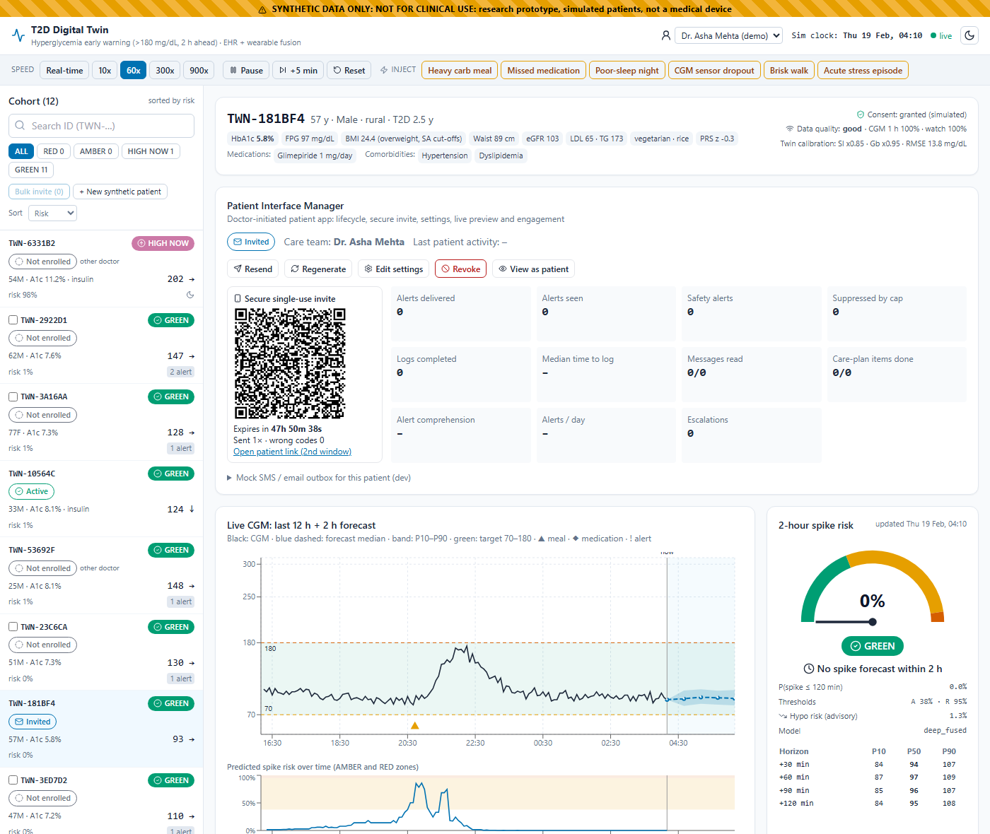
Doctor dashboard: triage, explanation, app control
Cohort sorted by risk, with a status column and bulk invite
Live CGM + 2-h forecast band, risk gauge and countdown
"Why this alert?" factors from EHR and wearable
Inject events live: heavy meal, missed dose, poor sleep, dropout
Patient Interface Manager: secure invite + QR, live preview, engagement
Every action written to an audit trail
Notes:
This is the doctor's dashboard, a real running React application, not a mock-up.
On the left the cohort is sorted by risk. Each badge has an icon and a word, and the status column shows whether each patient's app is not enrolled, invited, active or paused.
For the selected patient we see the profile with HbA1c, medications and comorbidities, then the Patient Interface Manager, which we will come back to, then the live glucose chart with the last 12 hours, the two-hour forecast band, the target range and alert markers, and next to it the risk gauge with the countdown.
Below the screenshot there are aligned panels for sleep stages, heart rate and HRV, and steps, the "Why this alert?" panel, glucose metrics including time-in-range and an ambulatory glucose profile, the what-if simulator, and clinician actions: acknowledge, note, suggest an intervention.
For the demo, the top bar lets us change the stream speed and inject events such as a heavy carb meal or a sensor dropout, so the audience can watch the prediction react in real time. Every action is written to an audit trail.

Slide 13
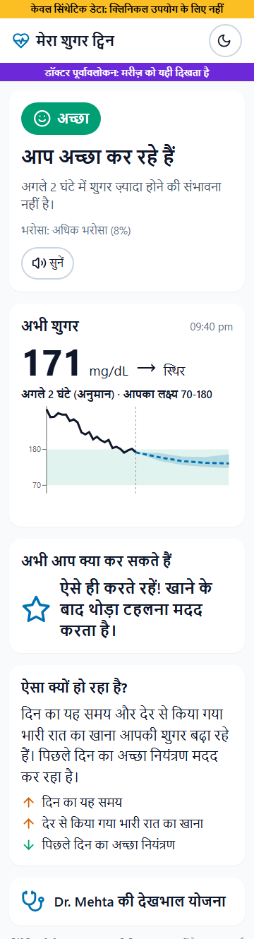
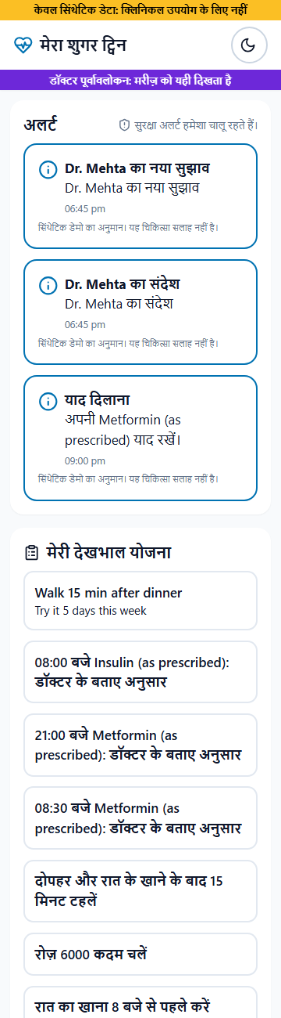
Patient app: doctor-launched, in the patient's language
Enrol
Configure
Invite + QR
OTP
Consent
ACTIVE
Home: one plain sentence, glucose + trend, 2-h estimate in the target zone, one next action
My Day: timeline and "why" in everyday language
Try it: walk / roti vs rice / earlier dinner
Quick Log: Indian food presets in under 10 seconds
Care: alerts, care-plan cards, doctor messages
Me: progress, access log, withdraw consent
Notes:
The second client of the twin is the patient app, a mobile-first progressive web app in English, Hindi and Tamil. The screenshots are the real app at phone width, in Hindi.
The patient never signs up on their own. The doctor enrols the patient, configures the app with a template in under two minutes (language, target range, features, care plan, alert limits), previews exactly what the patient will see, and launches a secure single-use invite as a link and QR code with an expiry.
The patient opens it, verifies with a one-time PIN, reads and accepts a consent screen, picks a language, takes a short tour, and connects the simulated wearable. Only then does the state become active and the live twin connect.
The home screen gives one status with an icon and a word, one plain sentence such as "your sugar may go high in about 90 minutes", the current glucose with a trend arrow, a simplified forecast inside the target zone, and one recommended action. My Day explains why in everyday words; Try it shows simple what-ifs; Quick Log takes Indian meals, walks, medicines and symptoms in a tap; Care holds alerts, the doctor's care-plan cards and messages; and Me shows progress and the privacy centre.

Slide 14
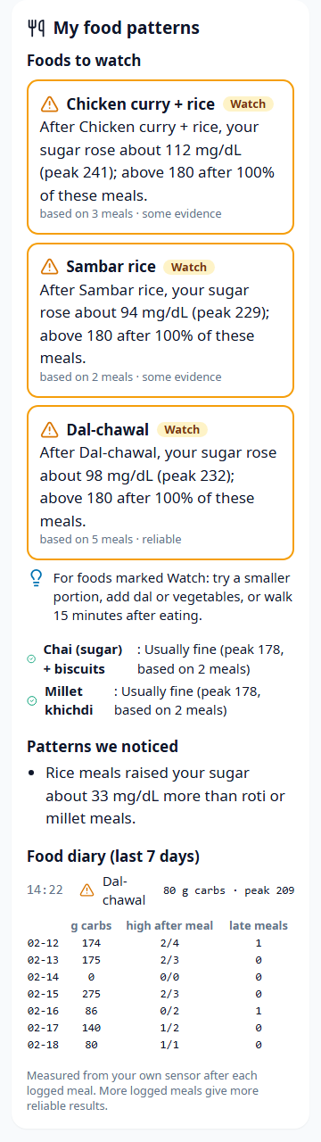
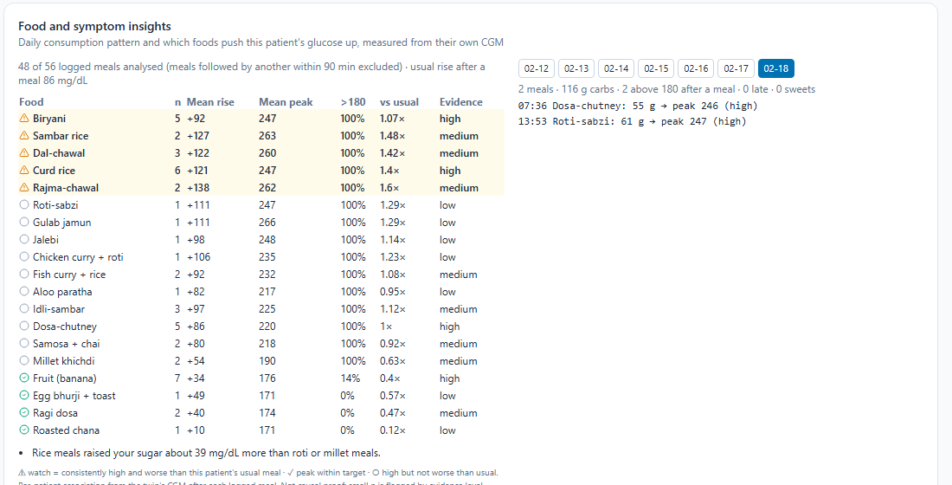
Personal food-impact AI: which foods push my sugar up?
14 days
food diary per patient, with daily carbs, late meals, sweets and highs after meals
3 demo
Measures each meal from the patient's own CGM
Flags foods worse than this patient's usual meal
Links logged symptoms to foods eaten 4 h before
Warns gently when a flagged food is logged again
patient accounts (English / Hindi / Tamil), already activated for the demo
Notes:
Many patients ask: which of my foods are actually the problem? General advice says "less rice", but responses are personal. So the twin keeps a 14-day food diary and learns this patient's own response to each food.
For every logged meal it reads the patient's own glucose sensor: the level at the meal, the peak in the next two and a half hours, the rise, and the minutes spent above target. If another meal followed within 90 minutes the two responses overlap, so that meal stays in the diary but is left out of the statistics.
It then flags a food only if it consistently goes above target and is clearly worse than this patient's usual meal: at least 1.2 times their usual rise. For a poorly controlled patient whose every meal goes high, this singles out the foods that are worse than usual, instead of flagging everything. Each finding shows how many meals it is based on, labelled as an early sign, some evidence, or reliable.
It also spots patterns such as late dinners peaking higher than early ones, or rice meals compared with roti and millet. It links symptoms the patient logs, like thirst or dizziness, to foods eaten in the four hours before, together with the glucose at that time. When a flagged food is logged again, the patient gets a gentle, capped warning: "the last five times after biryani your sugar went above 180; a short walk after eating can help". The doctor sees the same analysis as a table and a day-by-day diary.
For demos we also ship three ready-made patient accounts in English, Hindi and Tamil, activated through the same audited lifecycle.

Slide 15
Safety, privacy and consent built in, not bolted on
1
Always-on safety
2
No medication changes
3
Consent gate
RED and low-glucose alerts cannot be disabled or capped; first aid and tap-to-call 108
Reminders only for the existing prescription; questions go to the doctor
No twin data before consent; withdrawal disconnects instantly and stops logs
4
Secure invites
5
Role-based access
6
Audit + minimisation
Signed single-use tokens, expiry, OTP with lockout, device binding, rate limits
Doctors see only assigned patients; patients only themselves; caregiver opt-in
Every view and change logged; the patient sees who viewed their data
Notes:
Because this touches health, safety and privacy are designed in from the start, aligned with India's DPDP Act and with HIPAA principles.
Safety: red alerts and low-glucose warnings, whether predicted or measured, are always on. The configuration schema literally cannot switch them off, and they bypass the frequency caps that protect patients from alarm fatigue. Low-glucose alerts show first aid (take 15 grams of fast sugar and re-check in 15 minutes) and a tap-to-call button for 108. Every alert shows a confidence level and a "not medical advice" notice. The app never diagnoses and never changes medication; it only reminds the patient about the existing prescription.
Privacy: no twin data reaches the app before consent, and withdrawing consent disconnects the app immediately. Invites are signed, single-use and expiring, with one-time PIN verification, lockout after five wrong codes, device binding and rate limits. Access is role-based: a doctor can only launch apps for their assigned patients, and a patient can only see their own twin. Everything is audited, and the patient can see their own access log.
All of this is covered by automated tests.

Slide 16
Simulated patients who follow the app spend less time high
Simulation only
A mechanism check inside our own simulator, not clinical evidence. Real-world benefit needs a trial.
No added lows
Time below 70: 0% → 0%. Spike counts fell by about one per day in both following arms.
Notes:
Does acting on the app's advice help? We can't answer that for real people without a clinical study, but we can check that the loop works mechanically.
We ran the same 12 virtual test patients for three days in three paired arms, with identical meals, sleep and sensor noise: no app; following the app's lifestyle suggestions half of the time; and following them every time. Following means taking a 15-minute walk, or choosing roti or millet instead of rice at the next meal, whenever the twin's prediction would trigger that suggestion.
Time above 180 fell from 20.6 percent with no app to 13 percent at half adherence and 10.5 percent at full adherence, with no increase in low glucose.
Spike counts fell by about one per patient-day in both following arms, but not monotonically: a walk can split one long excursion into two short ones, so time above range is the more stable measure.
Again, this is a simulation in the same world the model was trained on. It shows the mechanism works; it is not evidence of clinical benefit.

Slide 17
Technical stack and engineering quality
Python 3.12 · NumPy / pandas / SciPy · PyTorch (GRU fusion) · LightGBM · scikit-learn · SHAP
63 + 16
Data & ML
FastAPI · Uvicorn · WebSockets · Pydantic · SQLite audit · PyJWT
automated tests (pytest + vitest), incl. end-to-end
Backend
React 18 · Vite · TypeScript · Tailwind · Recharts · react-i18next · PWA
1 cmd
Frontend
make demo: backend, doctor dashboard and patient app on one port
make / tasks.py · Docker Compose · training 6 min + evaluation on a laptop CPU
Ops
Notes:
A quick word on the engineering.
The machine-learning stack is Python with PyTorch for the fusion network, LightGBM as the baseline, scikit-learn for calibration and SHAP for explanations. The backend is FastAPI with WebSockets for the live stream, Pydantic for validated configuration, SQLite for the audit log and JWT for role-based access. The frontend is React with TypeScript, Tailwind and Recharts, and the patient app is an installable progressive web app with three languages.
Everything is reproducible: one command generates the data, about six minutes of laptop-CPU training plus evaluation rebuilds the models and the evaluation report, and make demo starts the backend, the doctor dashboard and the patient app together.
There are 63 Python tests and 16 frontend tests. They cover the data generator, the food-impact detection, feature causality (no peeking into the future), the alert maths, the twin and the what-if engine, the full API, the patient-interface state machine, invites, one-time PINs, the consent gate, role-based access, safety alerts and frequency caps, plus an end-to-end journey from enrolment to revocation.

Slide 18
Limitations and the path to real-world validation
Synthetic data: the models partly learn our simulator's assumptions
Not a medical device; no clinical validation
Small test set (23 patients); fairness estimates are noisy
Hypoglycaemia is rare in the cohort, so the hypo head is advisory
Hindi and Tamil text is machine-drafted: needs native review
Retrospective study
Consented Indian CGM + EHR, ethics approval
1
Federated learning
Train across hospitals; data stays on site
2
ABDM / FHIR
Consent manager + FHIR R4 (export ready)
3
Silent trial → CDSCO
Prospective validation, then SaMD pathway
4
Notes:
We want to be clear about the limits of a proof of concept.
The biggest one is synthetic data. The same simulator produced the inputs and the labels, so part of what the models learned are our own assumptions. Real-world performance will be lower. This is not a medical device and has no clinical validation. The test set is only 23 patients, so the fairness breakdowns are hypotheses, not findings. Low glucose is rare in our cohort, so the low-glucose head is advisory only. And the Hindi and Tamil text was drafted by machine and needs native-speaker and clinical review.
The path to the real world has four steps. First, a retrospective study on consented Indian glucose-sensor and EHR data under ethics committee approval. Second, federated learning, so hospitals can train together without moving patient data. Third, integration with India's digital health mission, ABDM, using its consent manager and FHIR R4; our FHIR export is already there. Fourth, a prospective silent trial where alerts run in the background without reaching clinicians, followed by the CDSCO pathway for software as a medical device.

Slide 19
Thank you
Code: https://github.com/KoderOP/DigitalTwin · MIT License
Demo: make demo → http://127.0.0.1:8000 (doctor) and /patient/ (patient app)
[FILL IN: team name · members · college / incubator · contact]
Notes:
To summarise: Sugar Twin fuses a synthetic Indian type 2 diabetes record with a live wearable stream into a per-patient digital twin. It warns about glucose spikes up to two hours ahead, catches 80 percent of spikes about 45 minutes ahead at roughly one false alert a day, explains why in plain language in three Indian languages, lets doctors and patients try what-ifs, and puts the doctor in control of a consent-first patient app.
Everything is open source under the MIT license at the repository on screen, and the whole system runs with one command on a laptop.
Next, we will switch to the live demo, and after that we're happy to take questions. Thank you.

