Slide 1
First Code Hub of the Spring Semester
Växjö, 29 January 2019
Privacy in online dating: does it matter?
presented by Julia Ostheimer
Kodkollektivet
Linnaeus University

Slide 2
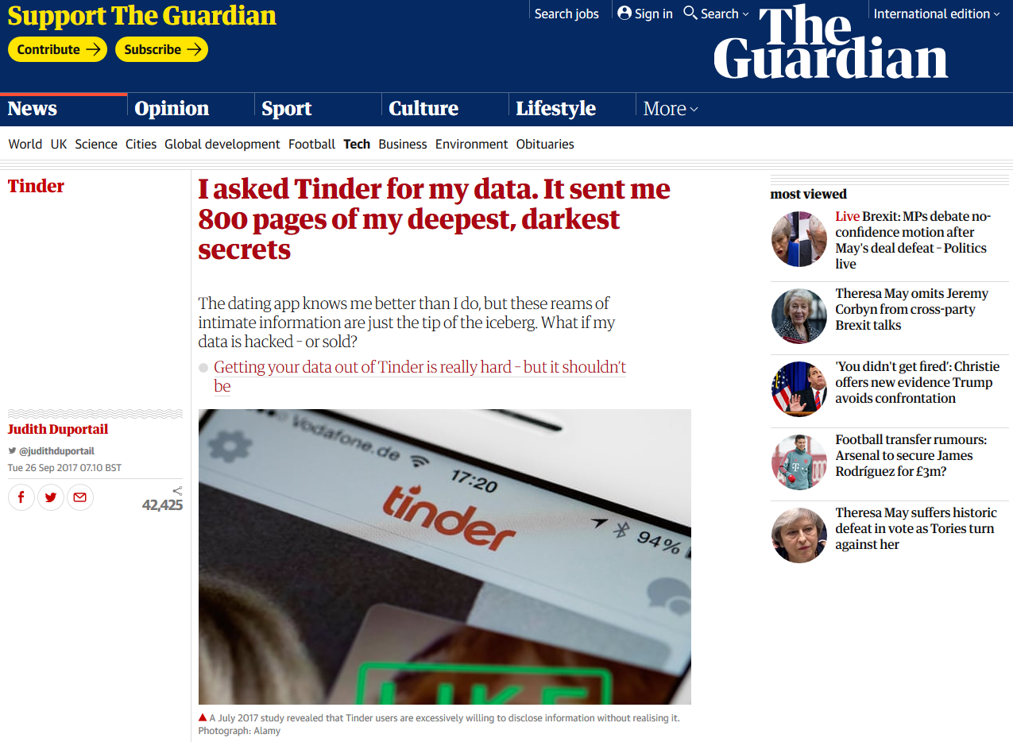

Slide 3


Slide 4
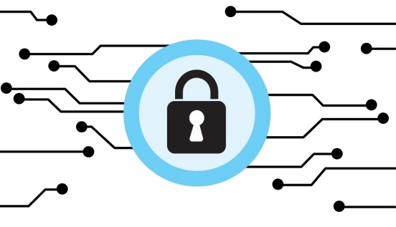
Defining the term PRIVACY
“a right to appropriate [the] flow of personal information” (Nissenbaum, 2010, p. 127)
Privacy in Tinder does not matter
Privacy in Tinder does matter

Slide 5


Privacy in Tinder does not matter
Benefits through registering with existing social media profile
Benefitting social privacy concerns → where other individuals are involved
“Through this [Facebook connection] you could have seen if you have common friends – regarding security issues – and if the other person really exists” (Tinder user)
Quick profile set-up

Slide 6
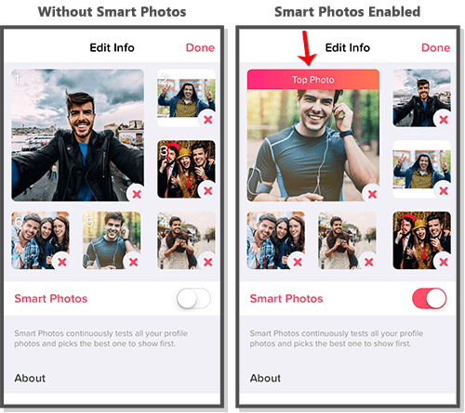
Privacy in Tinder does not matter
Improved UX through non-disclosure of data & algorithms
Institutional privacy: “how institutions (…) deal with personal data” (Lutz and Ranzini, 2017, p.3)
Rejection removed!
Elo score
Smart Photos feature
“Knowledge is always beneficial, but some things you
really don’t want to know” (Tinder user)
Smart Photos feature

Slide 7
Privacy in Tinder does matter
Unintentional disclosure of information
Little awareness of institutional privacy:
“We can‘t feel data!“
Disclosure of friends‘ data
Updated Privacy Policies throughout research
“You can only write, you can not even send
pictures or anything” (Tinder user)
“When I sign up on Tinder, I’m in Tinder and that’s it. Don’t collect other sh*t from different places” (Tinder user)

Slide 8
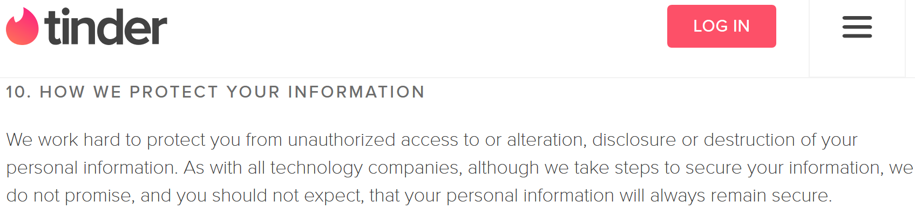
Privacy in Tinder does matter
Unsecured data retention
Storing pictures of Tinder users unencrypted
“it will be interesting to know if they still have my photos and do they share [them] with other people?” (Tinder user)

Slide 9
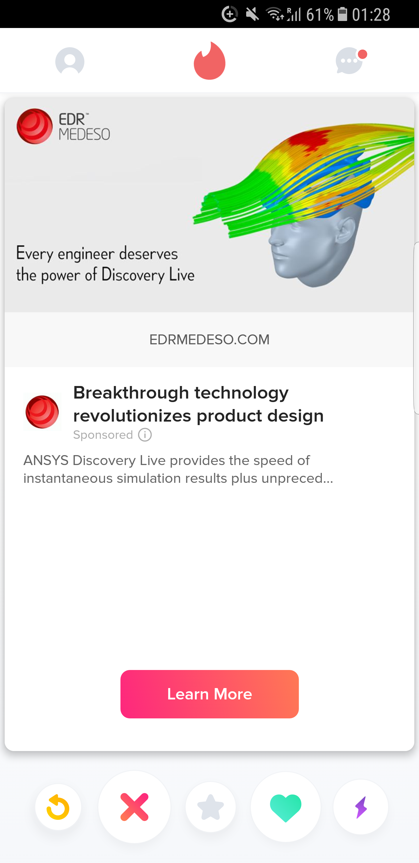


Privacy in Tinder does matter
Affecting users’ existence through data gathering
→ Selling information to third parties
Advertisement in Tinder

Slide 10
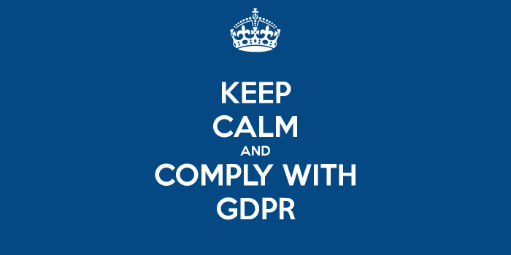
Conclusion & Future Research
PRIVACY MATTERS!
Read Privacy Policies → choose appropriate service
Don‘t just go mainstream
GDPR = Hope for EU?

Slide 12
TERIMA KASIH!
THANK YOU!

