Slide 1
Kodluyoruz Svm Nb Boosting Classifier
Abbas Can Güven

Slide 2
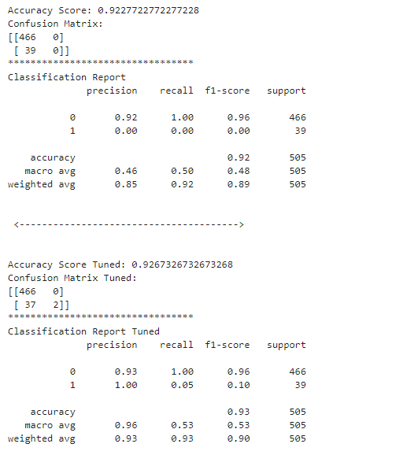

SVC
Best Params

Slide 3
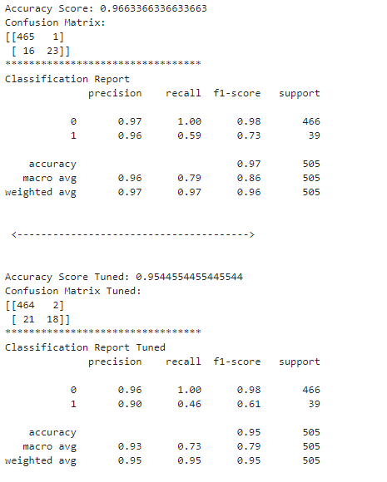

XGB
Best Params

Slide 4
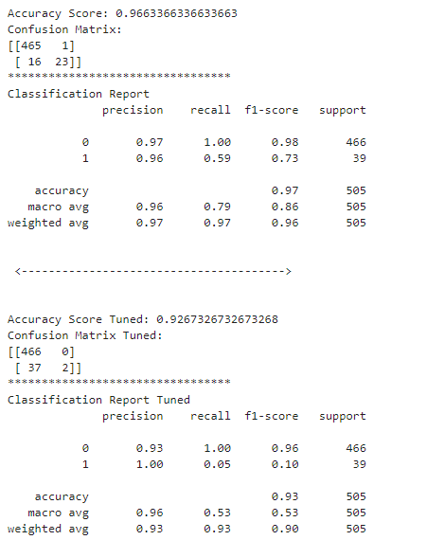
KNN
Best Params: n_neighbors= 14

Slide 5
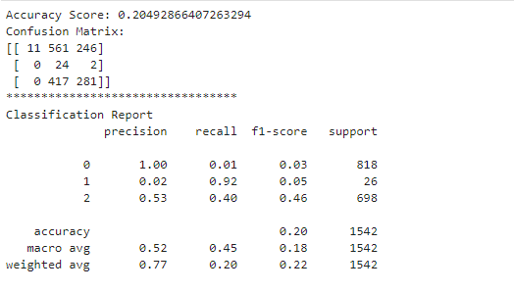
NB

