Slide 1
Kodluyoruz Lojistik Reg
Abbas Can Güven

Slide 2
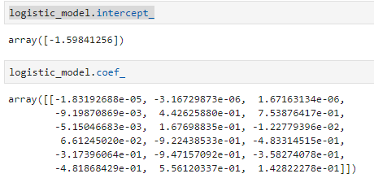
Coef ve İntercept

Slide 3
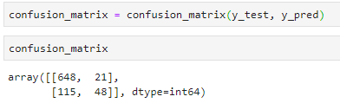
Confusion Matrix (Treshold 0.5)

Slide 4
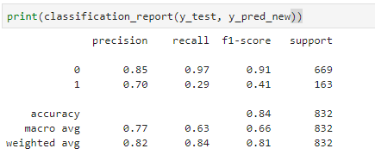
Threshold 0.5

Slide 5

Confusion Matrix (Threshold 0.32)

Slide 6
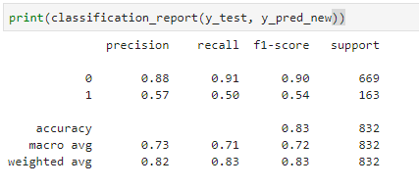
Treshold 0.32

Slide 7

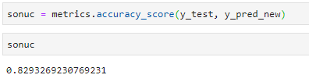
Threshold 0.5 Accuracy Score
Threshold 0.32 Accuracy Score

Slide 8
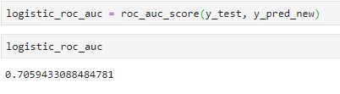
Roc Curve Skoru

