Slide 1
Kodluyoruz Cart, RF, NN Classifier
Abbas Can Güven

Slide 2
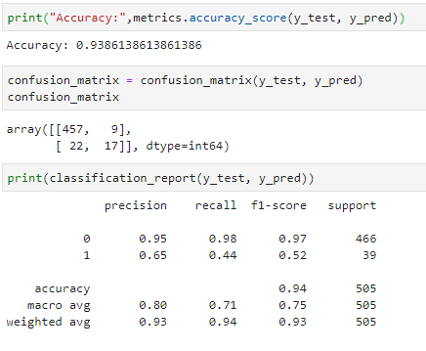
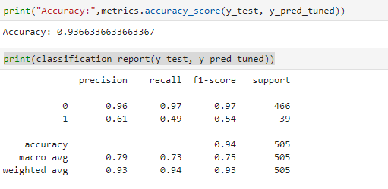
Cart
Best Params
İlkel Cart
Tuned edilmiş Cart

Slide 3
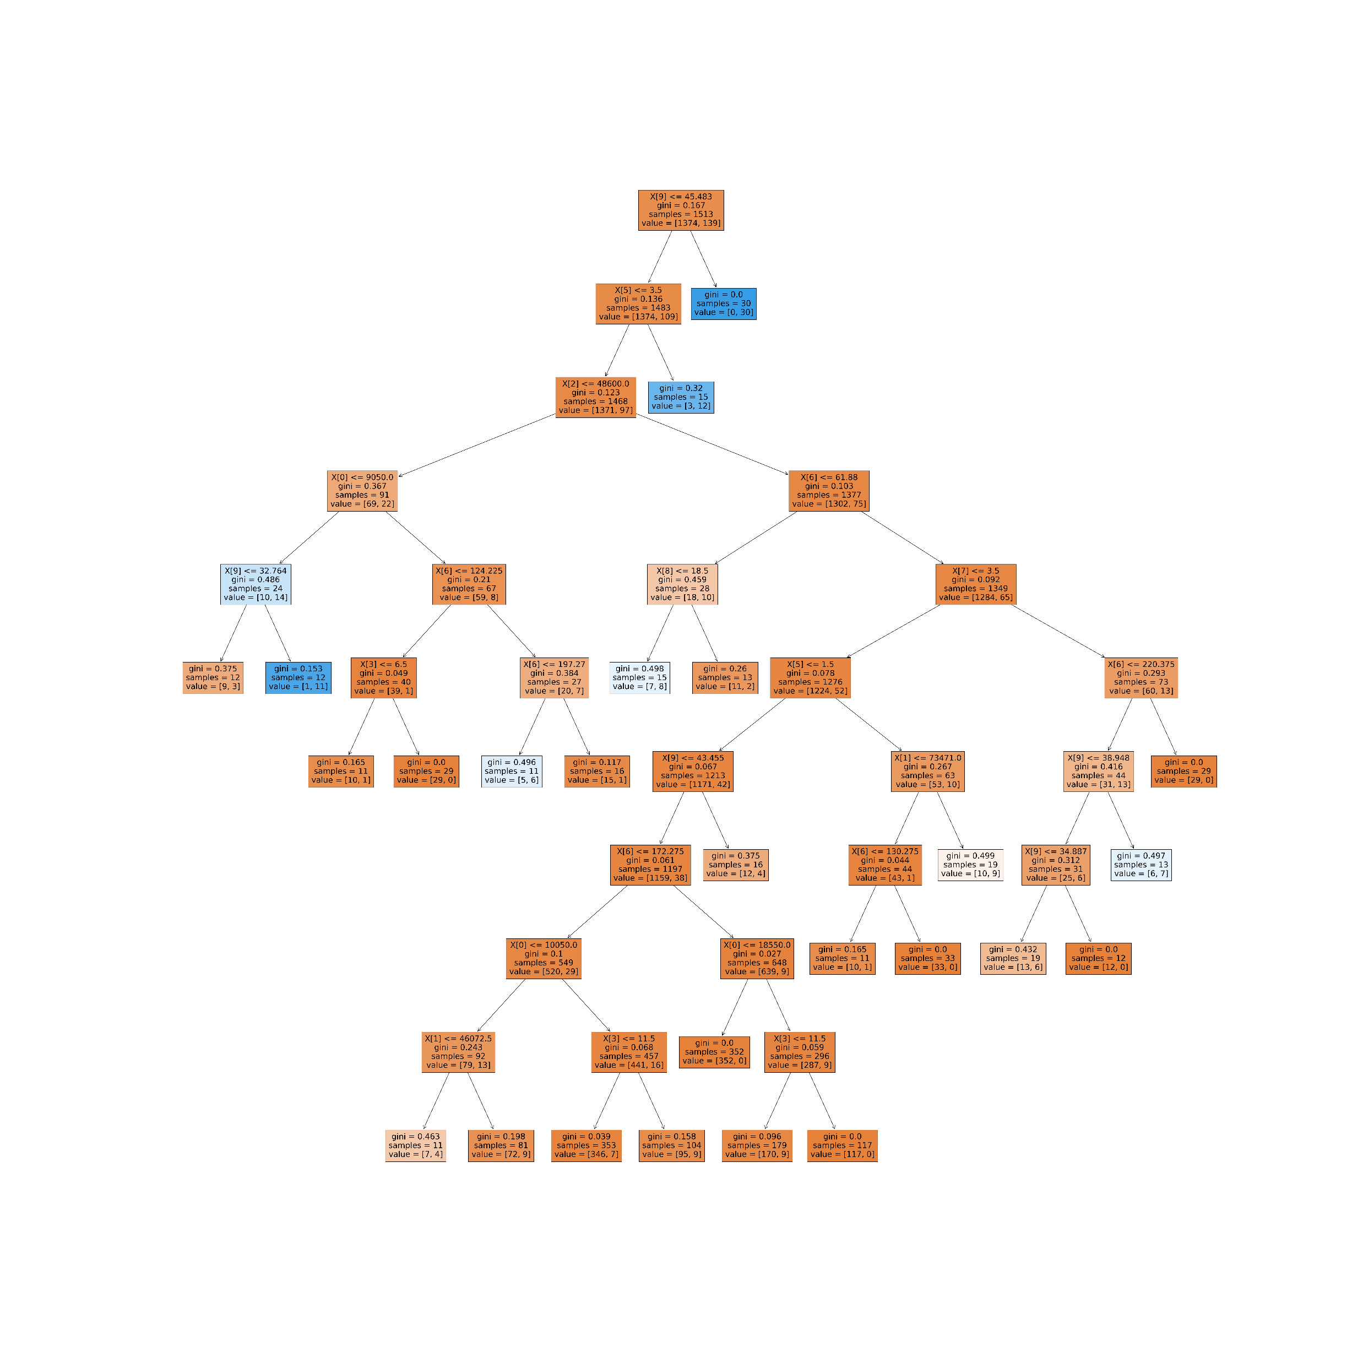

Slide 4
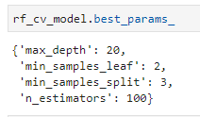
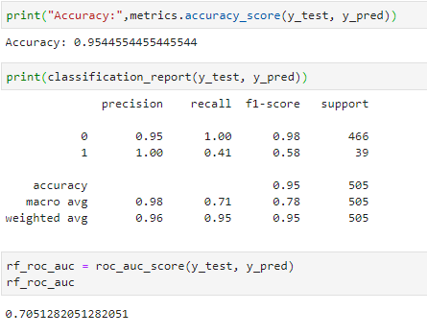
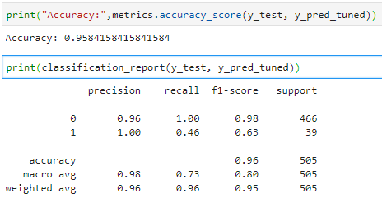
RandomForest
Best Params
İlkel Random Forest
Tuned Edilmiş Random Forest

Slide 5
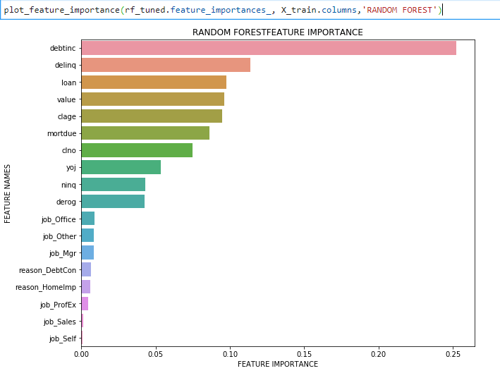
İmportance Random Forest

Slide 6
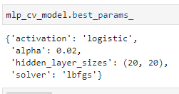
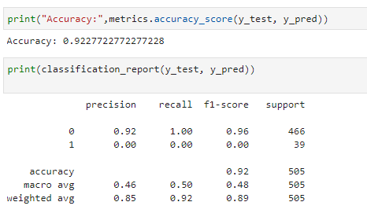
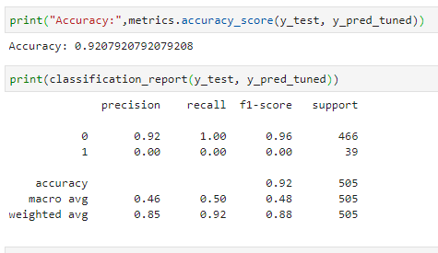
Neural Network
Best Params
İlkel Neural Network
Tuned Edilmiş Neural Network

