Slide 1
Kodluyoruz Cart, Rf, Mlp Regressor
Abbas Can Güven

Slide 2

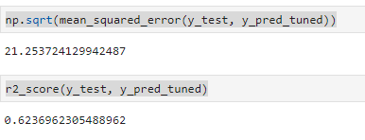
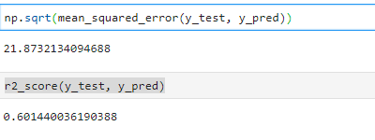
Cart
Best Params
İlkel Cart
Tuned Edilmiş Cart

Slide 3

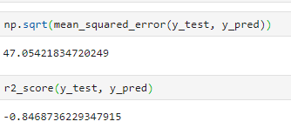
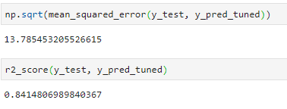
Random Forest
Best Params
İlkel Random Forest
Tuned Edilmiş Random Forest

Slide 4
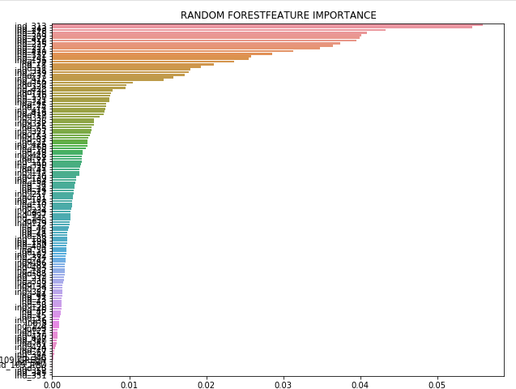
Random Forest İmportance

Slide 5
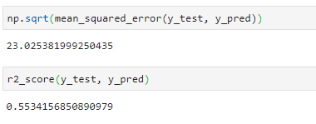
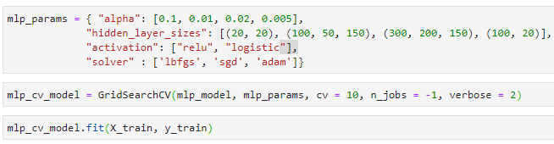
Neural Network
İlkel Neural Network
Best Params bulma

