Slide 1
Kodluyoruz homework #3 -PCA-
Beyza Ecem Erce

Slide 2
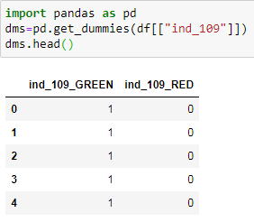
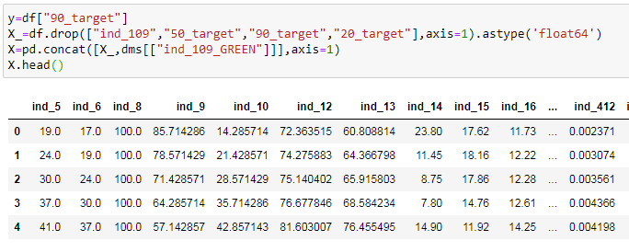

Principal Component Analysis(PCA)
Dummy
Model (train)

Slide 3
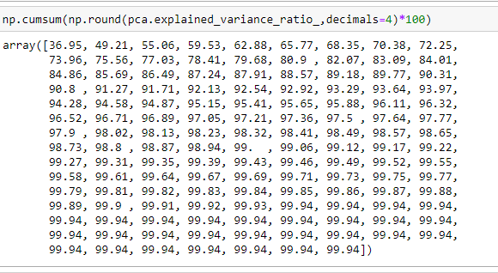
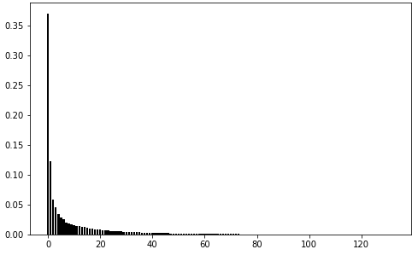
Explained Variance Ratio

Slide 4
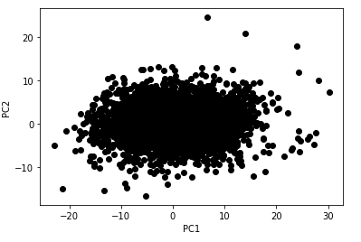
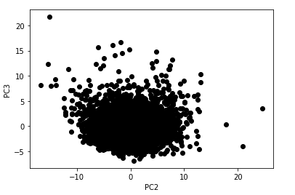
Components

Slide 5
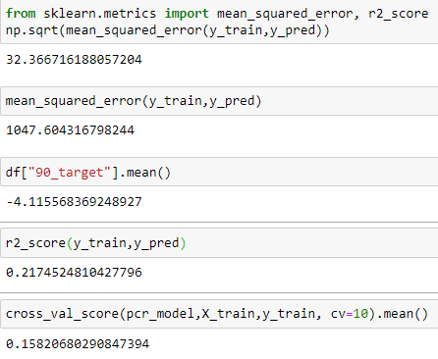
Evaluation

