Slide 1
Kodluyoruz 53. Ankara Data Science Bootcamp Homework 2
Beyza Ecem Erce

Slide 2



Data Information

Slide 3
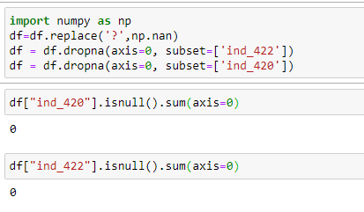
Deleting Null variables

Slide 4
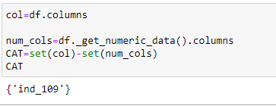
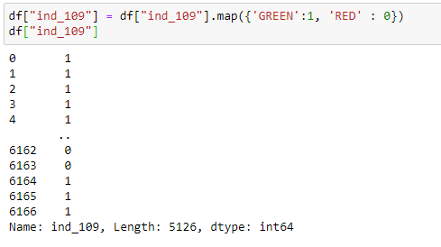
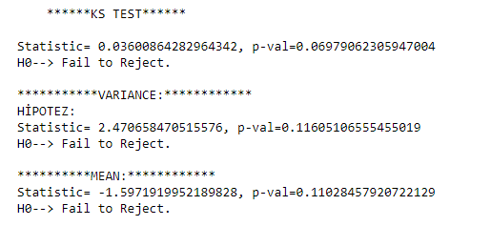
Categorical Variable
Dummy

Slide 5
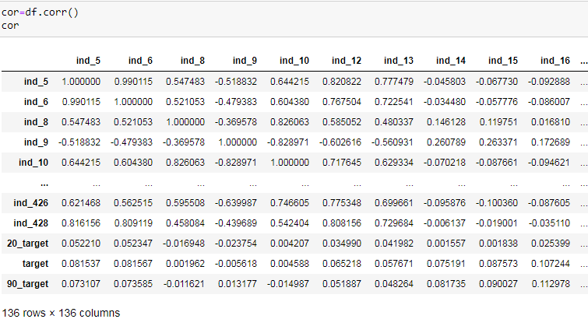
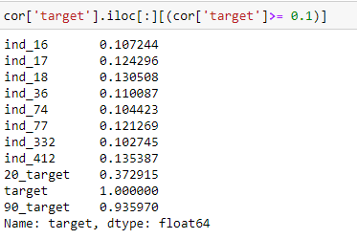
Correlation
Highest values of correlation on target →

Slide 6
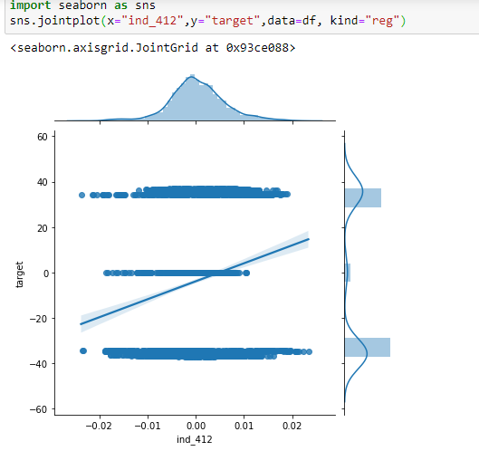
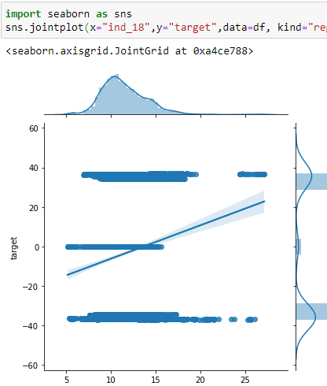
Highest Correlated Features

Slide 7
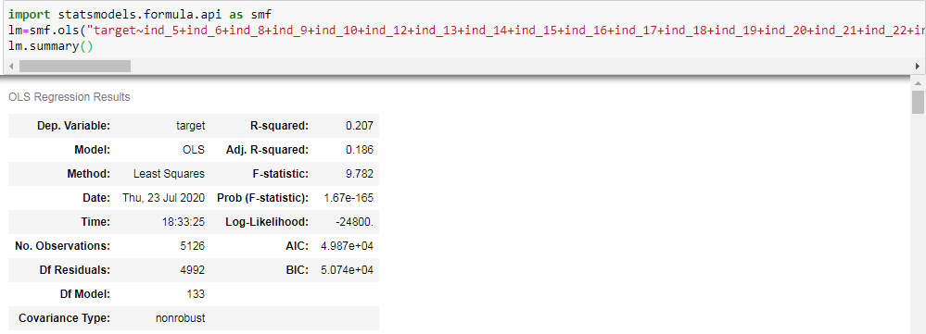
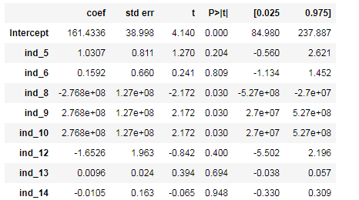
Regression Model

Slide 8
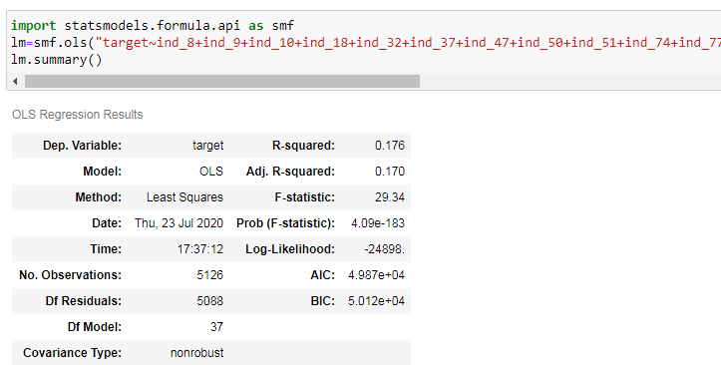
After removing all features that have P>|t| is less then 0.05….

Slide 9
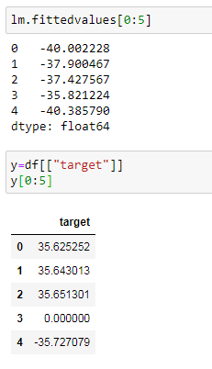
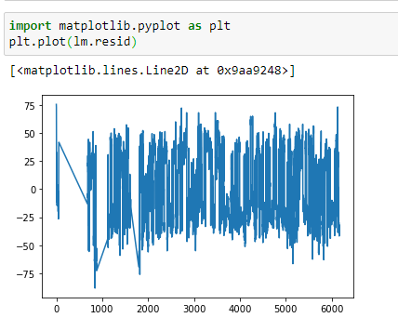
Fitted Values and Residuals

Slide 10
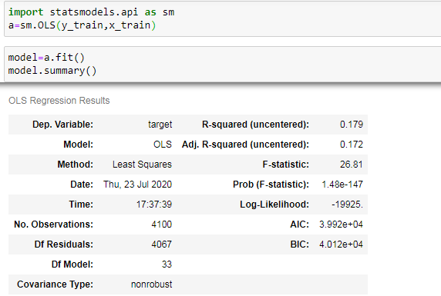
Train/Test Set

Slide 11
