Slide 1
RRK - CONSULTANCY

Slide 2
How you conduct or contribute to customer meetings and interact with stakeholders in the sales process?
In customer meetings and with stakeholders, I act as data solution guider and collaborator. Here's how I contribute:
Understanding client Needs: I'll ask questions to identify your data challenges and business goals. Think of me as an expert who listens closely to find the perfect fit for your problems.
Clear Communication: I explain how Google Cloud Platform (GCP) data solutions can address your specific needs in a way that's easy for everyone on your team to understand, regardless of their technical background.
Building Trust: Through clear communication, I help build trust and collaboration, which is key to a successful data project.
Always Available: Feel free to ask me anything about GCP or data solutions throughout the entire process. I'm here to help!
Preparation is Key: Before meetings, I work together to define your goals and challenges. This allows us to tailor demos and discussions to your specific situation, maximizing the benefit for the stakeholder.
Keeping client Informed: After each meeting, I'll provide summarizing key points, next steps and resources. This ensures everyone stays on the same page and demonstrates my commitment to client / stakeholder success.
Building Relationships: I focus on building strong relationships with everyone involved in the decision-making process. This collaborative approach fosters trust and increases the chance of a successful data project.

Slide 3
Example about collaboration and meeting
Collaboratively Building a Data Pipeline for Onboarding Team with Datastream
Challenge: Onboarding team manually pushed data to PostgreSQL. BI tools and data union with BigQuery were needed.
Solution: Implemented Google Cloud Datastream for near real-time data replication. Datastream captures PostgreSQL changes and replicates them to BigQuery tables.
Collaboration: Collaborated with the onboarding team to define data transfer frequency, data selection and BigQuery schema. Explained Datastream benefits for data transfer automation and improved BI accessibility.
Implementation: Obtained PostgreSQL access credentials and designed the Datastream pipeline. Defined source/destination connections and data mapping configurations. Performed testing to validate functionality and data integrity.
Knowledge Transfer: Documented the process in Confluence and Git. Provided instructions for pipeline management and monitoring, empowering team autonomy.
Outcome: Automated data transfer, ensured continuous BigQuery data availability. Saved time and resources, provided a scalable solution. Demonstrated GCP's effectiveness in streamlining data infrastructure.

Slide 4
Preparation for customer meetings
Collaboration: I actively collaborate with the teams to understand the stakeholders background, goals and technical pain points.
Research: I delve into the stakeholders industry and current cloud infrastructure to tailor the meeting agenda and demonstrations.
Anticipating Needs: I anticipate(expect, forecast) potential questions and objections based on common challenges in similar client scenarios.
Preparation Materials: I prepare demos, proofs of concept (POCs) and technical resources specific to the customer's needs.
Example
Our team led the selection process for a new Business Intelligence (BI) tool. We gathered feedback from management and evaluated leading solutions like Superset, Power BI, Looker, Looker Studio, and Tableau. A comprehensive analysis of each product was prepared for stakeholder discussions, facilitating informed decision-making on the best tool for our organization. So in the meeting we had some prepared informatio / analysis about BI tools.

Slide 5
Preparation for evaluating opportunities
Understanding Requirements: During meetings, I ask insightful questions to fully understand the customer's specific technical and business requirements for their cloud migration or project.
Solution Mapping: I map GCP solutions and services to the stakeholders needs, highlighting how these solutions can address pain points and deliver value.
Quantifying Benefits: I leverage GCP cost calculators and case studies to quantify the potential cost savings, performance improvements or other positive outcomes achievable with GCP.
Risk Assessment: I work with the other teams to identify potential risks and address them proactively. This could involve discussing migration strategies, security concerns or integration challenges.

Slide 6
Example for evaluating opportunity
Client Challenge: Migrate a high-volume, on-premises MySQL database for e-commerce transactions to the cloud, ensuring scalability and strong data consistency across locations.
GCP Solution: Google Cloud Spanner - a globally distributed relational database offering:
Horizontal scaling for future growth
Strong data consistency across locations
ACID compliance for reliable transactions
Benefits:
Reduced operational overhead
Improved scalability
Enhanced data consistency
Risks:
Schema adjustments for Spanner
Downtime minimized with Database Migration Service
Thorough testing and validation before production

Slide 7
Preparation for handling customers objections
Active Listening: I practice active listening to fully understand the root cause of the customer's objection.
Clarification: I ask clarifying questions to ensure I grasp the concern completely. Sometimes objections disguise a deeper need.
Addressing Concerns: Based on the objection, I provide solutions that leverage my technical knowledge of GCP. This could involve showcasing case studies, demonstrating alternative solutions or addressing specific security or compliance concerns.
Focus on Value: I maintain a focus on the value proposition of GCP throughout the objection handling process. I ensure the customer understands how GCP can solve their problems and ultimately benefit their business.

Slide 8
Example for customer objection
Customer Objection: The customer is interested in building data pipelines on GCP but is concerned about the potential ongoing costs associated with managed services like Cloud Dataflow.
Active Listening: Acknowledge their concern and ask clarifying questions:
Can you elaborate on what aspects of cost concern you the most?
Have you estimated the costs of managing your current on-premises data pipelines?
Clarification: Understand the customer's cost sensitivity and their current data pipeline infrastructure.
Addressing Concerns:
Highlight Cost Optimization Strategies: Explain GCP's built-in cost optimization features like scheduled starts/stops for Dataflow pipelines, autoscaling and custom resource configurations to minimize resource usage.
Focus on Long-Term ROI: Demonstrate how managed services can save costs in the long run by reducing IT overhead for managing infrastructure and allowing them to focus on core business needs. Provide examples of pay-per-use pricing for services like Dataflow.
Transparent Cost Estimation: Offer to work with the customer to create a customized cost estimate based on their specific data pipeline needs. Utilize GCP's pricing calculators for transparency.
Consider Alternatives: Discuss alternative solutions like Apache Beam for building custom, potentially more cost-effective pipelines, if suitable for their expertise.
Focus on Value Proposition: Throughout the conversation, emphasize the benefits of using Dataflow in GCP:
Increased Efficiency: Highlight how managed services can streamline data processing and reduce development time.
Improved Scalability: Explain how GCP allows for easy scaling of data pipelines to meet changing data volumes.
Enhanced Reliability: Mention built-in redundancy and fault tolerance features that minimize downtime and ensure data integrity.

Slide 9
RRK – CLOUD FOUNDATIONAL KNOWLEDGE

Slide 10
Cloud Computing Value (scalability, cost optimization)
Scalability: Highlight how cloud computing allows businesses to scale resources (compute, storage, etc.) up or down dynamically based on demand. This eliminates the need for upfront investment in physical infrastructure and reduces costs during low-usage periods.
Example: A retail company uses Google Kubernetes Engine (GKE) to deploy its e-commerce platform. During peak sales seasons, they can easily scale up their virtual machine instances to handle increased traffic. After the sales period, they can scale down to reduce costs.
Cost Optimization: Emphasize the pay-as-you-go model of cloud computing, where businesses only pay for the resources they use. This eliminates the need for expensive upfront hardware purchases and ongoing maintenance costs.
Example: A startup leverages Google Cloud Storage for its data storage needs. They only pay for the storage they use, eliminating the upfront costs of purchasing physical storage devices and ongoing maintenance expenses.

Slide 11
Cloud Computing Value (agility and innovation, reliability and disaster recovery)
Increased Agility and Innovation: Explain how cloud computing enables faster development and deployment cycles. Businesses can quickly provision resources to test new ideas and applications without significant infrastructure investment.
Example: A data science team utilizes Google Cloud Dataproc to set up a secure Hadoop cluster for data analysis projects. GCP's pre-configured environment allows them to quickly provision resources and start working on their analysis tasks without spending weeks setting up their own infrastructure.
Improved Reliability and Disaster Recovery: Cloud providers offer robust infrastructure with built-in redundancy and disaster recovery features. This ensures high availability of applications and data, minimizing downtime in case of outages.
Example: A financial services company uses Google Cloud Spanner, a globally-distributed relational database service, for its core financial applications. Spanner offers automatic replication across geographically distributed data centers, ensuring data availability even in case of regional outages.

Slide 12
Cloud Computing Value (global reach, focus on code)
Global Reach: Cloud computing offers geographically distributed data centers, allowing businesses to deploy applications closer to their users for improved performance and latency.
Example: A gaming company deploys its game servers on Compute Engine instances across multiple GCP regions. This allows them to place servers closer to their player base in different parts of the world, reducing latency and improving the gaming experience.
Focus on Code: Explain how serverless solutions allow developers to focus on writing code without worrying about server management, provisioning, or scaling. This increases development speed and efficiency.
Example: A data analyst uses Cloud Functions to write a serverless function that automatically triggers data cleaning and transformation tasks whenever new data arrives in a Cloud Storage bucket. This frees them from managing servers and allows them to focus on writing the data processing logic.

Slide 13
Cloud Computing Value (reduced operations, cost-effectiveness)
Reduced Operational Overhead: Serverless solutions eliminate the need for server management tasks, freeing up IT resources to focus on other priorities. This reduces operational costs and complexity.
Example: A data engineering team utilizes Cloud Dataflow for Serverless to build data pipelines for their analytics workflows. This serverless approach eliminates the need for managing and scaling dedicated compute resources for data processing tasks, reducing operational overhead for the team.
Cost-Effectiveness: Emphasize that businesses only pay for the resources they use with serverless solutions. This is ideal for applications with unpredictable or spiky workloads.
Example: A research institution uses Cloud Functions to process sensor data collected from their experiments. Since the data collection happens sporadically, a serverless approach allows them to avoid paying for idle server resources, resulting in cost savings.

Slide 14
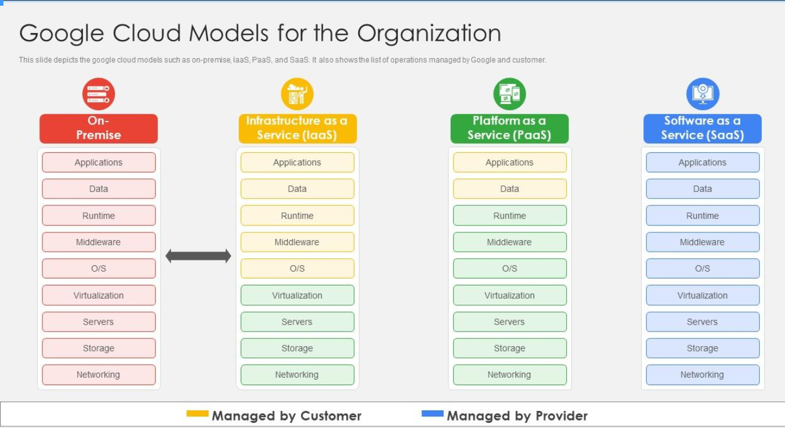

Slide 15
IaaS (Infrastructure as a Service): use case, example, pros, cons
Provides on-demand access to the fundamental building blocks of IT infrastructure like compute (virtual machines), storage (Cloud Storage) and networking (Cloud VPN) resources.
Use Case: Building a highly customized data pipeline for complex data ingestion and processing.
GCP Example: You can use Google Compute Engine (GCE) to create virtual machines (VMs) with specific configurations tailored to your data processing needs. You can install and manage open-source tools like Rust Datafusion library on these VMs for distributed data processing.
Pros: Offers granular control over every aspect of the infrastructure, ideal for unique processing needs.
Cons: Requires significant IT expertise for VM management, software installation and ongoing maintenance.

Slide 16
containers as a Service (CaaS): use case, example, pros, cons
CaaS provides a managed environment for deploying and running containerized applications. It eliminates the need to manage the underlying infrastructure (servers, OS) allowing developers to focus on the application code.
Use Case: Rapid development, deployment, and scaling of microservices-based applications.
GCP Example: You can use Google Kubernetes Engine (GKE) to deploy and manage containerized applications. GKE takes care of provisioning, scaling, and load balancing your container clusters. You can focus on building and deploying your containerized microservices.
Pros:
Faster deployments: Simplified deployments with built-in orchestration tools.
Scalability: Easy scaling of applications based on demand.
Portability: Containers run consistently across different environments.
Reduced resource usage: Containers share the underlying OS, leading to efficient resource utilization.
Cons:
Less control compared to IaaS: Limited control over the underlying infrastructure.
Security considerations: Shared kernel across containers requires proper security practices.

Slide 17
PaaS (Platform as a Service): use case, example, pros, cons
Delivers a complete development and deployment environment in the cloud. Think development tools, pre-configured environments and services to simplify application building and management.
Use Case: Rapid data analysis and visualization for business intelligence dashboards.
GCP Example: Utilize Google App Engine (GAE) to deploy pre-built web applications for data exploration and visualization. Integrate services like Google Cloud Datastore or Cloud SQL for data storage, and connect them to GAE for building interactive dashboards.
Pros: Faster deployment and easier management compared to IaaS. Provides tools and frameworks for development.
Cons: Less control over underlying infrastructure compared to IaaS. May not be suitable for highly customized data processing pipelines.

Slide 18
FaaS (Function as a Service): use case, example, pros, cons
FaaS provides a platform to run stateless functions without managing servers or runtime environments. Developers can focus on writing the function code and GCP handles provisioning and scaling.
Use Case: Event-driven applications, data processing tasks, microservice functionalities.
GCP Example: Google Cloud Functions allows deploying functions triggered by events like file uploads, database changes or HTTP requests. You can write functions in various languages and GCP manages execution.
Pros:
Cost-effective: Pay only for the resources your function uses.
Scalability: Functions automatically scale based on traffic.
Faster development: Focus on code without server management.
Cons:
Limited execution time: Functions may have timeout limitations (cloud function up to 60 minutes)
Debugging complexity: Debugging functions can be more challenging compared to traditional applications.

Slide 19
SaaS (Software as a Service): use case, example, pros, cons
Provides access to pre-built software applications delivered entirely over the internet. Users access the software through a web browser or mobile app, eliminating the need for local installation or maintenance.
Use Case: Cost-effective data exploration and basic analytics for smaller datasets.
GCP Example: Leverage BigQuery, a fully managed data warehouse service. Upload your data to BigQuery and utilize its web UI or SQL interface for ad-hoc analysis and generating reports.
Pros: Easiest to use and requires minimal technical expertise. Scalable and cost-effective for smaller datasets.
Cons: Limited customization compared to IaaS and PaaS. May not be suitable for complex data transformations or large-scale analytics.

Slide 20
When choosing the right cloud services model, consider the following factors:
Data size and complexity: For large, complex datasets, IaaS might be suitable (also SaaS can be excellent choice). For smaller datasets, SaaS could suffice.
Technical expertise: If your team has strong IT skills, IaaS might be manageable. If not, PaaS or SaaS offer easier management.
Customization needs: IaaS offers the most control, while SaaS offers the least. PaaS falls in between.
Budget: IaaS can be more expensive due to management overhead, while SaaS is typically pay-as-you-go

Slide 21
Shared Security Model
Cloud providers are responsible for the security of the underlying infrastructure (servers, network, physical security).
Enterprises are responsible for securing their data, configurations and access within the cloud environment.

Slide 22
Key Cloud Security Concepts for Migration (1)
Mapping On-Premise Roles to Cloud Roles:
Imagine your company departments and access levels on-premise (e.g., Finance team has access to financial data). IAM helps translate those roles to similar ones in Google Cloud.
Translating On-Premise Permissions:
This is where you match the specific actions users could do on-premise (e.g., edit financial data) to similar permissions in Google Cloud.
Cloud Role Options:
Google Cloud offers pre-built roles for common tasks, saving you time. These roles group together specific permissions for, say, a "Cloud Storage Viewer" or a "Compute Engine Admin."
Customizing Roles (Optional):
Need a very specific permission setup? No problem! You can create custom roles with exactly the permissions needed for each team or user.
Including Everyone:
IAM isn't just for traditional user accounts. It can also manage access for service accounts, which are special accounts used by applications to access cloud resources. This ensures everyone who needs access on-premise can access it securely in the cloud.
Additional Security Measures:
Role-Based Access Control (RBAC):
This is the foundation of IAM. RBAC ensures users only get the minimum level of access (least privilege) needed to do their jobs. This minimizes security risks.
Multi-Factor Authentication (MFA):
MFA adds an extra layer of security by requiring a second verification step (like a code from your phone) when logging in. This makes it much harder for unauthorized access, even if someone gets a hold of a username and password.

Slide 23
Key Cloud Security Concepts for Migration (2)
Encryption: Keeping Your Data Secret
Cloud Provider Encryption: Google Cloud automatically encrypts your data at rest (when stored) using a very strong code (AES-256). This acts like a vault, keeping your data private even if someone hacks into Google's systems.
Encryption in Transit: Google Cloud also scrambles your data while it's moving between your systems and the cloud (in transit). This prevents anyone from eavesdropping and stealing your data during transfer.
Bring Your Own Encryption Key (Optional): For an extra layer of security, you can choose to use your own secret code (encryption key) to further lock down your data. This gives you even more control over who can access it.
Data Classification and Access Control: Who Sees What
Data Labeling: Classify your data based on its sensitivity. Imagine labeling documents "Public," "Confidential," or "Top Secret" based on their importance.
Role-Based Access Control: Only authorized users can access data based on its label and their role within your organization. For example, only managers might be allowed to see "Top Secret" data.
Data Masking (Optional): Google Cloud offers an extra layer of protection for highly sensitive data. It can scramble the data itself, making it unreadable even if someone manages to bypass other security measures.
Data Residency: Keeping Your Data Where it Belongs
Compliance with Regulations: Some regulations, like GDPR (General Data Protection Regulation), require data to be stored in specific regions. Google Cloud understands this and offers a global infrastructure with data centers in various locations. This allows you to choose where your data is physically stored, ensuring compliance with regional regulations.

Slide 24
Key Cloud Security Concepts for Migration (3)
Network security is crucial for protecting your cloud resources from unauthorized access. Here's how cloud providers like Google Cloud help you secure your network:
Cloud Firewalls: Your First Line of Defense
Granular Traffic Control: Google Cloud Firewalls act like security guards, inspecting incoming and outgoing traffic (data flowing to and from your cloud resources). They offer fine-grained control, allowing you to specify exactly what kind of traffic is allowed (protocols, ports, IP addresses).
Policy-Driven Approach: Define clear security policies that dictate which traffic can access your resources. This ensures consistency and simplifies security management across your entire cloud environment.
Leveraging IAM: Cloud Firewalls can work hand-in-hand with IAM (Identity and Access Management). This allows you to use role-based access control (RBAC) to define who (users or services) can access specific resources based on their permissions. Imagine a firewall only allowing access from authorized users with the proper IAM roles.
Hierarchical Security Management: Google Cloud lets you create security rules at different levels (organization, folder, or VPC). This is especially helpful for large deployments. Think of it as having different security zones within your cloud environment, each with its own set of rules.
Segmentation: Isolating Workloads for Enhanced Protection
Workload Isolation: Google Cloud offers tools like Virtual Private Cloud (VPC) and Cloud Workspaces. These services help you create isolated environments for different workloads. Imagine having separate buildings for different departments in your company. This isolation prevents a security breach in one area from spreading to others, minimizing the damage.
Minimizing Blast Radius: If a security incident occurs within a segmented environment, the damage is contained to that specific segment. Other workloads in different segments remain secure. This reduces the overall impact (blast radius) of the breach. Imagine a fire outbreak in one building; the fire doesn't spread to other isolated buildings.
Improved Security Posture: Segmentation promotes a "defense-in-depth" strategy. By adding multiple layers of security, it becomes more difficult for attackers to move laterally within your cloud environment and compromise critical systems. Think of it as having multiple security checkpoints, making it harder for intruders to bypass them all.

Slide 25
Key Cloud Security Concepts for Migration (4)
Maintaining visibility into your cloud environment is critical for identifying potential threats and ensuring smooth operation. Here's how cloud providers like Google Cloud can help you monitor your cloud:
Cloud Logging and Monitoring: Your Eyes and Ears in the Cloud
Centralized Logging (Cloud Logging): Imagine having a central log repository for all your cloud activity. Cloud Logging acts as that repository, collecting log data from your applications, Google Cloud Platform (GCP) resources, and even external sources. By analyzing these logs, you can identify unusual events, troubleshoot issues, and track user activity.
Real-time Insights (Cloud Monitoring): Cloud Monitoring provides a real-time view of your GCP environment's health, performance, and resource utilization. Think of it as a dashboard that shows how your cloud resources are performing. You can set up alerts to be notified of potential issues, such as sudden increases in errors or unusual resource consumption.
Audit Trail (Cloud Audit Logs): This service automatically records any administrative actions performed within GCP. Imagine an audit log for your cloud environment. This helps you maintain a secure record of activity and detect any suspicious access attempts.
Integrating Existing Security Tools for Centralized Monitoring
Connecting Your Security Arsenal (APIs and SDKs): GCP provides tools (APIs and SDKs) that allow your existing security software to communicate with GCP security services. This enables data exchange and centralized monitoring from a single location. Imagine having all your security tools feeding information into one central console.
Cloud Security Command Center (SCC): Think of SCC as your mission control center for cloud security. It acts as a central hub for managing your security posture across different GCP services. SCC can also integrate with many third-party security tools, allowing you to view security alerts and logs from various sources in a single console. This provides a unified view of your security posture across your entire environment.
Open XDR for Seamless Integration: GCP supports Open XDR, a standardized format for security data exchange. This allows security data from different tools to be seamlessly integrated. Imagine having all your security data speaking the same language. This facilitates comprehensive threat detection and response across your entire IT infrastructure, including both on-premise and cloud environments. By leveraging Open XDR, you can effectively monitor your entire security landscape.

Slide 26
Migrations considerations
Security Assessment:
Vulnerability Scanning: Utilize GCP Security Command Center or integrate existing vulnerability scanners to identify and prioritize known vulnerabilities in your workloads before migration.
Threat Modeling: Conduct a threat modeling exercise to identify potential attack vectors and ensure security controls address them during migration.
Data Security Assessment: Evaluate data classification (public, private, confidential) and implement appropriate data encryption at rest and in transit according to GCP's security best practices.
Phased Migration:
Prioritization: Classify workloads based on criticality and security sensitivity. Migrate lower-risk workloads first to gain experience and refine the process before tackling sensitive applications.
Pilot Program: Run a pilot migration with a non-critical workload to test the migration approach, identify potential issues, and refine security controls before large-scale migration.
Change Management: Integrate security considerations into the overall migration plan. Involve security teams throughout the process to ensure proper security controls are implemented at each phase.
Security Testing:
Penetration Testing: Engage a qualified security team to conduct penetration testing on the migrated workloads to identify exploitable vulnerabilities after migration.
Vulnerability Scans: Schedule regular vulnerability scans on migrated workloads to detect and address new vulnerabilities promptly.
Security Information and Event Management (SIEM): Implement a SIEM solution to collect and analyze security logs from GCP services and migrated workloads for continuous threat detection and monitoring.

Slide 27
Migrations considerations, example
Cloud security is a shared responsibility between Google Cloud Platform (GCP) and your organization. While GCP secures the underlying infrastructure, you're responsible for securing your data and configurations within the cloud.
During a migration, I'd focus on implementing robust Identity and Access Management (IAM) practices. This includes meticulously mapping your on-premise user roles to granular GCP roles, ensuring least privilege access through Role-Based Access Control (RBAC). Multi-Factor Authentication (MFA) would be crucial to add an extra layer of security, significantly reducing the risk of compromised login credentials.
For data security, I'd recommend leveraging Google Cloud's encryption capabilities to encrypt data at rest and in transit. This protects your sensitive information even if it's intercepted. We'd also implement data classification and access controls based on data sensitivity. Additionally, understanding your data residency requirements and choosing a compliant cloud provider like GCP is essential for regulatory adherence.
Network security would involve utilizing security groups or Cloud Firewalls to control inbound and outbound traffic flow. Segmentation can further isolate workloads, minimizing the potential impact of a security breach.
Finally, maintaining strong visibility and monitoring is key. I'd leverage Cloud Monitoring and Logging to track activity, identify suspicious behavior, and proactively address potential threats. Integrating your existing security tools with the GCP environment would provide a holistic view of your security posture.

Slide 28
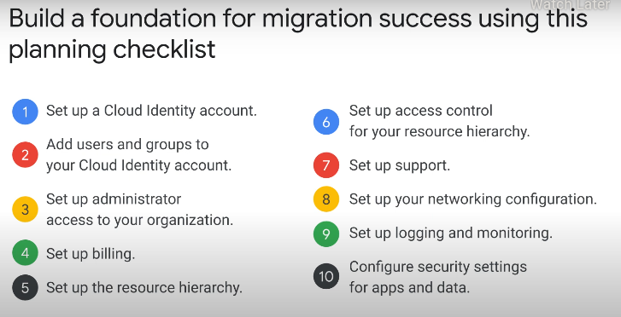

Slide 29
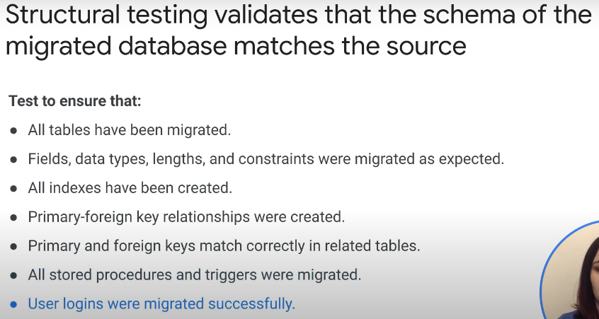
Test - structural

Slide 30
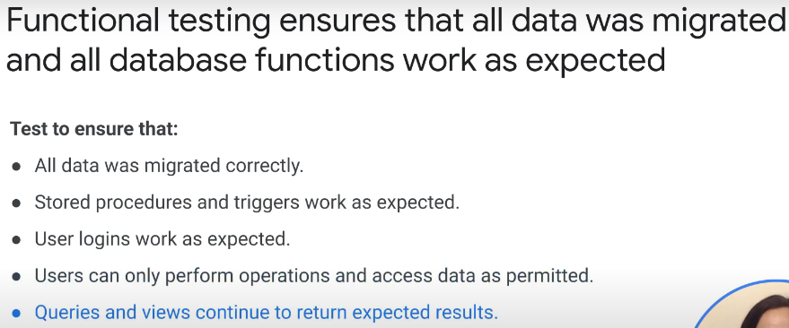
Test - functional

Slide 31
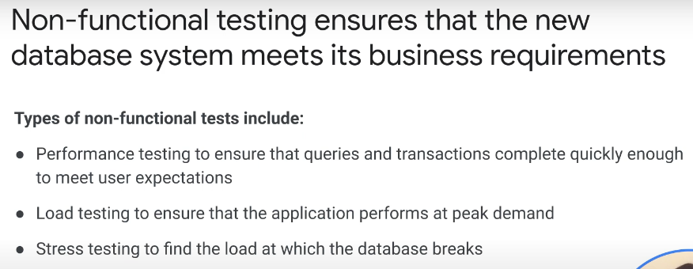
Test - functional

Slide 32
Here's a breakdown of different GCP database migration approaches with a focus on their steps and summaries:
1. Scheduled Maintenance:
Steps:
Backup: Create a full backup of your source database.
Downtime window: Schedule a maintenance window for minimal application disruption.
Migration: During downtime, create the destination database instance in GCP (e.g., Cloud SQL).
Data transfer: Transfer data from the source database backup to the destination.
Verification: Verify data integrity in the destination database.
Application update: Update the application to point to the new database instance.
(Optional) Decommission the source database after successful migration.
Summary: Simple approach for small databases with some downtime tolerance. Ideal for planned migrations with minimal complexity.
2. Continuous Replication:
Steps:
Set up Database Migration Service (DMS): Configure DMS in GCP to manage the migration.
Create a migration job: Define the source and destination database details in DMS.
Initial data transfer: DMS performs a full data transfer from source to destination.
Continuous replication: DMS establishes ongoing replication to keep the destination in sync with source changes.
Cutover: Once satisfied, use DMS to switch application usage to the replicated destination database.
Summary: Minimizes downtime by continuously replicating data during migration. Suitable for larger databases requiring high availability, but adds complexity.

Slide 33
3. Split Reading and Writing (using Cloud Spanner):
Steps:
Set up Cloud Spanner: Create a Cloud Spanner instance in GCP.
Schema design: Design your schema to handle reads and writes separately (e.g., read replicas for queries).
Data migration: Migrate data to Cloud Spanner, potentially using a combination of scheduled maintenance and ongoing replication for different data segments.
Application update: Modify the application to use Cloud Spanner for reads and writes based on schema design.
Summary: Scales well for read-heavy workloads by separating reads and writes. Requires schema design changes and managing separate instances, making it more complex.
4. Data Access Microservice:
Steps:
Develop a data access microservice: Create a separate service responsible for interacting with the database(s). This service acts as an abstraction layer for your application.
Migrate data: Migrate your database(s) to GCP using a suitable approach (e.g., scheduled maintenance, continuous replication).
Update application: Modify your application to communicate with the new data access microservice instead of the database directly. The microservice handles data retrieval, manipulation, and storage.
(Optional) Implement additional features within the data access microservice, like data validation, caching, or security controls.
Summary:
Offers flexibility and scalability: The data access layer is decoupled from the application, allowing independent scaling and updates.
Improves maintainability: Centralizes database logic, making it easier to manage and modify.
Enhances security: The microservice can enforce access controls and data validation, improving data security.

Slide 34
RRK – TECHNICAL DEPTH & WHITEBOARDING
(services)

Slide 35
What is Pub / Sub?
Cloud Pub/Sub is a highly scalable and reliable asynchronous messaging service offered by Google Cloud Platform (GCP). It acts as a central message bus that enables decoupled communication between applications and services. Publishers can send messages (events) to topics, and subscribers interested in those events can subscribe to the relevant topics. Pub/Sub delivers messages to subscribers efficiently and at scale, ensuring loose coupling between components in your architecture.
Concepts:
Central message bus: This is the core idea - Pub/Sub acts as a central hub for messages.
Decoupled communication: Publishers and subscribers don't need to know about each other.
Topics and Subscriptions: Remember these as the building blocks - publishers send to topics, subscribers listen to topics.
Scalability and Reliability: Pub/Sub's able to handle high message volume and ensure delivery. Google use Pub/Sub scan over internet few times a day.
Real life example:
Think of a classroom with a teacher (publisher) sending announcements (messages) to students (subscribers) through a central notice board (topic).

Slide 36
How does Pub / Sub works?
Steps:
1. Publisher creates a topic (bulletin board section) and pins a message (data).
2. Subscribers sign up for a topic (follow a section).
3. Pub/Sub delivers the message (pins a copy) to all subscribers of that topic.
4. Subscriber retrieves the message (reads the pinned data).
5. Subscriber confirms receiving the message (tells the board they saw the data).
6. Pub/Sub removes the message after confirmation (takes down the pin).

Slide 37
What is Pub / Sub: use cases, pros, cons?
Microservices Communication: Facilitate communication between microservices in a distributed system without tight coupling or dependencies.
Event-driven Architectures: Build event-driven architectures where applications react to events published by other services.
Real-time Analytics: Deliver data streams to analytical tools like BigQuery or Dataflow for near real-time processing and insights.
Serverless Workflows: Trigger serverless functions on Cloud Functions or Cloud Run based on messages published to specific topics.
Notification Systems: Send alerts and notifications to various endpoints based on events occurring within your system.
Pros:
Asynchronous Messaging: Enables decoupled communication, improving scalability and fault tolerance.
Scalability: Handles millions of messages per second and scales automatically to meet demand.
High Availability: Messages are replicated across zones for durability and disaster recovery.
Flexible Delivery: Supports push and pull delivery models to cater to different application needs.
Cost-effective: Pay-per-use model ensures you only pay for the messages you publish and deliver.
Integration with GCP Services: Integrates seamlessly with other GCP services like Cloud Functions and BigQuery for efficient data processing and workflows.
Cons:
Limited Message Content Size: Message payloads have a size limit (currently 10MB). For larger data needs, consider alternative solutions.
Learning Curve: Understanding asynchronous messaging patterns and pub/sub concepts might require additional learning.
Vendor Lock-in: Migrating applications reliant on Pub/Sub to another platform can be complex.

Slide 38
What is Pub / Sub: alternatives, right tool
Cloud Pub/Sub: Best for highly scalable and reliable messaging between various applications in a distributed system. It's powerful and flexible.
Cloud Functions with Triggers: Ideal for simpler event-driven workflows where serverless functions are triggered by events from other GCP services. Think of it for specific actions based on triggers.
Cloud Scheduler with Cloud Functions: Use this for scheduled tasks that trigger Cloud Functions at specific times. It's good for repetitive actions on a schedule.
Cloud Messaging (FCM): This is specifically designed for sending push notifications to mobile devices.

Slide 39
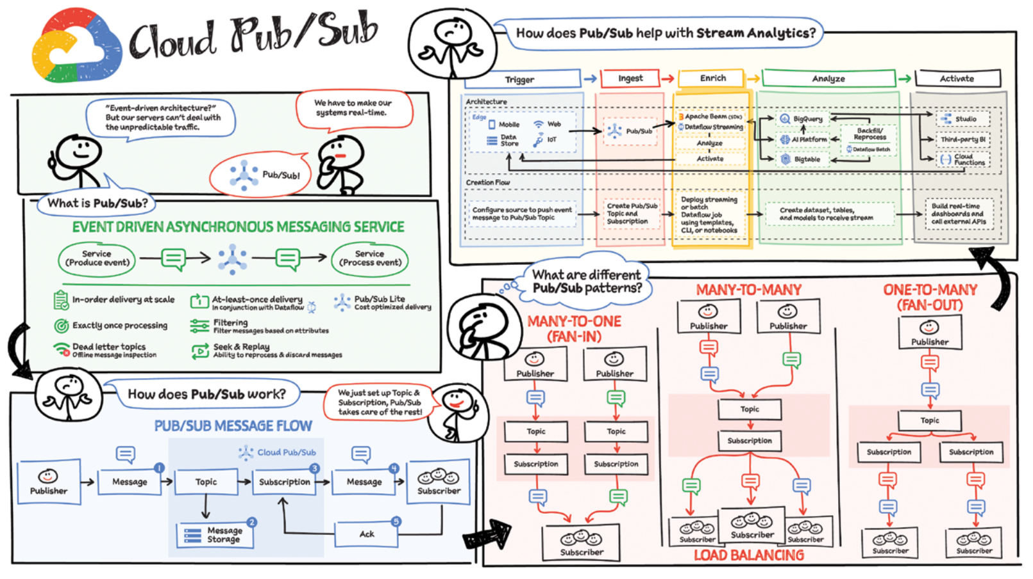

Slide 40
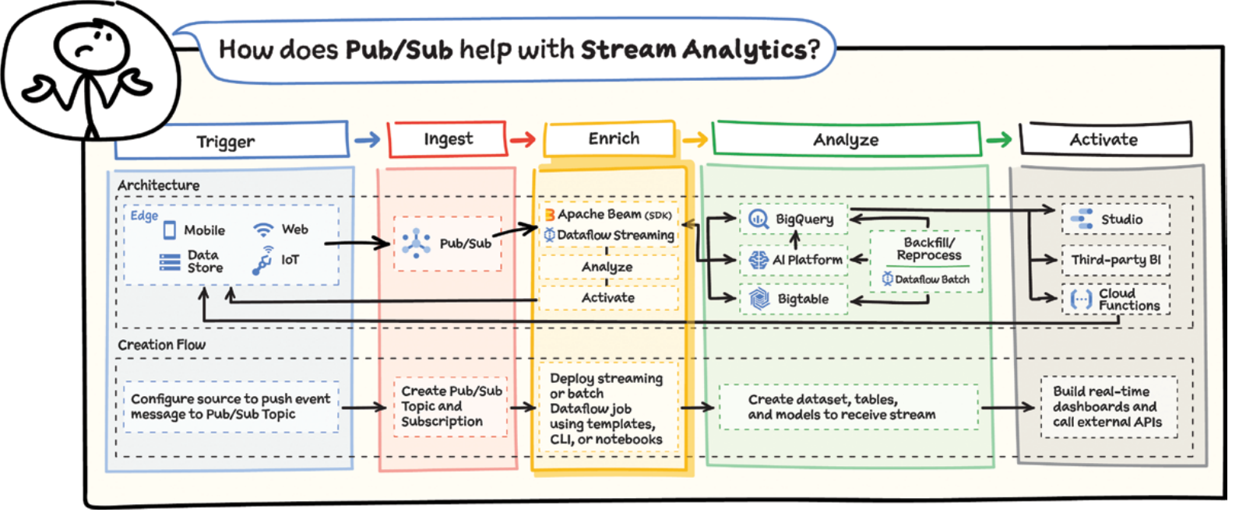

Slide 41
What is Dataflow?
GCP Dataflow is a fully-managed, serverless data processing service offered by Google Cloud Platform (GCP). It allows you to build and execute data pipelines for both batch and real-time (streaming) data processing. Dataflow utilizes the Apache Beam programming model, enabling a unified approach for handling both data types.
Conceps:
Fully-managed, serverless: You don't need to manage servers, Dataflow takes care of the infrastructure.
Data pipelines: These are workflows that process data, like cleaning, transforming and analyzing it.
Batch and real-time (streaming) data: Dataflow can handle both one-time large datasets (batch) and continuous streams of data (real-time).
Apache Beam programming model: This is a unified way to write code for data pipelines, regardless of batch or streaming data.
Key Points to Remember:
Dataflow is ideal for building scalable data processing pipelines.
It offers flexibility for handling both historical and real-time data.

Slide 42
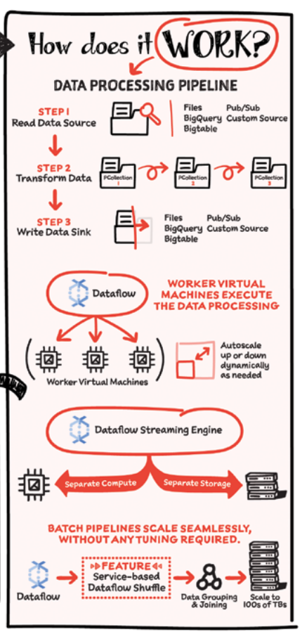
How Dataflow works?
Break it down into stages:
Read data: Data is pulled from a source (like Cloud Storage) into a PCollection (parallel collection) for distributed processing.
Transform data: One or more operations (transforms) are applied to the PCollection to clean, filter or modify the data. Each transform creates a new PCollection (since the original is immutable).
Write data: The final PCollection is written to a destination (sink) like BigQuery for storage or analysis.
Key points to remember:
Dataflow uses PCollections for parallel processing across machines.
Transforms are like building blocks, modifying data within PCollections.
Dataflow is serverless, you define the pipeline and it handles execution.
Autoscaling adjusts resources based on workload for efficiency.
Streaming engine separates processing from storage for better performance.

Slide 43
Dataflow: use cases, pros, cons?
Use Cases - Remember the "Big Four":
Data Integration & Transformation: Think of Dataflow as a data janitor, cleaning and preparing data from various sources for further analysis.
Real-time Stream Processing: Imagine a live news feed - Dataflow can analyze that data stream in real-time for fraud detection or other applications.
Batch Data Processing: This is like processing historical sales data - Dataflow can handle large datasets for complex analysis.
Machine Learning Model Training: Dataflow can prepare and feed data to train machine learning models on GCP, making them smarter.
Pros - Focus on the Benefits for You:
Serverless - Easy to Use: No need to worry about servers, focus on building your data pipelines.
Unified Programming (Beam): Write code once for both batch and streaming pipelines, saving time and effort.
Scalability - Handles Growth: Dataflow automatically scales up or down based on your data volume, so you don't have to worry.
Cost-Effective - Pay as You Go: You only pay for the resources your pipelines use, making it budget-friendly.
GCP Integration - All in One Place: Works seamlessly with other GCP services for a smooth data processing workflow.
Built-in Features - Less Work: Dataflow has features like job monitoring and error handling, saving you time managing pipelines.
Cons - Be Aware of the Trade-offs:
Learning Curve - New Concepts: You might need to learn Apache Beam or similar frameworks, but there are many resources available.
Vendor Lock-in - Not Universal: Migrating pipelines to other platforms might be complex, consider if it's a concern for you.
Limited Control - Less Flexibility: You have less control over the underlying infrastructure compared to building everything yourself.

Slide 44
Dataflow: alternatives, right tools?
Focus on When to Use Each Service:
Cloud Dataproc: Ideal for existing Hadoop or Spark workloads you want to run on GCP's managed environment.
Cloud Functions: Best for simple data transformations or short-lived microservices triggered by events.
Apache Beam on Kubernetes Engine: This is for scenarios where you need more control over the infrastructure for your Beam pipelines or have specific runner requirements. (Think of a runner as the engine that executes your Beam pipeline code)
Key Takeaway:
Dataflow is the go-to option for serverless, scalable batch and streaming data pipelines.
The other options are more specialized for specific needs like existing workloads (Dataproc), simple tasks (Cloud Functions), or granular control (Beam on Kubernetes Engine).

Slide 45
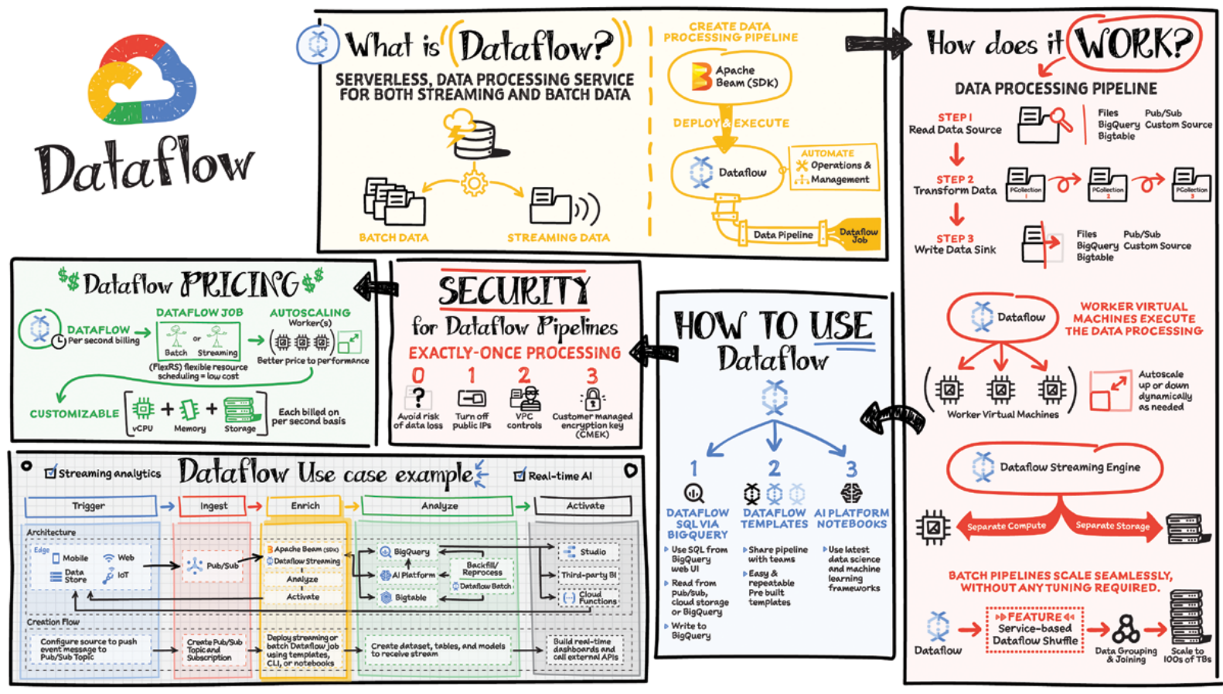

Slide 46
What is Dataproc?
Google Cloud Dataproc is a fully managed, highly scalable service for running Apache Spark, Apache Hadoop, Apache Flink, Presto, and other popular open-source big data processing tools.
Key Concepts for Google Cloud Dataproc:
Managed Service: Dataproc handles cluster creation, management, and scaling, eliminating manual configuration.
Open-Source Big Data Tools: Supports popular frameworks like Spark, Hadoop, Flink, and Presto for data processing.
Highly Scalable: Easily scales clusters up or down to meet processing demands.
Data Storage Integration: Processes data from Google Cloud Storage (GCS) and potentially other cloud storage solutions.
Cluster Orchestration: Dataproc orchestrates tasks across the cluster for efficient processing.
Key Points to Remember:
Focus on Data Processing: Dataproc frees you from managing clusters, letting you focus on data analysis and transformation.
Cost-Effective: Pay only for the resources you use with per-second billing and preemptible VM options.
Fast and Easy to Use: Quickly provision clusters and get started with big data processing.
Integrated with GCP: Works seamlessly with other Google Cloud services like BigQuery and Cloud Storage.
One-Stop Shop: Dataproc provides everything needed to run big data jobs on GCP.

Slide 47
How Dataproc works?
Key Concepts for Dataproc Workflows:
Disaggregated Storage and Compute: Dataproc separates storage (data) from processing (compute), offering flexibility and cost benefits.
Scalability: You can independently scale storage and compute resources to meet workload demands.
Data Source Agnostic: Dataproc can process data from various sources like Cloud Storage, BigQuery or Bigtable.
Flexible Data Destination: Processed data can be stored back in original sources, BigQuery (BQ) or Bigtable (BT).
Integration with Analytics Tools: Dataproc allows data exploration in tools like notebooks and log analysis with Cloud Monitoring.
Cluster Options: Choose long-lived clusters for continuous processing or ephemeral, job-specific clusters for cost optimization.
Fine-Grained Resource Allocation: Allocate memory, CPU and disk space based on specific application needs.
Key Points to Remember:
Dataproc's disaggregated architecture provides cost savings and simplifies scaling.
You can tailor the data processing workflow based on your needs, choosing data sources, destinations, and analysis tools.
Ephemeral clusters are cost-effective for one-time jobs, while long-lived clusters handle continuous processing.
Dataproc allows for resource optimization by allocating resources specific to your application's requirements.

Slide 48
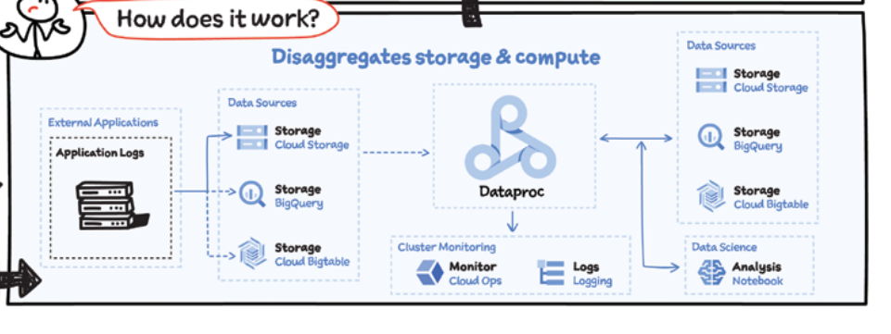
How Dataproc works?

Slide 49
Dataproc: features, benefits, use cases?
Key Features:
Managed Clusters: Dataproc handles cluster creation, configuration and lifecycle management, eliminating the need for manual cluster administration.
Scalability: Easily scale your clusters up or down based on your processing needs, optimizing resource utilization and costs.
Variety of Open-source Tools: Supports a wide range of popular big data frameworks like Spark, Hadoop, Flink, Presto, and more, offering flexibility for various data processing tasks.
Integration with GCP Services: Integrates seamlessly with other GCP services like Cloud Storage, BigQuery, Cloud SQL and Cloud Monitoring for building end-to-end data pipelines.
Security Features: Provides access control mechanisms to secure your clusters and data processing jobs.
Benefits of Using Dataproc:
Simplified Big Data Processing: Dataproc abstracts away cluster management complexities, allowing you to focus on writing your big data processing jobs.
Scalability and Cost-efficiency: Easily scale clusters based on workload demands and leverage preemptible VMs for cost-effective processing.
Flexibility with Open-source Tools: Choose the right tools for your specific data processing needs from a vast ecosystem of supported frameworks.
Integration with GCP Services: Effortlessly build data pipelines by connecting Dataproc with other GCP services for storage, analysis, and monitoring.
Reduced Operational Overhead: Dataproc manages the underlying infrastructure, freeing up IT resources for other tasks.
Use Cases:
Log Analysis: Process and analyze large volumes of log data for insights into system behavior and security.
Data Warehousing and ETL (Extract, Transform, Load): Build data pipelines to extract data from various sources, transform it to a desired format, and load it into data warehouses.
Machine Learning Model Training: Prepare and process large datasets for training machine learning models.
Big Data Analytics: Run complex analytics jobs on massive datasets to uncover hidden patterns and trends.
Scientific Computing: Perform computationally intensive scientific simulations and data analysis tasks.

Slide 50
Dataproc: alternatives, right tools?
When considering big data processing on Google Cloud Platform (GCP), you have several options beyond just Dataproc. Here's a breakdown of the key choices and what to consider:
Dataproc:
Pro: Managed, scalable, cost-effective, integrates well with GCP services.
Con: Not ideal for maximum control or real-time processing.
Best for: Big data processing tasks using Spark, Hadoop, etc. on GCP.
Self-managed Hadoop/Spark clusters on Compute Engine:
Pro: Maximum control and customization.
Con: Requires significant effort for setup, management, and maintenance.
Best for: Advanced users who need fine-grained control over their clusters.
Cloud Dataflow:
Pro: Serverless, managed service for streaming data pipelines.
Con: Not designed for general big data processing.
Best for: Real-time data processing pipelines.
Apache Beam Programming Model:
Pro: Unified approach to building data pipelines, works with Dataproc, Dataflow, etc.
Con: Requires coding expertise in Beam.
Best for: Building flexible data pipelines across various processing backends.

Slide 51
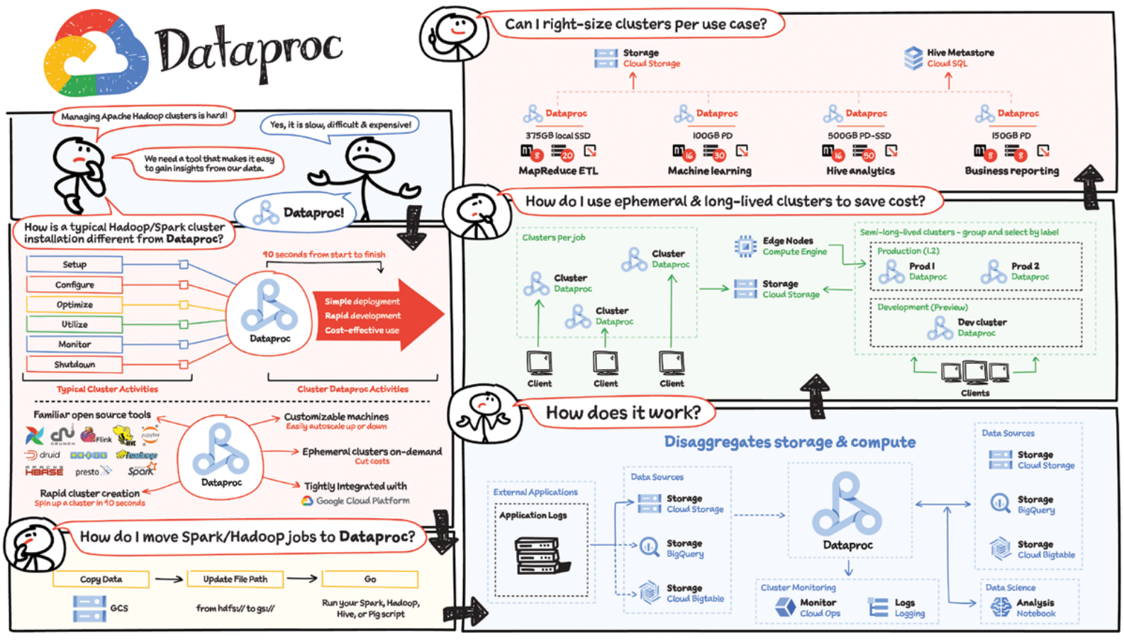

Slide 52
What is Dataprep?
Google Cloud Dataprep, by Trifacta, is a cloud-based service on Google Cloud Platform (GCP) designed for visually exploring, cleaning, and transforming data before analysis or machine learning. It provides a user-friendly interface that allows you to manipulate your data without writing complex code.

Slide 53
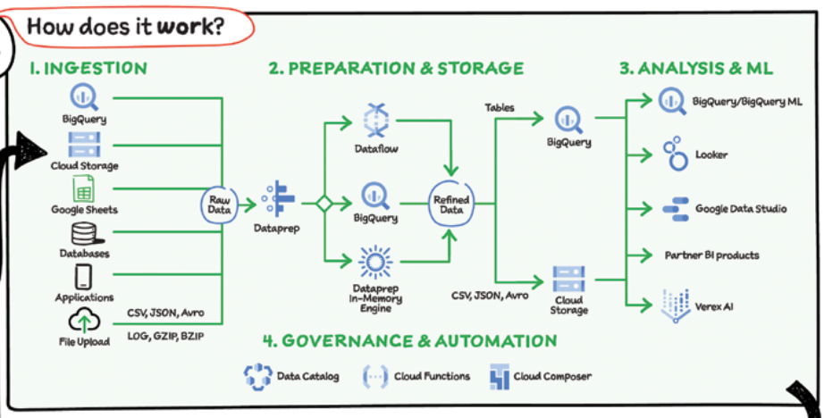
How Dataprep works?
Data Connectors: Dataprep connects to various data sources like BigQuery, Cloud Storage, Google Sheets, and more, for easy access and manipulation of data.
Scalable Data Processing: Built on top of Dataflow and BigQuery, Dataprep allows your data transformation and cleaning steps to scale seamlessly for large datasets.
Data Transformation Recipes: Dataprep lets you design reusable sets of instructions for data cleaning and transformation, making the process efficient.
Transformation Execution: These recipes are translated into Dataflow jobs (for complex transformations) or BigQuery SQL statements (for simpler tasks) for efficient execution.
Output Destinations: Once prepared, your data can be exported to BigQuery or Cloud Storage for further analysis using tools like Data Studio, Looker, or partner solutions like Qlik and Tableau.
Cloud-Native Integration: Dataprep leverages Google Cloud services seamlessly. It can be integrated with Cloud Composer or Cloud Functions for automated workflows and governed through APIs.

Slide 54
Dataprep: features, benefits, use cases
Key Features:
Visual Data Exploration: Explore your data through interactive tables and charts to gain initial insights.
Intuitive Transformations: Clean and transform your data using a drag-and-drop interface with pre-built recipes for common tasks.
Data Profiling: Analyze data quality, identify missing values, and understand data distribution through built-in profiling tools.
Wrangling Operations: Perform various data manipulation tasks like filtering, sorting, joining, splitting, pivoting, and more.
Data Lineage Tracking: Track transformations applied to your data for better traceability and auditability.
Benefits of Using Dataprep:
Simplified Data Preparation: The visual interface reduces the need for complex coding, making data preparation accessible to a wider range of users.
Increased Efficiency: Streamline data cleaning and transformation tasks, saving time and effort.
Improved Data Quality: Ensure clean and consistent data for better analysis and machine learning results.
Collaboration and Reusability: Share and reuse data transformations within teams, promoting collaboration and knowledge sharing.
Faster Time to Insights: Accelerate data exploration and analysis by simplifying data preparation.
Integration with GCP Ecosystem: Integrates smoothly with other GCP services for building comprehensive data pipelines.
Use Cases:
Data Cleaning and Normalization: Cleanse messy data, identify and handle missing values, and standardize data formats for better analysis.
Data Transformation: Transform data to meet specific analysis or machine learning model requirements.
Data Exploration and Feature Engineering: Explore data visually, identify patterns, and prepare features for machine learning models.
Data Integration: Combine data from various sources into a unified dataset for analysis.
Self-Service Data Preparation: Empower business users and analysts to prepare data for their own needs.

Slide 55
Dataprep: alternatives, right tools?
Alternatives and When to Use Them:
Open-source Data Wrangling Tools (Pandas, Trifacta Wrangler): Powerful tools for programmatic data manipulation, but require coding skills. Suitable for experienced users comfortable with Python or similar languages.
Cloud Storage Transformations: Offers basic data transformation capabilities within Cloud Storage, but lacks the comprehensiveness and user-friendliness of Dataprep. Good for simple tasks if data already resides in Cloud Storage.
BigQuery Data Transformation: BigQuery allows data transformation within the data warehouse, but lacks the visual exploration and wrangling capabilities of Dataprep. Use BigQuery transformations for complex, serverless data processing after initial cleaning with Dataprep.
Choosing the Right Tool:
Use Dataprep if:
You need a user-friendly and visual interface for data exploration, cleaning, and transformation (without coding).
You want to streamline data preparation for analysis or machine learning within the Google Cloud ecosystem.

Slide 56
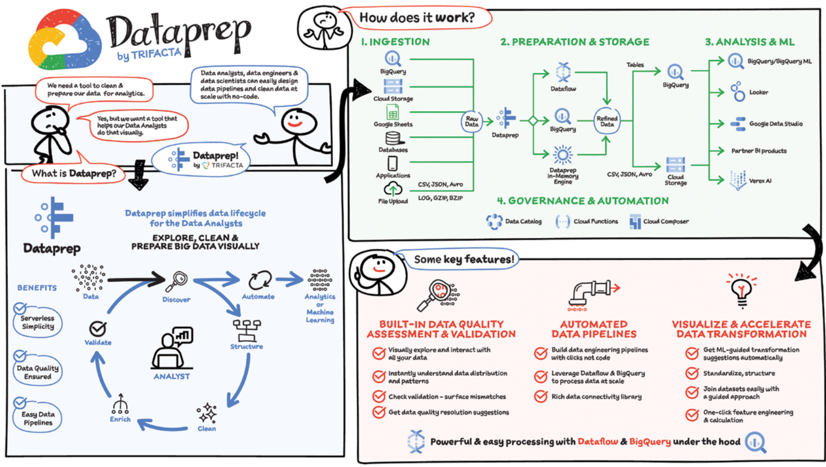

Slide 57
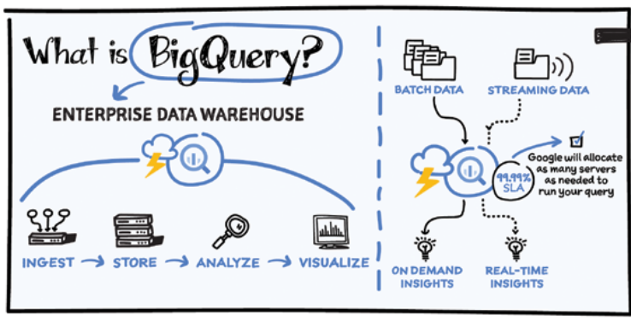
What is Bigquery?
Enterprise Data Warehouse: BigQuery is a service for storing and analyzing large datasets designed for organizational use.
Large-Scale Analytics: BigQuery is optimized to handle massive amounts of data, allowing you to run complex analyses on petabytes of information.
Actionable Insights: The goal of BigQuery is to help you extract meaningful information from your data that can guide decision making.
Data Ingestion: BigQuery allows you to load data in two ways: uploading batches of data or continuously streaming data for real-time analysis.
Fully Managed Service: Google takes care of the underlying infrastructure that runs BigQuery, so you don't need to worry about server maintenance or scaling (SaaS).
SQL Support: BigQuery uses SQL, a widely used language for querying databases, making it accessible to users familiar with relational databases.
BigQuery is Google Cloud’s enterprise data warehouse designed to help organizations run large-­scale analytics with ease and quickly unlock actionable insights.

Slide 58
How Bigquery works?
Data Ingestion: You can bring your own data or leverage public datasets. BigQuery offers flexibility by supporting both batch uploads and real-time data streaming from various sources like web applications, IoT devices, and mobile phones. There are also tools to import data from other cloud platforms, on-premise systems and external services.
Decoupled Storage and Compute: BigQuery separates data storage from the computing power used to analyze it. This allows them to scale independently. You only pay for the compute resources you use for queries, reducing costs compared to traditional data warehouses where you have to provision compute resources even when not actively analyzing data.
Automated Management: BigQuery takes care of backups, restores and infrastructure management, freeing you to focus on data analysis.
Multiple Access Options: You can interact with BigQuery through a user interface, a command-line tool or programmatically using APIs in various languages.
Integration with Tools: BigQuery integrates with data visualization tools like Looker and others, allowing you to easily create charts and dashboards from your data.

Slide 59
BigQuery: use cases, pros, cons
Use Cases:
Enterprise Data Warehousing: Consolidate data from various sources into a central repository for in-depth analysis and reporting.
Business Intelligence (BI): Fuel BI dashboards and reports with real-time or historical data for data-driven decision making.
Data Analytics: Perform large-scale data exploration and analysis on structured, semi-structured and unstructured data.
Machine Learning: Leverage BigQuery as a training data source for machine learning models hosted on GCP.
Pros:
Serverless: No infrastructure management required, allowing you to focus on data analysis.
Scalability: Handles massive datasets efficiently and scales seamlessly to meet growing data volumes.
Performance: Delivers fast query speeds on large datasets using Google's Dremel technology.
Cost-effective: Pay-per-use model ensures you only pay for the storage and queries you utilize.
Built-in Machine Learning: Analyze data and train machine learning models directly within BigQuery.
Integration with GCP Services: Integrates seamlessly with other GCP services for a unified data platform.
Cons:
Learning Curve: While the SQL interface is familiar, some advanced features may require additional learning.
Pricing: Costs can accumulate for very large datasets and frequent complex queries.
Limited Schema Flexibility: Schema changes can be cumbersome compared to traditional data warehouses.
Vendor Lock-in: Migrating data out of BigQuery to another platform can be complex.

Slide 60
Bigquery: alternatives, right tools?
Alternatives to BigQuery: GCP offers other data storage and management services:
Cloud Spanner: For globally distributed, mission-critical applications requiring high consistency (think globally available databases).
Cloud SQL: For familiar relational database environments using MySQL, PostgreSQL or SQL Server.
Cloud Storage: For cost-effective storage of large amounts of raw data (data lakes).
Choosing the Right Tool: The best option depends on your specific needs:
BigQuery: Ideal for massive datasets requiring extreme scalability and performance for data analysis.
Cloud Spanner: Perfect for critical applications needing strong consistency and global data distribution.
Cloud SQL: Best for existing workloads that require a familiar relational database environment.
Cloud Storage: Ideal for archiving large amounts of data in a cost-effective way.

Slide 61
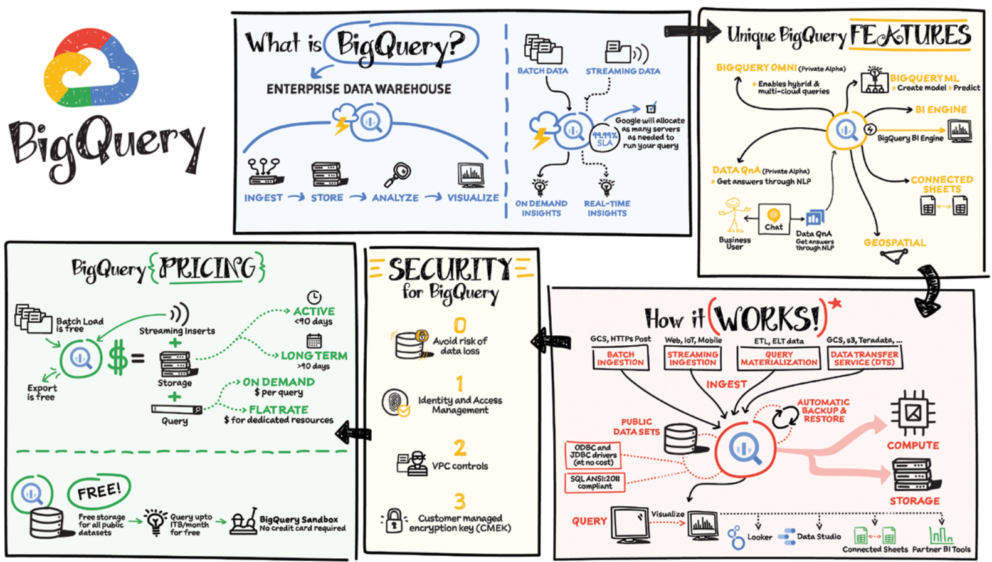

Slide 62
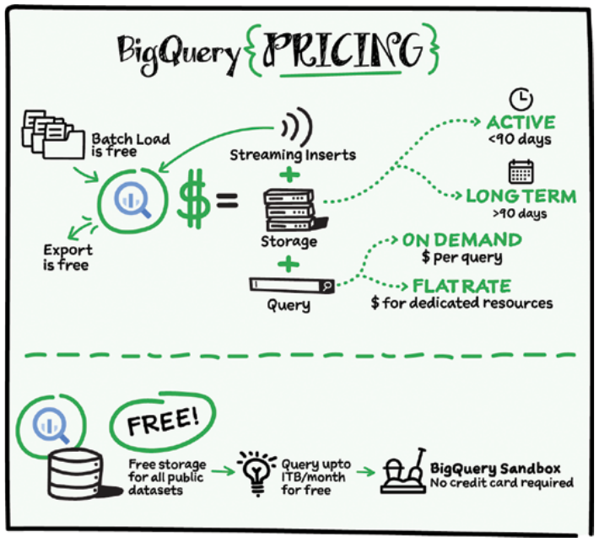

Slide 63
What is Datafusion?
A huge challenge with data analytics is that the data is all over the place and is in different formats. As a result, you often need to complete numerous integration activities before you can start to gain insights from your data. Data Fusion offers a one-­stop shop for all enterprise data integration activities, including ingestion, extract transform load (ETL), extract load transform (ELT), and streaming, and with an execution engine optimized for SLAs and cost. It is designed to make lives easier for ETL developers, data analysts and data engineers.
Data Fusion is Google’s cloud-­native, fully managed, scalable enterprise data integration platform. It enables bringing transactional, social, or machine data in various formats from databases, applications, messaging systems, mainframes, files, SaaS, and IoT devices; offers an easy to use virtual interface and provides deployment capabilities to execute data pipelines on ephemeral or dedicated Dataproc clusters in Spark. Cloud Data Fusion is powered by open source CDAP which makes the pipelines portable across Google Cloud or hybrid or multicloud environments.

Slide 64
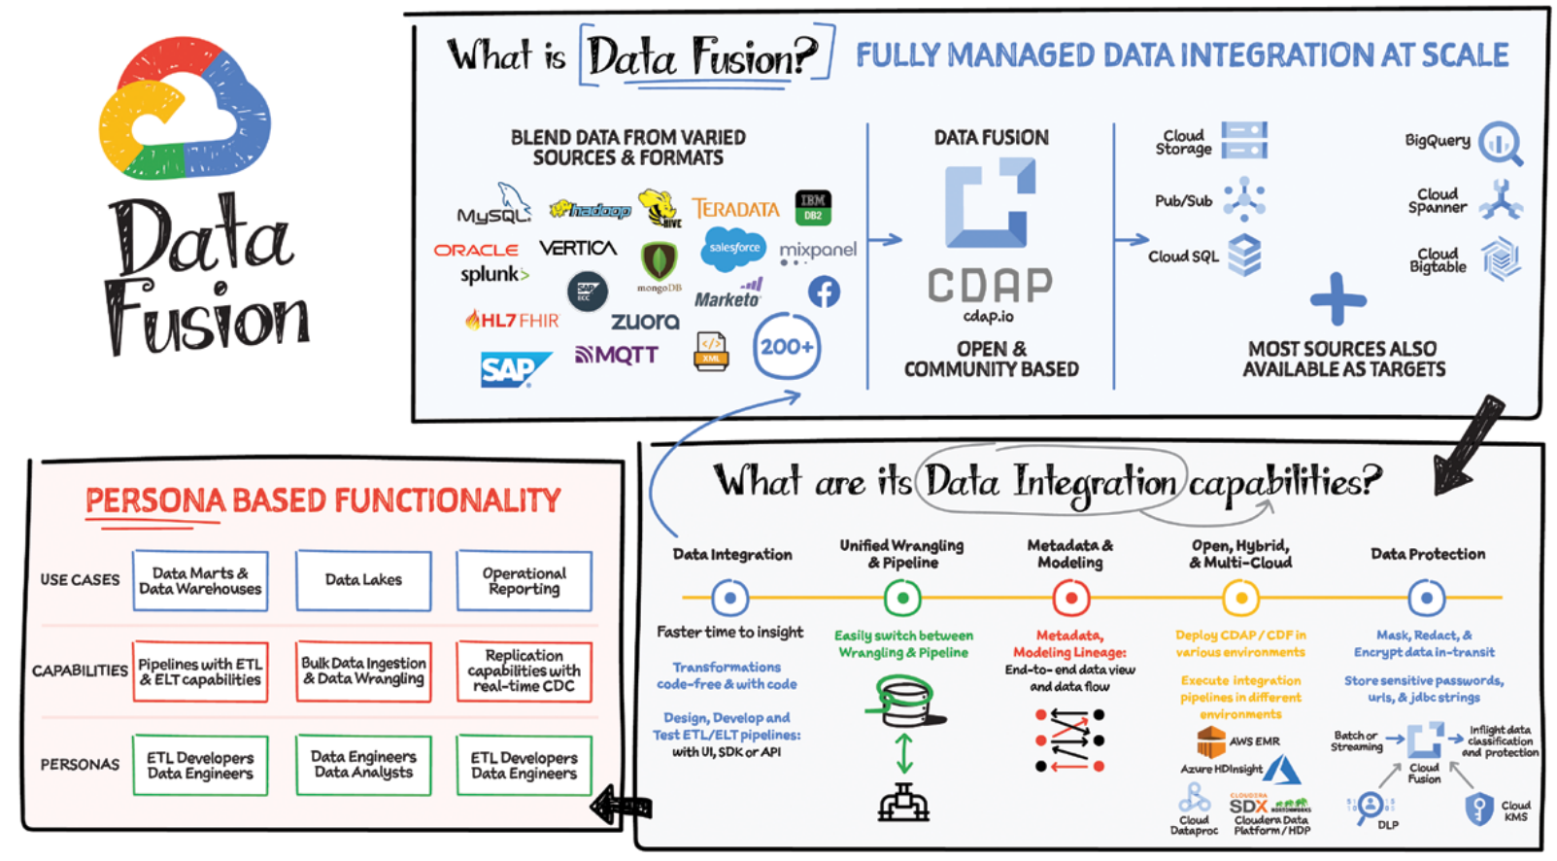
What is Datafusion?

Slide 65
What is Datacatalog?
A Data Catalog is a centralized repository that stores information about your organization's data assets. It acts as a detailed inventory, helping data users discover, understand, trust and effectively utilize the data they need.
Concepts:
Centralized repository: GCP Data Catalog acts as a single source of truth for information about all your organization's data assets in Google Cloud Platform (GCP).
Data assets: This refers to any piece of data stored within GCP, such as tables in BigQuery, Cloud Storage buckets or Datastore entities.
Metadata: Data Catalog stores metadata, which is data about your data assets. This metadata provides details like the data's format, location, purpose, and how it's used.
Data discovery: Data Catalog helps users find the specific data they need for their projects and analyses.
Data understanding: By providing details and descriptions, Data Catalog helps users understand the contents and purpose of a particular data asset.
Data trust: Accurate and comprehensive metadata builds trust in the data, ensuring users can rely on it for making decisions.
Data utilization: By making data discovery and understanding easier, Data Catalog empowers users to effectively leverage the data for analytics and other tasks.

Slide 66
Datacatalog: features, benefits, who use
Imagine your data as a giant warehouse. This warehouse holds all sorts of information, but it can be messy and hard to find things. A data catalog is like a super organized filing system for this warehouse.
Here's what a data catalog does:
Labels everything (Metadata Management): It adds descriptions, like titles and creation dates, to all the data in the warehouse. This makes it easier to know what something is and where it came from.
Helps you find things fast (Data Search and Discovery): Think of it like a search bar for the warehouse. You can type in what you're looking for and the data catalog will show you exactly where it is.
Tracks where things have been (Data Lineage Tracking): Just like following footprints, the data catalog shows you where each piece of data came from and how it's been changed over time. This is important for making sure the data is accurate and reliable.
Checks the quality of things (Data Quality Insights): The data catalog is like a quality inspector. It checks things like completeness (is everything there?) and accuracy (is it correct?) to make sure the data is good to use.
Keeps things organized (Data Governance): The data catalog helps control who can access and use the data in the warehouse. It also makes sure everyone is using the same data standards.
Works with your tools (Integration with Data Tools): The data catalog can connect to other tools you already use, like maps or analysis software. This way, you can see all your data in one place.
Benefits of using a data catalog:
Find things faster: No more wandering the warehouse lost!
Better data quality: You can trust that the data you're using is accurate and reliable.
Everyone's on the same page: Everyone uses the same data and understands where it comes from.
Easier to share data: Break down the walls between departments and work together more effectively.
Makes following the rules easier: The data catalog helps you comply with data privacy regulations.
Better decisions: With good data, you can make confident choices for your business.

Slide 67
Datacatalog: how it works?
Data Catalog provides unified search across all projects, systems and regions. It does this by:
- Automatically syncing technical metadata from Cloud Storage, Pub/Sub, BigQuery, and other Google Cloud sources
- Providing open source connectors to bring in metadata from external data sources
- Auto-­tagging personally identifiable information (PII) data through DLP integration

Slide 68
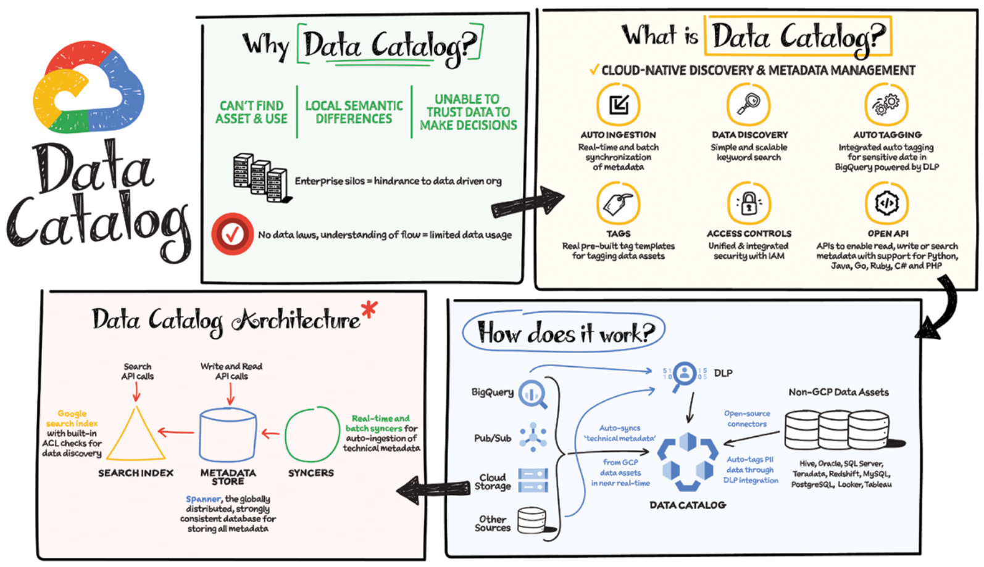

Slide 69
What is Cloud Composer?
Cloud Composer: Managed Workflow Orchestration
Cloud Composer is a fully-managed workflow orchestration service built on top of the popular open-source project, Apache Airflow. It allows you to design, schedule, and monitor data pipelines that can span across: * Hybrid environments: Combining on-premise infrastructure with cloud resources. * Multi-cloud environments: Utilizing multiple cloud providers for different aspects of your workflow.
Benefits of Cloud Composer
Cloud Composer offers several advantages over managing your own Airflow instance:
Reduced Operational Overhead: Google Cloud handles installation, management, patching, and backups, freeing you to focus on building and maintaining your workflows.
Enterprise-Ready Security: Cloud Composer incorporates robust security features to ensure the integrity and confidentiality of your workflows.
Autoscaling for Efficiency: The latest version supports autoscaling, which automatically adjusts resources based on your workload, optimizing costs and improving reliability for workflows with fluctuating execution demands.
In Summary
Cloud Composer provides a managed solution for orchestrating complex workflows across diverse environments. It leverages the power of Apache Airflow while eliminating the need for manual infrastructure management and offering built-in security features. Additionally, autoscaling ensures cost-effectiveness and caters to workflows with varying execution patterns.

Slide 70
How Cloud Composer works?
Imagine you have a recipe with multiple steps – that's kind of like a workflow in data analytics. Cloud Composer helps you manage these workflows, which involve processing data in various ways.
Think of steps as tasks: Each step in your data recipe (ingesting, transforming, analyzing) becomes a task in Cloud Composer.
Organize tasks with a flow chart: Cloud Composer uses a visual tool called a Directed Acyclic Graph (DAG). Think of it as a flow chart that shows the order tasks need to be completed. No circles allowed, so each task can only run once!
Write the instructions in Python (optional): While Cloud Composer offers a visual interface, you can also define your workflows with Python code, giving you more control.
Run the tasks in order: Cloud Composer ensures each task runs at the right time, based on the dependencies you set up in the DAG. For example, cleaning data (task 1) might need to happen before analysis (task 2).
Basically, Cloud Composer takes care of the order and timing of your data processing steps, so you can focus on what the data tells you!

Slide 71
Cloud Composer: features, use cases, benefits
Cloud Composer's Strengths (Key Features):
Familiar friend: Apache Airflow based: Leverages the popular open-source project for a familiar interface and vast community resources.
Define workflows your way: Use Python or a user-friendly web interface for visual scripting.
Scheduling made easy: Schedule workflows to run at specific times or trigger them based on events.
Keeping an eye on things: Monitor workflow execution, track tasks, and set alerts for issues.
Scales with your needs: Cloud Composer automatically scales to handle complex workflows with many tasks.
Plays well with others: Integrates seamlessly with other Google Cloud services for building comprehensive data pipelines.
Security first: Provides access controls to keep your workflows and resources secure.
Cloud Composer in Action (Use Cases):
Data Pipeline Master: Orchestrate complex data processing workflows involving data ingestion, transformation, and analysis using various Google Cloud services.
Machine Learning Made Easy: Automate the machine learning lifecycle, including data preparation, model training, evaluation, and deployment.
ETL Automation: Automate the process of extracting data, transforming it, and loading it into a target data store.
Batch Job Boss: Schedule and manage batch jobs that run specific tasks periodically or on-demand.
Cloud Agnostic Champion: Orchestrate workflows that include tasks running on Google Cloud services, on-premises resources, or even other cloud platforms.
Benefits of Using Cloud Composer:
Goodbye complexity, hello efficiency: Streamline complex workflows and reduce manual intervention.
Automate your way to success: Automate routine tasks and data pipelines for improved productivity.
Scale with ease: Cloud Composer automatically scales to handle fluctuating workloads.
See all, know all: Gain insights into workflow execution and identify potential issues proactively.
Develop faster: Leverage the visual interface and Python code for efficient workflow definition.
A dream team: Build comprehensive data solutions by connecting Cloud Composer with various Google Cloud services.

Slide 72
Cloud Composer: alternatives, right tools?
Cloud Composer Alternatives: Choosing the Right Tool
Cloud Composer is great, but it's not the only option! Here are some alternatives to consider, depending on your needs:
For the Do-It-Yourselfer: Airflow on Kubernetes Engine (GKE)
Think of this as building your own Cloud Composer. You get more control over Apache Airflow, but it's also more work to set up and maintain. Ideal if you need deep customization but have the resources to manage it.
For Simple Tasks: Cloud Functions
Imagine a single, quick recipe step. Cloud Functions are perfect for simple tasks or workflows that don't require complex scheduling. They're serverless, so you don't have to worry about managing servers.
For Serverless Workflows: Cloud Workflows
Think of this as a serverless version of Cloud Composer. It's great for building workflows that run without managing your own Airflow environment. Ideal if you want a serverless approach but still need some workflow orchestration.

Slide 73
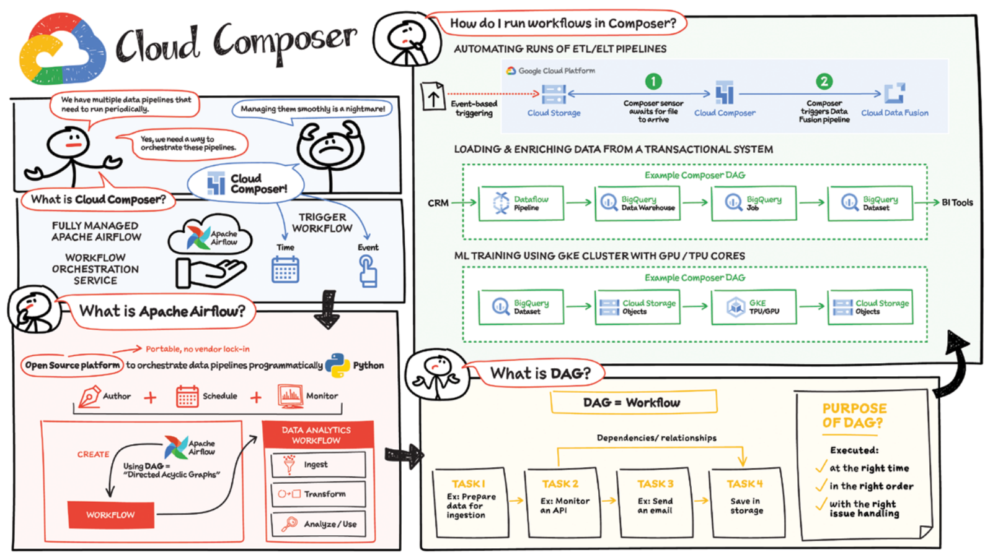

Slide 74
What is Datastream?
Imagine you have data constantly flowing in and out of different databases, storage systems and applications. Keeping everything in sync can be a hassle. GCP Datastream comes to the rescue as a serverless change data capture (CDC) service.
What does it do?
Continuously monitors your source data (databases, storage systems, etc.) for changes (inserts, updates, deletes).
Captures these changes with minimal delay.
Replicates the captured changes to your desired destination within GCP.
Think of it as a data bridge:
Datastream sits between your source and destination, ensuring a smooth flow of updates.
It minimizes the latency (delay) in data transfer, keeping everything as close to real-time as possible.s

Slide 75
How Datastream works?
1. Create a source connection profile.
2. Create a destination connection profile.
3. Create a stream using the source and destination connection profiles, and define the objects to pull from the source.
4. Validate and start the stream.
Once started, a stream continuously streams data from the source to the destination. You can pause and then resume the stream.

Slide 76
Datastream: use cases, pros, cons
Use Cases:
Real-time Analytics: Keep BigQuery or other analytical tools up-to-date with the latest changes in your operational databases, enabling real-time insights and dashboards.
Database Replication: Replicate data from source databases to Cloud SQL or Spanner for disaster recovery, high availability, or offloading analytical workloads.
Event-driven Architectures: Leverage captured data streams in Cloud Storage to trigger downstream workflows or event-driven applications built with Cloud Functions or Cloud Run.
Data Integration: Seamlessly integrate data from various sources into a unified data platform within GCP for centralized management and analysis.
Pros:
Serverless: No infrastructure management required, allowing you to focus on data movement and integration.
Minimal Latency: Delivers change data streams with minimal delay, ensuring near real-time data updates in your destination.
Flexibility: Supports various source and destination options within GCP, catering to diverse data integration needs.
Scalability: Handles large data volumes and scales automatically to accommodate growing data streams.
Ease of Use: User-friendly interface simplifies setup and stream management.
Integration with Dataflow: Works seamlessly with Dataflow templates for building custom data processing workflows on the captured data stream.
Cons:
Limited Source and Destination Options (as of June 2024): Currently supports a specific set of source databases (e.g., Oracle, MySQL) and GCP destinations. More options are planned for the future.
Vendor Lock-in: Migrating data streams to other platforms might require additional development effort.
Limited Schema Management: While Datastream can handle schema changes, complex transformations might require additional tools like Dataflow.

Slide 77
Datastream: alternatives, right tools?
While Datastream is a great option, there are situations where other tools might be a better fit. Here's a breakdown to help you choose the right one:
Need Real-time, Easy-to-Use Solution?
Go with Datastream: It's serverless, requires minimal setup, and delivers changes with near real-time speed.
Need More Control Over Data?
Consider Cloud Functions with Triggers: Build custom functions to transform or process data during transfer. (More technical setup required)
Need Simpler Periodic Data Exports?
Try Cloud Scheduler with Pub/Sub: Schedule regular exports from your database and use Pub/Sub for message delivery. (Great for basic data movement)
Your Database Isn't Supported?
Explore Third-Party CDC Tools: Open-source or paid tools might offer broader database compatibility.

Slide 78
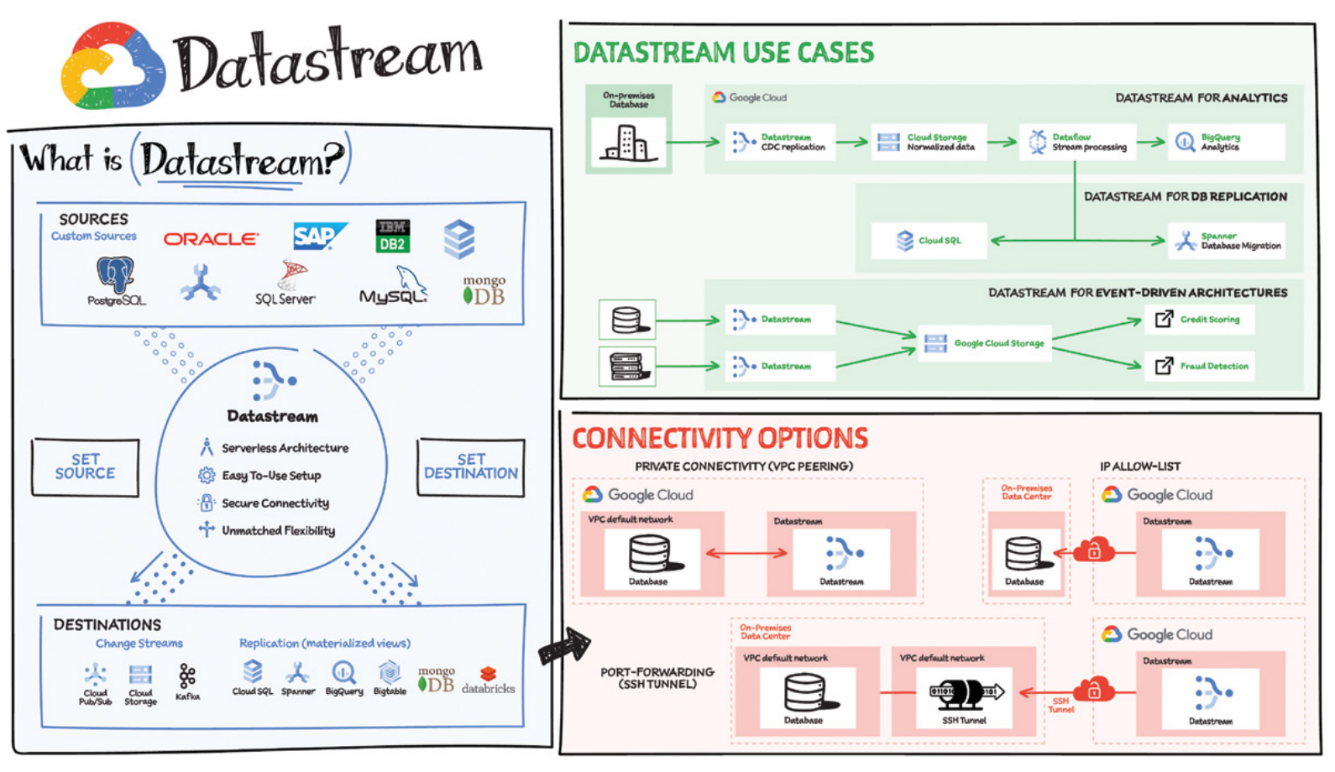

Slide 79
What is Looker?
To make the most of your investment in a modern data warehouse such as BigQuery, you need a modern business intelligence (BI) and analytics solution. That’s where Looker comes in. Looker, was built to leverage the power of modern data storage and provide governed access to real-­time metrics —­helping users gain an accurate and up-­to-­date understanding of their business.
All of this is powered by Looker’s platform and its unique architecture, which differentiates itself from other BI tools with a combination of in-database architecture, a semantic modeling layer, and by being cloud-­native.

Slide 80
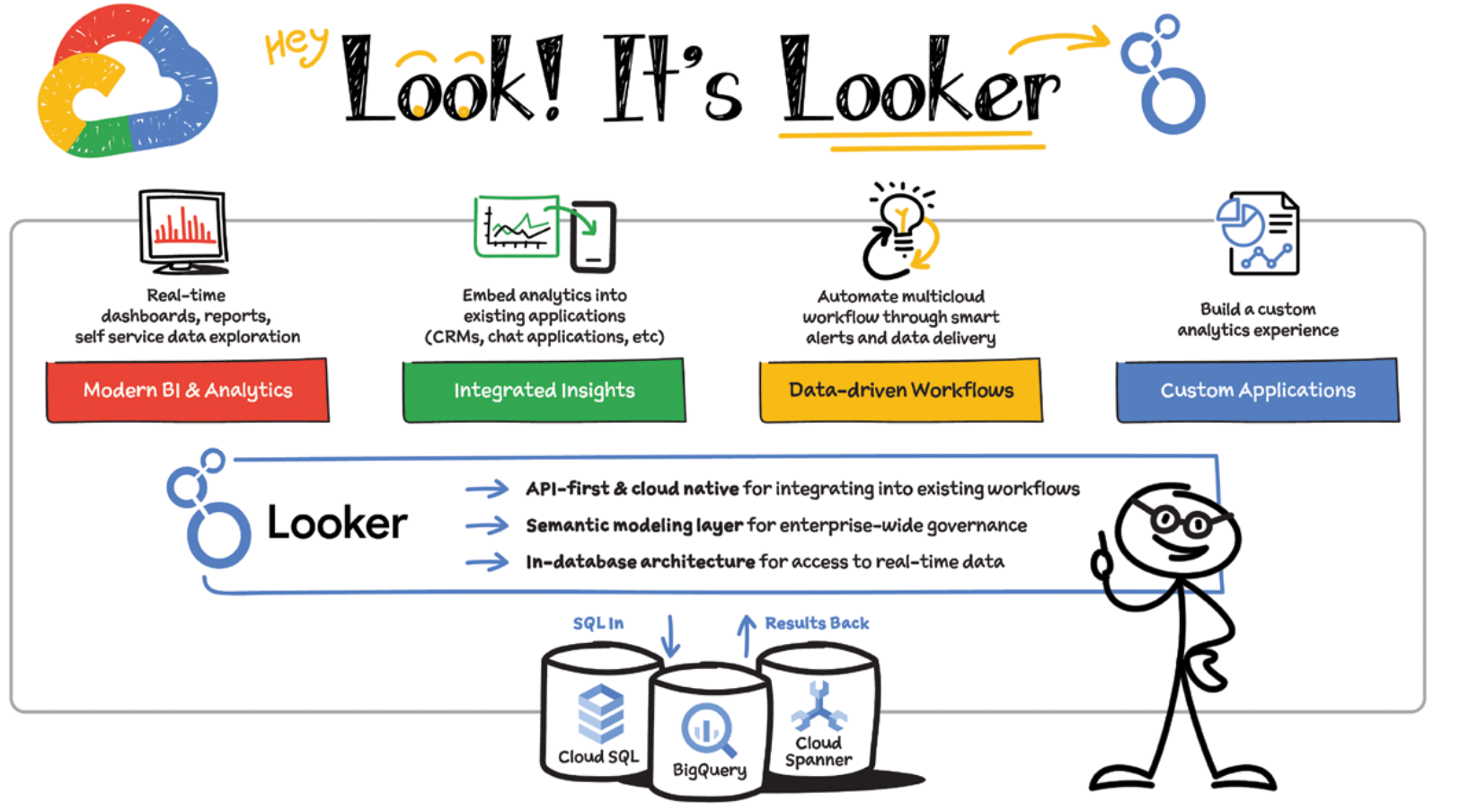

Slide 81
What is Google Kubernetes Engine?
Google Kubernetes Engine (GKE) is a managed, production-ready container orchestration service offered by Google Cloud Platform (GCP). It allows you to deploy, manage, and scale containerized applications using Kubernetes, an open-source system for automating container deployment, scaling, and management.
Why Containers compared to VM’s?
Faster Startup: Containers share the kernel, leading to quicker boot times compared to VMs.
Reduced Resource Consumption: Containers require fewer resources compared to VMs because they don't need a full-blown OS.
Improved Portability: Containers are independent of the underlying hardware, making them easier to move between different environments.
Simplified Deployment: Containerized applications are easier to deploy and scale due to their lightweight nature.
Enhanced Reusability: Containers can be easily reused across different projects since they are self-contained units.
"It Worked on My Machine" Fix: Containers eliminate environment discrepancies by providing a consistent environment for development, testing, and production.

Slide 82
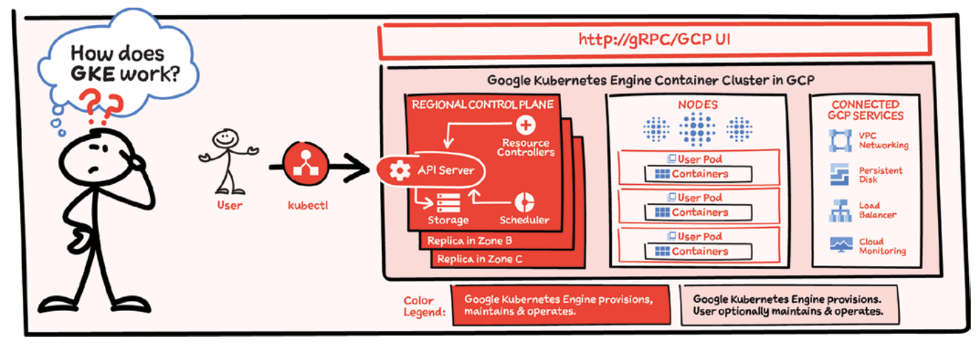
How Google Kubernetes Engine works?
GKE manages a Kubernetes cluster for you, handling the nitty-gritty tasks so you can focus on your applications. Here's a breakdown:
Automated Control Plane: Google's SRE team maintains the control plane, the brain of the cluster. This includes keeping it up-to-date, secure, and running smoothly. They have the expertise and vast experience (managing tons of clusters) to proactively address any potential issues.
Simplified Node Management: GKE takes care of your cluster's worker nodes, the machines that run your applications. This includes automatically setting them up, patching security vulnerabilities, and scaling them up or down based on your needs. Some upgrades are optional, allowing you control when to update.
Container Security Built-In: GKE secures your containers by default. This includes features like private networking to keep your container traffic isolated, and potentially hybrid networking options for connecting your cluster to your on-premises environment.
In a nutshell, GKE handles the complex Kubernetes machinery, letting you deploy and manage your containerized applications without worrying about the underlying infrastructure.

Slide 83
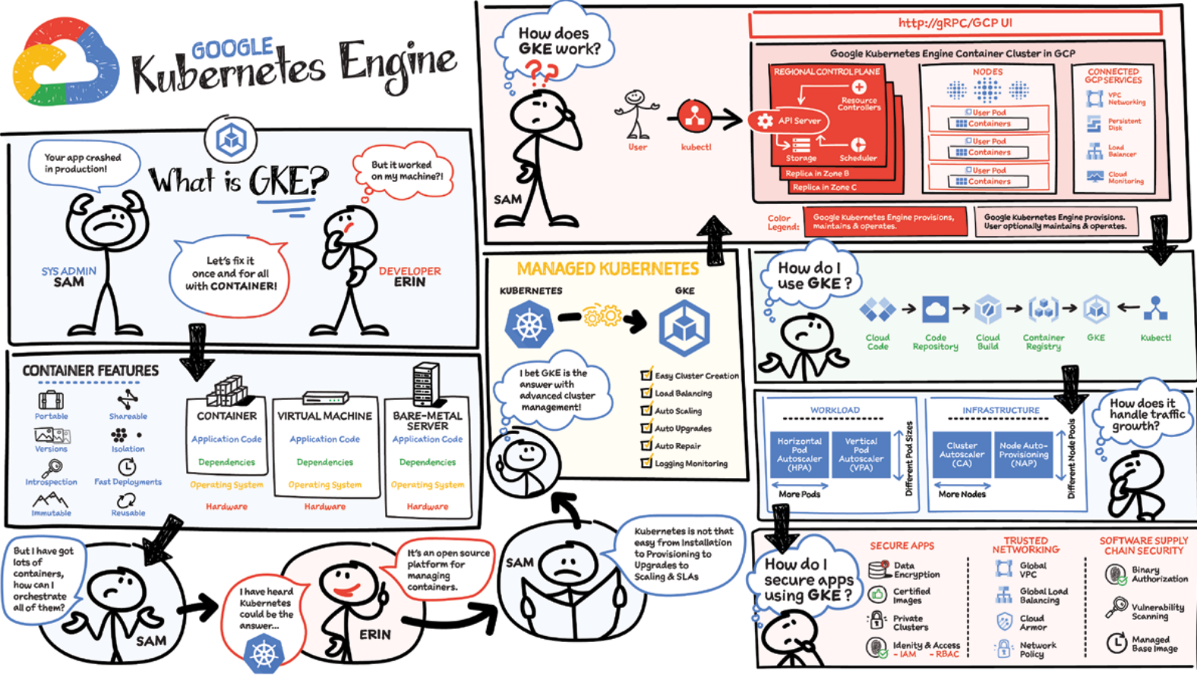

Slide 84
What is Cloud Run?
Cloud Run lets you deploy code in containers without managing the underlying servers.
Here's the breakdown:
Containers: Imagine tiny, self-contained boxes holding your application and its dependencies (libraries it needs). Cloud Run takes care of creating and running these boxes.
Serverless: You don't worry about provisioning (setting up) servers or managing clusters (groups of servers working together). Cloud Run handles that automatically.
HTTP containers: Cloud Run is designed for applications that respond to web requests (HTTP). Think web applications or APIs.
Autoscaling: Cloud Run automatically scales your application up or down based on traffic. You only pay for what you use!
Think of it like this:
You write your code.
You package it in a container (think of a box with everything your code needs).
Cloud Run takes that container and runs it on Google's infrastructure, scaling it up or down as needed.
This lets you focus on your code without getting bogged down in server management.

Slide 85
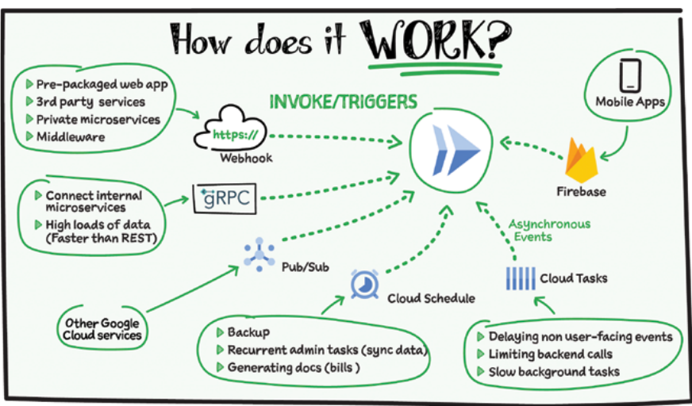
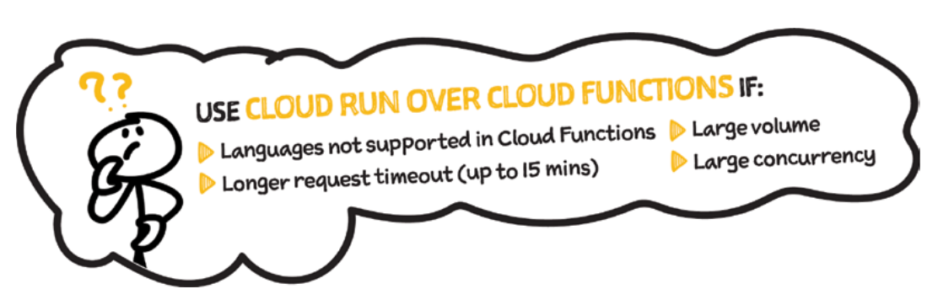
How Cloud Run works?

Slide 86
What is App Engine?
App Engine is a serverless platform for building and deploying web applications.
Concepts:
Serverless: Just like Cloud Run, you don't manage servers or infrastructure. App Engine takes care of everything behind the scenes.
Low-latency, highly scalable: App Engine excels at handling web traffic that needs super-fast responses and can automatically scale your application to handle massive amounts of users (from zero to "planet scale" as the text says!).
Web-focused: App Engine is built for web applications that use things like routes, HTTP methods (GET, POST, etc.), and APIs.
Think of it like this:
You write your web application code.
You deploy it to App Engine.
App Engine handles the servers, scaling, and infrastructure, letting your application focus on serving users.

Slide 87
Cloud Run vs App Engine
Control vs. Simplicity:
Cloud Run: Offers more control. You package your code in containers, allowing for more flexibility in environments and libraries. However, this requires some knowledge of containerization (like Docker).
App Engine: Provides a simpler experience. You deploy your code directly without worrying about containers. This is ideal if you prefer a more managed approach.
Cost:
Cloud Run: Generally considered more cost-effective, especially for low-traffic applications. You only pay for resources used when your container is running.
App Engine: Can be slightly more expensive as instances run continuously, even during low traffic periods (though automatic scaling helps). However, App Engine has a free tier with resource quotas.
Scalability:
Cloud Run: Scales very well based on traffic. You have more control over resource allocation (CPU, memory) for your containers.
App Engine: Also scales well, but resource allocation is managed by App Engine itself.
Use Cases:
Cloud Run: Ideal for containerized applications, microservices, and workloads requiring fine-grained control over resources.
App Engine: Excellent for web applications, APIs, and workloads that benefit from a fully managed environment with built-in scaling.
Here's an analogy:
Cloud Run: Like renting an apartment and furnishing it yourself (more control, but more work).
App Engine: Like staying in a hotel (less control, but everything is taken care of)

Slide 88
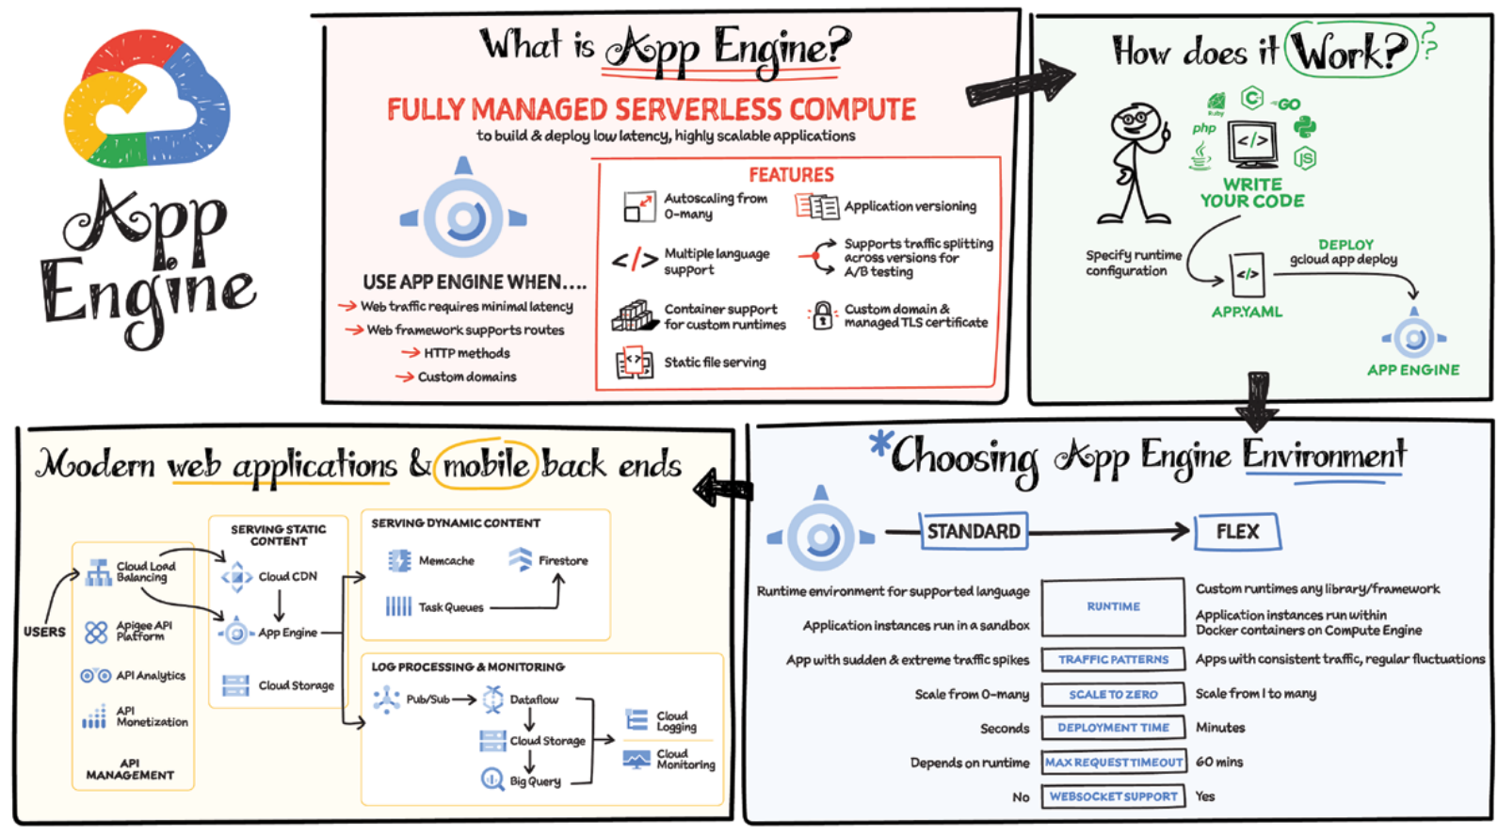
How App Engine works?

Slide 89
What is Cloud Functions?
Cloud Functions is a core service within Google Cloud Platform (GCP) that provides a serverless function-as-a-service (FaaS) environment.
Here's a breakdown of the key concepts:
Serverless: You write code (functions) without worrying about server management, scaling or infrastructure provisioning. GCP handles all that.
Event-driven: Cloud Functions are triggered by events emitted from other GCP services or external sources. This allows for a highly reactive and modular architecture.
Single-purpose functions: Each Cloud Function should be focused on a single, well-defined task. This promotes code maintainability and reusability.
Fully managed environment: GCP manages the underlying infrastructure and runtime, including scaling resources based on traffic.
Integrated with Cloud Operations: Cloud Functions provide built-in observability and logging for easier monitoring and troubleshooting.
Open source framework: Cloud Functions utilizes an open-source foundation, simplifying migration from other FaaS platforms.

Slide 90
How Cloud Functions work?
Supported languages: Cloud Functions offer a wide range of languages for development, including Go, Python, Java, Node.js, PHP, Ruby, and .NET. This flexibility allows developers to choose the language they're most comfortable with.
Deployment options: You can deploy your Cloud Functions through various methods:
Cloud Console: A user-friendly interface for deploying functions directly within the GCP console.
gcloud CLI: The Google Cloud command-line tool allows for programmatic deployment via scripts.
Cloud Build: Integrate Cloud Functions deployment with your CI/CD pipeline using Cloud Build, enabling automated deployments triggered by code changes.
Event triggers: Cloud Functions can be triggered by various events, including:
HTTP(s) requests: Functions can be directly invoked through HTTP calls from web applications or other services.
Cloud Storage events: Respond to file uploads, deletions, or changes within Cloud Storage buckets.
Pub/Sub messages: React to messages published on Pub/Sub topics, enabling real-time event processing.
Firebase events: Integrate with Firebase for triggering functions based on user actions or data changes.
Cloud CLI (command-line interface): Functions can be invoked directly through the gcloud CLI for testing purposes.

Slide 91
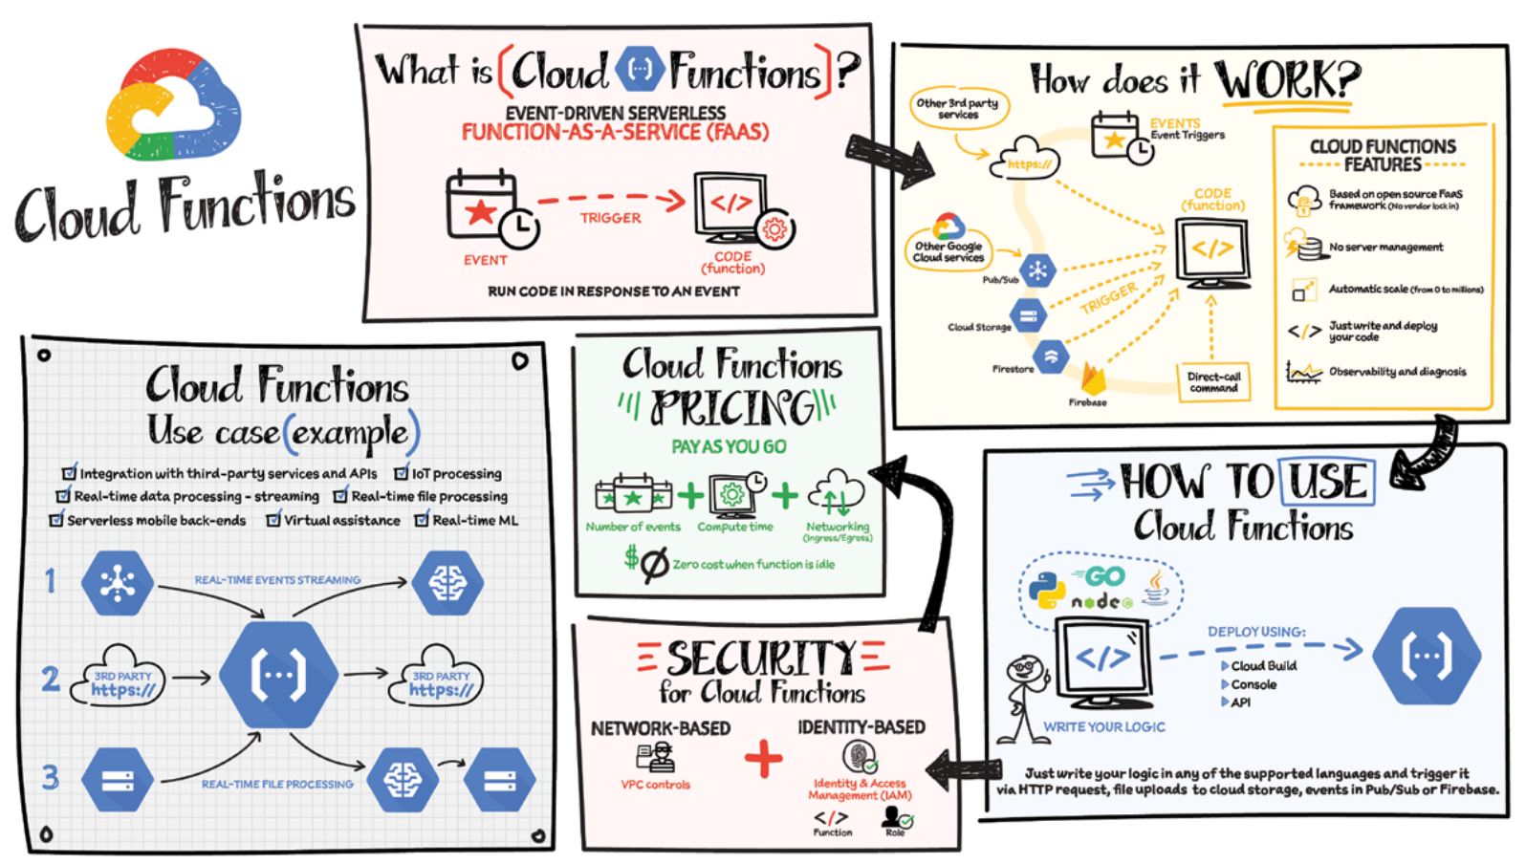

Slide 92
What is VMWare Engine?
Here's a breakdown of the text about GCVE, with a technical explanation simplified for easier understanding:
What is GCVE?
Imagine you have a bunch of workloads (software programs) running on VMware, a popular virtualization platform. You want to move these workloads to the cloud for benefits like:
Agility: Easier scaling and adapting your resources up or down as needed.
Reduced Cost (TCO): Potentially lower overall expenses compared to running everything yourself.
GCVE is a service from Google Cloud that lets you do just that. It's like renting a powerful computer (bare-metal infrastructure) from Google, but instead of the usual Google Cloud operating system, you get VMware pre-installed. This allows you to run your existing VMware workloads in the cloud without major changes.
Technical Breakdown:
Managed VMware Service: Google takes care of the underlying infrastructure, so you focus on managing your workloads.
Bare-Metal Infrastructure: Dedicated physical servers just for your use, not shared with others.
VMware Software Stack: The core software that allows you to run multiple virtual machines on a single server.
Fully Dedicated & Isolated: Your workloads are separate from other Google Cloud customers for security and performance reasons.
Easy-to-Understand Analogy:
Think of GCVE like renting a fully furnished apartment in a high-rise building. Google manages the building (infrastructure), you get your own private space (bare-metal server), and you bring your own furniture (VMware software) to set it up how you like (run your workloads).

Slide 93
How Vmware Engine works?
Here's a technical breakdown of how VMware Engine works in GCP (Google Cloud Platform):
1. Bare-Metal Infrastructure:
Google provides dedicated physical servers for your VMware environment.
These servers are isolated from other Google Cloud customers, offering security and performance benefits.
2. VMware Software Stack:
Google installs the entire VMware software suite on these servers, including ESXi (hypervisor) and vCenter (management tool).
This allows you to run your existing VMware workloads (virtual machines) without modification.
3. Management Responsibilities:
Google manages the underlying physical infrastructure (hardware, network).
You manage the VMware software stack and your virtual machines just like you would on-premises.
4. Integration with GCP Services:
While VMware Engine provides a familiar environment, you can also leverage Google Cloud services like Cloud Storage or BigQuery for additional functionality.
Think of it like this:
Imagine inserting your own "VMware cartridge" into a powerful Google Cloud server. You manage the software and workloads within the cartridge, while Google handles the server itself. This allows you to seamlessly migrate your existing VMware environment to the cloud and enjoy benefits like scalability and cost optimization

Slide 94
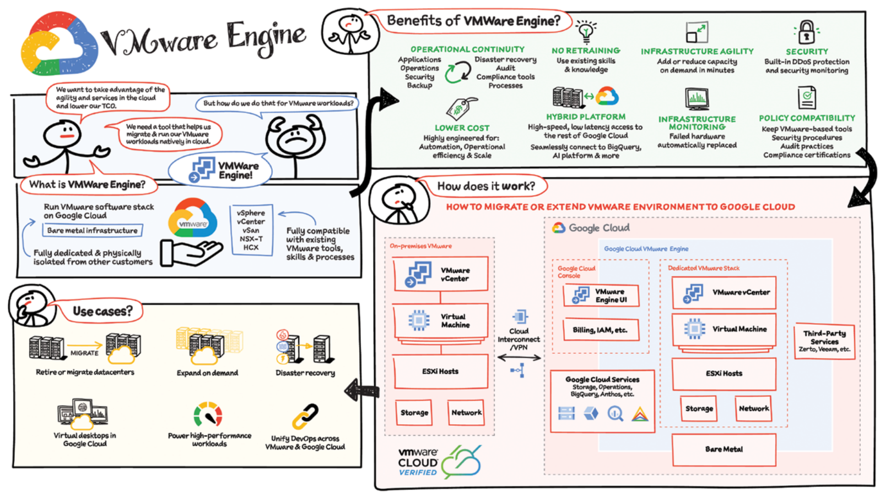

Slide 95
What is Cloud Storage?
Cloud Storage is a global, secure, and scalable object store for immutable data such as images, text, videos and other file formats. You can add data to it or retrieve data from it as often as your application needs.
Store Anything, Forever
GCP Cloud Storage lets you store all kinds of data (images, videos, documents) forever.
Think of it as a giant, secure online filing cabinet.
Plus, you can access your files whenever you need them.
Organized and Secure
Each file has a unique ID and details like security level and which apps can access it.
This makes it easy to find and control your data.
Great for Many Uses
Cloud Storage is flexible and works for many tasks, like websites and data analysis.
Key Takeaways:
Immutable storage: Files can't be changed or deleted, keeping them safe.
Scalable: Add more storage as you need it.
Global: Access files from anywhere in the world.

Slide 96
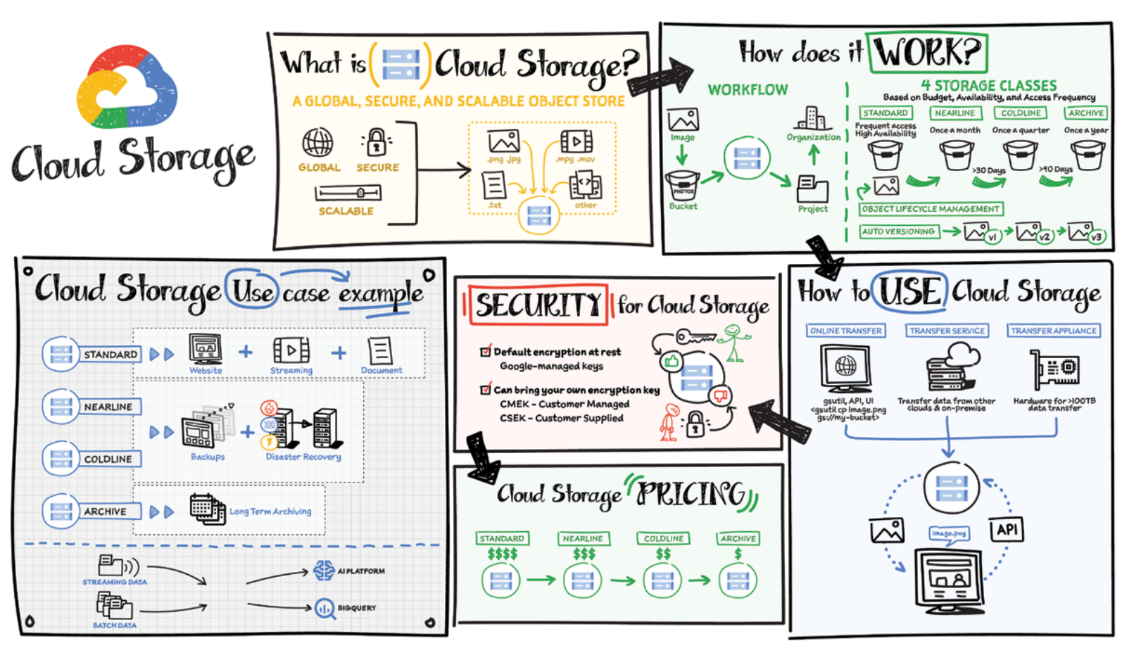

Slide 97
What is Filestore?
Filestore is a managed file storage service in the cloud. It's designed for unstructured data, which means data that doesn't have a fixed format, like documents, images, or videos. Think of it like a high-speed filing cabinet in the cloud.
Key features:
Fully managed: Google takes care of setting up, managing, and maintaining the storage. You just focus on using it.
NoOps (No Operations): No need to worry about server administration tasks.
High-performance: Filestore is built for speed, making it ideal for applications that need fast access to data.
Shared storage: Multiple virtual machines (VMs) and containers can access the same files simultaneously. This is perfect for workloads like collaborative editing or data analysis.
NFS support: Filestore can be accessed by anything that understands NFS, a common file sharing protocol. This makes it easy to integrate with existing applications.
Cloud migration friendly: Easily move your existing applications that rely on file storage to the cloud without major code changes.
In simpler terms:
Imagine you have a bunch of documents and files scattered on different computers. Filestore lets you put them all together in a secure, central location in the cloud. Everyone who needs access can reach them quickly and easily, and you don't have to worry about managing the storage itself.

Slide 98
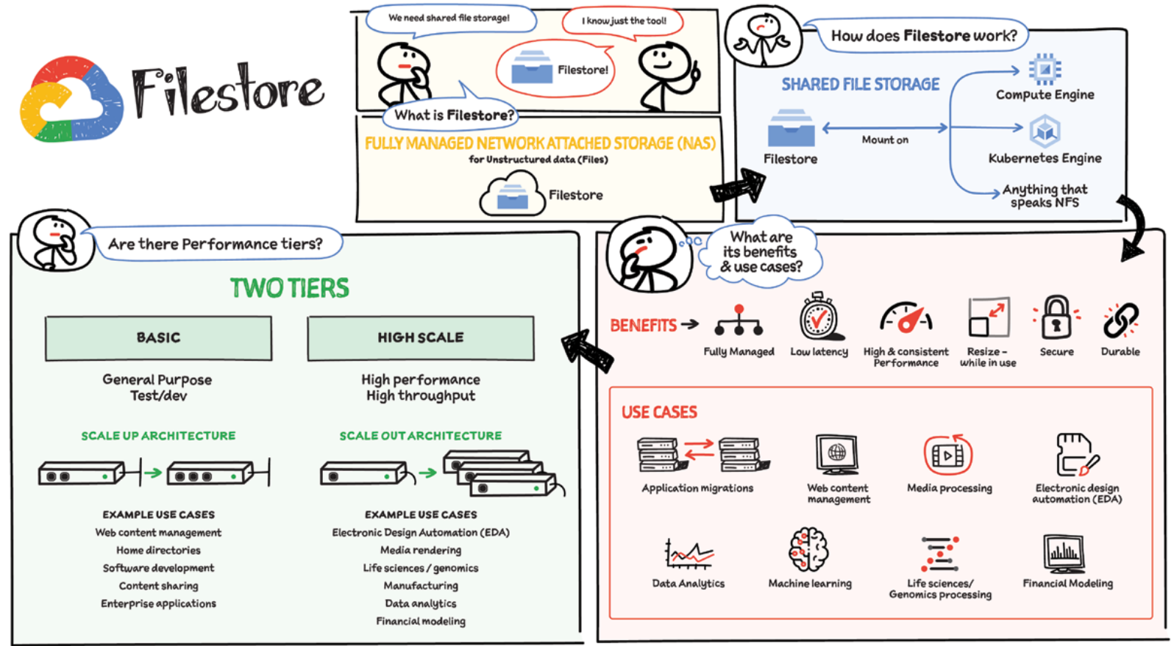

Slide 99
What is Cloud SQL?
Cloud SQL is a managed relational database service offered by Google Cloud Platform (GCP). It allows you to set up, manage, and scale relational databases in the cloud. Unlike Filestore which handles unstructured data, Cloud SQL is built specifically for structured data, like data stored in tables with rows and columns - think of it like an organized spreadsheet in the cloud.
Key features:
Managed service: Google handles the infrastructure behind the database, freeing you to focus on managing your data and applications.
Familiar tools: You can use familiar tools and languages like MySQL and PostgreSQL to manage your databases.
Scalability: Easily scale your database storage and performance up or down based on your needs.
High availability: Cloud SQL offers options for high availability, ensuring your database is always accessible for your applications.
Security: Built-in security features protect your data from unauthorized access.
Pay-per-use: You only pay for the resources you use, making it a cost-effective solution.
In simpler terms:
Cloud SQL takes the burden of managing relational databases off your shoulders. Imagine having a critical database application that needs to be reliable and secure. Cloud SQL lets you focus on keeping your data organized and accessible for your applications, while Google takes care of the underlying infrastructure. You can scale the database up or down as needed, and only pay for what you use.

Slide 100
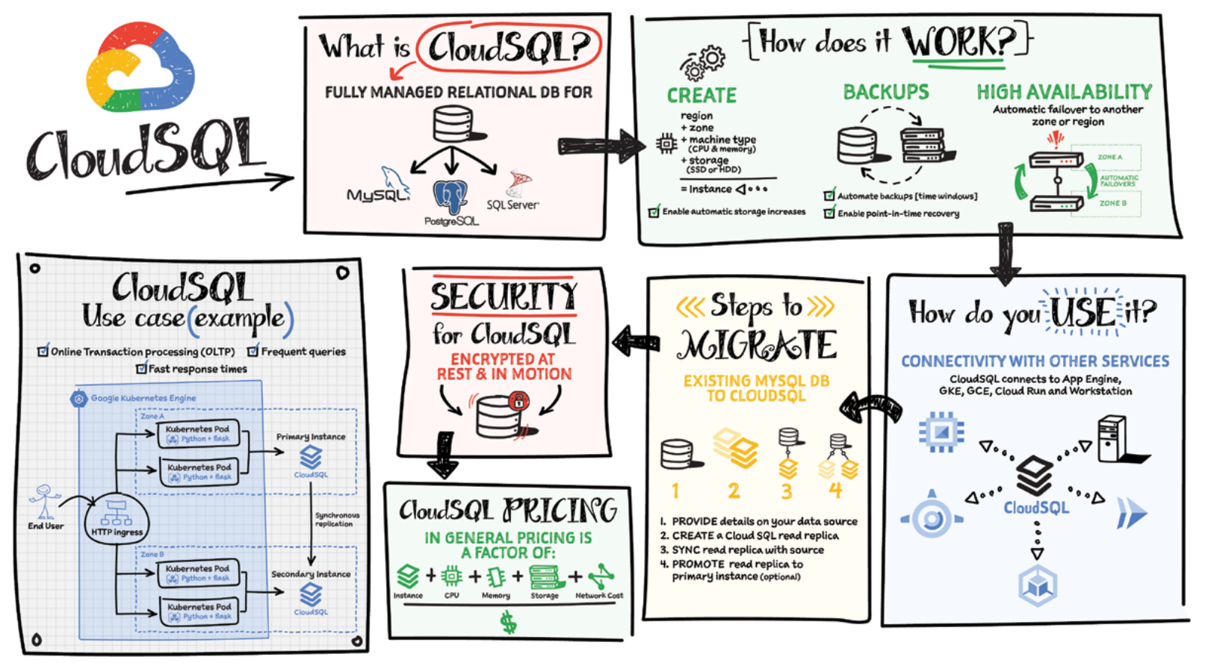

Slide 101
What is Cloud Spanner?
Cloud Spanner is a heavyweight player in Google Cloud Platform's (GCP) database lineup. It's a globally-distributed relational database, meaning it stores your data across multiple regions and offers top-notch features for critical applications.
Think of it as a super-powered relational database:
Strong Consistency: Unlike some databases, Cloud Spanner guarantees that all reads see the latest data, no matter where you access it from. This is crucial for applications where data accuracy is paramount, like financial systems.
Scalability: Cloud Spanner can handle massive amounts of data and high transaction volumes. Need to expand? Simply add more resources – no complex sharding or data partitioning required.
High Availability: A cloud-based service, Spanner is built for reliability. If a hardware failure occurs, your database remains accessible with minimal downtime.
SQL Friendly: Use familiar SQL queries to manage your data, making it easy for developers familiar with relational databases to get started.
Easy Management: GCP takes care of the infrastructure behind the scenes, allowing you to focus on your application development.
Surprisingly, Cloud Spanner offers a user-friendly experience. Here's why:
Fully Managed: No need to worry about server administration or complex configurations.
Online Schema Changes: Update your database structure without taking it offline, minimizing application impact.
Built-in Security: Cloud Spanner prioritizes data security with features like encryption and access controls.
In simpler terms:
Imagine you have a critical application that requires consistent, reliable data access across the globe. Cloud Spanner acts like a high-performance, secure filing cabinet in the cloud, accessible from anywhere. It automatically scales to meet your needs and ensures everyone sees the latest information. Plus, you don't have to worry about managing the underlying infrastructure – Google takes care of that.

Slide 102
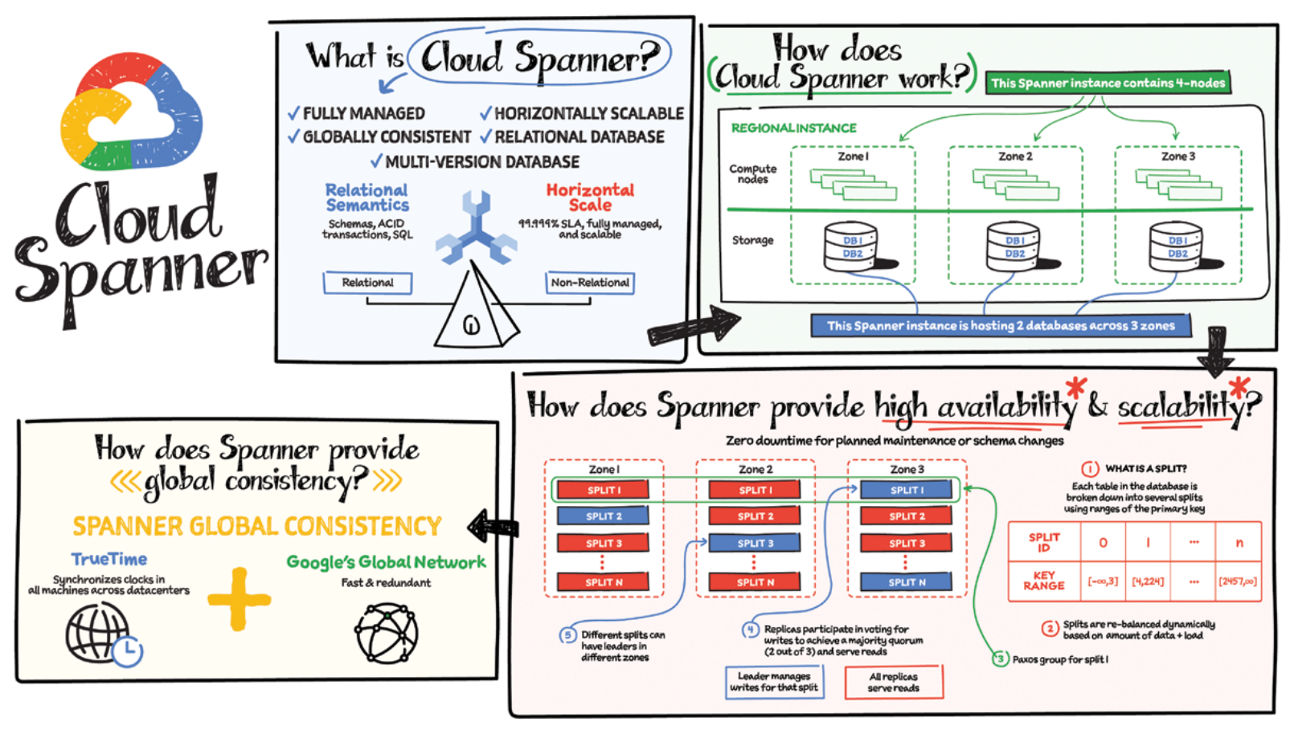

Slide 103
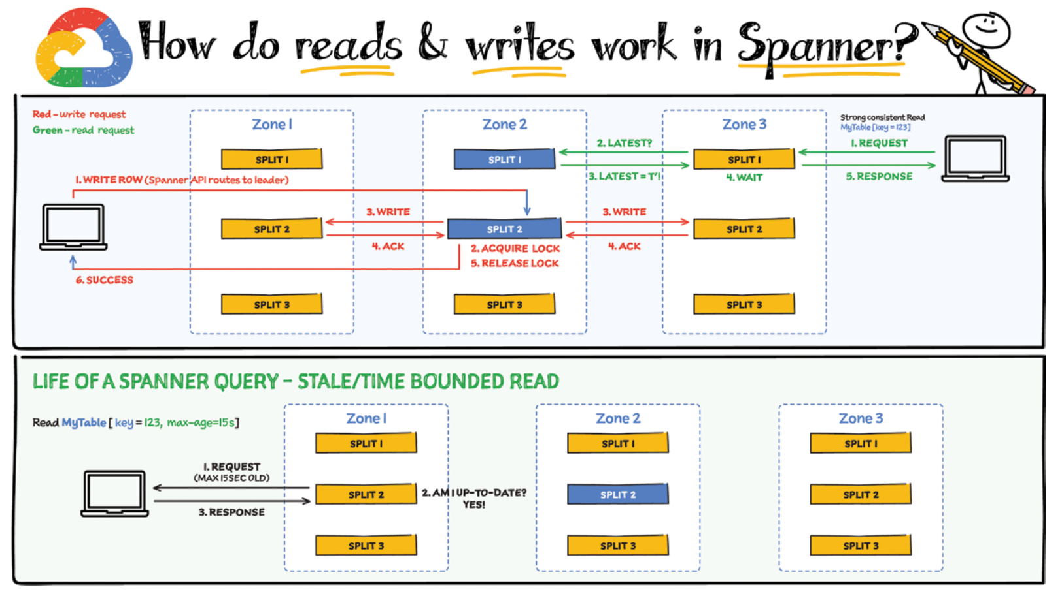

Slide 104
What is Firestore?
Firestore is a serverless, fully managed NoSQL document database that scales from zero to global scale without configuration or downtime. Here’s what makes Firestore unique:
- Ideal for rapid, flexible, and scalable web and mobile development with direct connectivity to the database.
- Supports effortless real-­time data synchronization with changes in your database as they happen.
- Robust support for offline mode, so your users can keep interacting with your app even when the internet isn’t available or is unreliable.
- Fully customizable security and data validation rules to ensure data is always protected.
- Built-­in strong consistency, elastic scaling, high performance, and best in-­class 99.999% availability.
Integration with Firebase and Google Cloud services like Cloud Functions and BigQuery.
In addition to a rich set of Google Cloud service integrations, Firestore offers deep one-­click integrations with a growing set of third-­party partners via Firebase Extensions to help you build applications even more rapidly.

Slide 105
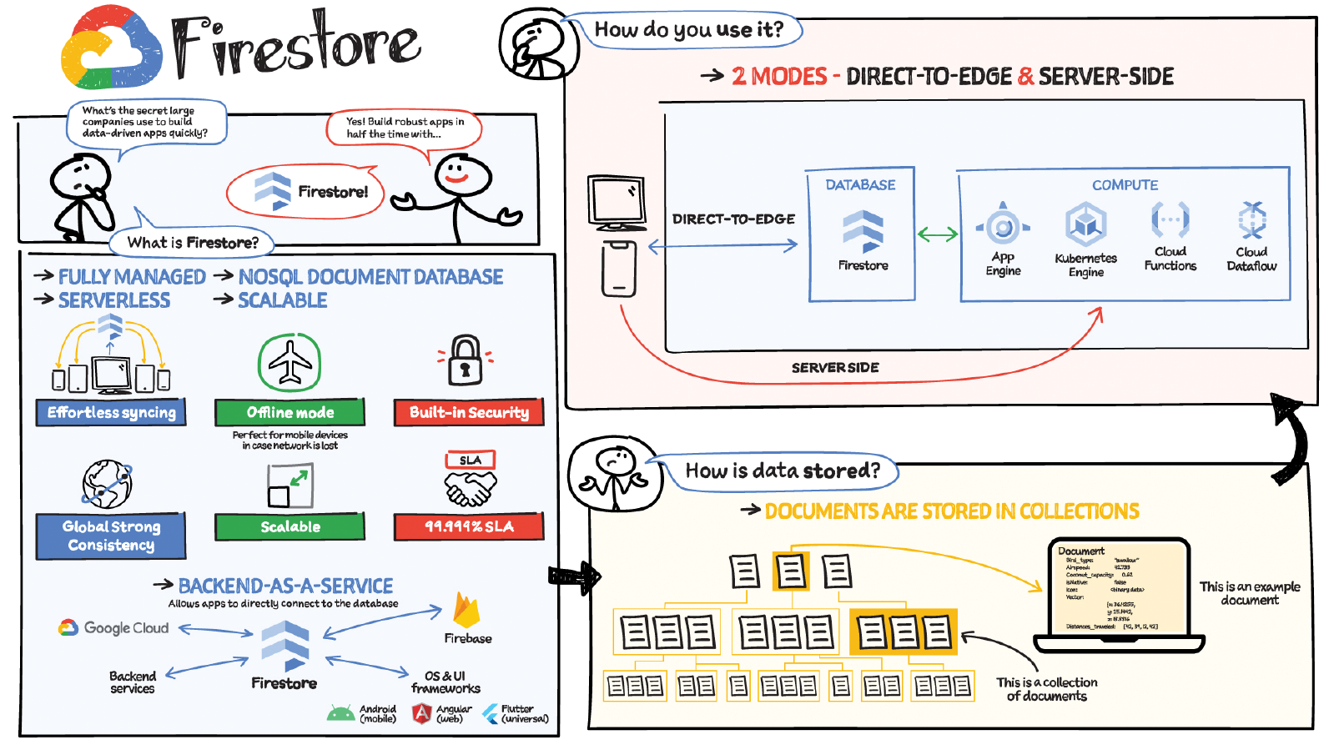

Slide 106
What is Bigtable?
Bigtable is a powerhouse NoSQL database service offered by Google Cloud Platform (GCP). It's designed to handle massive amounts of data with blazing-fast speed, making it ideal for applications that need real-time access to constantly changing information.
Think of it as a super-sized phonebook on steroids:
High Performance: Bigtable excels at storing and retrieving large datasets quickly, perfect for applications like social media feeds or real-time analytics.
Scalability: Need to store more data? No problem! Bigtable scales seamlessly to accommodate growing datasets.
Flexible Schema: Unlike traditional databases with rigid structures, Bigtable allows you to store data in a flexible format, adapting to your specific needs.
Semi-Structured Data: Bigtable excels at handling data that has some structure but isn't as rigid as a traditional database table.
NoSQL: Bigtable is a NoSQL database, meaning it doesn't rely on the traditional row-and-column structure. This makes it ideal for data that doesn't fit neatly into those constraints.
Bigtable offers a different approach to data storage compared to relational databases. Here's what to keep in mind:
Learning Curve: Understanding Bigtable's data model and querying methods might require some additional learning compared to familiar SQL databases.
Focus on Reads and Writes: While Bigtable is great for retrieving and storing data, it doesn't excel at complex data analysis tasks. Consider using BigQuery alongside Bigtable for in-depth analytics.
In simpler terms:
Imagine you have a constantly growing stream of data, like social media updates or sensor readings, that needs to be stored and accessed quickly. Bigtable acts like a massive, lightning-fast filing cabinet in the cloud. You can easily add new information and retrieve it instantly, all without worrying about rigid data structures. However, it might take a little practice to get used to its unique way of organizing information.

Slide 107
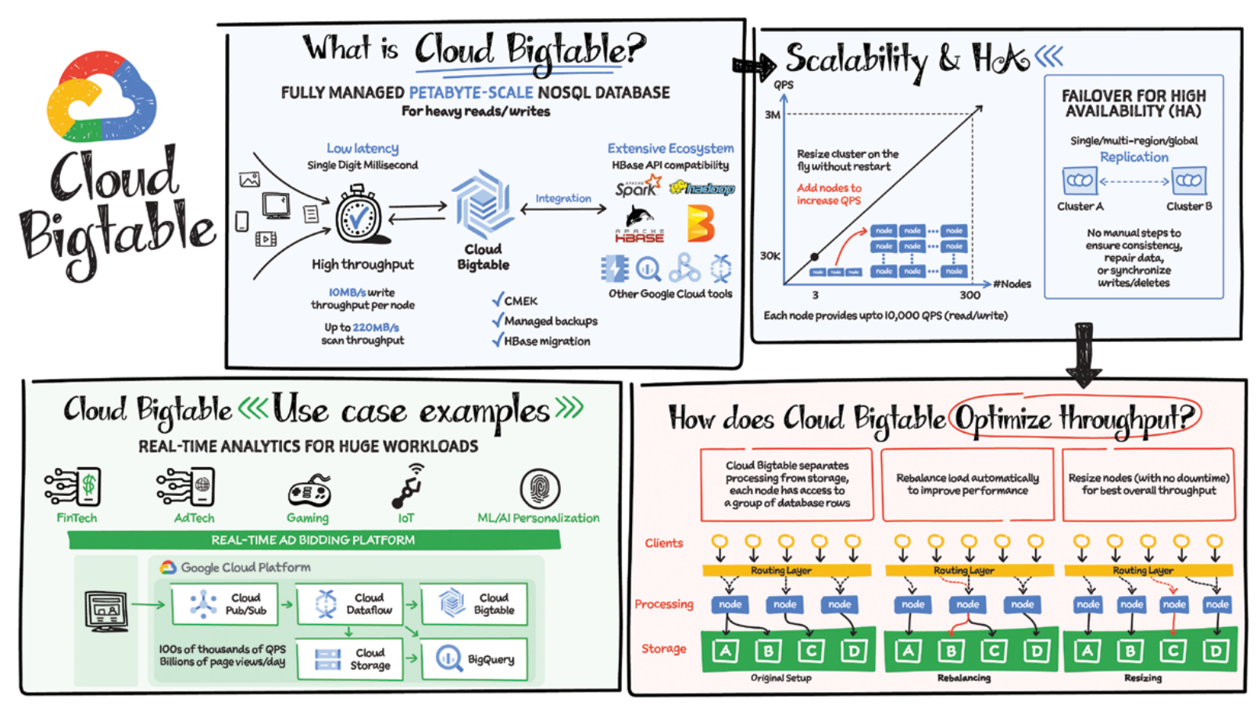

Slide 108
What is Memorystore?
Memorystore on Google Cloud Platform (GCP) isn't your typical storage solution. It's a managed in-memory data store built for speed. Think of it like having a personal assistant for your applications, remembering everything they need instantly.
Key features:
Blazing Fast: Memorystore stores data in RAM, delivering lightning-fast access times compared to traditional disk-based storage. This is perfect for applications that rely on real-time data, like leaderboards in games or fraud detection systems.
Multiple Choices: GCP offers Memorystore for Redis and Memcached, two popular in-memory data store options. Choose the one that best suits your application's needs.
Fully Managed: Google handles the infrastructure behind Memorystore, freeing you to focus on developing and managing your applications.
Scalability: Easily scale your Memorystore instance up or down based on your application's demands.
Cache Your Way to Success: Use Memorystore to cache frequently accessed data, significantly reducing the load on your primary databases and improving application performance.
Think of it this way:
Imagine your application constantly needs to access the same information repeatedly. Memorystore acts like a super-powered notepad, readily accessible by your application, holding the most frequently used data for instant retrieval. This frees up your main database and keeps your application running smoothly.
But is it all about speed?
While speed is king, Memorystore has some limitations to consider:
Volatile Data: Data stored in Memorystore is lost upon restarts or outages. Ensure you have a backup plan for critical information.
Cost Considerations: In-memory storage can be more expensive than traditional options. Evaluate your needs and budget before deploying Memorystore.
In simpler terms:
Memorystore is like a performance booster for your applications. It stores frequently used data in super-fast memory, so your applications can access it instantly. This translates to quicker response times and a smoother user experience, but remember, the data isn't permanent and might come at a slightly higher cost.

Slide 109
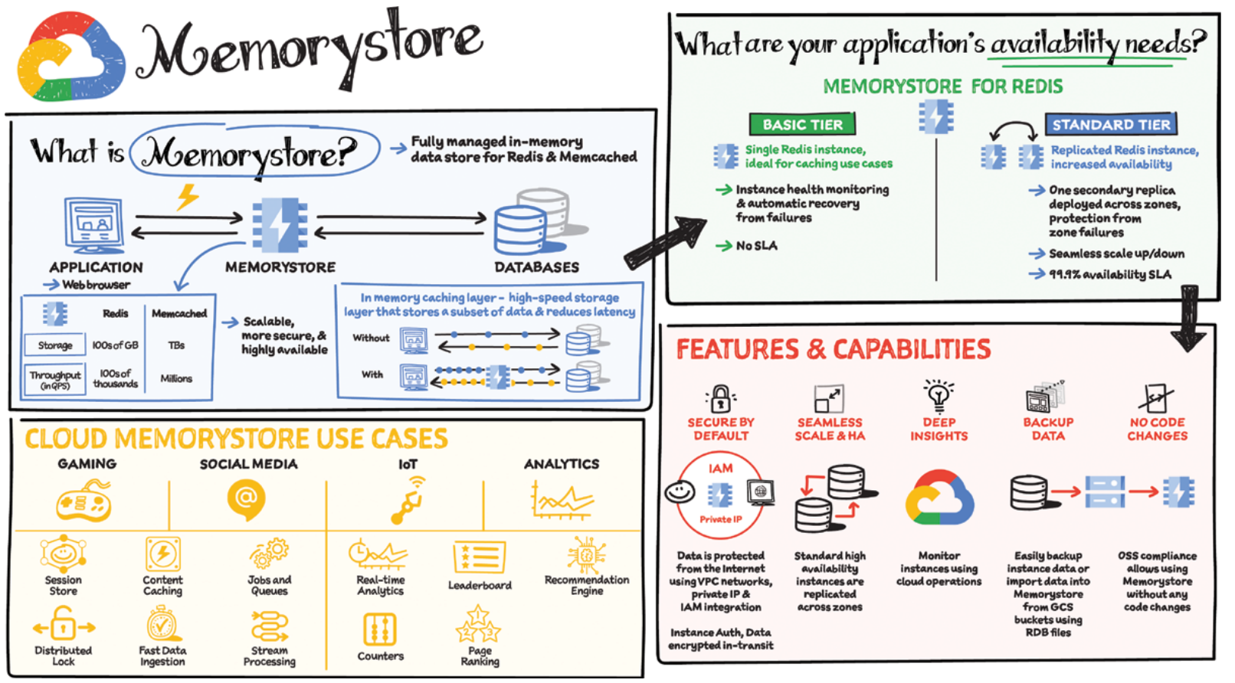

Slide 110
RRK – TECHNICAL DEPTH & WHITEBOARDING
(architecture, migration, solutions)

Slide 111
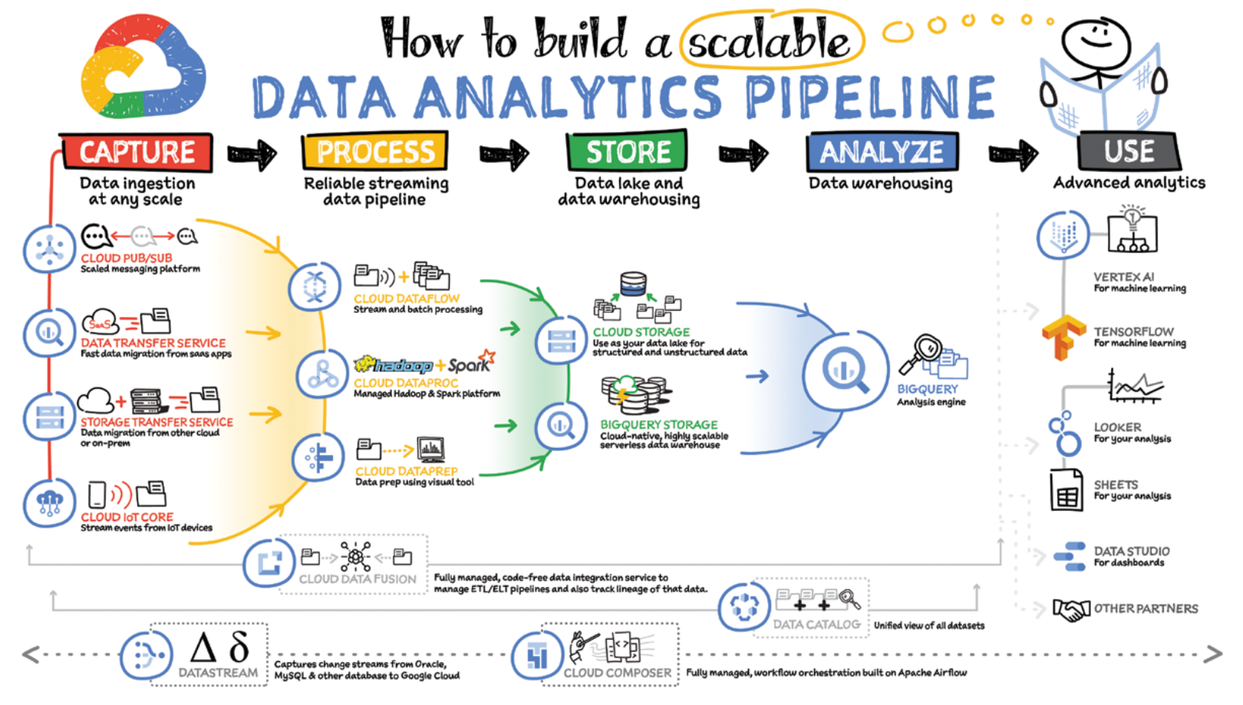
How to build scalable data analytics platform?

Slide 112
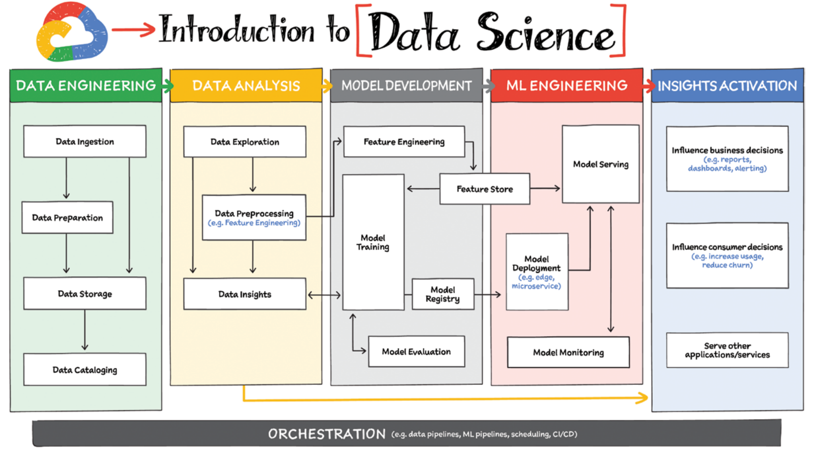

Slide 113
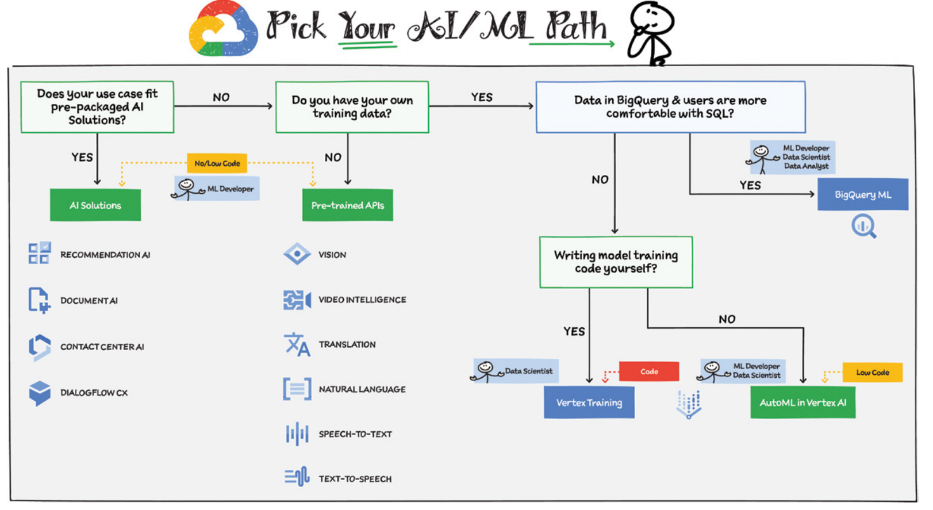

Slide 114
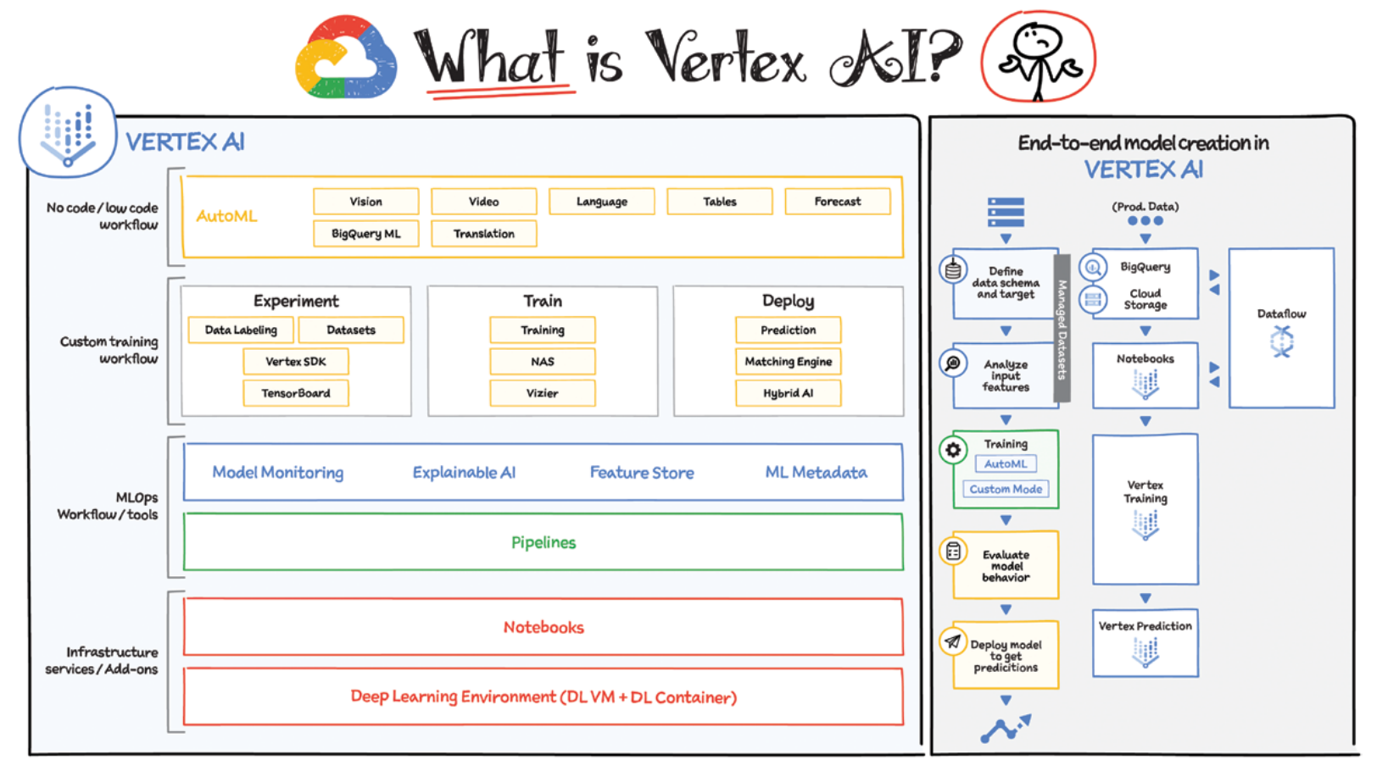

Slide 115
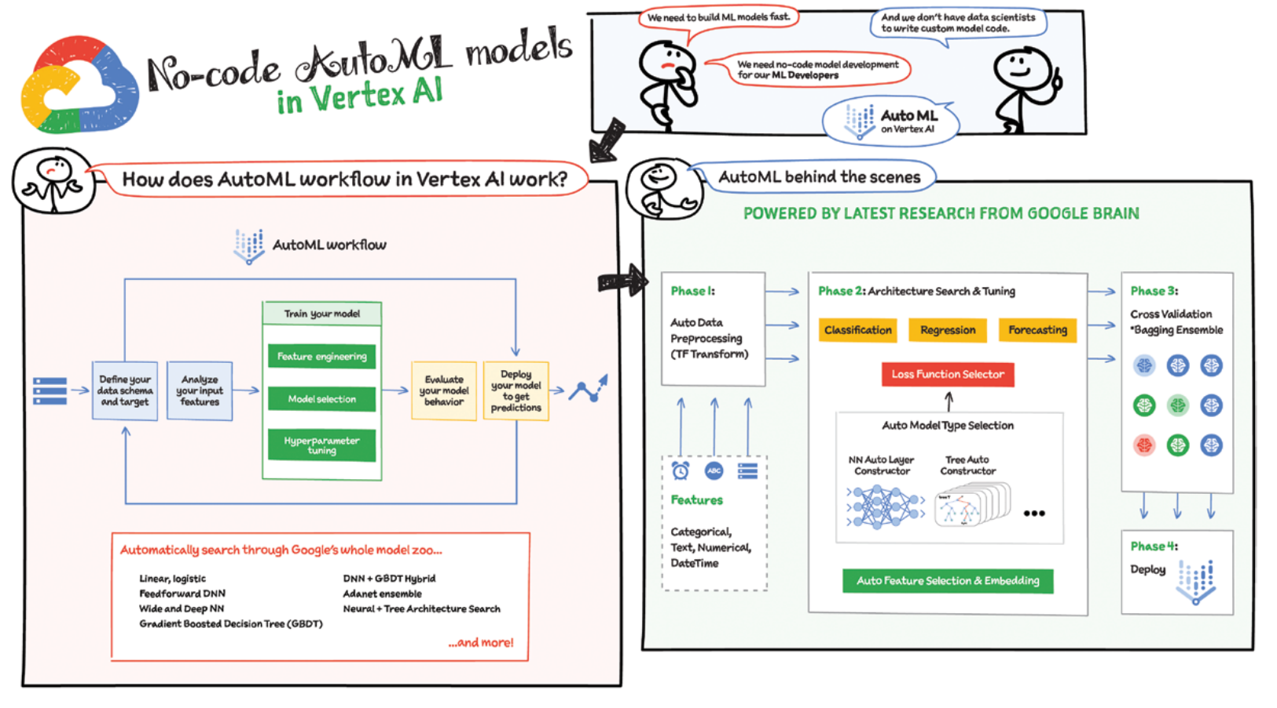

Slide 116
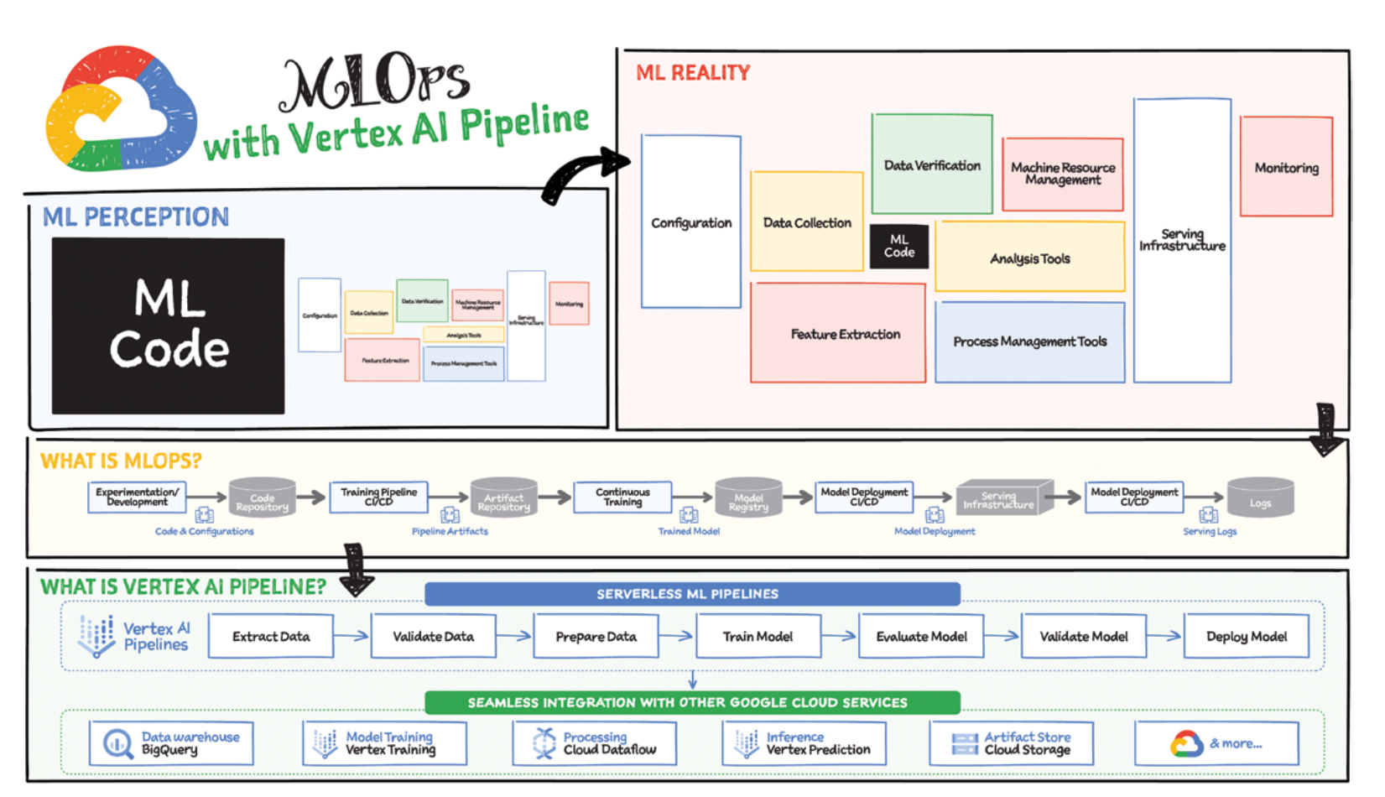

Slide 117
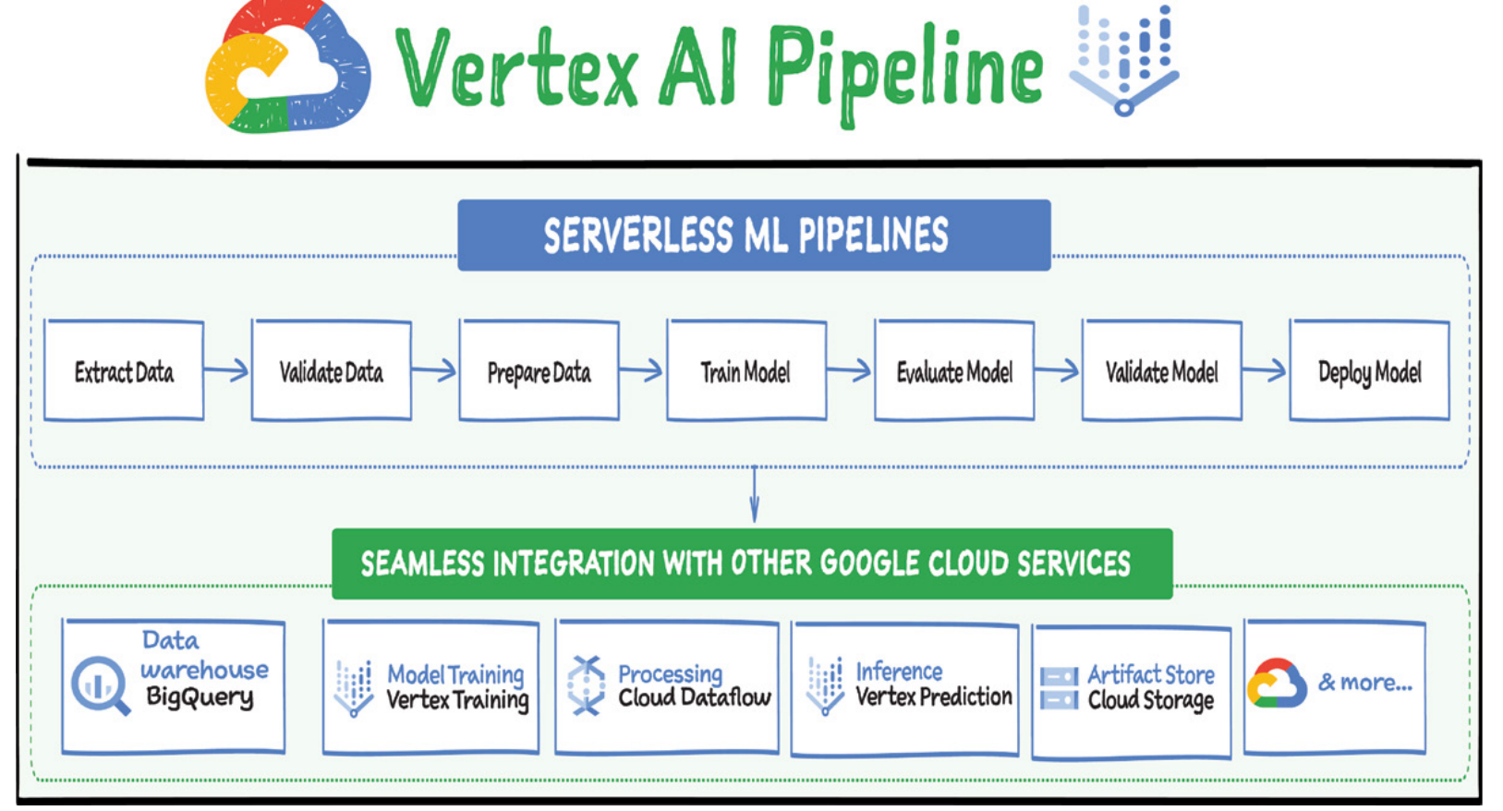

Slide 118
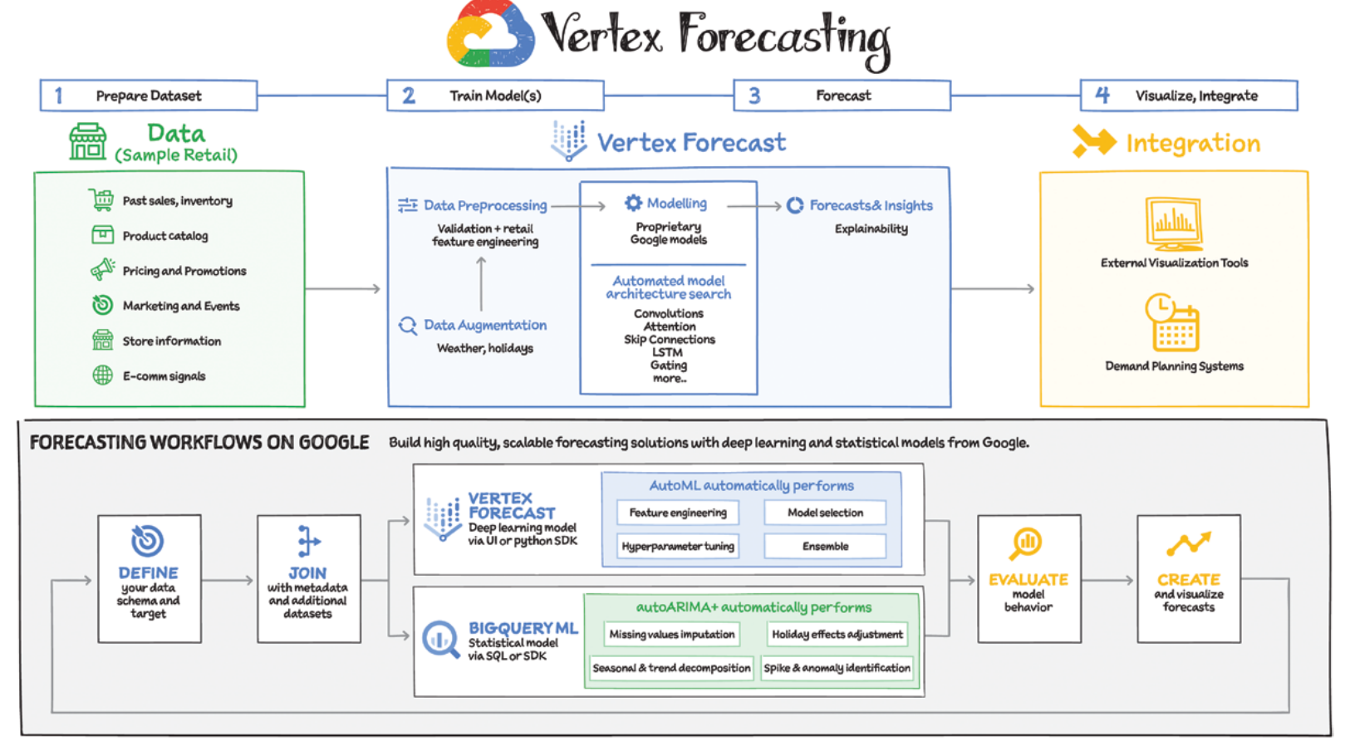

Slide 119
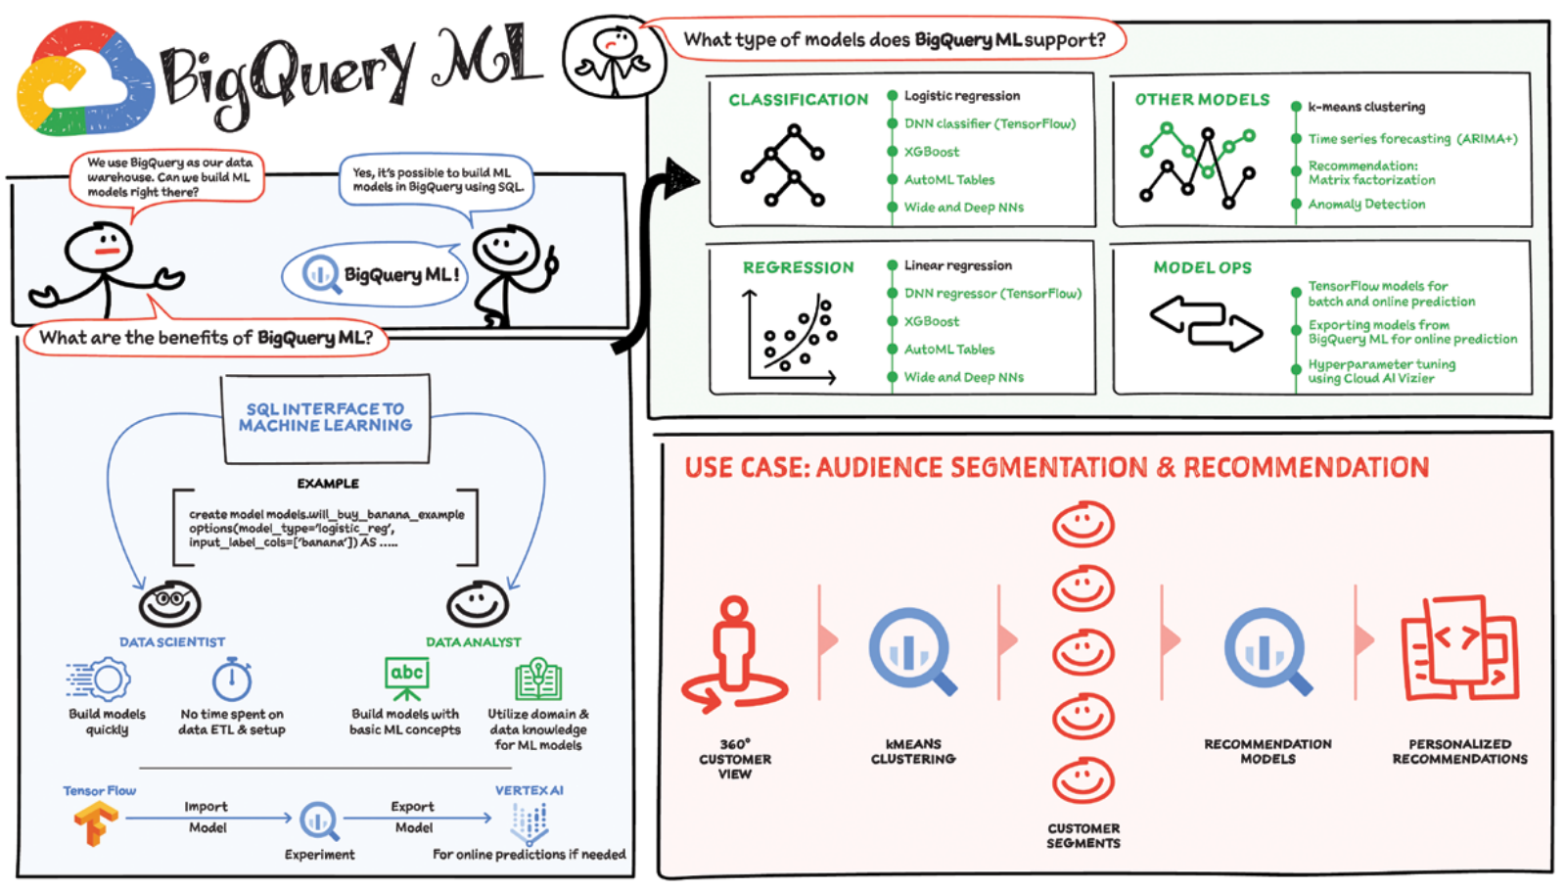

Slide 120
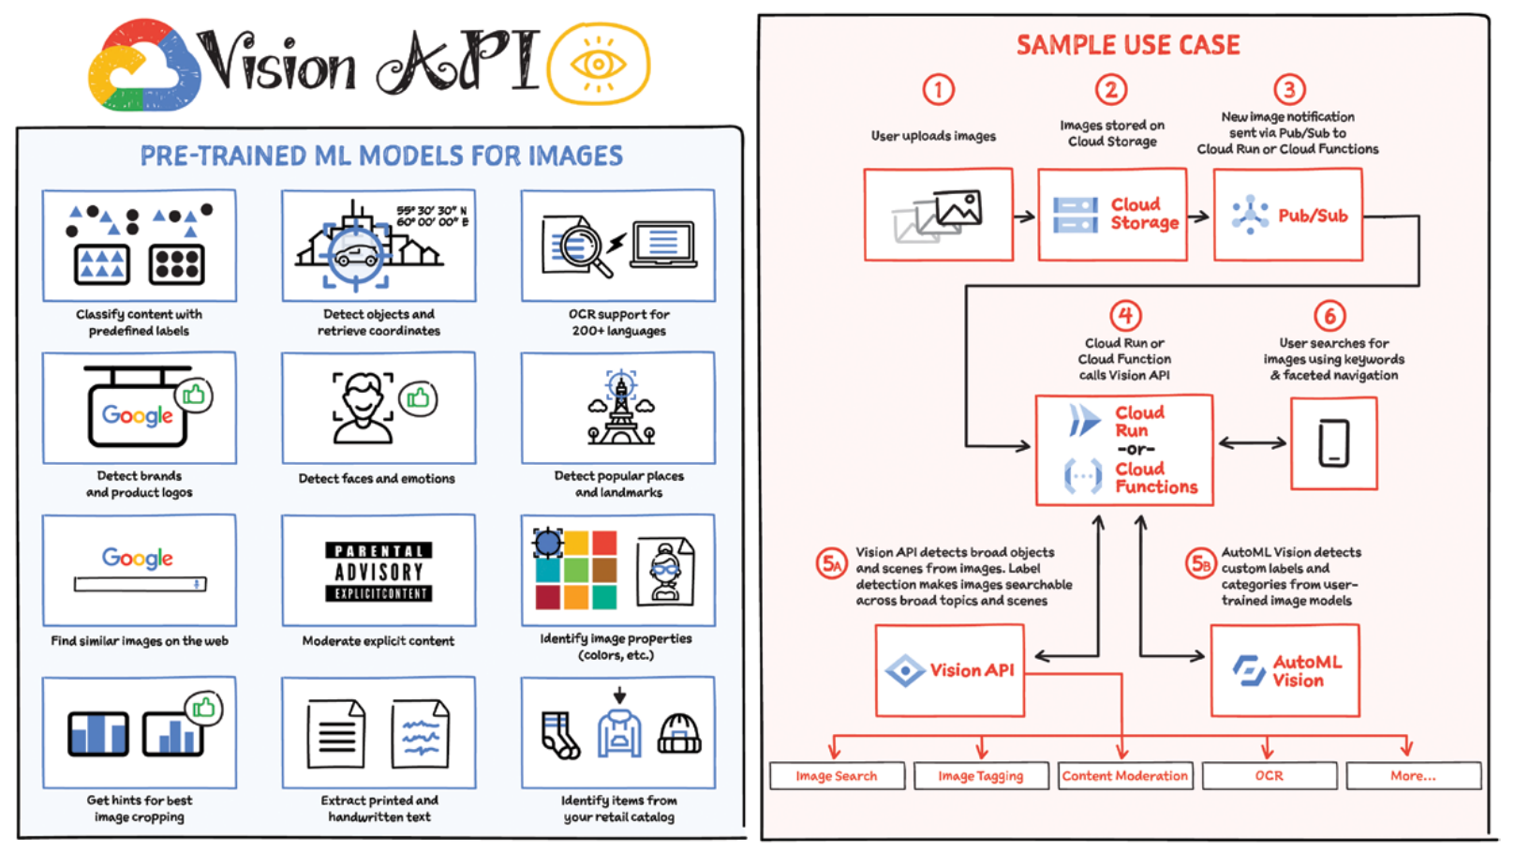

Slide 121
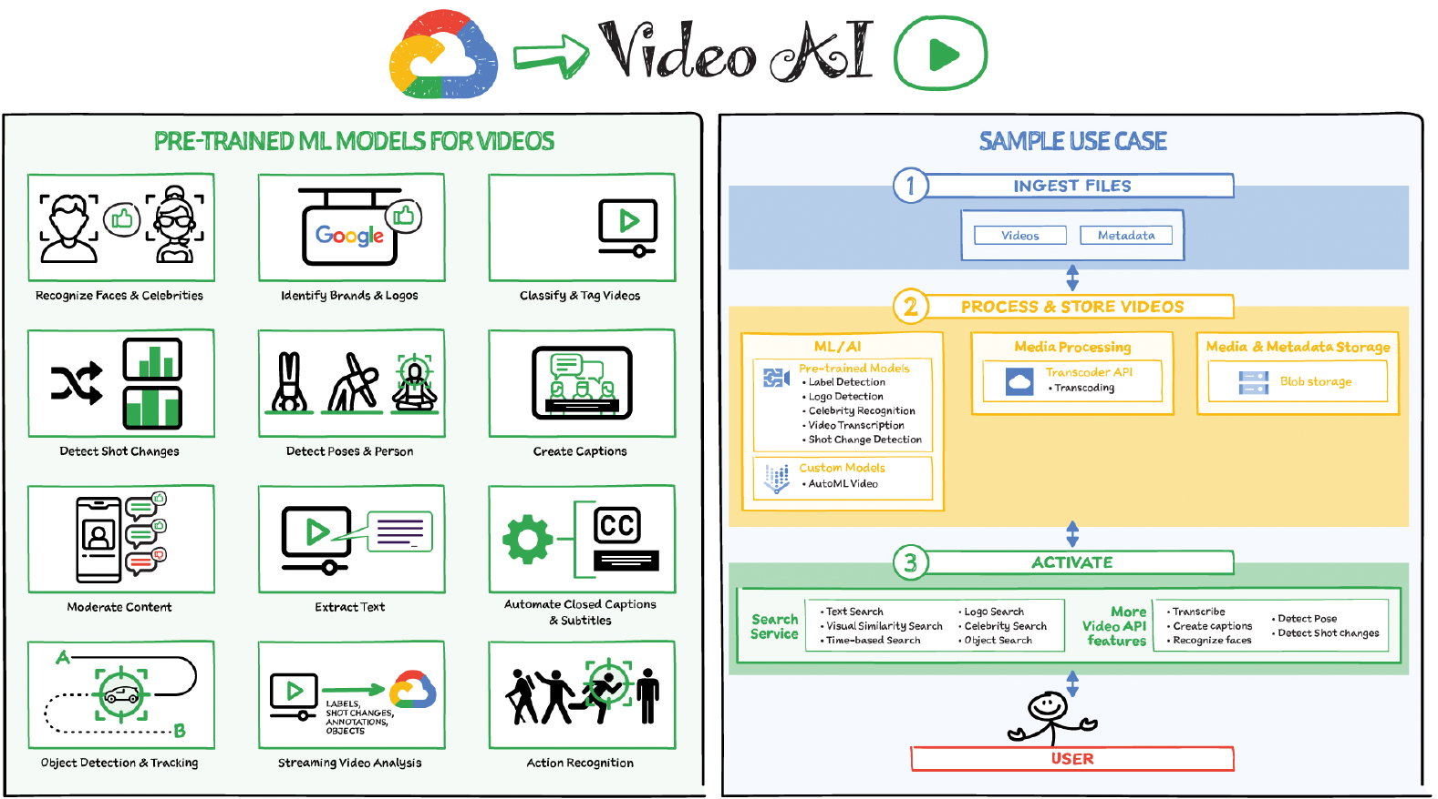

Slide 122
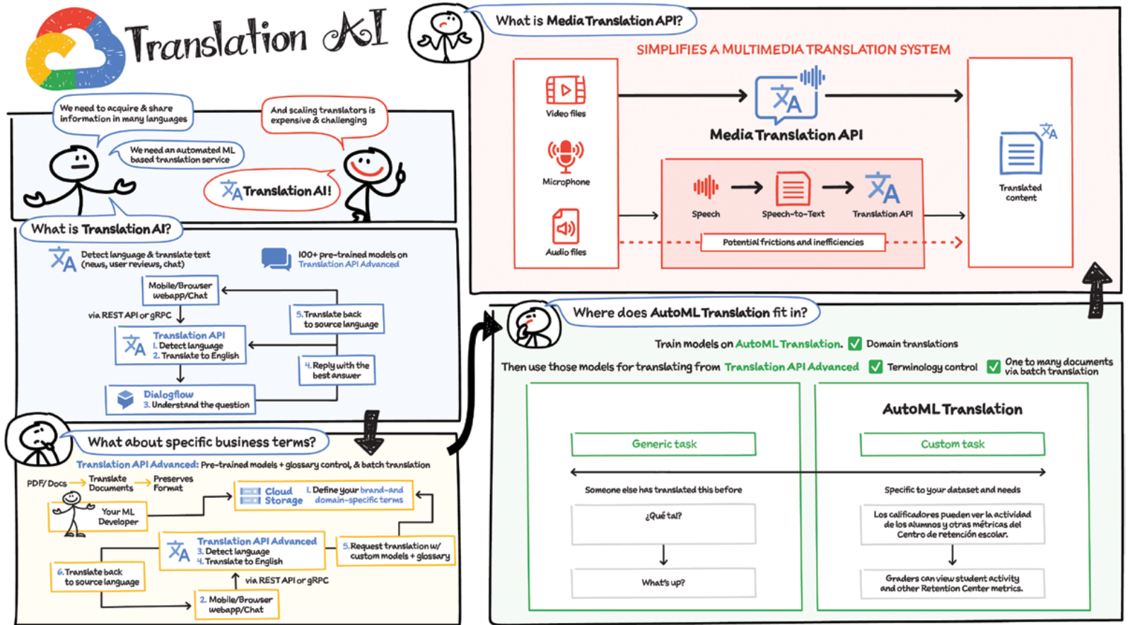

Slide 123
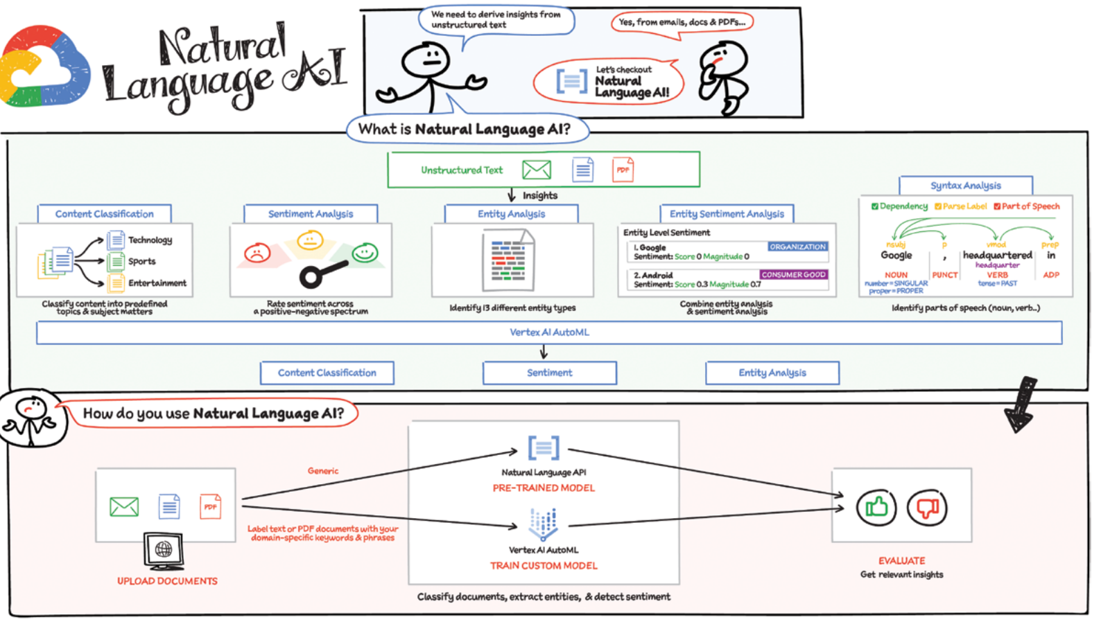

Slide 124
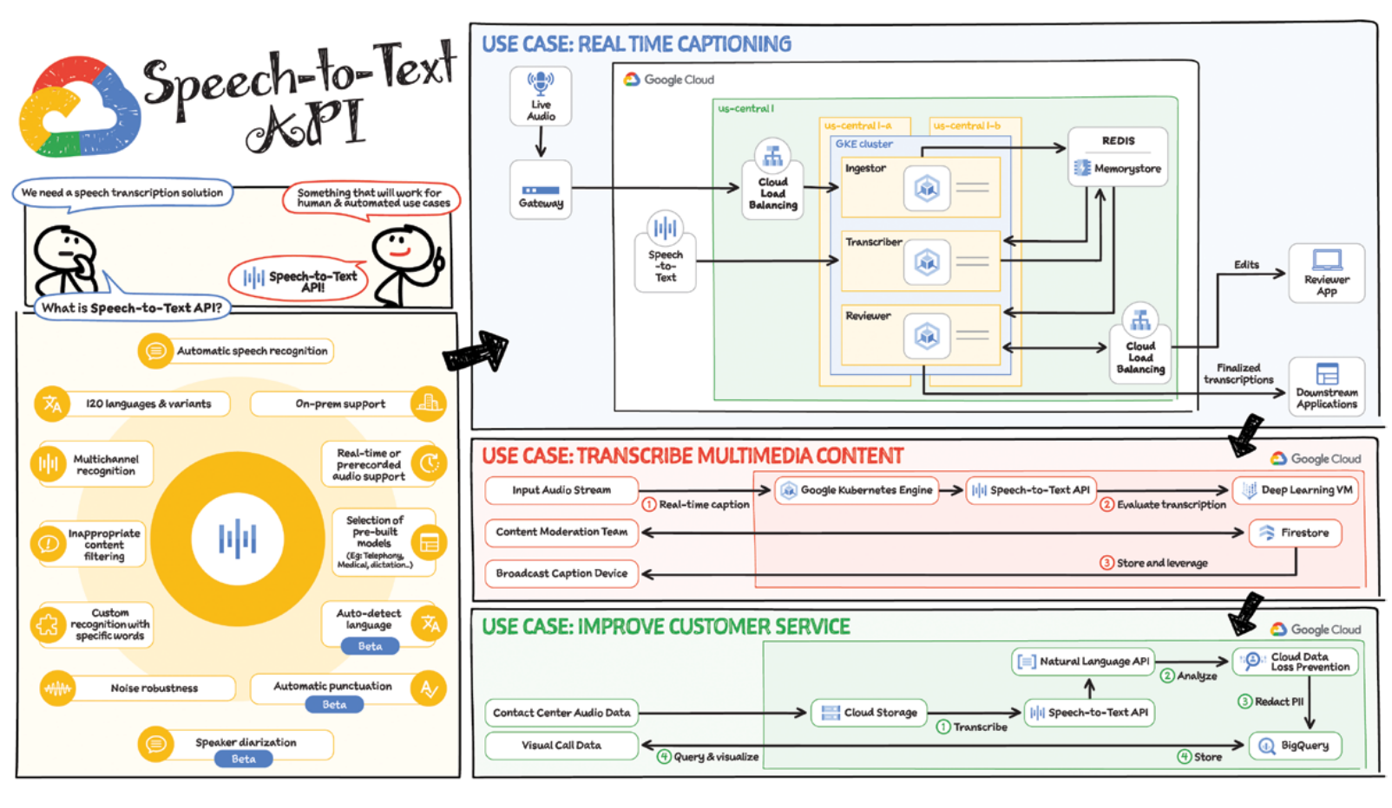

Slide 125


Slide 126


Slide 128


Slide 129


Slide 130


Slide 131


Slide 132


Slide 133


Slide 134

Use Case 1: Hybrid Cloud Burst
- Set up the connectivity between on-­premises and the cloud using Cloud Interconnect.
- Create a cloud landing zone; this includes creating the project and the resources such as Google Compute Engine (GCE), Google Kubernetes Engine (GKE), Google Cloud VMware Engine (GCVE), or Anthos.
- Then “lift and shift” or “lift and optimize” from on-­premises to the cloud in the appropriate resource.
-At this point, you are ready to send the traffic bursts or excess traffic to Google Cloud to lower the stress on the existing data center.
Use Case 2: Modernize with Anthos
- Establish network connectivity to Google Cloud using Cloud Interconnect.
- Create the cloud landing zone.
- Then, “lift and shift” workloads to free up capacity on-­premises.
- Build Anthos on-­premises landing zone.
- Then, modernize apps both on-­premises and in the cloud.

Slide 135


Slide 136


Slide 137


Slide 138


Slide 139


Slide 140


Slide 141


Slide 142


Slide 143


Slide 144


Slide 145


Slide 146


Slide 147


Slide 148


Slide 150


Slide 151


Slide 152
RRK – TECHNICAL DEPTH & WHITEBOARDING
(various data architectures)

Slide 153


Slide 154


Slide 155

Cloud data analytics for genome architecture

Slide 156


Slide 157


Slide 158


Slide 159


Slide 160


Slide 161


Slide 162


Slide 163


Slide 165


Slide 166


Slide 167

Ephemeral clusters solution

Slide 168

Cloud native solution

Slide 169


