Slide 1
ADVANCED SKIN DISEASE LEVARGING IMAGE PROCESSING
PRESENTED BY
ABHIJEET ANIL WABLE
ARIGALA JAGADEESH
BAIG MANZOOR
BHARATHI KODURU
HARIPRIYA CHANDUPATLA

Slide 2
OBJECTIVE
The objective of this project is to develop an AI/ML-based model utilizing Support Vector Machine (SVM) to classify and predict skin conditions by analyzing image-derived features. The focus of the model is to detect the presence of a specific skin anomaly by extracting and analyzing numerical feature data from medical images. This model aims to enhance the accuracy and efficiency of skin condition detection and classification for medical applications.

Slide 3
INTRODUCTION
Skin conditions, ranging from common issues like eczema and acne to more complex conditions such as psoriasis and dermatitis, are prevalent worldwide and often require accurate diagnosis for effective treatment. With advancements in medical imaging and machine learning, there is a growing potential to utilize artificial intelligence (AI) to assist in diagnosing these conditions. This project focuses on developing an AI/ML-based model using Support Vector Machine (SVM) to analyze medical images and classify various skin conditions. By extracting numerical feature data from these images, the model aims to detect specific skin abnormalities, such as inflammatory lesions or growths. The objective is to provide healthcare professionals with a more efficient and accurate tool for diagnosing skin conditions, leading to improved patient care and faster clinical decision-making.

Slide 4
FLOW CHART
Load and Preprocess Dataset
Select Features and Target
Data Splitting
Test a Random Image
Train SVM Model
Test the Model
Evaluate Model Performance

Slide 5
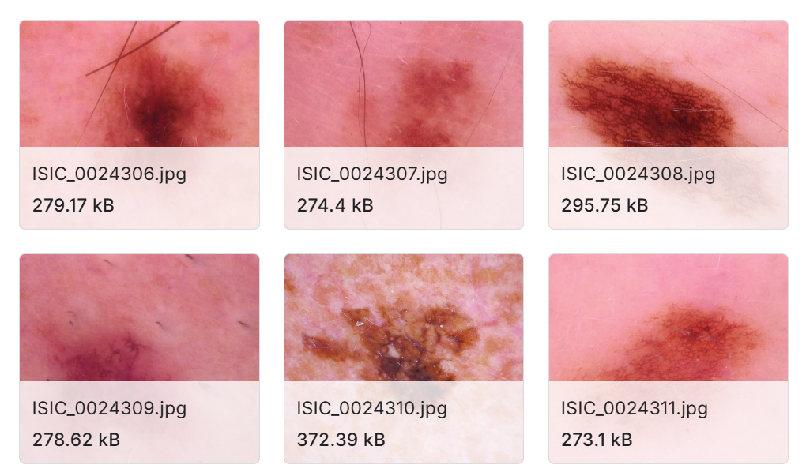
SKIN DISEASE IMAGES

Slide 6
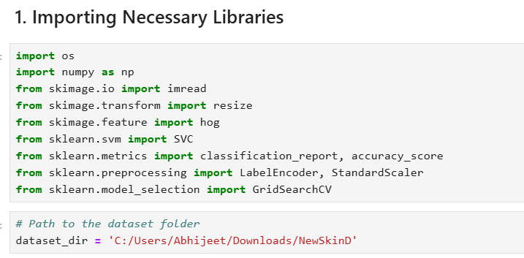
PROJECT MODEL CODE

Slide 7
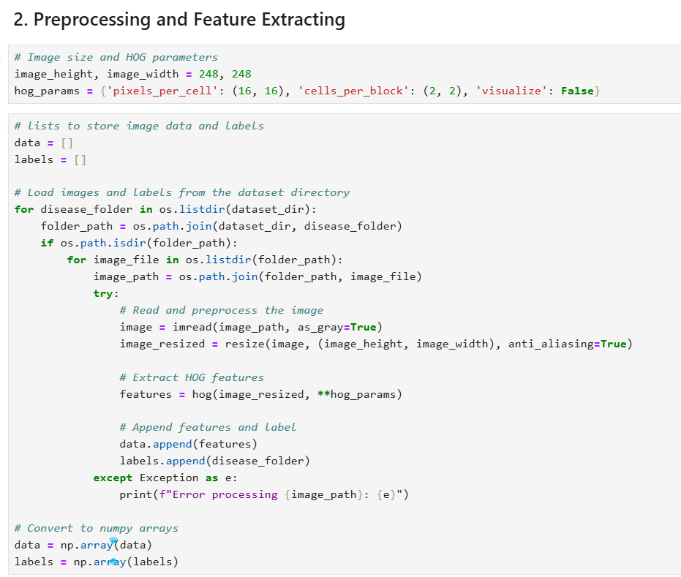

Slide 8
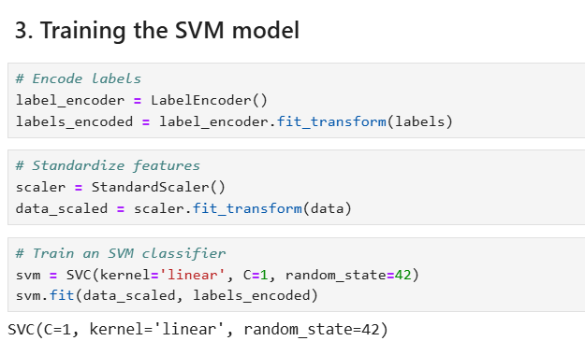

Slide 9
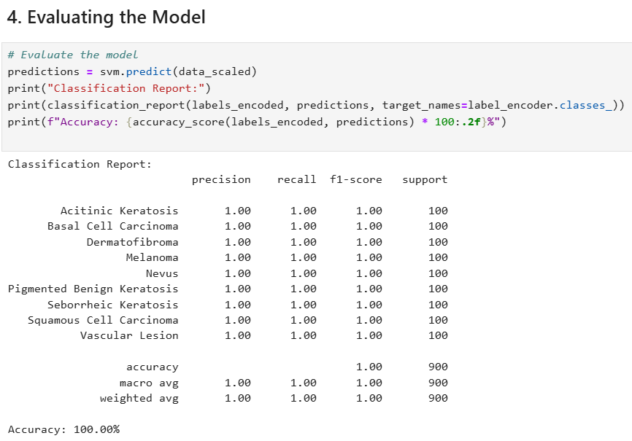
RESULTS

Slide 10
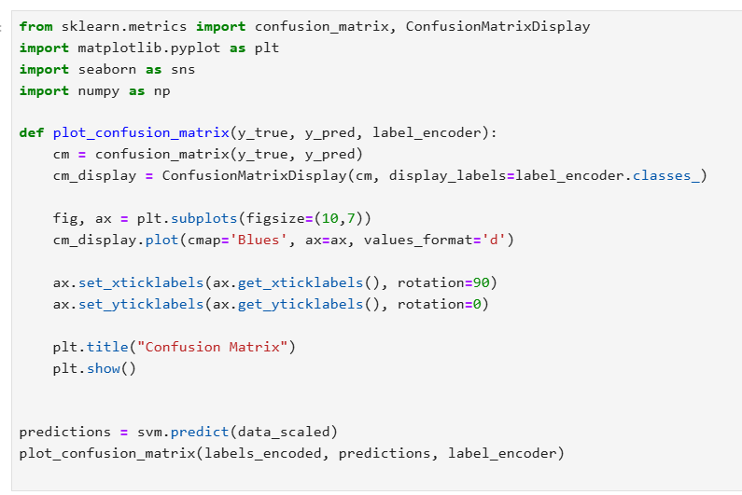
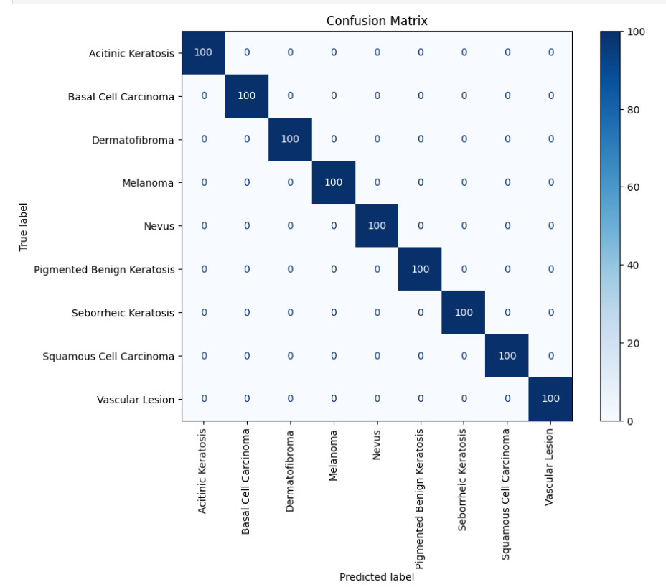
CONFUSION MATRIX

Slide 11
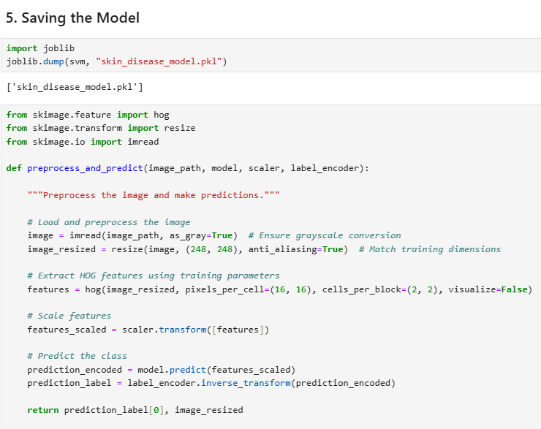

Slide 12
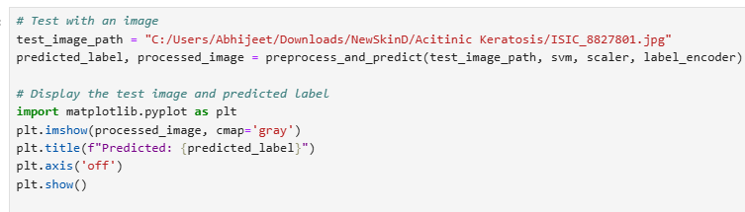
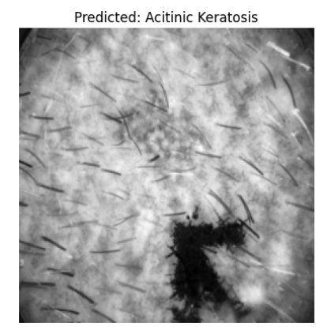

Slide 13
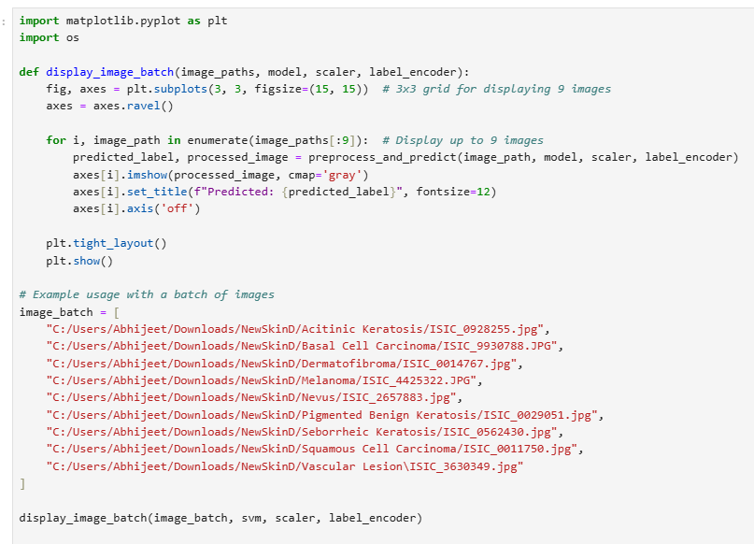

Slide 14
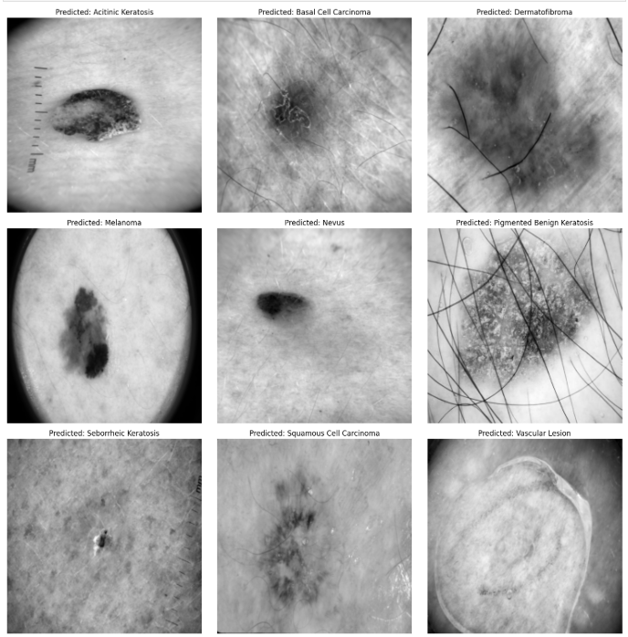

Slide 15
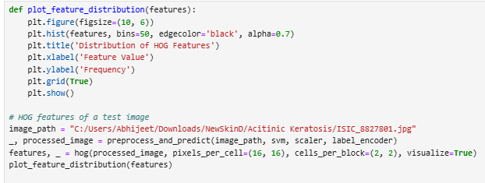
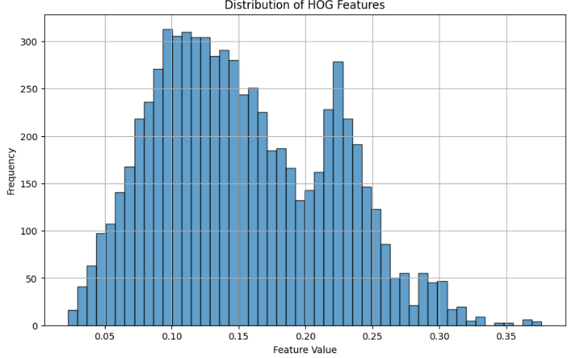

Slide 16
CONCLUSION
The Support Vector Machine (SVM) model achieved an accuracy of 100%, demonstrating its capability to classify skin conditions based on the selected features from medical images. While the model shows potential, a 100% accuracy indicates room for improvement to enhance its reliability and effectiveness in real-world applications. The classification report provides a detailed breakdown of performance metrics such as precision, recall, and F1-score, offering insights into the model's strengths and weaknesses for each class. Testing on a randomly selected sample further highlights the model's practical application in individual case pred
Accuracy of the SVM model after hyperparameter tuning: 1.00

